Slide 1
🍎 classmoji
Evaluating Understanding Beyond the Commit
AI-Driven Oral Examinations
for Code Assessment
Tim Tregubov & Pape Sow Traore
DALI Lab, Dartmouth College
SIGCSE 2026
how might we help human students
understand their AI-assisted work
— more AI anybody?
Notes:
help students learn concepts and fundamentals when their AI is actually doing all their assignments for them

Slide 2
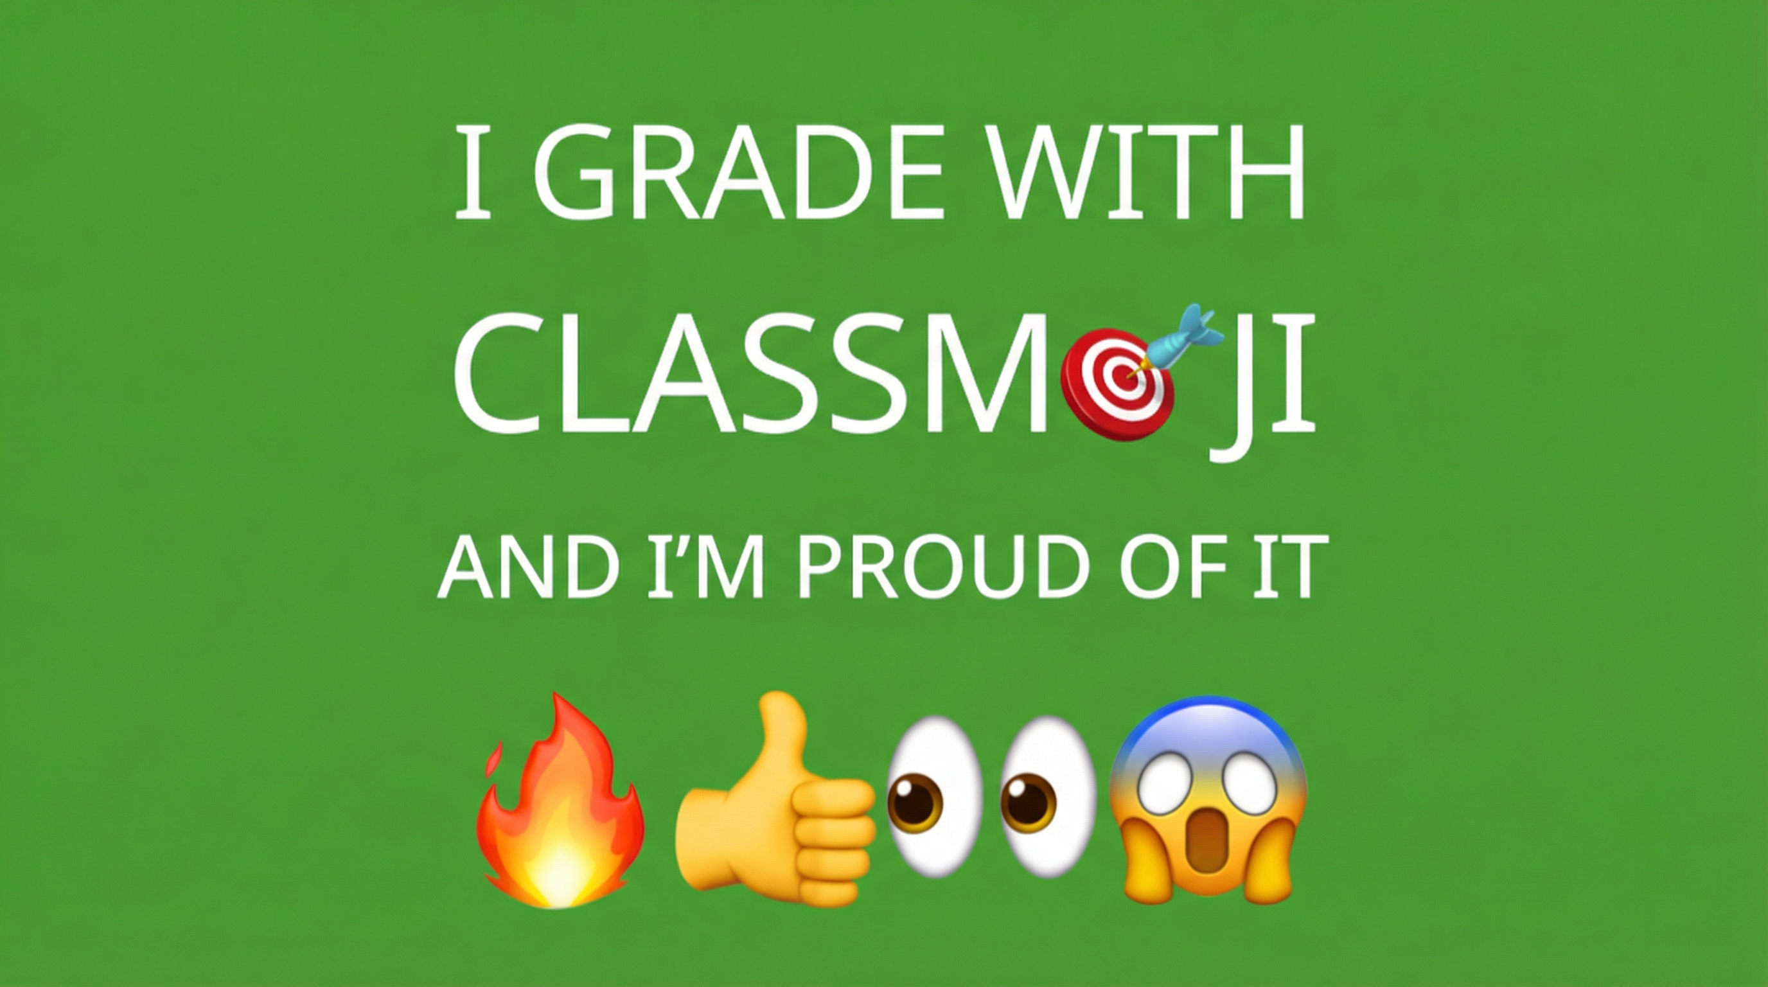
Notes:
Before I go on I have to admit that I X. based on some alternative grading methods

Slide 3
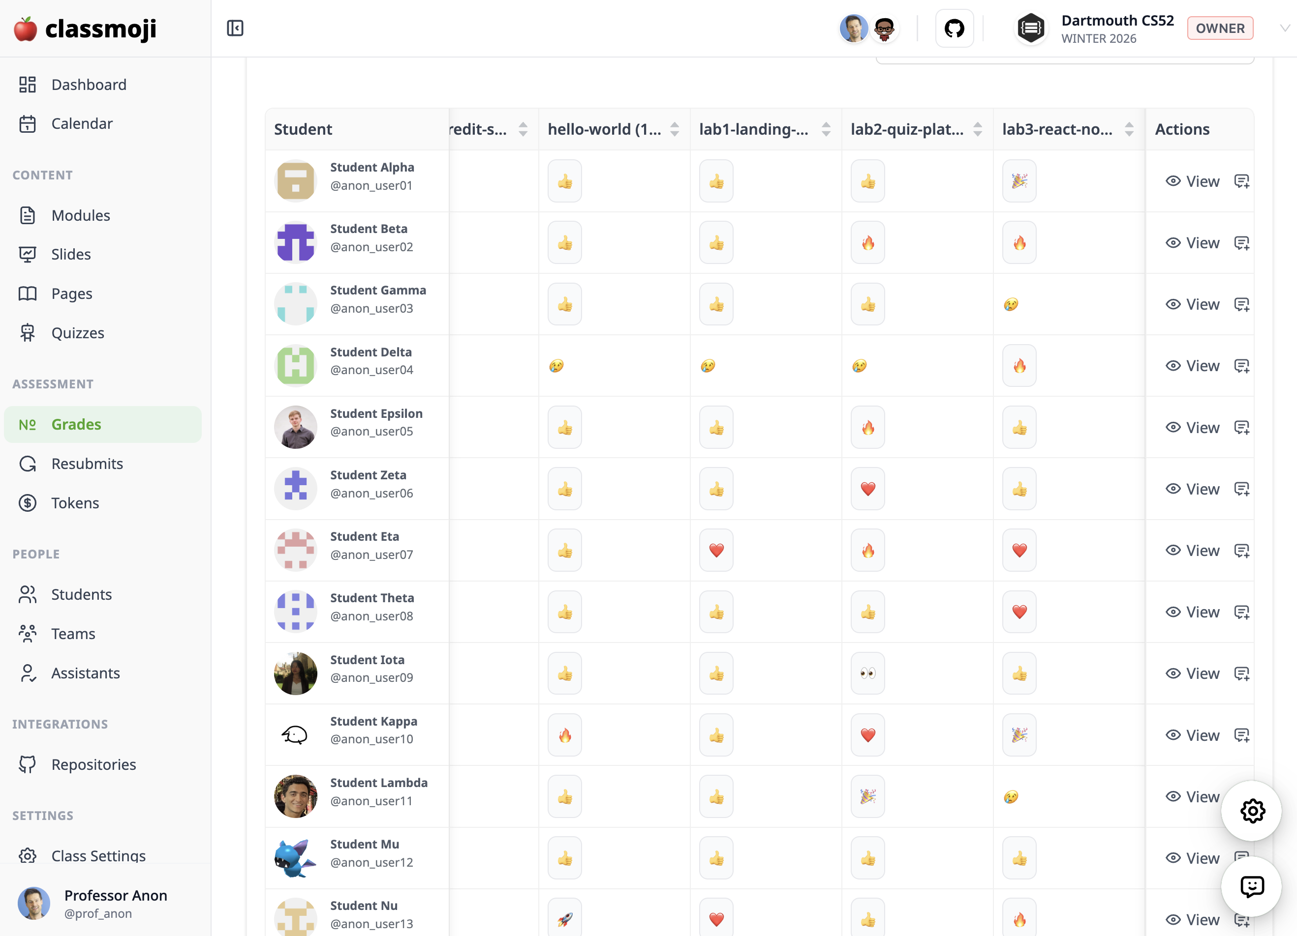
Notes:
here's what your dashboard might look like if you grade with emoji! i recommend it, no more time spent deducting points. more time spent on constructive love and feedback

Slide 4


Learning via Projects/Assignments in the Age of Vibe Coding
The shift from generative to evaluative
Knowledge.
Students need to steer the ship.
→
How do we verify students understand their own code — not just that it works?
Notes:
so whats the big problem, students just turn in whatever the AI wrote for them, they have no idea what it does. They struggle to analyze and reason through it. we’re shifting gears from being generators of code to being evaluators and that is great! if we can teach it.

Slide 5
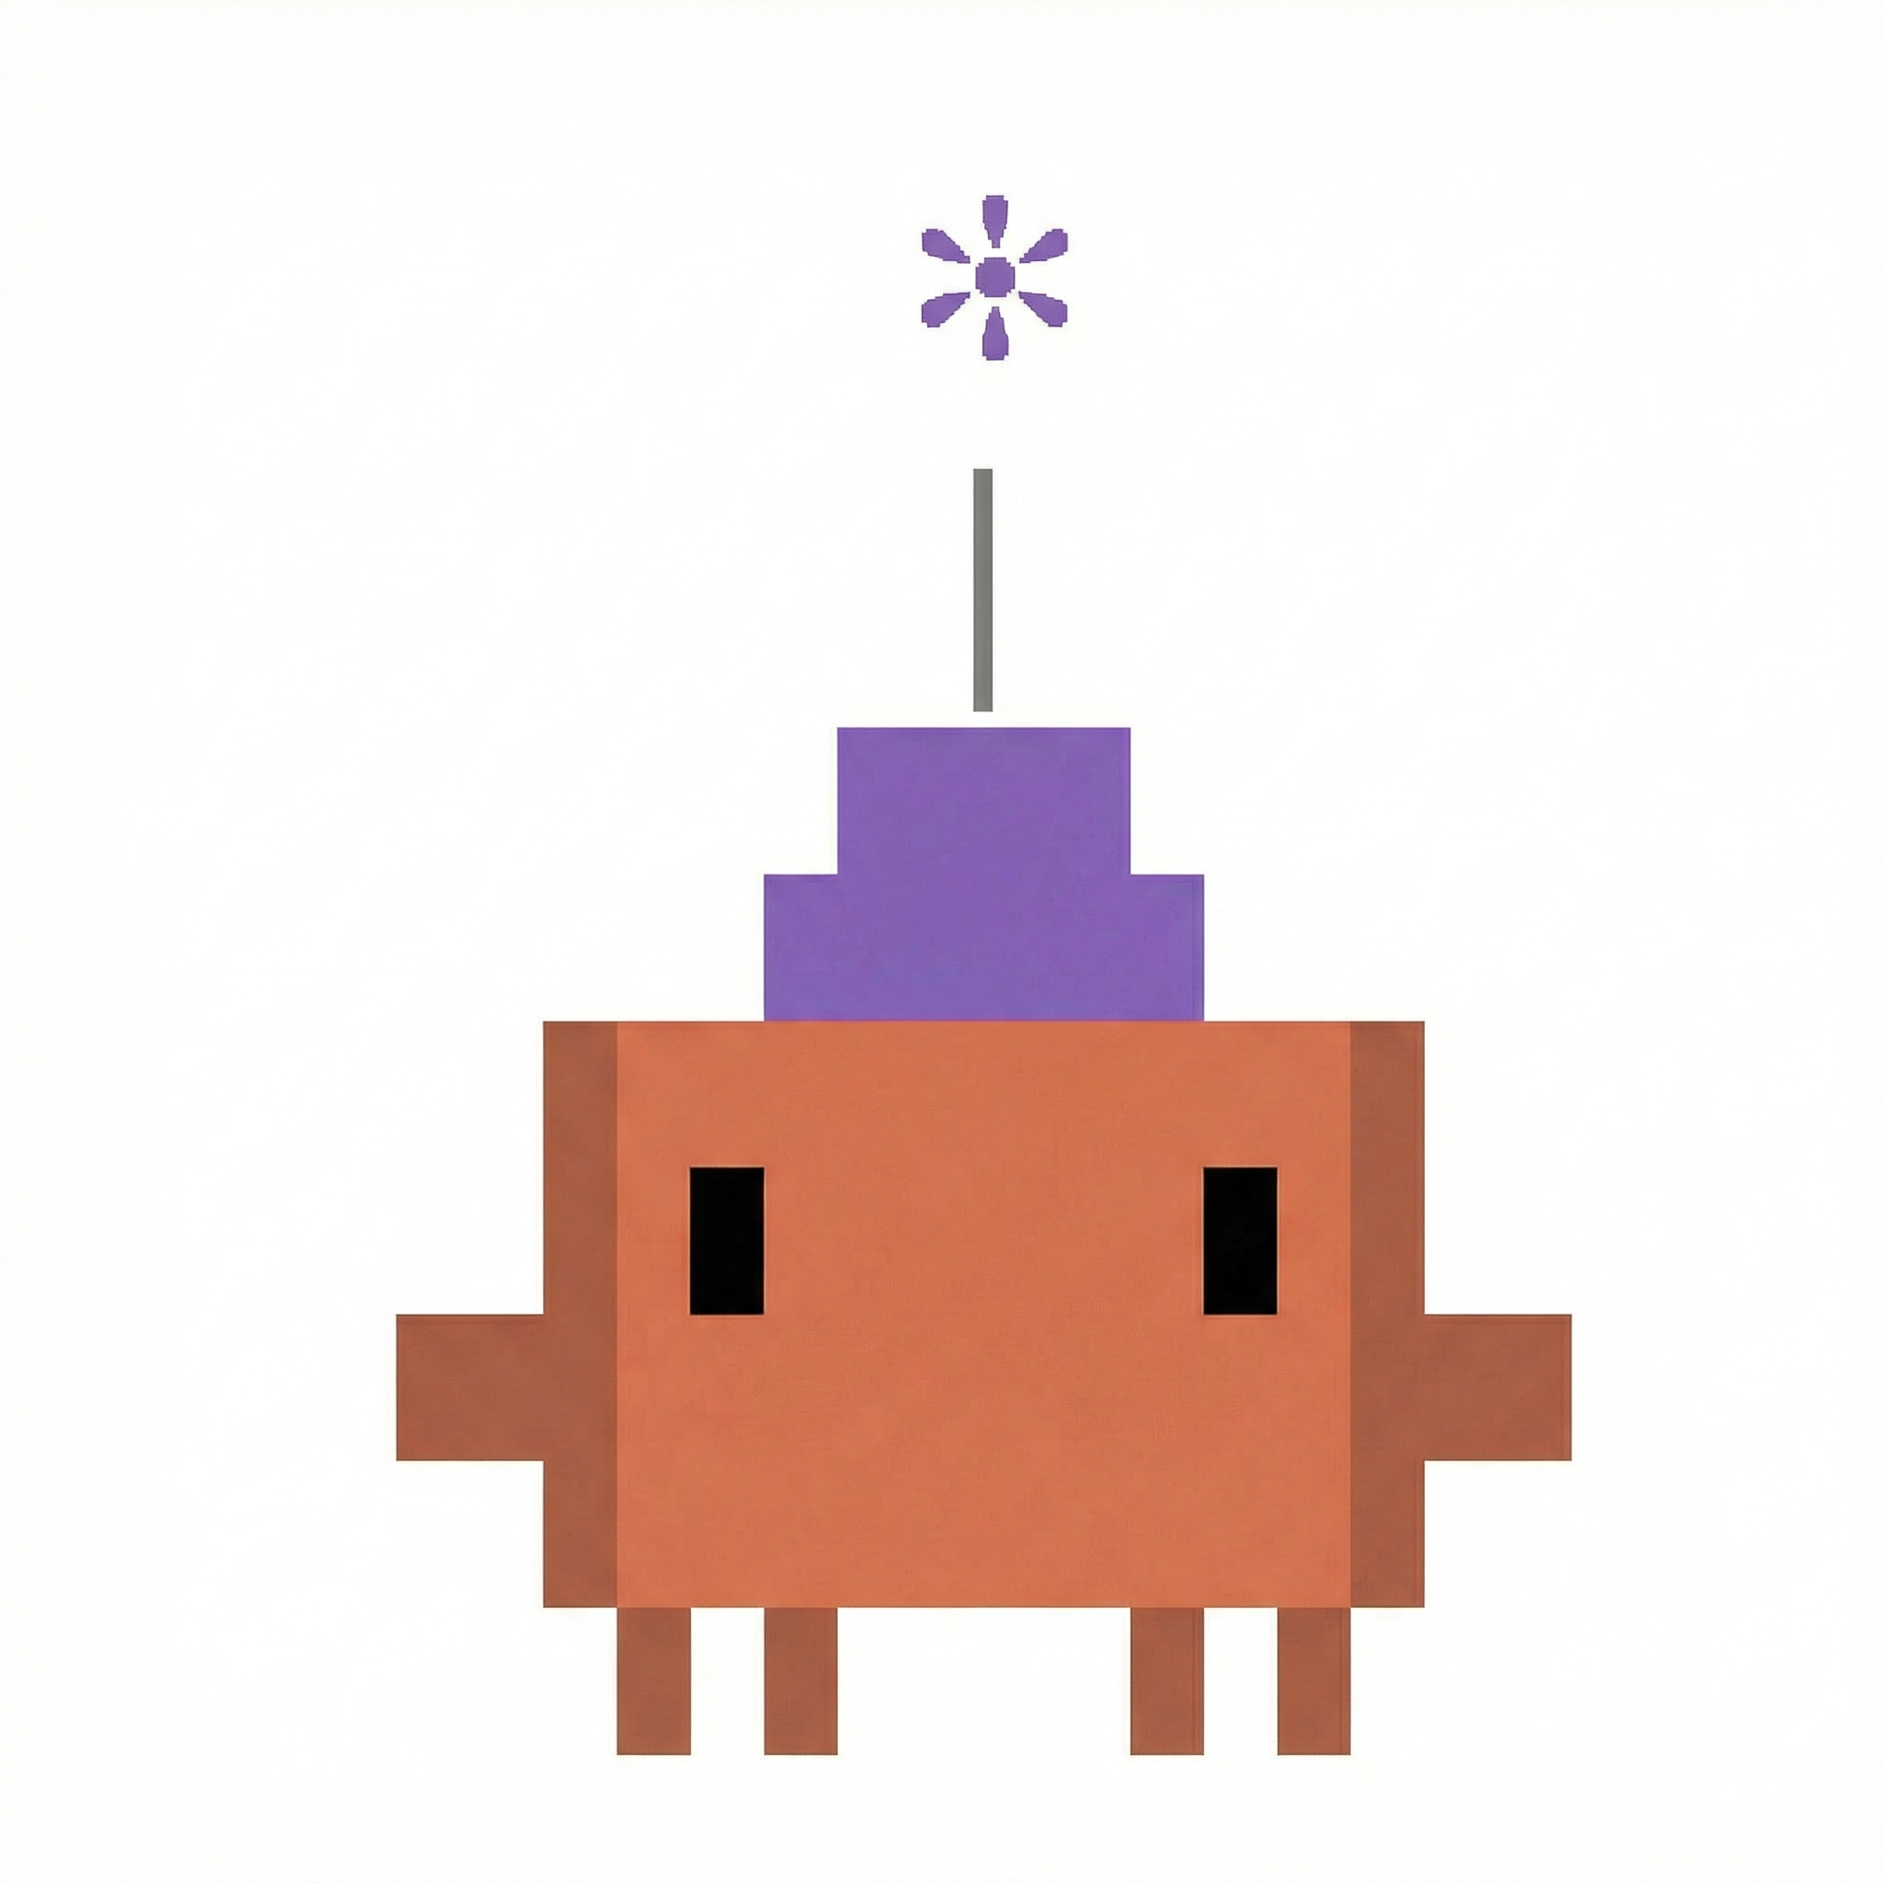
How You Use AI Matters
Anthropic Research: "The Impact of AI Assistance on Coding Skill Development"
DELEGATION
CONTINUOUS CURIOSITY
"Just generate the code"
Scored lowest on skill assessments
after completing a coding task —
even though their code worked fine.
The code passes. The learning didn't.
Ask AI to explain. Question its choices.
Understand before moving on.
Developed significantly stronger skills
in the same amount of time.
Same tool. Different outcome.
You can use AI and not learn anything, or you can use it and learn more than you would have doing it manually.
Notes:
Turns out there are techniques that can help – there is behavior change that doesn’t involve forbidding its use straight to jail. there can be knowledge building while working with an ai. how do we motivate them to do this.

Slide 6

Oral Exams Work... But Don't Scale
A 10-minute conversation reveals more than a long written exam.
You can probe reasoning, follow up on confusion, hear the thinking, BUT
I can't "whatever” love each student like that.
There are too many of them.
Too many students to treat each person fairly
without an army of cloned me’s… well actually…
Notes:
oral exams work, but they are hard scale. There is research showing our brains can only know 150 people or so, so when I have 200 students that means by the pidgeon hole principle I start forgetting the names of my children.

Slide 7

Let AI Share the Love
With the right prompting and tooling, AI agents are
remarkably good at interrogating students about their code.
They read the repo. They ask pointed questions.
They follow up when answers are vague. They give hints when students are stuck.
Formative and supportive assessment?
💻
🗣️
💡
🎯
Reads the student's
actual code
Asks personalized
questions
Gives progressive
hints
Evaluates
understanding
Notes:
They can actually be pretty great at working through material – why not have them interrogate the students about their code? They also like to put their best foot forward, my claudbot wrote this slide about himself. i hope he doesn't think i butchered the delivery.

Slide 8
Notes:
Students submit their code with git, in class we do a quiz, it clones each of their repos and asks them tough questions, while also giving them multiple attempts and hints to be formative rather than punative. they leave the quiz with greater knowledge, they don't wait 2 weeks for a red x on the question

Slide 10
Notes:
This is an ai responding to an ai interrogating it about its ai generated code. Spent a lot of time red teaming the model – and my claudebot did too. It said crazy stuff, like its grandmother had died and could it just get a break it was having a rough day. The bots pretty good at tough love.

Slide 11
How It Works
Depth of Knowledge + Socratic Questioning → Adaptive Dialogue
1
EXPLORE
2
QUESTION
3
EVALUATE
• AI agent explores the student's GitHub repo
• Reads actual source files, not just tests
• Maps implementation choices and patterns
• Personalized questions about their code
• Probes reasoning, not just recall
• Progressive hints on retry:
1st: 100% → 2nd: 75% → 3rd: 60%
• Assesses conceptual understanding
• Specific feedback on strengths & gaps
• Tracks engagement: focus time, persistence, attempts
Under the hood: Anthropic Agent SDK with custom tools for presenting questions, exploring code, tracking scores & attempts. Heavy prompt engineering for consistent evaluation.

Slide 12
Some Survey Results
5-point Likert scale • Midterm survey (n=20) • CS 52 W26
LEARNING
FORMAT PREFERENCE
my own code > generic questions
4.4
prefer conversational over MC
4.1
helped identify gaps in understanding
4.1
felt more like learning than a test
4.0
hints helped learn, not just get answer
3.6
retry system reduced test anxiety
4.0
BEHAVIORAL CHANGE
AI EVALUATION TRUST
asked AI more clarifying questions
4.1
evaluation was fair and accurate
4.0
spent more time understanding code
3.9
understood imprecise terminology
3.8
relied less on code I didn't understand
3.8
trust AI as well as human instructor
3.2
changed how I approached assignments
3.3
Notes:
knowledge building while working on the assignments, some issues, i haven’t tried jacking up the weight of the quizzes. they are worth small points. if thy were worth more the students may complain about LLM accuracy.

Slide 13
What It Looks Like
Real exchanges from a quiz last week
AI Examiner
You use useRef to store drag data like isDragging and startX. Why useRef instead of useState?
Student
useRef is faster and components can be referenced quicker with .current compared to useState which is slower
AI Examiner
💡 Hint: When you call setState, it triggers a re-render. During a drag, mousemove fires dozens of times per second...
Student
tf you have to re-render every time the mouse moves dozens of times per second, the website would crash. that's why we use useRef. it doesn't trigger re-renders
AI Examiner
Exactly! useRef doesn't trigger re-renders, so mutating dragState.current keeps the component performant. Great job working through that!
Key: Questions are personalized to their code • Follow-ups probe deeper • Evaluation is immediate

Slide 14
Some Quiz Stats
React Fundamentals Quiz • CS 52 W26 • 7 questions, code-aware, unlimited retakes
PROGRESSIVE HINT SYSTEM
First attempt avg: 74% With hints avg: 89% Improvement: +15pp
Credit decay per hint: 100% → 75% → 60% → 50% → 40%
71% in-session retry rate
— students actively chose to try again with hints rather than moving on

Slide 15
Some Choice Quotes
HONEST SELF-ASSESSMENT
TREATING AI AS A PEER
"My knowledge of useEffect is rusty. I think it runs every time the page is loaded. Is this true?"
"That's a good question. Mostly just separation of concerns... But I admit there's more nuance to it."
— Student turned the quiz into a learning conversation
— Student adopted professional code-review discourse
PUSHING BACK ON AI
METACOGNITION
"I think you are being really nit picky... I literally said that the first time."
"prop-drill is not good but it was a mistake that has been learned"
— Student challenged the AI's evaluation — and was right
— Student named the anti-pattern and framed it as growth
BEYOND THE CURRICULUM
METACOGNITIVE CLARITY
"This is implementing a mutex lock... a better way in the future is to use a CRDT to resolve conflicts."
"Can you rephrase your question? Not sure I understand."
— Student went beyond course material unprompted
— Admitting confusion led to faster learning than guessing

Slide 16
The Accountability Loop
Ask AI to
explain code
→
Know the quiz
is coming
→
Deeper
understanding
↑
↓
←
Formative Learning in AI Quiz
→
"I always had the agent walk back through the edits and explain what it did and WHY."
"Knowing I had to understand and explain it gives more motivation to understand what the code does."
"I did try to learn the material a bit more because of this."
Behavioral change scored 75% on survey,
but qualitative data tells a richer story.
Students changed how they use AI, not just whether they use it.

Slide 17
Formative Engagement
PREFERRED ASSESSMENT FORMAT
Avg rank (lower = more preferred)
"I always had the agent walk back through the edits... This vastly helped understand not just my code but the tools we learned in class."
AI quiz (own code)
1.75
No assessment
2.56
"Knowing I had to understand and explain it gives more motivation... even though the punishment doesn't feel severe."
AI quiz (generic)
3.06
Traditional MC
3.44
"Writing out how I understood state and React while taking the quiz made me learn it better."
Written exam
4.19

Slide 18
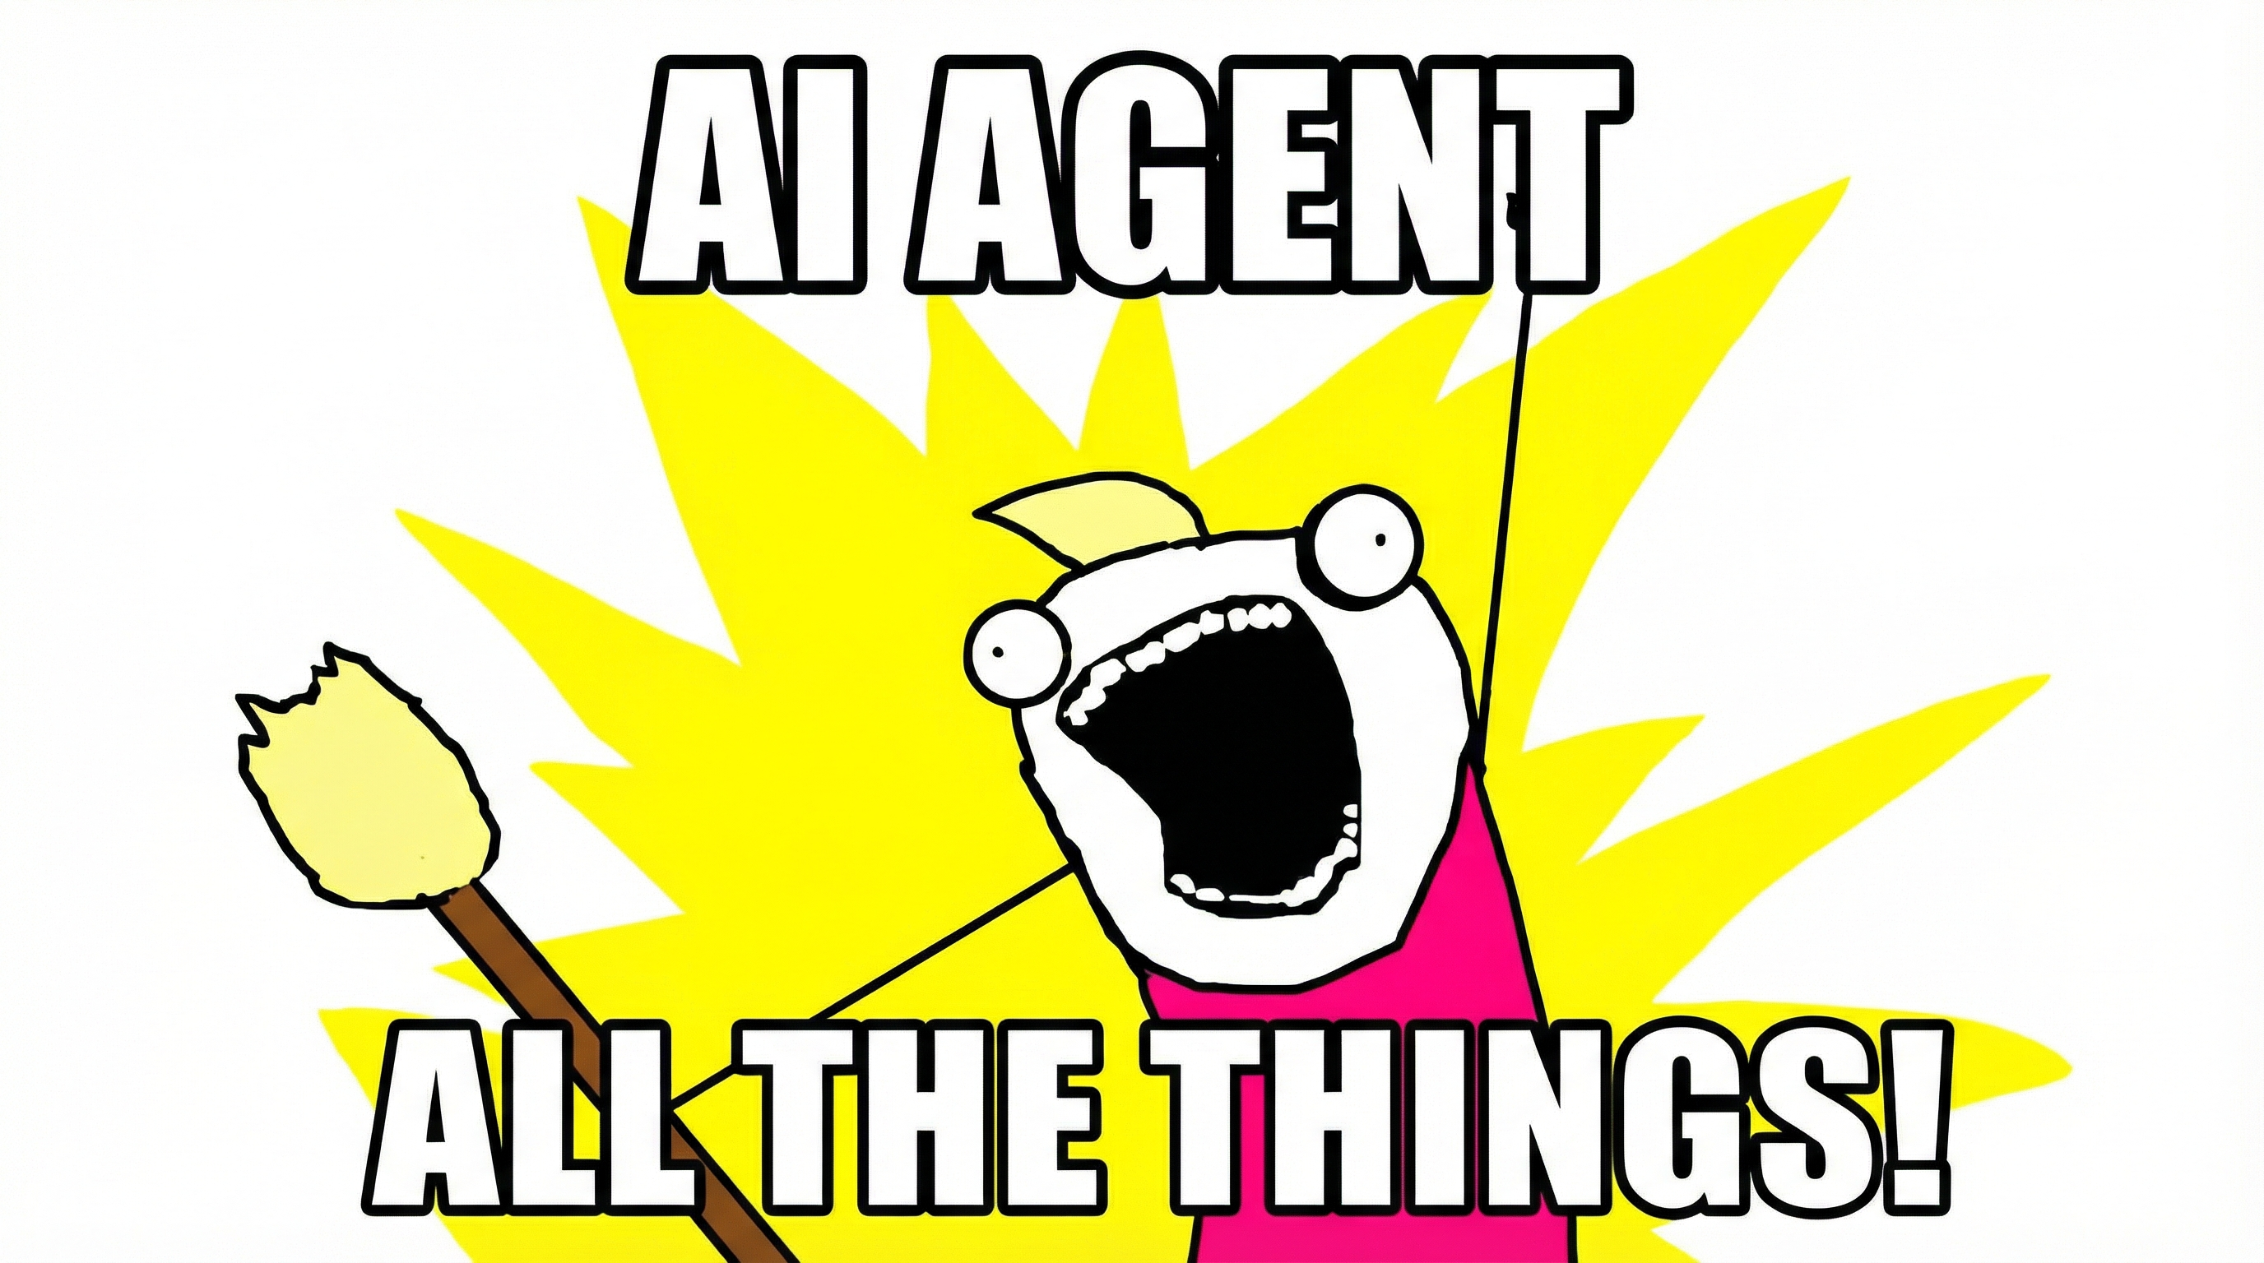
🍎
Thank You
Tim Tregubov & Pape Sow Traore
DALI Lab, Dartmouth College
classmoji.io • github.com/classmoji
hello@classmoji.io
Questions?
Notes:
look i don’t want a future where we do paper exams for everything. i’m a builder and i learn by doing. this is my way or building a class i would want to take. students get to work on interesting assignments and are somewhat more motivated to understand the material so they can reason about it and be in the drivers seat.

