Slide 1
Chap:3
Servlet
Prof. JINAL JOSHI

Slide 2
Syllabus Content
Servlet Introduction
Architecture of a Servlet
Servlet API (Javax.servlet and javax.servlet.http)
Servlet Life Cycle
Developing and Deploying Servlets
Handling Servlet Requests and Responses
Reading Initialization Parameters
Session Tracking Approaches (URL Rewriting, Hidden
Form Fields, Cookies, Session API)
Servlet Collaboration
Prof. JINAL JOSHI

Slide 3
Servlet Introduction
You learn Applet in core which is run on browser but applet is client side programming which is does not handle server side programming.
So now java need to some contain which is use for server side.
That way it developed Servlets.
Servlets are server side components that provide a powerful mechanism for developing server side programs.
Servlets provide component-based, platform-independent methods for building Web-based applications without the performance limitations of CGI (Common gateway interface)programs use to write server side scripting language.

Slide 4
Servlet Introduction
Using servlets web developers can create fast and efficient server side application which can run on any servlet enabled web server.
Servlets run entirely inside the Java Virtual Machine.
Servlets can access the entire family of Java APIs, including the JDBC API to access enterprise databases.
Servlets are not designed for a specific protocols. It is different thing that they are most commonly used with the HTTP protocols Servlets uses the classes in the java packages javax.servlet and javax.servlet.http.
Its standard framework and use the highly portable java language.

Slide 5
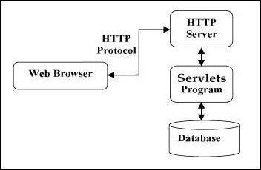
Servlets Architecture
The following diagram shows the position of Servlet in a Web Application.
Servlets perform the following major tasks −

Slide 6
Servlet Architecture
Read the explicit data sent by the clients (browsers). This includes an HTML form on a Web page or it could also come from an applet or a custom HTTP client program.
Read the implicit HTTP request data sent by the clients (browsers). This includes cookies, media types and compression schemes the browser understands, and so forth.
Process the data and generate the results. This process may require talking to a database, executing an RMI or CORBA call, invoking a Web service, or computing the response directly.
Send the explicit data (i.e., the document) to the clients (browsers). This document can be sent in a variety of formats, including text (HTML or XML), binary (GIF images), Excel, etc.
Send the implicit HTTP response to the clients (browsers). This includes telling the browsers or other clients what type of document is being returned (e.g., HTML), setting cookies and caching parameters, and other such tasks.

Slide 7
Benefits of Servlets: (IMP)
1. Performance:
Its performance is better than CGI because it is not necessary to create the separate process to handle each HTTP request, it executes within the address space of web server.
so it saves the memory resources and make performance better than CGI.
2. Platform Independence:
A number of web-server from different vendor supports Servlet API.
It is written in Java so program developed for this API can be run on any environment without re-compilation.

Slide 8
3. Security:
Servlet run under the JVM and it is secured .It is also using java security manager .
it is server side component, so it inherits the security provided by the web server.
4. Efficient Servlet Initialization Code:
It is only executed for the first time when the web server loads it. Once the server has been loaded, it is only a matter of calling the service to handle the new request. So it is efficient for each & every request.

Slide 9
5. Persistent:
Servlets can maintain the state between requests. Once the servlet has been loaded, it takes its state in the memory until the last request will arrive. Taking the advantage of persistent characteristic of servlet will improve the performance of applications.
6. Portable:
Servlets are developed using java therefore they are portable.
7. Robust:
Servlets are developed with the jdbc.
So they provide maximum robust solution with the help of java's well defined exception hierarchy, garbage collection, network support, file support etc.

Slide 10
Flexible:
SeFlexible:
Servlets are quite flexible because it can be added to a static page using the servlet tag
<servlet>.rvlets are quite flexible because it can be added to a static page using the servlet tag
<servlet>.

Slide 11
Servlet API
The javax.servlet and javax.servlet.http packages represent interfaces and classes for servlet API.
1. Javax.servlet package and
2.javax.servlet.http package

Slide 12
1. Javax.servlet package :
The javax.servlet package contains many interfaces and classes that are used by the servlet or web container. These are not specific to any protocol.
Interfaces in javax.servlet package:
There are many interfaces in javax.servlet package. They are as follows:
Servlet Interface: It is having the method which define the life cycle of servlet.
ServletRequest Interface: It is used to read the client request.
ServletResponse Interface: It is used to read the server responce.
ServletConfig Interface: It provides basic or initialization parameter of the servlet also logs the events using log().
ServletContext interface: It provides basic or initialization parameter of the servlet.

Slide 13
1. Javax.servlet package :
The javax.servlet package contains many interfaces and classes that are used by the servlet or web container. These are not specific to any protocol.
Interfaces in javax.servlet package:
There are many interfaces in javax.servlet package. They are as follows:
SingleThreadModel Interface: It provides the mechanism to make servlet thread safe.
Servlet Exception Class: It define servlet occurred errors.
Unavailable Exception class: It defines that servlet is paramanently or temporarily not available.
Servlet Input stream class:I t provides input stream to read tha data from the client request.
Servlet Output stream class::It provides output stream to writting tha data as a response to the client.
GenericsServlet Class: It implements the servlet ,servletConfig and serialization interface.

Slide 14
2.javax.servlet.http package
There are many interfaces in javax.servlet.http package. They are as follows:
1.HttpServletRequest Interface: It allows the servlet to read the data from HTTP request.
2.HttpServletResponse Interface: It allows the servlet to write the data to the HTTP response.
3.HttpSession Interface: It used to create session and provides the way of reading and writing the session accessing the information related to session.
3.HttpSessionListener Interface: It informs the object that it is bound or unbound to the session.
4.HttpSessionBinding Event class: It defines that when session should be bound or unbound with the object value and its attribute.

Slide 15
Servlet Life Cycle
A servlet life cycle can be defined as the entire process from its creation till the destruction.
Life Cycle between the beginning of the servlet loading into the application server memory and ending of the servlet by termination.
There are Three method…
Init()
Service()
Destroy()

Slide 16
Servlet Life Cycle
Calls the Init
Method
Servicing request by calling method
If first Request
Loading
If Servlet is already Loaded
Destroying servlet by destroy method
Servlet class
Garbage Collection

Slide 17
1) init() method (Initialization Phase)
Creates the instance of the servlet
If successfully instantiated, the servlet is available for providing service
If failed to instantiate, it will unload the servlet.

Slide 18
It is called by servlet container to initialize the servlet itself.
It is called only once when servlet engine loads the servlet.
It finishes its work before service() starts for
request and response.

Slide 19
2) service() method (Servicing Phase)
Gets information about the request from the request object
Processes the request
Uses methods of the response object to create the client response.
Can invoke other methods to process the request, such as doGet(), doPost() methods.

Slide 20
3) destroy() methods(Termination Phase )
Stops a servlet by invoking the servlet’s destroy() method.
The destroy() method runs only one time during the lifetime of the servlet and signals the end of the servlet.
After calling destroy() method, the servlet engine unloads the servlet
Unloaded servlets are collected by JVM Garbage Collection.

Slide 21
Developing and Deploying Servlets
Steps to Create Servlets Application:
A web server is required to develop a servlet application. We are using Apache Tomcat server to develop servlet application.
Following are the steps to develop a servlet application: 1. Create directory structure 2. Create a servlet 3. Compile the servlet 4. Create a deployment descriptor 5. Start the server and deploy the application

Slide 22
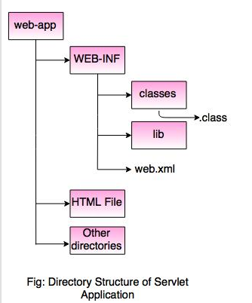
Developing and Deploying Servlets
Create directory structure:
There is a unique directory structure that must be followed to create Servlet application. This structure tells where to put the different types of files.

Slide 23
Developing and Deploying Servlets
2. Create a Servlet
//ServletDemo.java import java.io.*;
import javax.servlet.*;
import javax.servlet.http.*;
public class demo extends HttpServlet
{
public void doGet(HttpServletRequest req,HttpServletResponse res)throws IOException,ServletException
{
res.setContentType("text/html");
PrintWriter out=res.getWriter();
out.println("hello");
}
}

Slide 24
Developing and Deploying Servlets
3. Compile the Servlet program
Assuming the class path and environment is setup properly, run the above Java program.
C:\javac demo.java
4. Create a deployment descriptor
The deployment descriptor is an xml file. It is used to map URL to servlet class, defining error page.

Slide 25
Developing and Deploying Servlets
4. Create a deployment descriptor
The deployment descriptor is an xml file. It is used to map URL to servlet class, defining error page.
//web.xml <web-app> <servlet> <servlet-name>demo1</servlet-name> <servlet-class>demo</servlet-class> </servlet> <servlet-mapping> <servlet-name>demo1</servlet-name> <url-pattern>/demo</url-pattern> </servlet-mapping> </web-app>

Slide 26
Developing and Deploying Servlets
5. Start the server and deploy the application
Now start the Tomcat server by using Open browser and type http://localhost:8081/demo

Slide 27
Handling Servlet Requests and Responses
1.ServletRequest Interface
2. Servlet Response Interface

Slide 28
Handling Servlet Requests and Responses
1.ServletRequest Interface:
An object of ServletRequest is used to provide the client request information to a Servlet such as content type, content length, parameter names and values, header information's, attributes etc.
Methods of ServletRequest interface:
1.getParameter():is used to obtain the value of a parameter by name.

Slide 29
Handling Servlet Requests and Responses
Methods of ServletRequest interface:
getParameter()
getParameterNames()
getParameterValues()
getAttribute()
getAttributeNames()
getRemoteHost()
getRemoteAdds()
getHeaders()
getCookies()
getQueryString()
getSession()

Slide 30
Handling Servlet Requests and Responses
Methods of ServletRequest interface:
getParameter()
getParameterNames()
getParameterValues()
getAttribute()
getAttributeNames()
getRemoteHost()
getRemoteAdds()
getHeaders()
getCookies()
getQueryString()
getSession()

Slide 31
Handling Servlet Requests and Responses
Welcome.html
<form action="./req_demo" method="get">
Enter your name<input type="text" name="name"><br>
<input type="submit" value="login">
</form>

Slide 32
Handling Servlet Requests and Responses
req_demo.java
import java.io.*;
import javax.servlet.*;
import javax.servlet.http.*;
public class req_demo extends HttpServlet
{
public void doGet(HttpServletRequest req,HttpServletResponse res)throws IOException,ServletException
{
res.setContentType("text/html");
PrintWriter out=res.getWriter();
String name=req.getParameter("name");//will return value
out.println("Welcome"+name);
}
}

Slide 33
Handling Servlet Requests and Responses
Web.xml
<web-app>
<servlet>
<servlet-name>req_demo</servlet-name>
<servlet-class>req_demo</servlet-class>
</servlet>
<servlet-mapping>
<servlet-name>req_demo</servlet-name>
<url-pattern>/req_demo</url-pattern>
</servlet-mapping>
<welcome-file-list>
<welcome-file>login.html</welcome-file>
</welcome-file-list>
</web-app>

Slide 34
Handling Servlet Requests and Responses
2. Servlet Response Interface:
The response object allows you to format and send the response back to the client.
Method of ServletResponse interface
setContentType()
setHeader()
setStatus()
getWrite()

Slide 35
Reading Initialization Parameters
2. Servlet Response Interface:
The response object allows you to format and send the response back to the client.
Method of ServletResponse interface
setContentType()
setHeader()
setStatus()
getWrite()

Slide 36
Session Tracking in Servlets

Slide 37
Session Tracking in Servlets
Session simply means a particular interval of time.
Session Tracking is a way to maintain state (data) of an user. It is also known as session management in servlet.
Http protocol is a stateless so we need to maintain state using session tracking techniques.
Session Tracking Techniques:
There are four techniques used in Session tracking:
1.Cookies
2.Hidden Form Field
3.URL Rewriting
4.HttpSession

Slide 38
1.Cookies:
A cookie is a small piece of information that is persisted between the multiple client requests.
A cookie has a name, a single value, and optional attributes such as a comment, path and domain qualifiers, a maximum age, and a version number.
Types of Cookie:
There are 2 types of cookies in servlets.
1.Non-persistent cookie
2.Persistent cookie

Slide 39
1.Non-persistent cookie:
It is valid for single session only. It is removed each time when user closes the browser.
2.Persistent cookie:
It is valid for multiple session . It is not removed each time when user closes the browser.
It is removed only if user logout or signout.

Slide 40
Advantage of Cookies:
Simplest technique of maintaining the state.
Cookies are maintained at client side.
Disadvantage of Cookies
It will not work if cookie is disabled from the browser.
Only textual information can be set in Cookie object.

Slide 41
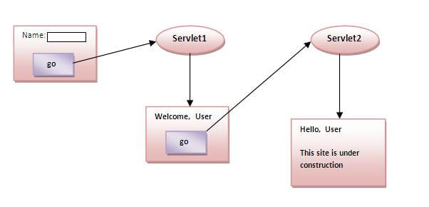
Example:

Slide 42
Example: cookie1.html
<form action="cookie_2" method="get">
Name:<input type="text" name="userName"/><br/>
<input type="submit" value="go"/>
</form>

Slide 43
Example: cookie2.java
import java.io.*;
import javax.servlet.*;
import javax.servlet.http.*;
public class cookie_2 extends HttpServlet
{
public void doGet(HttpServletRequest req,HttpServletResponse res)throws IOException,ServletException
{
res.setContentType("text/html");
PrintWriter out=res.getWriter();
String n=req.getParameter("userName");
out.print("Welcome "+n);
Cookie ck=new Cookie("uname",n);//creating cookie object
res.addCookie(ck);//adding cookie in the response
//creating submit button
out.print("<form action='cookie_3'>");
out.print("<input type='submit' value='go'>");
out.print("</form>");
}
}

Slide 44
Example: cookie3.java
import java.io.*;
import javax.servlet.*;
import javax.servlet.http.*;
public class cookie_3 extends HttpServlet
{
public void doGet(HttpServletRequest req,HttpServletResponse res)throws IOException,ServletException
{
res.setContentType("text/html");
PrintWriter out=res.getWriter();
Cookie ck[]=req.getCookies();
out.print("Hello "+ck[0].getValue());
}
}

Slide 45
Example: cookie3.java
<web-app>
<welcome-file-list>
<welcome-file>cookie1.html</welcome-file>
</welcome-file-list>
<servlet>
<servlet-name>cookie_2</servlet-name>
<servlet-class>cookie_2</servlet-class>
</servlet>
<servlet-mapping>
<servlet-name>cookie_2</servlet-name>
<url-pattern>/cookie_2</url-pattern>
</servlet-mapping>
<servlet>
<servlet-name>cookie_3</servlet-name>
<servlet-class>cookie_3</servlet-class>
</servlet>
<servlet-mapping>
<servlet-name>cookie_3</servlet-name>
<url-pattern>/cookie_3</url-pattern>
</servlet-mapping>
</web-app>

Slide 46
2.Hidden Form Field
In case of Hidden Form Field a hidden (invisible) textfieldis used for maintaining the state of an user.
In such case, we store the information in the hidden field and get it from another servlet. This approach is better if we have to submit form in all the pages and we don't want to depend on the browser.
Syntax:
<input type="hidden" name="uname" value="Vishal">

Slide 47
2.Hidden Form Field
Advantage of Hidden Form Field:
It will always work whether cookie is disabled or not.
Disadvantage of Hidden Form Field:
It is maintained at server side.
Extra form submission is required on each pages.
Only textual information can be used.

Slide 48
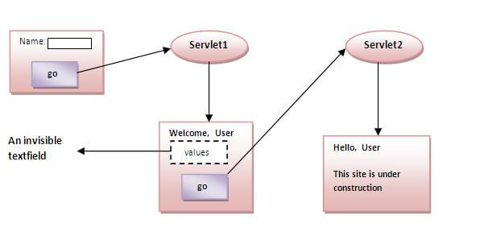
2.Hidden Form Field
Example:

Slide 49
2.Hidden Form Field
Example:hidden1.html
<form action="./hidden2">
Name:<input type="text" name="userName"/><br/>
<input type="submit" value="go"/>
</form>

Slide 50
Example:hidden2.java
import java.io.*;
import javax.servlet.*;
import javax.servlet.http.*;
public class hidden2 extends HttpServlet {
public void doGet(HttpServletRequest request, HttpServletResponse response){
try{
response.setContentType("text/html");
PrintWriter out = response.getWriter();
String n=request.getParameter("userName");
out.print("Welcome "+n);
//creating form that have invisible textfield
out.print("<form action='hidden3'>");
out.print("<input type='hidden' name='uname' value='"+n+"'>");
out.print("<input type='submit' value='go'>");
out.print("</form>");
out.close();
}catch(Exception e){System.out.println(e);}
}
}

Slide 51
Example:hidden3.java
import java.io.*;
import javax.servlet.*;
import javax.servlet.http.*;
public class hidden3 extends HttpServlet
{
public void doGet(HttpServletRequest request, HttpServletResponse response)
{
try
{
response.setContentType("text/html");
PrintWriter out = response.getWriter();
//Getting the value from the hidden field
String n=request.getParameter("uname");
out.print("Hello "+n);
out.close();
}
catch(Exception e)
{
System.out.println(e);
}
}
}

Slide 52
3.URL Rewriting
In URL rewriting, we append a token or identifier to the URL of the next Servlet or the next resource.
We can send parameter name/value pairs using the following format:
url?name1=value1&name2=value2&??.
A name and a value is separated using an equal = sign, a parameter name/value pair is separated from another parameter using the ampersand(&).
When the user clicks the hyperlink, the parameter name/value pairs will be passed to the server. From a Servlet, we can use get Parameter() method to obtain a parameter value.

Slide 53
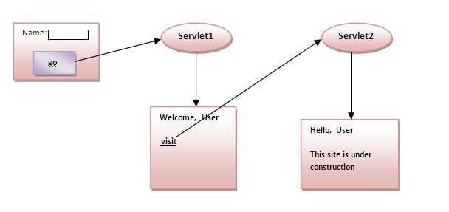
3.URL Rewriting
Advantage of URL Rewriting:
It will always work whether cookie is disabled or not (browser independent).
Extra form submission is not required on each pages.

Slide 54
3.URL Rewriting
Disadvantage of URL Rewriting:
It will work only with links.
It can send Only textual information.
Example: url1.html
<form action="./url2">
Name:<input type="text" name="userName"/><br/>
<input type="submit" value="go"/>
</form>

Slide 55
Example: url2.java
import java.io.*;
import javax.servlet.*;
import javax.servlet.http.*;
public class url2 extends HttpServlet {
public void doGet(HttpServletRequest request, HttpServletResponse response){
try{
response.setContentType("text/html");
PrintWriter out = response.getWriter();
String n=request.getParameter("userName");
out.print("Welcome "+n);
//appending the username in the query string
out.print("<a href='url3?uname="+n+"'>visit</a>");
out.close();
}catch(Exception e){System.out.println(e);} }
}

Slide 56
Example: url3.java
import java.io.*;
import javax.servlet.*;
import javax.servlet.http.*;
public class url3 extends HttpServlet
{
public void doGet(HttpServletRequest request, HttpServletResponse response) {
try{
response.setContentType("text/html");
PrintWriter out = response.getWriter();
//getting value from the query string
String n=request.getParameter("uname");
out.print("Hello "+n);
out.close();
}
catch(Exception e) {
System.out.println(e)
} } }

Slide 57
Example: web.xml
<web-app>
<servlet>
<servlet-name>url2</servlet-name>
<servlet-class>url2</servlet-class>
</servlet>
<servlet-mapping>
<servlet-name>url2</servlet-name>
<url-pattern>/url2</url-pattern>
</servlet-mapping>
<servlet>
<servlet-name>url3</servlet-name>
<servlet-class>url3</servlet-class>
</servlet>
<servlet-mapping>
<servlet-name>url3</servlet-name>
<url-pattern>/url3</url-pattern>
</servlet-mapping>
<welcome-file-list>
<welcome-file>url1.html</welcome-file>
</welcome-file-list>
</web-app>

Slide 58
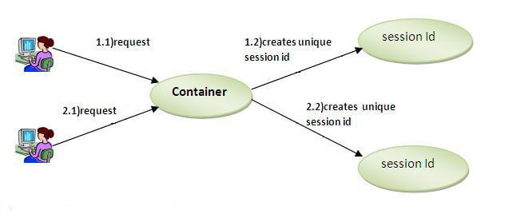
4.HttpSession Interface:
In such case, container creates a session id for each user.
The container uses this id to identify the particular user.
An object of HttpSession can be used to perform two tasks:
1.bind objects
2.view and manipulate information about a session, such as the session identifier, creation time, and last accessed time.

Slide 59
4.HttpSession Interface:
methods of HttpSession interface:
getId():Returns a string containing the unique identifier value.
getSession():Returns the current session associated with this request, or if the request does not have a session, creates one.

Slide 60
Example:
session1.html
<form action="./session2">
Name:<input type="text" name="userName"/><br/>
<input type="submit" value="go"/>
</form>

Slide 61
Example:
session2.java
import java.io.*;
import javax.servlet.*;
import javax.servlet.http.*;
public class session2 extends HttpServlet {
public void doGet(HttpServletRequest request, HttpServletResponse response){
try{
response.setContentType("text/html");
PrintWriter out = response.getWriter();

Slide 62
Example:
session2.java
String n=request.getParameter("userName");
out.print("Welcome "+n);
HttpSession session=request.getSession();
session.setAttribute("uname",n);
out.print("<a href='session3'>visit</a>");
out.close();
}catch(Exception e){System.out.println(e);}
}
}

Slide 63
Example:
session3.java
import java.io.*;
import javax.servlet.*;
import javax.servlet.http.*;
public class session3 extends HttpServlet {
public void doGet(HttpServletRequest request, HttpServletResponse response){
try{
response.setContentType("text/html");
PrintWriter out = response.getWriter();
HttpSession session=request.getSession(false);
String n=(String)session.getAttribute("uname");
out.print("Hello "+n);
out.close();
}catch(Exception e){System.out.println(e);} }
}

Slide 64
Servlet Collaboration

Slide 65
Servlet Collaboration:
Servlet technology is used to create a web application (resides at server side and generates a dynamic web page).
The exchange of information among servlets of a particular Java web application is known as Servlet Collaboration.
This enables passing/sharing information from one servlet to the other through method invocations.
The servlet api provides two methodnamely:
1.getRequestDispatcher()
getNamedDispatcher()

Slide 66
Servlet Collaboration:
1.getNamedDispatcher():
This method takes a string argument indicating the name of a servlet known to the ServletContext.
If a servlet is known to the ServletContext by the given name.
2.getRequestDispatcher():
The RequestDispatcher interface provides the facility of dispatching the request to another resource it may be html, servlet or jsp.
This interface can also be used to include the content of another resource also. It is one of the way of servlet collaboration.

Slide 67
Servlet Collaboration:
There are two methods defined in the RequestDispatcher interface.
forward():
Forwards a request from a servlet to another resource (servlet, JSP file, or HTML file) on the server.
include():
Includes the content of a resource (servlet, JSP page, or HTML file) in the response.

Slide 68
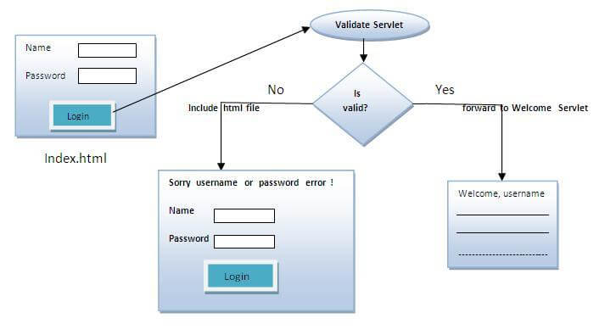
Servlet Collaboration:

Slide 69
Servlet Collaboration:
Example : Req_Disp.html
<form action="./Req_Disp2" method="post">
Name:<input type="text" name="userName"/><br/>
Password:<input type="password" name="userPass"/><br/>
<input type="submit" value="login"/>
</form>

Slide 70
Servlet Collaboration:
Example : Req_Disp2.java
import java.io.*;
import javax.servlet.*;
import javax.servlet.http.*;
public class Req_Disp2 extends HttpServlet {
public void doPost(HttpServletRequest request, HttpServletResponse response)
throws ServletException, IOException {
response.setContentType("text/html");
PrintWriter out = response.getWriter();

Slide 71
Servlet Collaboration:
Example : Req_Disp2.java
String n=request.getParameter("userName");
String p=request.getParameter("userPass");
out.println("Hello");
if(n.equals("123") &&
p.equals("123"))
{
RequestDispatcher dis=request.getRequestDispatcher("Req_Disp3");
dis.forward(request, response);
}
else
{
out.print("User name or password is incorrect!");
RequestDispatcher dis=request.getRequestDispatcher("Req4.html");
dis.include(request, response);
}
}
}

Slide 72
Servlet Collaboration:
Example : Req_Disp3.java
import java.io.*;
import javax.servlet.*;
import javax.servlet.http.*;
public class Req_Disp3 extends HttpServlet {
public void doPost(HttpServletRequest request, HttpServletResponse response)
throws ServletException, IOException {
response.setContentType("text/html");
PrintWriter out = response.getWriter();
String n=request.getParameter("userName");
out.print("Welcome "+n);
}
}
Example:Req4.html
<h1>Incorrect User Name and Password</h1>

Slide 73
Servlet Collaboration:
Example : web.xml
<web-app>
<servlet>
<servlet-name>Req_Disp2</servlet-name>
<servlet-class>Req_Disp2</servlet-class>
</servlet>
<servlet-mapping>
<servlet-name>Req_Disp2</servlet-name>
<url-pattern>/Req_Disp2</url-pattern>
</servlet-mapping>
<servlet>
<servlet-name>Req_Disp3</servlet-name>
<servlet-class>Req_Disp3</servlet-class>
</servlet>
<servlet-mapping>
<servlet-name>Req_Disp3</servlet-name>
<url-pattern>/Req_Disp3</url-pattern>
</servlet-mapping>
<welcome-file-list>
<welcome-file>Req_Disp.html</welcome-file>
</welcome-file-list>
</web-app>

