Slide 1
Session tracking

Slide 46
Session API:
When we write any servlet, it is necessary for the developer to maintain sessions.
HTTPSession interface:-
It provides a way to identify a user across more than one page request or visit to a web site and to store information about that user.
An HttpSession class was introduced in the Servlet API. Instances of this class can hold information for one user session between requests.
HttpSession session = request.getSession(true);

Slide 47
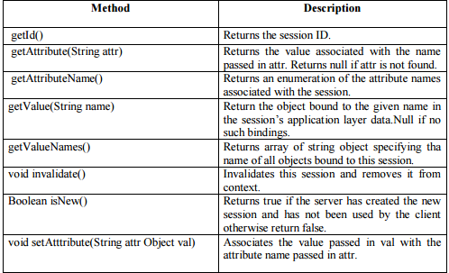
This method takes a Boolean argument. True means a new session shall be started if none
exist, while false only returns an existing session.

Slide 48
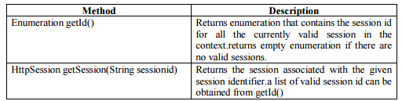
HttpSessionContext interface:- HttpSessionContext provides access to all of the currently active sessions on the server. *This can be useful for servlets that is inactive sessions, displaystatistics, otherwise share information. *A servlet obtains a HttpSessionContext object getSessionContext() of HttpSession.

Slide 49
Generic Servlet Class
It belongs to the javax.servlet package.
It implements the servlet, ServletConfig, serializable interface in it.
It is extended to provide the protocol based things like FTP, SMTP protocol but it is not
having a HTTP protocol facility. So most probably with web application we need to extend the HttpServlet Class.
Generic servlet class provides the implementation of servlet interface because in most of the classes they are required to use service() to handle request and response.

Slide 50
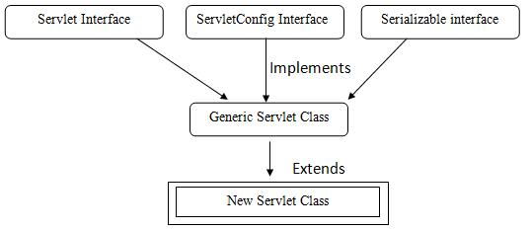

Slide 51
(1)init()
It is called by servlet container to initialize the servlet itself. It is called only once when servlet engine loads the servlet.
Basic format of this method is:
public abstract void init(ServletConfig config ) throws ServletException
(2) service()
It provides the servlet request response facility to each and every servlet should override this method directly writing service () with the program or indirectly using doXXX () of HttpServlet class. Basic format of this method is:
Public abstract void service (ServletRequest req, ServletResponse res) throw ServletException, IOException

Slide 52
(3) destroy ()
It is called by servlet container at the end of the execution. We can override this method in our subclass to do some clean up task, when servlet is taken out of service.
Basic format of destroy () is as follows:
Public abstract void destroy ()
(4) log ()
log () is used to write the server log file.
we can use in two ways.
First method log (String message) method writes the servlet name and message to web container log file and
Second method log (String message, Throwable t) writes the servlet name and the exception stack trace of the given Throwable Exception to web container log file.
Basic format of destroy () is as follows:
Public void log (String message)
Public void log (String message,Throwable

Slide 53
(5) getInitParameter()
It is used to get the initialization parameter.
If the parameter does not exists it returns null. Basic format of this () is as follows: Public string getInitParameter (String name)
(6) getInitParameterNames()
It returns the name of initialization parameter names in the form of enumeration.
Basic format of this () is as follows:
Public Enumeration getInitParameter Names ()
(7) getServletContext()
It returns the object of ServletContext. Basic format of this () is as follows:
Public Enumeration getInitParameter Names ()

Slide 54
8) getServletName()
It returns the name of the servlet. Basic format of this () is as follows:
Public String getServletName ()

Slide 55
import java.io.*;
import javax.servlet.*;
public class simple_servlet extends GenericServlet
{
public void service (ServletRequest req, ServletResponse res) throws ServletException,IOException
{
res.setContentType ("text/html");
PrintWriter out=res.getWriter ();
out.println ("<b><i>Generic servletexample</i></b>");
out.close ();
}
}

Slide 56
HTTP SERVLET CLASS
HttpServlet class extends GenericServlet Class.
It is commonly used by programmers when developing servlet that receive and process HTTP requests, because it is having HTTP protocol functionality.
Hierachrchy of HttpServlet class is shown below

Slide 57
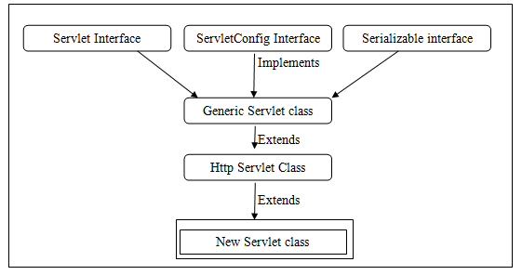

Slide 58
Methods of HttpServlet Class are as follows:
(1) doGet()
doGet() is called by servlet via service() to handle an Http request.
A GET request allows client to sent form data to server. With the get request the form data is attached to the end of the URL sent by the web browser to the server as a query string.
The amount of form data that can be sent is limited to the maximum length of the URL. Basic format of doGet() is as follow:
public void doGet(HttpServletRequest req, HttpServletResponse res)throws ServletException, IOException

Slide 59
(2) doPost()
doPost() is called by servlet via service() to handle an Http POST request. A POST request allows client to sent form data to server. With the post request, the form data is sent to the server separately instead of being appended to to the URL . This allows a large amount of data to be sent. Basic format of doPost() is as follows.
public void doPost(HttpServletRequest req, HttpServletResponse res)throws ServletException,IOException
(3) doDelete ()
doDelete() is called by servlet via service() to handle an Http DELETE request. A DELETE request allows client to remove a document or web page from the server. Basic format of doDelete() is as follows.
public void doDelete(HttpServletRequest req, HttpServletResponse res)throws ServletException,IOException

Slide 60
(4) doOption()
doOption() is called by servlet via service() to handle an Http OPTION request. An OPTION determines which Http method the server supports and sends the information back to the client by way of header.Basic format of doOption() is as follows.
public void doOption(HttpServletRequest req, HttpServletResponse res)throws ServletException,IOException

Slide 61
(5) doPut()
doPut() is called by servlet via service() to handle an Http PUT request. A PUT request allows client to sent place a file on the server and is conceptually similar to sending the file to the server via FTP.
Basic format of doPut() is as follows.
public void doPut(HttpServletRequest req, HttpServletResponse res)throws ServletException,IOException
(6) doTrace()
doTrace() is called by servlet via service() to handle an Http TRACE request. A TRACE request returns the header sent with the TRACE request back to the client. This can be useful for debugging purpose.
This method is rarely overridden. Basic format of doTrace() is as follows.
public void doTrace(HttpServletRequest req, HttpServletResponse res)throws ServletException,IOException

Slide 62
Single Thread Model
In CGI single instance creates multiple threads in order to process multiple request and response.
In the past also a single instance of a servlet creates multiple threads for multiple requests and response.
In this process the shared non local variables must be synchronized is implemented at the cost of system performance because thread waits in a queue for the current thread to complete its job.
Therefore synchronizing the code increases time to perform a single task,it downs the performance of the system.
In certain cases synchronization may not be appropriate method to implement thread safely.
so in such a case we need to implement the SingleThreaModel.

Slide 63
SingleThreadModel is implemented by SingleThreadModel interface. It ensures that servlet handle only one request at a time. This interface has no methods.
If a servlet implements this interface you are guarantee by synchronizing access to single instance of servlet.
SingleThreadModel does not solve all thread safety issues in some situation.

Slide 64
(1) ServletException:-
Servlet Exception indicates that a servlet problem has occurred. The general form of Servlet Exception class is:
public class Servlet Exception extends Exception
ServletException has following constructor.
• Public ServletException():Basic exception constructor
• Public ServletException (String msg): It creates a new servlet exception with a message.
• Public ServletException (String msg, Throwable t): It creates a new servlet exception with a message and a wrapped exception.

Slide 65
(2) Unavailable Exception:-
Unavailable Exception extends ServletException. It defines exception that a servlet throws to indicate that it is permanently or temporarily unavailable.when a servlet is permanently unavailable, something is wrong with it, and it can not handle request until some action is taken.
A system administrator may need to take corrective action.
Servlet container can safely treat both type of unavailable exception in the same way.
General form of unavailable exception is:
public class UnavailableException extends ServletException

Slide 66
UnavailableException has following constructor.
• Public UnavailableException():Basic exception constructor
• Public UnavailableException (String msg): It creates a new exception with a message that a servlet is permanently Unavailable.
This provides following methods:
I. getUnavailableSeconds () : It returns the number of seconds the servlet expects to be temporarily available.
II. getServlet (): It returns the servlet that threw this exception or null if the servlet instance was not provided to the constructor.
III. IsPermanent (): It indicates that the servlet is permanently unavailable or not.

Slide 67
Servlet Collaboration
Sometimes servlets have to co-operate that is useful by sharing some information.
This communication can be called as Sort Servlet Collaboration.
The servlets which are collaborating can pass the shared information directly from one servlet to another.

Slide 68
Request Dispatcher Interface:
It defines an object they receives request from the client and send them to any resources such as servlet, html file call JSP file and the server. The servlet container creates the Request Dispatcher.
They define two methods.
1. forward
2. include
(1) void forward (ServletRequest req,ServletResponse res) throws ServletException,IOException
It will forward a request from the server to another resource. This method allows one servlet to do preliminary processing of a request and other resources to generate the response.
The request & response particular must be the object of the same class.

Slide 69
(2) void include (ServletRequest req, ServletResponse res) throws ServletException,IOException
It will include a request from the server to another resource. This method allows both servlet to do preliminary processing of a request and generate the response.

Slide 70
WEB.xml
When the web server receives a request for the application, it uses the deployment descriptor to map the URL of the request to the code that ought to handle the request.
The deployment descriptor is a file named web.xml. It resides in the app's WAR under the WEB-INF/ directory. The file is an XML file whose root element is <web-app>.
web.xml defines mappings between URL paths and the servlets that handle requests with those paths. The web server uses this configuration to identify the servlet to handle a given request and call the class method that corresponds to the request method.

Slide 71
To map a URL to a servlet, you declare the servlet with the <servlet> element, then define a mapping from a URL path to a servlet declaration with the <servlet-mapping> element.
The <servlet> element declares the servlet, including a name used to refer to the servlet by other elements in the file, the class to use for the servlet, and initialization parameters.
You can declare multiple servlets using the same class with different initialization parameters. The name for each servlet must be unique across the deployment descriptor

Slide 72
<servlet>
<servlet-name>redteam</servlet-name>
<servlet-class>myservlet</servlet-class>
<init-param>
<param-name>teamColor</param-name>
<param-value>red</param-value>
</init-param>
</servlet>

