Slide 1
Software Testing

Slide 2
Software Testing
Software Testing is a method to check whether the actual software product matches expected requirements and to ensure that software product is defect free.

Slide 3
Why is software testing necessary?
Software testing is necessary because we all make mistakes. Some of those mistakes are unimportant, but some of them are expensive or dangerous. We need to check everything and anything we produce because things can always go wrong –humans make mistake all the time.

Slide 4
Software Testing life cycle
Software Testing Life Cycle (STLC) is a sequence of specific activities conducted during the testing process to ensure software quality goals are met. STLC involves both verification and validation activities.

Slide 5
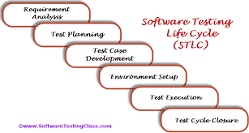

Slide 6
Requirement Analysis
Requirement Analysis in which test team studies the requirements from a testing point of view to identify testable requirementsAnalysis
Identify types of tests to be performed.
Gather details about testing priorities and focus.

Slide 7
Test Planning
Test Planning in STLC is a phase in which a Senior QA manager determines the test plan strategy along with efforts and cost estimates for the project.
Preparation of test plan document for various types of testing

Slide 8
Test Case Development Phase
The Test Case Development Phase involves the creation, verification and rework of test cases & test scripts after the test plan is ready. Initially, the test data is identified then created and reviewed and then reworked based on the preconditions.
Deliverables of Test Case Development
Test cases
Test data

Slide 9
Test Environment Setup
Test Environment Setup decides the software and hardware conditions under which a work product is tested.

Slide 10
Test Execution Phase
The process consists of test case execution and bug reporting. If bugs are reported then it is reverted back to development team for correction and retesting will be performed.

Slide 11
Test Cycle Closure
Test Cycle Closure phase is completion of test execution which involves several activities like test completion reporting, collection of test completion matrices and test results.

Slide 12
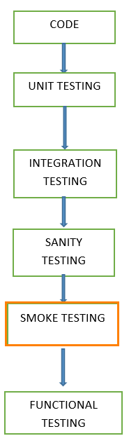

Slide 13
Unit testing
A unit is a testing the smallest piece of code and this will be tested during the development phase of the application software.
Example : Phone number, Email id format.

Slide 14
INTEGRATION TESTING
INTEGRATION TESTING is defined as a type of testing where software modules are integrated logically and tested as a group. A typical software project consists of multiple software modules, coded by different programmers. The purpose of this testing is to expose defects in the interaction between these software modules when they are integrated

Slide 15
Black Box testing / Behavioral Testing
Black Box Testing is a software testing method in which the functionalities of software applications are tested without having knowledge of internal code structure, implementation details.
Black Box Testing mainly focuses on input and output of software applications and it is entirely based on software requirements and specifications.

Slide 16
White Box Testing
Open box testing/ Transparent box testing/ Code-based testing /Glass box testing
White Box Testing is software testing technique in which internal structure, design and coding of software are tested to verify flow of input-output and to improve design, usability and security.
code is visible to testers

Slide 17
Sanity Testing
Sanity testing is a kind of Software Testing performed after receiving a software build, with minor changes in code, or functionality that the bugs have been fixed and no further issues are introduced due to these changes.
This tests logical reasoning related to the working of the program.

Slide 18
Smoke testing
Smoke Testing is a software testing process that determines whether the deployed software build is stable or not.
Smoke Testing is a software testing technique performed post software build to verify that the critical functionalities of software are working fine.

Slide 19
Functional testing
Is testing the functionality of software applications is implemented correctly or not.
The functional specification provided by the client.

Slide 20
Regression testing
Regression Testing is defined as a type of software testing to confirm that a recent program or code change has not affected existing features.
Regression Testing is nothing but a full or partial selection of already executed test cases which are re-executed to ensure existing functionalities work fine.

Slide 21
Compatibility Testing
Compatibility Testing is a type of Software testing to check whether your software is capable of running on different hardware, operating systems, applications, network environments or Mobile devices.

Slide 22
Build
Is the compiled and compressed version of code
a build is a version of a program

