Slide 1
Grade 10 Science • Lesson 1 of 5
Variables and Expressions
Notes:
Welcome the class and point to the course title. Explain that algebra helps scientists describe change, calculate values and test whether a model fits evidence. Ask students to think of one quantity that changes in science or daily life, such as temperature, distance, mass or volume. Link today’s lesson to a UAE context they will see later, then tell them the lesson ends with their own expression and a short check. Transition: ‘Before we start new learning, let’s warm up our calculation and unit skills.’
Timing: about 1 min

Slide 2
Retrieval Check
Order of operations: multiply before adding. In 3 × 4 + 2, calculate 12 + 2 = 14.
Unit conversion: 1000 mL = 1 L, so 2500 mL = 2.5 L. Keep the unit in your answer.
A reading of 38°C gives a temperature. The number can change; °C identifies the measurement unit.
Bridge to algebra: write temperature as T and volume as V. A letter represents a quantity, not an object.
Notes:
Give students 20 seconds per question and ask for answers on mini whiteboards. Check the first answer carefully: 3 × 4 + 2 = 14 because multiplication comes before addition. The second answer is 2.5 L. The third answer is that 38°C is a temperature reading. Watch for the common error of treating 2500 mL as 25 L. Ask one student to explain the unit conversion aloud. Transition straight to the WALT and WILF slide.
Teacher: Answer individually, then hold up boards.
Ask: Which operation do you do first?
Support: Work with a partner and use a calculator only for checking.
Stretch: Explain why 2500 mL becomes 2.5 L, not 25 L.
Timing: about 5 min

Slide 3
WALT and WILF
WALT identify variables, constants and coefficients.
1
WILF I can name each part correctly.
WALT write expressions from science contexts.
4
2
WILF I can write a matching expression.
5
WALT substitute values and calculate answers.
3
Notes:
Read the WALT and WILF aloud together. Ask students to turn and tell a partner which target feels easiest and which feels hardest. Keep the focus on three outcomes: name the parts, write an expression, and substitute a value. If students are unsure, rephrase each target in simpler language and point to an example on the board. Success is clear if they can say one variable, one coefficient and one constant by the end. Transition: ‘Now let’s learn the key words.’
Ask: Which success criterion feels hardest today?
Support: Read each line aloud and underline the key verbs.
Stretch: Add one more success criterion of your own.
Timing: about 2 min

Slide 4
Key Vocabulary
Term | Meaning
variable | A symbol for a quantity that can change.
constant | A number that stays fixed in one context.
coefficient | The number multiplying the variable directly.
expression | A calculation with variables, numbers and operations.
substitute | Replace a variable with a given value.
Notes:
Use the vocabulary slide as a quick pre-teach. Ask students to repeat each term and give a simple example. Emphasise that an expression has no equals sign. Use 3b + 5 to separate the parts: 3 is the coefficient because it multiplies b, and 5 is the constant because it stands alone. If students confuse coefficient and constant, ask, ‘What does the number multiply?’ Transition to the variable slide.
Ask: What does the coefficient multiply?
Support: Match each term to a colour card.
Stretch: Write one new science example for each term.
Timing: about 3 min

Slide 5
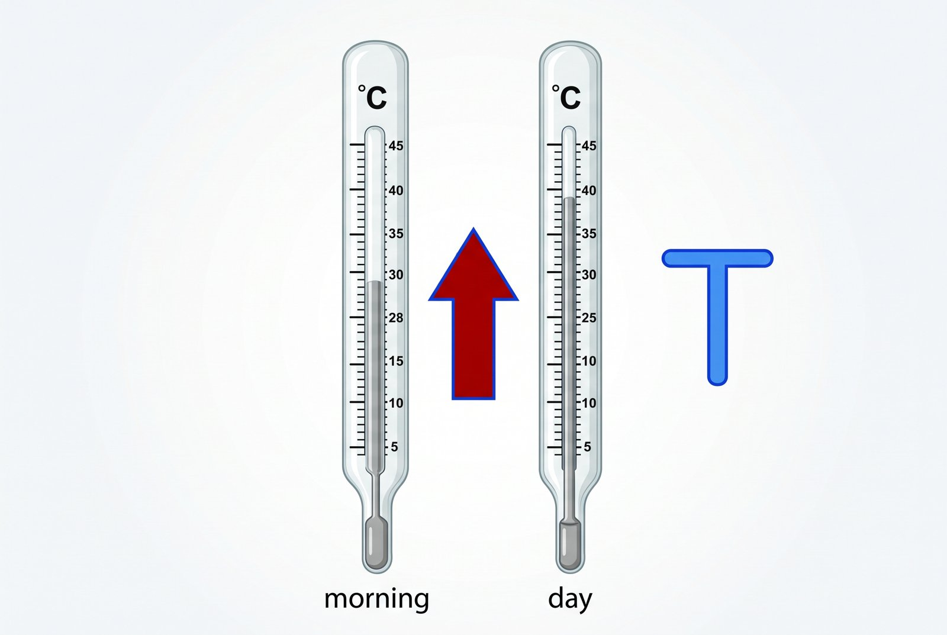
Variables Change
A variable represents a quantity that can change. Choose a letter and state what it measures.
Let T represent temperature in °C. Illustrative readings T = 28 and T = 35 describe different values of the same variable.
The change is 35 − 28 = 7°C. The letter remains T even when its value changes.
Check: if V is volume in litres, V = 2.5 means a volume of 2.5 L. Include units when interpreting a value.
Temperature T (°C)
Illustrative reading: 28°C
Later illustrative reading: 35°C
Change: 35 − 28 = 7°C
Notes:
Use the thermometer diagram to show that a variable is a quantity that can change. Ask for another changing quantity in science; accept mass, volume, speed or time. Correct the idea that a variable is only an unknown number. A variable can be any measured quantity that takes different values in different conditions. If students say ‘x’ for everything, remind them that the letter should match the context. Transition: ‘Now let’s separate the parts of an expression.’
Ask: What quantity changes in the diagram?
Support: Point to the changing number and say it aloud.
Stretch: Name two other changing quantities in science.
Timing: about 4 min

Slide 6

Parts of Expressions
In 3b + 5, b is the variable. Its value can change; the expression changes with it.
The coefficient 3 multiplies b: 3b means 3 × b, not 3 + b.
The constant 5 is added after multiplication. It does not depend on b.
Worked example: if b = 4, then 3b + 5 = 3 × 4 + 5 = 17.
An expression has no equals sign. An equation, such as 3b + 5 = 17, states that two quantities are equal.
3b + 5
3: coefficient (multiplies b)
b: variable (can change)
5: constant (added once)
b = 4 → 3 × 4 + 5 = 17
Notes:
Read the expression from left to right. Ask students which part changes, which number multiplies the variable, and which number stays fixed. Focus on 3b + 5 first, then connect to 500h as a science example. A common error is calling every number a coefficient; correct this by asking, ‘What is it multiplying?’ If they struggle, cover the last bullet and return to the example. Transition: ‘Now let’s use a real UAE science example.’
Image placeholder: upload a suitable image in the manual editor. A real illustration was unavailable.
Ask: Which number is the constant?
Support: Cover the second example until the first is secure.
Stretch: Explain why 500 is not the constant.
Timing: about 4 min

Slide 7
Desalination Model
Define the model: h is elapsed time in hours and V is water volume in litres. Start with zero collected water.
Assume a constant collection rate of 500 litres per hour. This is an illustrative model, not a measured plant output.
Write V = 500h: rate × time gives volume. Here 500 is the coefficient and h is the variable.
Substitute h = 3: V = 500 × 3 = 1500 L. After 4 hours, the model gives 2000 L.
Reasonableness check: doubling time doubles volume. A starting volume or changing rate would require a different model.
Notes:
Model the four steps slowly. Ask what h represents and what the 500 tells us. Students should see that V = 500h means volume in litres depends on hours. Work through the substitution: 500 × 3 = 1500 L. If learners struggle, use repeated addition: 500 + 500 + 500. Point out that the unit matters, so the answer must include litres. Ask the extension question: ‘What does V = 0 mean here?’ Transition to pair practice.
Ask: What does the 500 tell us here?
Support: Use repeated addition first.
Stretch: Explain what V = 0 means in this context.
Visual suggestion: A desalination plant tank filling with an arrow labelled 500 L per hour, a clock showing 3 h, and the chain V = 500h leading to 1500 L.
Timing: about 6 min

Slide 8
Write Your Own
Task A: assume a falcon travels at a constant 55 km/h. Write distance d, in km, after t hours.
Calculate d when t = 2. Explain why 55 is the coefficient and why the model has no added constant.
Task B: each sample adds 4 g to a 10 g container. Write total mass m, in grams, for x samples.
Find m for x = 5. Identify the variable, coefficient and constant, then compare your reasoning with a partner.
Extension: the total mass is 38 g. How many samples are present? Write and solve an equation.
Notes:
Put students in pairs and tell them to complete both tasks. One partner writes, the other checks the variable, coefficient and constant. Expected answers: d = 55t and m = 4x + 10. In the second expression, 4 is the coefficient and 10 is the constant. If learners need support, give sentence stems such as ‘The variable is…’ and ‘The coefficient is…’. Keep them moving quickly so they have time to compare answers before the next slide.
Teacher: Use think-pair-share.
Ask: Which part is the constant in Task B?
Support: Use sentence stems: ‘The variable is…’.
Stretch: Invent a new context and expression.
Timing: about 5 min
Answer key: A: d = 55t; d(2) = 110 km. B: m = 4x + 10; m(5) = 30 g. Extension: 4x + 10 = 38, so x = 7.

Slide 9
Substitution
Substitution replaces a variable with a specified value. Use brackets to show multiplication.
For m = 4x + 10 and x = 5, write m = 4(5) + 10.
Multiply first: 4 × 5 = 20. Then add the constant: m = 20 + 10 = 30.
Do not write 4(5 + 10): that multiplies the constant by 4 and changes the expression.
Quick check: if x increases from 5 to 6, m increases from 30 to 34. The coefficient describes this change.
m = 4x + 10
Substitute x = 5
4 × 5 = 20
20 + 10 = 30
x = 6 → m = 34
Notes:
Teach substitution as a routine: replace, then calculate. Ask what would happen if students added before multiplying. Reinforce that the coefficient stays with the variable until after substitution. Work through m = 4x + 10 with x = 5: 4(5) + 10 = 30. Keep the working written on every line. If students get 60, they have added too early. Transition to the two worked checks.
Image placeholder: upload a suitable image in the manual editor. A real illustration was unavailable.
Ask: What happens if you add before multiplying?
Support: Follow one step at a time with the example.
Stretch: Try x = 7 and calculate it.
Timing: about 3 min

Slide 10
Two Checks
Model 1: V = 500h. With h = 4 hours, substitute to obtain V = 500(4) = 2000 L.
Model 2: P = 2n + 3. With n = 6, calculate P = 2(6) + 3 = 15.
Compare: both models multiply a variable by a coefficient. Only the second adds a nonzero constant.
Prediction: increasing n by 1 increases P by 2. For n = 7, P = 17.
Explain the structure: at n = 0, P = 3. This baseline remains present regardless of n.
Notes:
Ask students to solve each example on their boards before you reveal the answer. Example 1 gives 2000 L. Example 2 gives 15. Emphasise that the 3 in P = 2n + 3 is a constant baseline, not linked to n. If students struggle, hide the units first and calculate the numbers, then add the unit back in. Ask, ‘How do we know the answer is reasonable?’ Transition to the exit ticket.
Ask: Why is the 3 not a coefficient?
Support: Cover the second example until the first is secure.
Stretch: Explain the role of the fixed number 3.
Visual suggestion: Two side-by-side calculation chains showing substitution in science expressions: V = 500h with h = 4, and P = 2n + 3 with n = 6.
Timing: about 5 min

Slide 11
Exit Ticket
In 6t + 9, identify the variable, coefficient and constant. Explain the job of each part.
Evaluate 6t + 9 for t = 2. Show substitution, multiplication and addition as separate steps.
A student answers 90 by calculating 6(2 + 9). Explain precisely why this changes the original expression.
Predict the change in the expression when t increases by 1. Justify your answer using the coefficient.
Notes:
Students answer independently first, then check quietly with a partner if time allows. Expected answers: coefficient 6, variable t, constant 9. For evaluation, 6(2) + 9 = 21. If they mislabel 9 as a coefficient, return to the question ‘What does it multiply?’ Use the final sentence to test understanding: a constant stays fixed. Collect boards or books before moving on. Transition to homework.
Teacher: Answer individually, then check quietly.
Ask: Which part stays fixed in 6t + 9?
Support: Read one question at a time and circle key words.
Stretch: Explain why 6 is not the variable.
Timing: about 4 min
Answer key: Variable t; coefficient 6; constant 9. At t=2: 6(2)+9=21. The incorrect brackets multiply 9 by 6. Increasing t by 1 increases the result by 6.

Slide 12
Homework
Create three everyday algebra models: distance at a constant speed, total cost with a fixed fee, and volume collected at a constant rate.
For each model, define the variable and its unit. Label the coefficient and any constant.
Choose a value for the variable and show every substitution step. Check that the resulting unit makes sense.
Explain one assumption for each model. State when that assumption might fail.
Challenge: write an expression whose value rises by 4 whenever its variable rises by 1, and equals 10 at zero.
Notes:
Explain that homework should use real quantities students can see at home, not invented numbers only. Encourage examples from a water bottle, room temperature, distance to school or electricity use. Remind them to label the variable, coefficient and constant in each expression and evaluate one with a real value. Ask them to bring one example to share next lesson. Finish by praising clear working and neat notation.
Ask: Which home quantity could be a variable?
Support: Choose everyday quantities you already know.
Stretch: Add a second evaluation for a different value.
Timing: about 3 min
Answer key: Challenge: 4x + 10. Examples are illustrative models; students must define quantities, units and assumptions.

