Slide 1

Firma convenzione Politecnico di Milano e Veneranda Fabbrica del Duomo di Milano
LOCALIZATION, NAVIGATION AND SMART MOBILITY 054309
Extended Kalman Filter applied to
NCP and NCV models
Claudia Baz Alvarez 10916443
Aula Magna – Rettorato
Mercoledì 27 maggio 2015

Slide 2
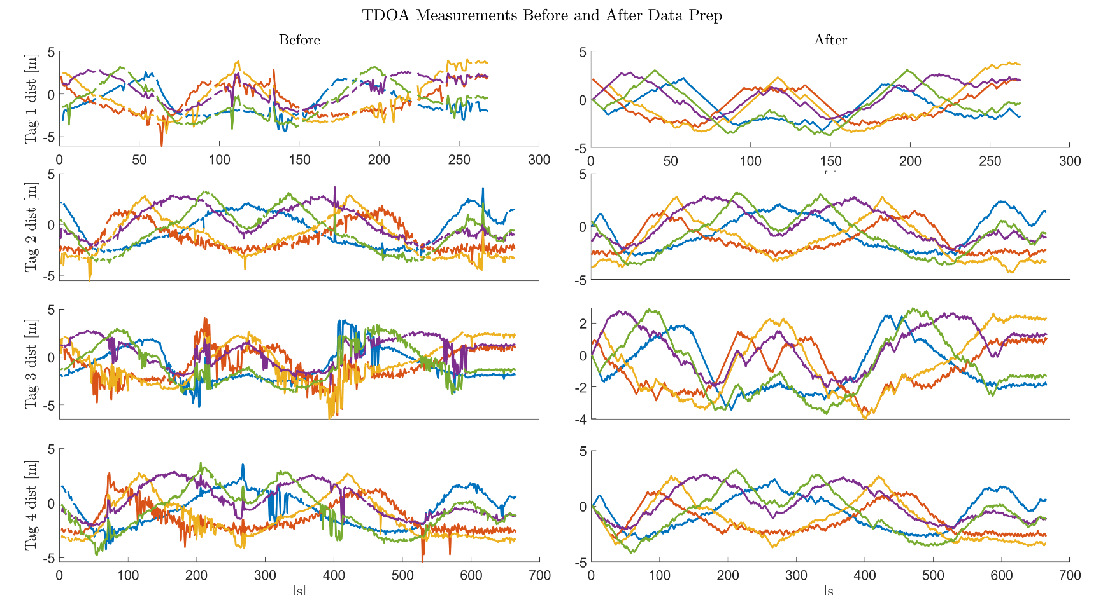
1. Load and analyze data
054309 - LOCALIZATION, NAVIGATION AND SMART MOBILITY
Notes:
tag 1 not good measurements Processes: interpolate Nan values + ignore outliers bigger than a trigger Result: more smooth curves for the algorithm

Slide 3
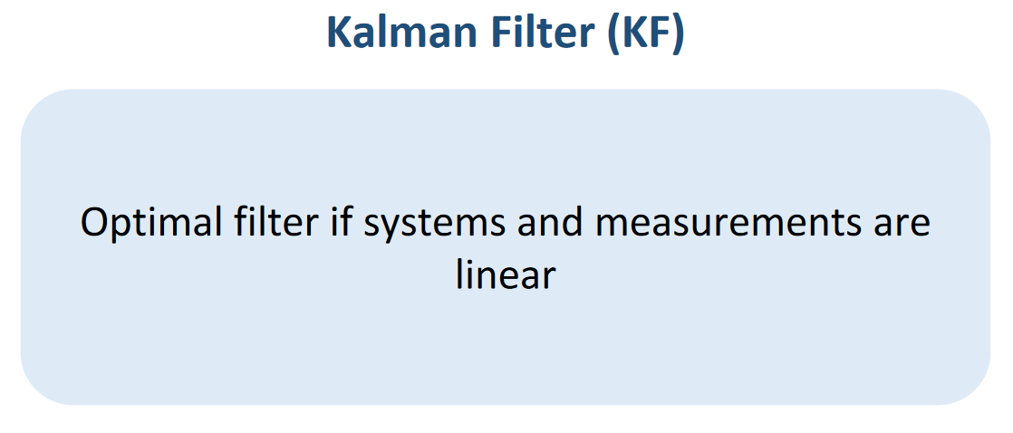
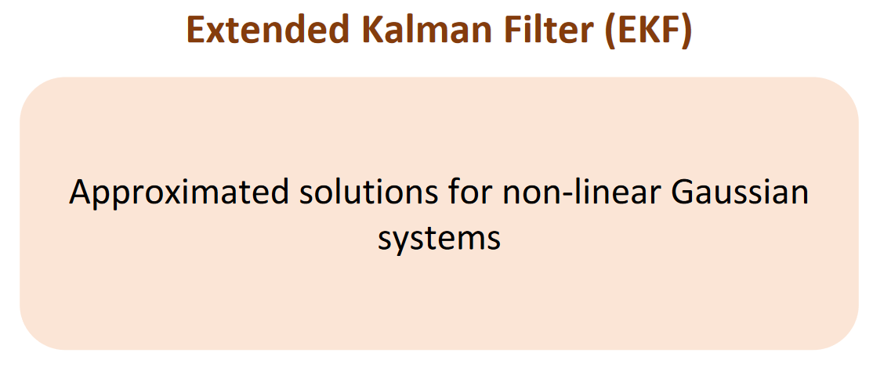
2. Localization algorithms implementation
054309 - LOCALIZATION, NAVIGATION AND SMART MOBILITY
Notes:
assumption of gaussian noise in the measurements the H matrix of the measurements will be the direction cosines of the type of TDOA measurements
result: system not linear and gaussian -> EKF

Slide 4
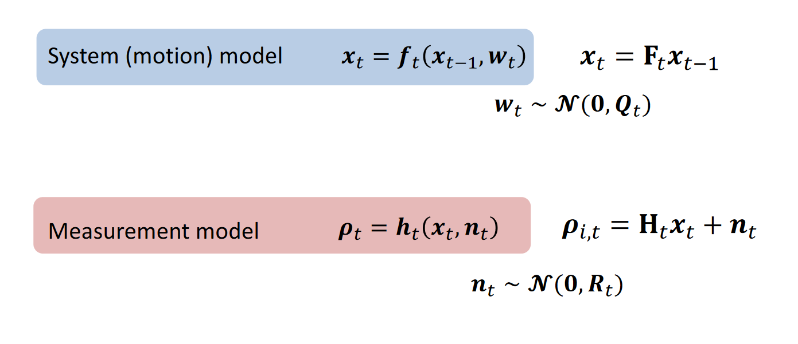
2. Localization algorithms implementation
NCP and NCV
TDOA
054309 - LOCALIZATION, NAVIGATION AND SMART MOBILITY
Notes:
assumption of gaussian noise in the measurements the H matrix of the measurements will be the direction cosines of the type of TDOA measurements
result: system not linear and gaussian -> EKF

Slide 5
3. Tune the tracking filter
Testing Bias of prior covariance
Testing different values of Q for NCP model
Testing different values of 𝛔 for NCV model
Comparasion NCP Vs NCV
054309 - LOCALIZATION, NAVIGATION AND SMART MOBILITY
Notes:
To avoid the initialization vector bias the model the prios covariance matrix mus be big enough to cover all the possible locations of the device

Slide 6
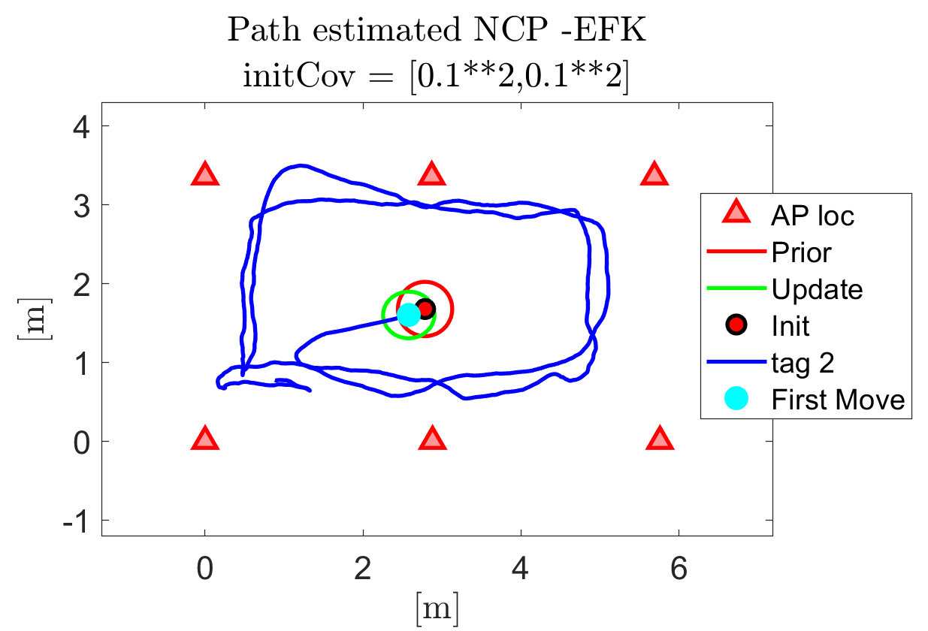
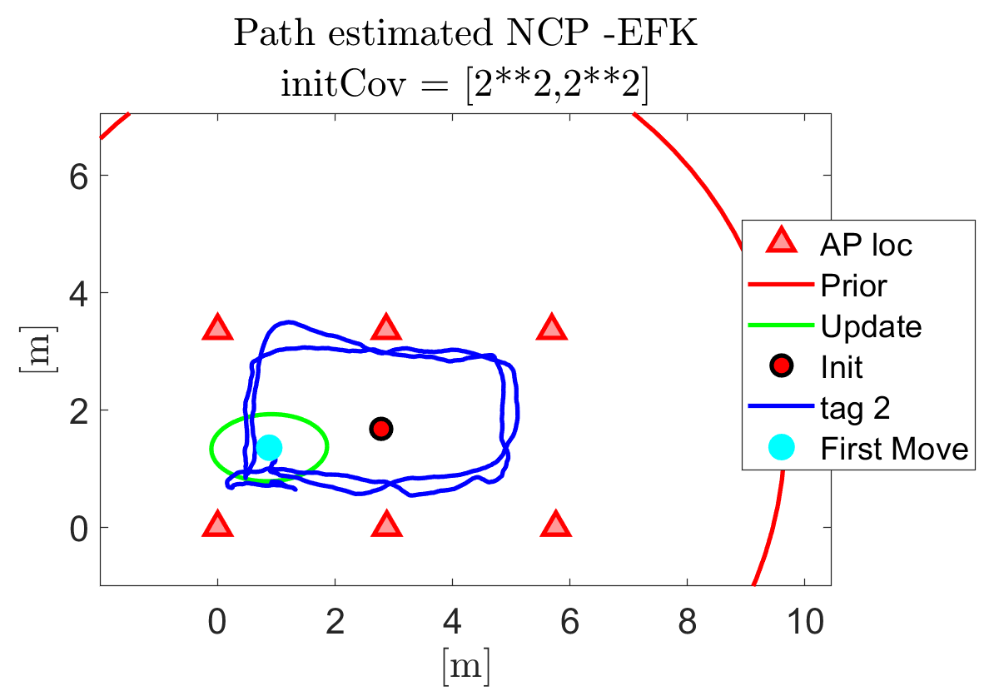
3. Tune the tracking filter: Testing Bias of prior covariance
054309 - LOCALIZATION, NAVIGATION AND SMART MOBILITY
Notes:
To avoid the initialization vector bias the model the prior covariance matrix must be big enough to cover all the possible locations of the device
For a random tag (2), this is show in the figures

Slide 7
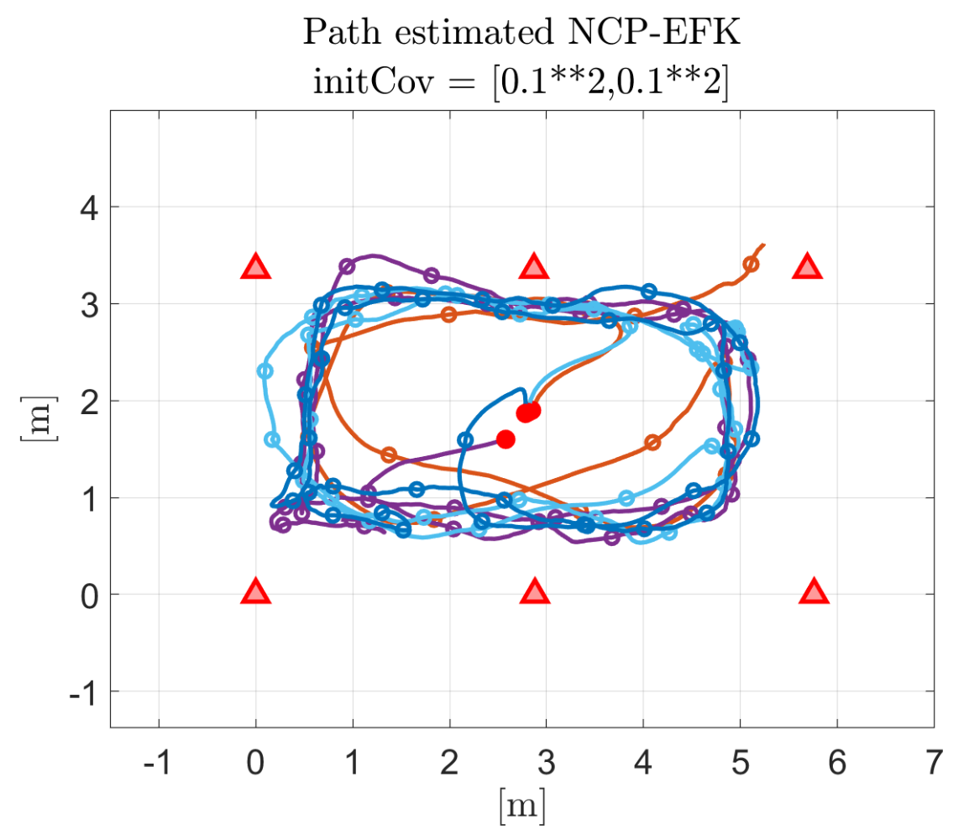
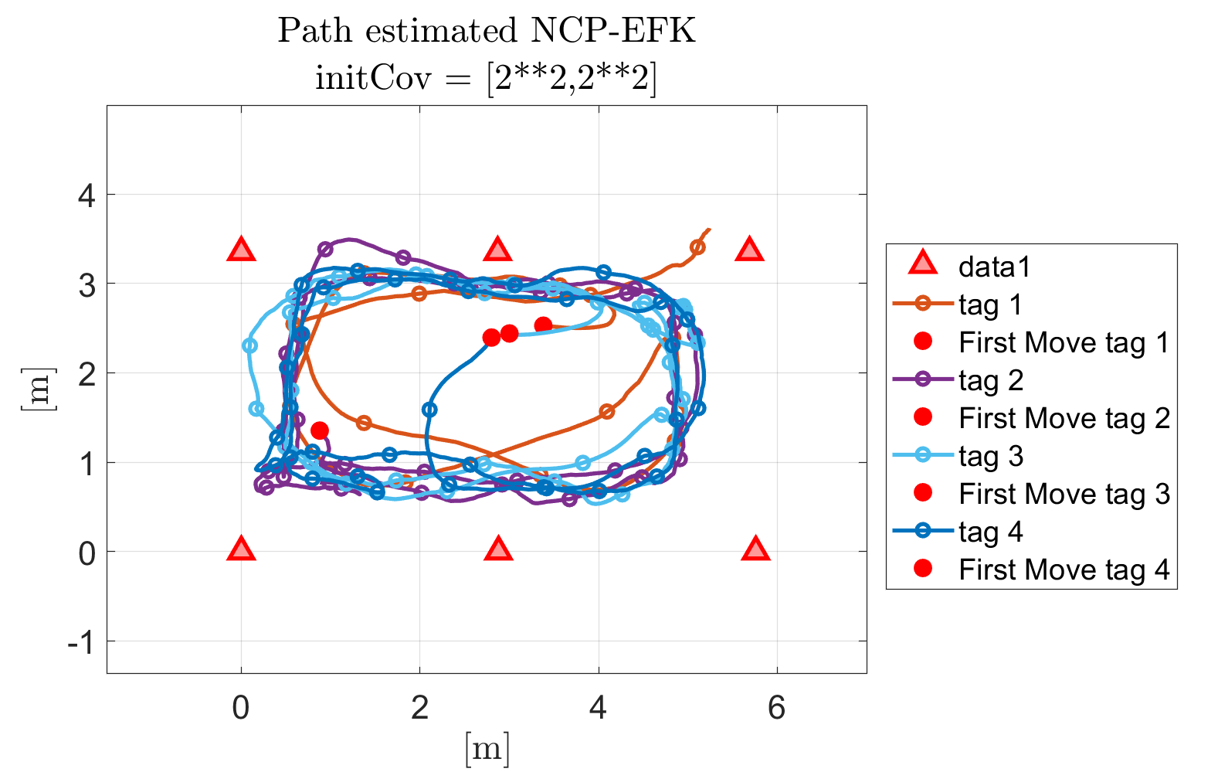
3. Tune the tracking filter: Testing Bias of prior covariance
054309 - LOCALIZATION, NAVIGATION AND SMART MOBILITY
Notes:
The same is replicated for the rest of the tags, it is important to pay attention to the first x predicted, in the case of the small covariance they are bias by the prior covariance

Slide 8
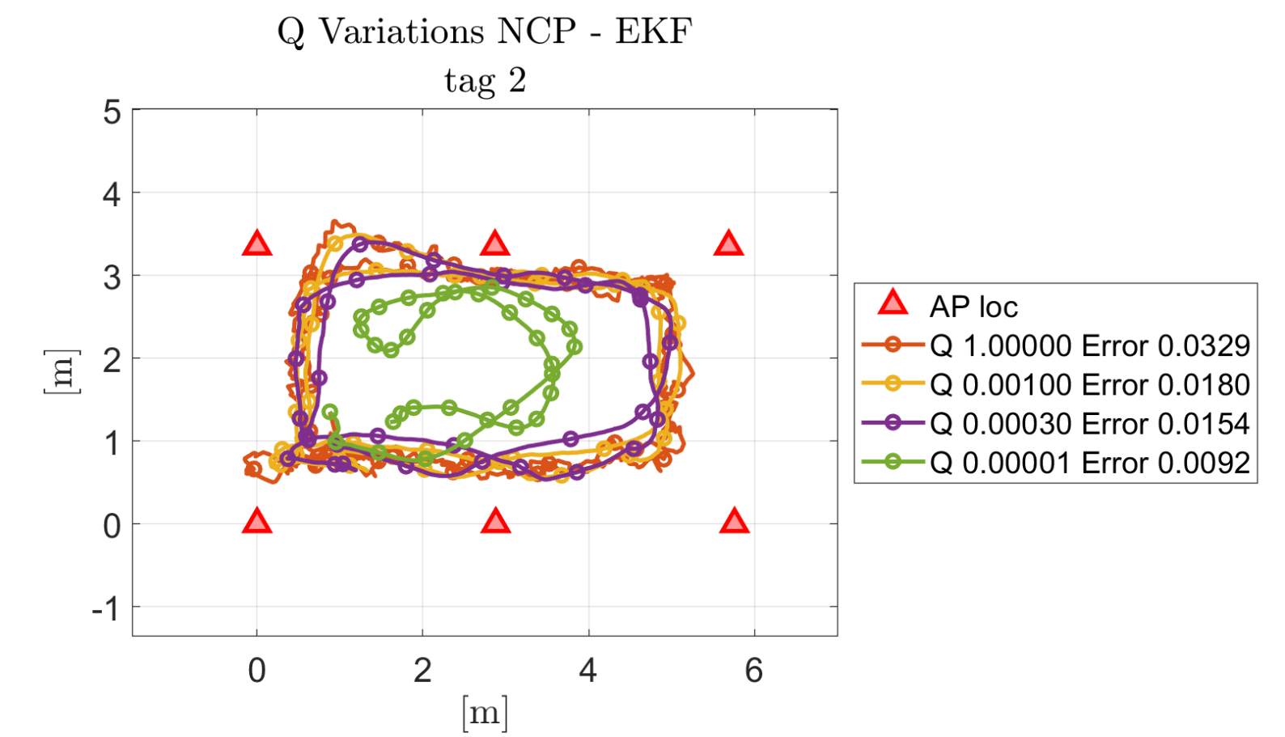
3. Tune the tracking filter: Testing different values of Q for NCP model
054309 - LOCALIZATION, NAVIGATION AND SMART MOBILITY
Notes:
Enlarging the covariance, the possible points where the device can be located is bigger. It is important to have a covariance bigger enough so it can follow the possible next positions of the device, but not as big to cause uncertainty. Is about the equilibrium.
a too small covariance next to zero, may unable the filter to follow the actual position of the device: example of the green line
About the others, the only information we have is the position

Slide 9
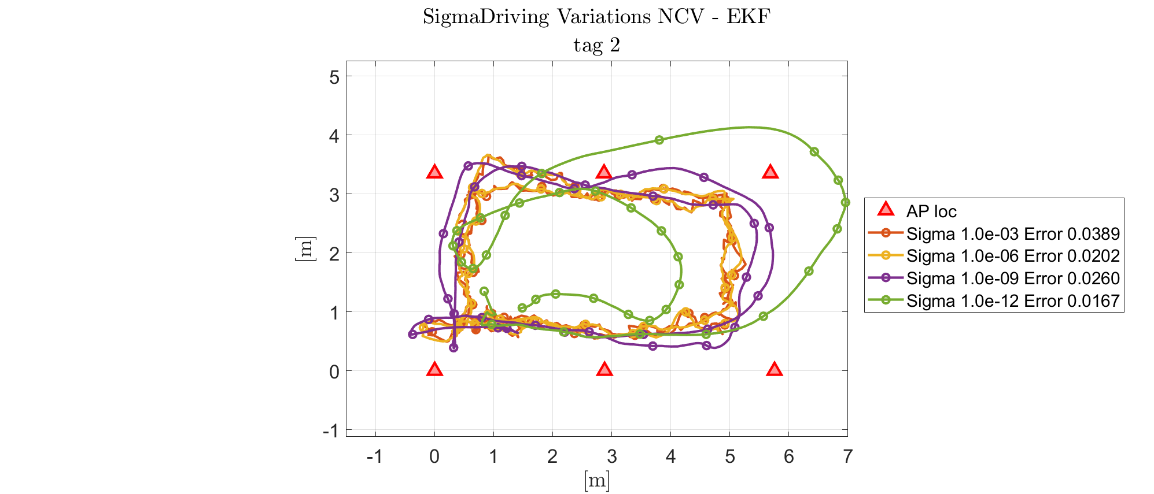
3. Tune the tracking filter: Testing different values of Q for NCV model
054309 - LOCALIZATION, NAVIGATION AND SMART MOBILITY
Notes:
In NVC we can analyze not just the position but also the velocity
Different values of sigma represent different adaptations to the velocity and motion change.
green line, not viable, the filter is not able to track the device and correct the position, sigma too small
to decide between the other sigmas it is convenient to look at the velocity profile of the experiment

Slide 10
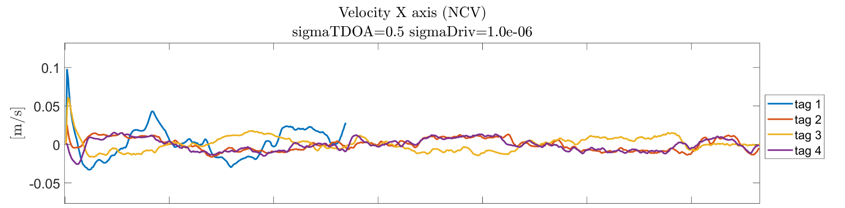
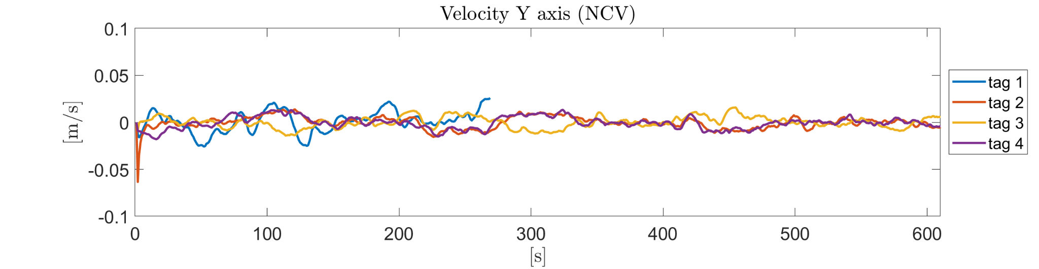
3. Tune the tracking filter: Testing different values of Q for NCV model
054309 - LOCALIZATION, NAVIGATION AND SMART MOBILITY
Notes:
the velocity all across the experiment appears to have a constant profile over time
Only the first seconds seem to have a peak in the velocity, this suggests the velocity seems to be constant all across the experiment with some periodical changes due to the circular motion
In this case a smaller sigma could be beneficial:
the smallest the sigma the more time it needs to adapt to high velocity changes, but tracks better constant motion

Slide 11
3. Tune the tracking filter: Testing different values of Q for NCV model
054309 - LOCALIZATION, NAVIGATION AND SMART MOBILITY
Notes:
output: chosen sigma: 10_6 milimeters per second, the smallest
when the sigma is bigger than 1mm it doesnt seem to have much difference in the trajectory: first 3 sigma trajectories overlap

Slide 12
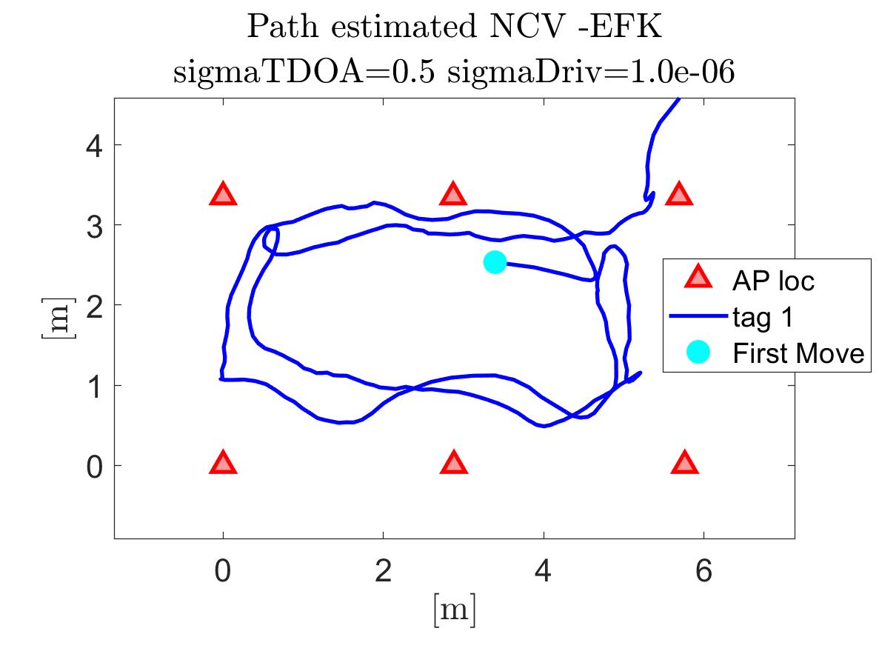
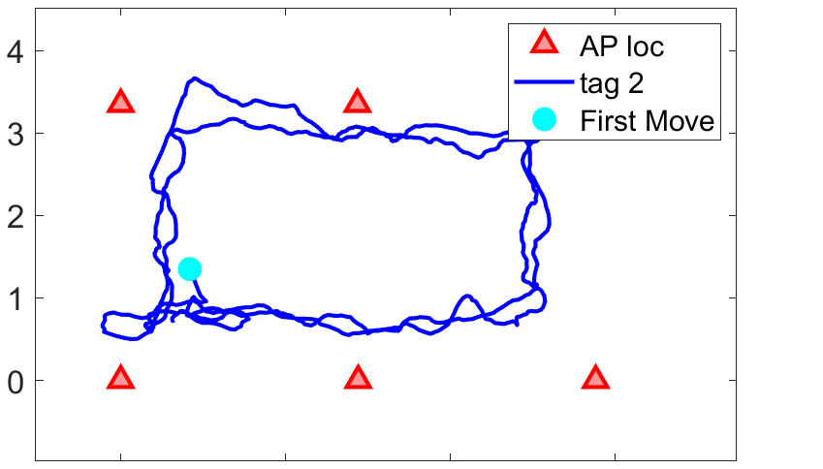
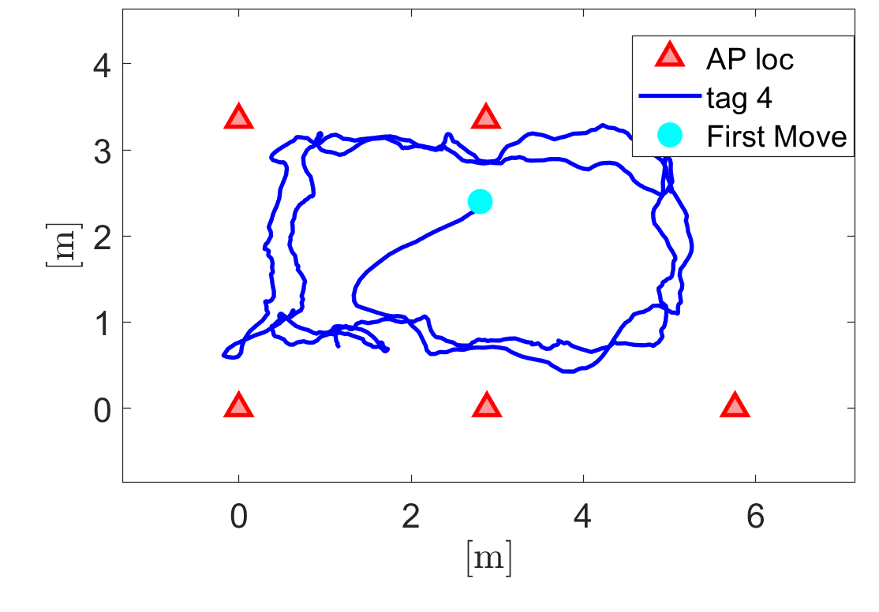
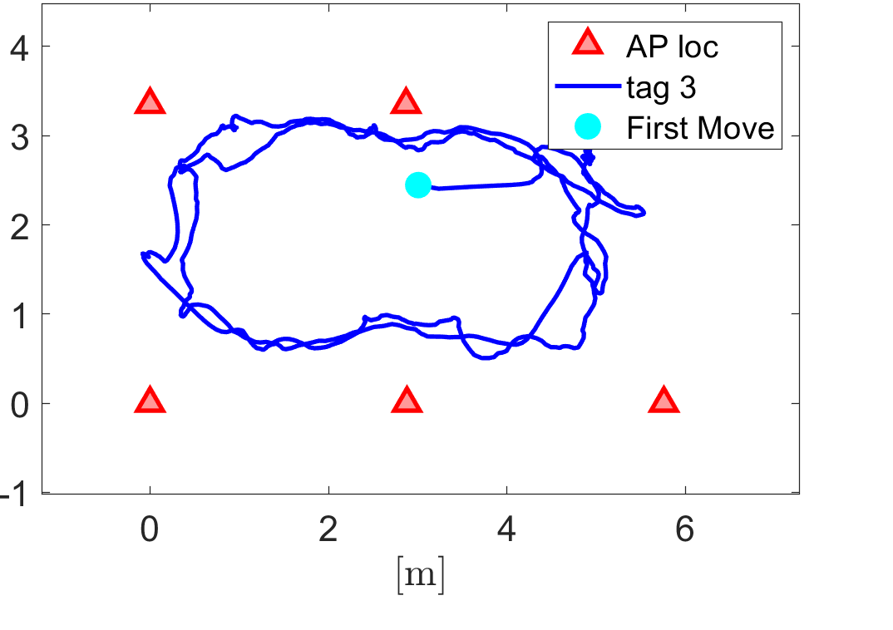
3. Results: NVC-EKF model with sigma = 1 mm
054309 - LOCALIZATION, NAVIGATION AND SMART MOBILITY
Notes:
final output. comments

