Slide 1

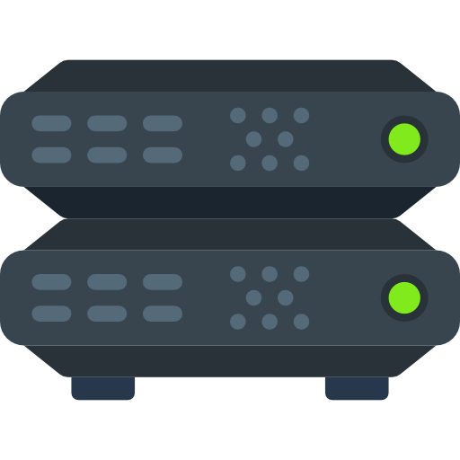
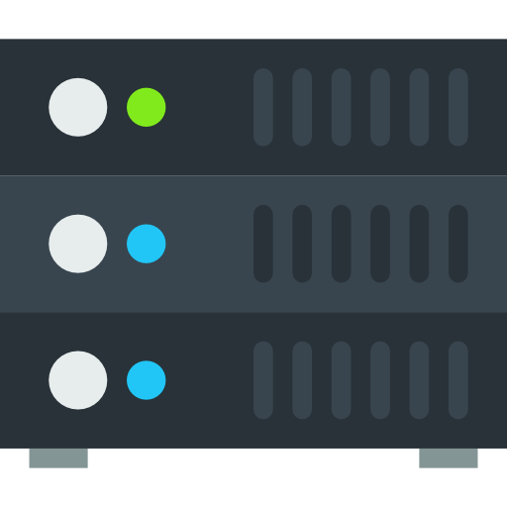

VPC
Public Subnet
c
Outbound Connection
Internet
Gateway
Inbound
Connection
Application Load Balancer
Public IP: 34.214.162.237
EC2 Instance
Public IP: 54.191.135.66
Container

Slide 2
VPC
Public Subnet
Private Subnet
c
c
Outbound
Connection
NAT Gateway
Public IP: 34.214.162.238
Internet
Gateway
EC2 Instance
Private IP: 10.0.0.1
Container
Inbound
Connection
Inbound
Connection
Application Load Balancer
Public IP: 34.214.162.237

Slide 3
VPC
Public Subnet
Private Subnet
c
c
Outbound
Connection
NAT Gateway
Public IP: 34.214.162.238
Internet
Gateway
Inbound
Connection
Inbound
Connection
EC2 Instance
Public IP: 54.191.135.66
Container
Application Load Balancer
EC2 Instance
Private IP: 10.0.0.1
Container
Application Load Balancer
Public IP: 34.214.162.237

Slide 4



VPC
Public Subnet
c
c
c
EC2 Instance
Private IP: 10.0.0.1
EC2 Instance
Private IP: 10.0.0.2
Container A
linkerd
Container B
linkerd
consul-registrator
consul-agent
consul-registrator
consul-agent

Slide 5

VPC
Private Subnet
c
EC2 Instance
Private IP: 10.0.0.1
Container
Direct Connection
Route 53
DNS lookup or API lookup to get service IP address
EC2 Instance
Private IP: 10.0.0.2
Container
Service Discovery API

Slide 6
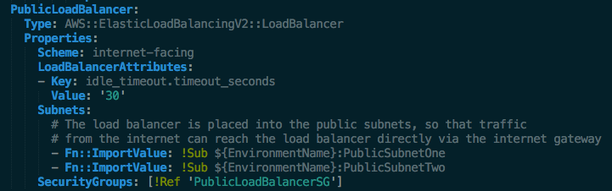
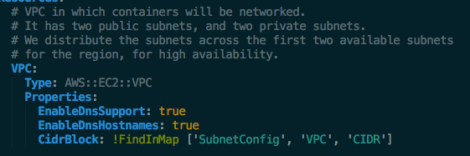
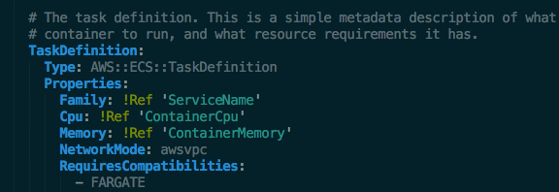
VPC
Public Subnet
Private Subnet
c
c
Outbound
Connection
NAT Gateway
Public IP: 34.214.162.238
Internet
Gateway
EC2 Instance
Private IP: 10.0.0.1
Container
Inbound
Connection
Inbound
Connection
Application Load Balancer
Public IP: 34.214.162.237

