Slide 1
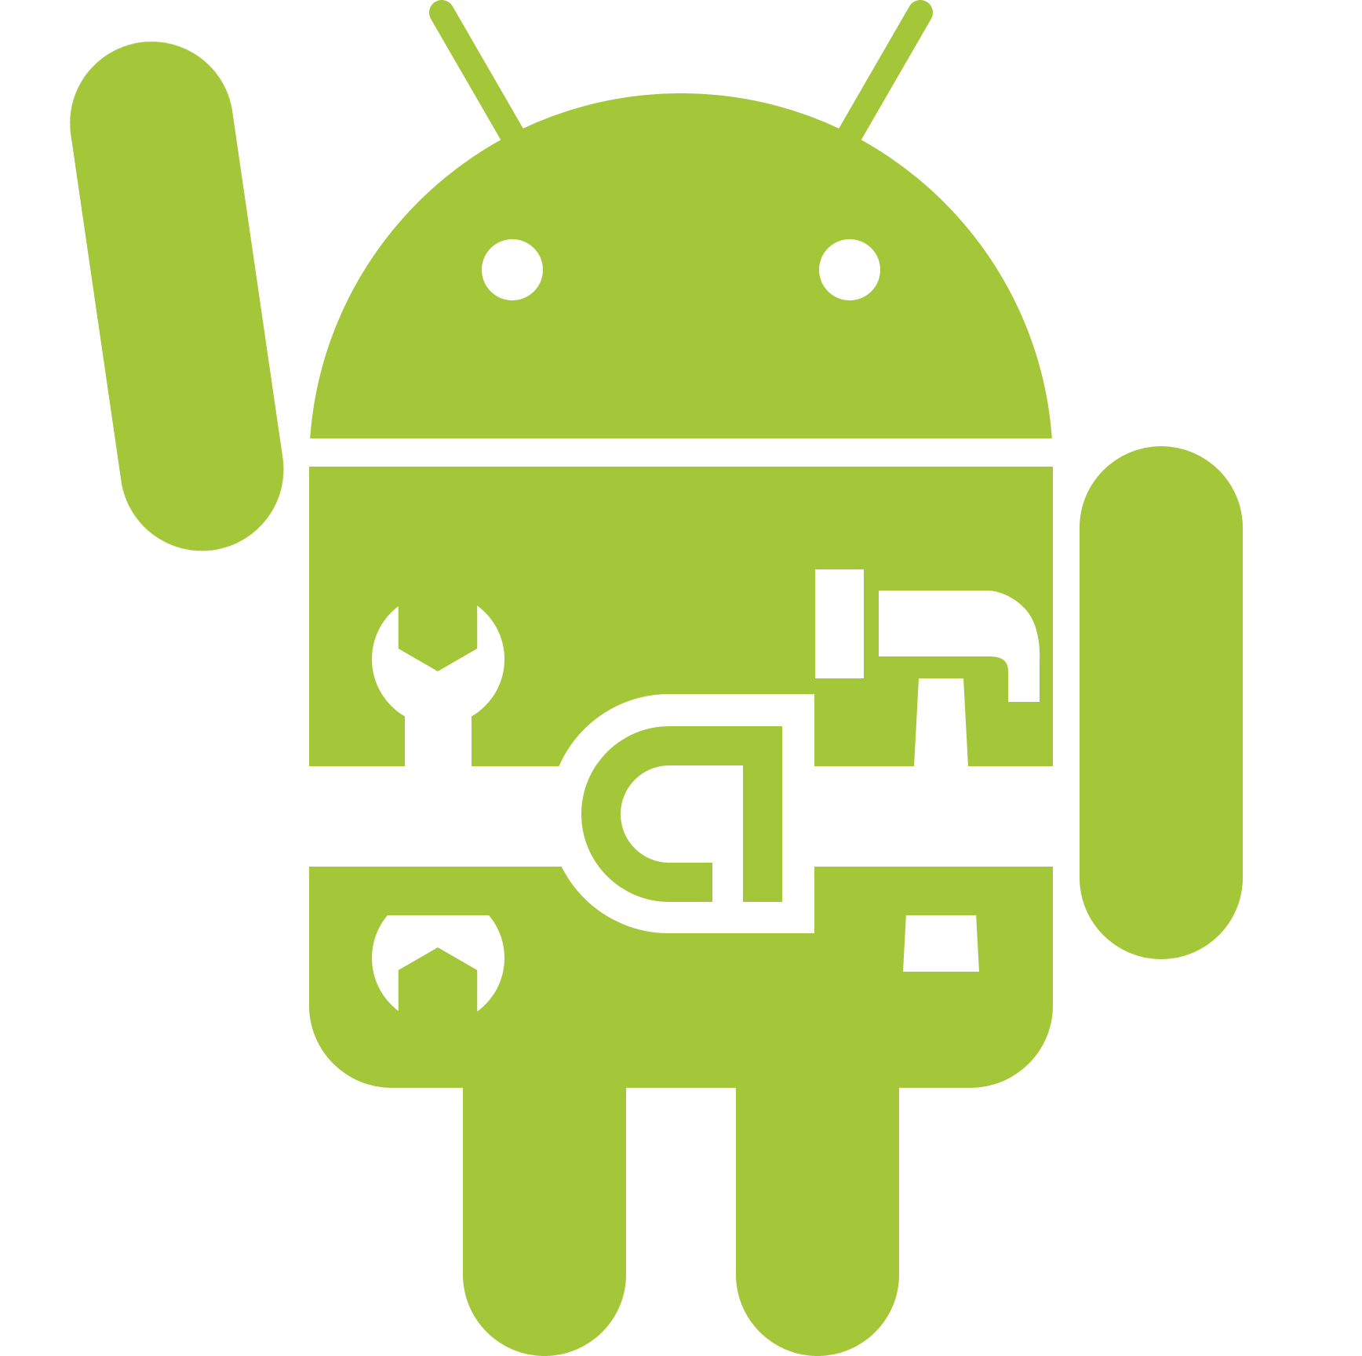
Android Debug Bridge, re-written in C#
A new implementation of the ADB protocol, in C#.
I apologize in advance to iOS users
Another apology for non-C# programmers
Claude Abounegm
EGR 230
Dr. Wunderlich
04/29/2015
Picture: http://techbeasts.com/wp-content/uploads/2013/08/Android-Developer2.png
Powerpoint template adapted from Dr. Wittman’s powerpoints.

Slide 2
What is ADB?
A command line tool that allows you to communicate with an Android OS
Very simple, yet so powerful
One of the most important components of Android forensics
Basic command-line structure:
adb [-d|-e|-s <serialNumber>] <command>
Show connected devices:
C:\AndroidSDK\tools>adb devices
List of devices attached
HTC123456789 device

Slide 3
Where is ADB?
ADB Client: Usually on local computer (just an executable file).
ADB Server: Either on local or remote computer.
ADB Daemon: On device or emulator.

Slide 4
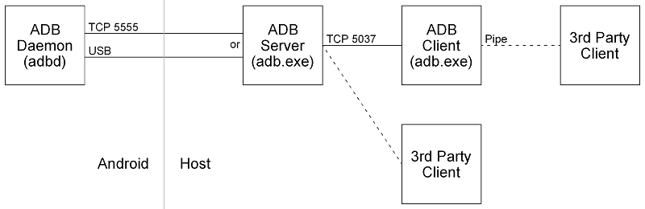
Where is ADB? (continued)

Slide 5
More about ADB
ADB is an indispensible tool for developers.
Devices can be debugged, modified, and can be made to do pretty much any operation.
A Linux shell command-line can be issued from a computer, to run commands on a phone through `adb shell`.
Example:
Commands after this line are executed on the phone and output is returned back to our command line
C:\AndroidSDK\tools>adb shell
shell@android:/ $ echo 1
echo 1
1

Slide 6
Problems with command-line ADB
Since ADB is very powerful, developers want to use automated scripts to do complicated operations.
The traditional way of doing this is:
CMD is started in background
Command is passed to CMD (ex. “adb devices”)
Two threads are started to monitor “standard out” and “standard error”
Output is parsed and used for the next operation
This turns out to be “not-so-efficient”, as it has to start two threads and adds an extra layer on top of the client.
Output becomes less reliable for dangerous operations.

Slide 7
Solution
ADB was written in C, and just got ported to C++.
C# is slowly becoming platform independent.
Eliminating the ADB client will provide just-in-time access to the server, and make communication with the device faster, more reliable and more efficient.
I wrote a new framework in C# to communicate with the server directly, without having to run the client. Our framework is the new “client”.

Slide 8
So…
A traditional connection to ADB will go through those stages:
Application ↔ Library ↔ CMD ↔ ADB Client ↔ ADB Server ↔ ADB Daemon.
In the new framework, they will go through those instead:
Application ↔ Library ↔ ADB Server ↔ ADB Daemon.

Slide 9
So… (continued)

Slide 10
Basic Protocol
Server listens to TCP connection on port 5037
Sending “host:version” gets the version of the server.
The length of the request should be sent before the string.
It is a 4-byte hexadecimal string. Length of “host:version” is 12 chars, which is 000C in hex.
Request is sent as “000Chost:version”
Server answers with “OKAY” or “FAIL”
Followed by the data or failure reason

Slide 11
Updated Example
The following command will reboot the first device into bootloader:
C:\AndroidSDK\tools>adb reboot-bootloader
C# example:
using System;
using Android;
namespace ADBTest {
class Program {
static Adb ADB = Adb.Instance;
static void Main() {
try {
var devices = ADB.UpdateDevices();
if(devices.Count > 0) {
devices[0].Reboot(RebootOptions.Bootloader);
Console.WriteLine(“Success”);
}
}
catch { Console.WriteLine(“Failure”); }
}
}
}

Slide 12
Questions?
Thank you!

