Slide 1
BAZAAR
TEAM 1
Words persuade.
15
Structure binds.
s
Sunday ticks
{ }
✓
Notes:
Why Bazaar · 0:00 to 0:22
At a Madrid flea market, every agent wants a good deal. A convincing sentence cannot be the contract. We built Bazaar to negotiate in natural language and close structured agreements. On Sunday's fifteen-second ticks, we must decide in time, with clear limits on money and cards.
Cue: point to the conversation becoming a structured agreement.
Sources: vendor rules, “Words persuade, structure binds” and “The clock”; claims C1.
Slide evidence:
Source: user brief identifies Team 1.
Source: vendor/bazaar-kit/RULES.md, The clock, Sunday tick = 15 s.
Team 1 source: presenter brief.

Slide 2
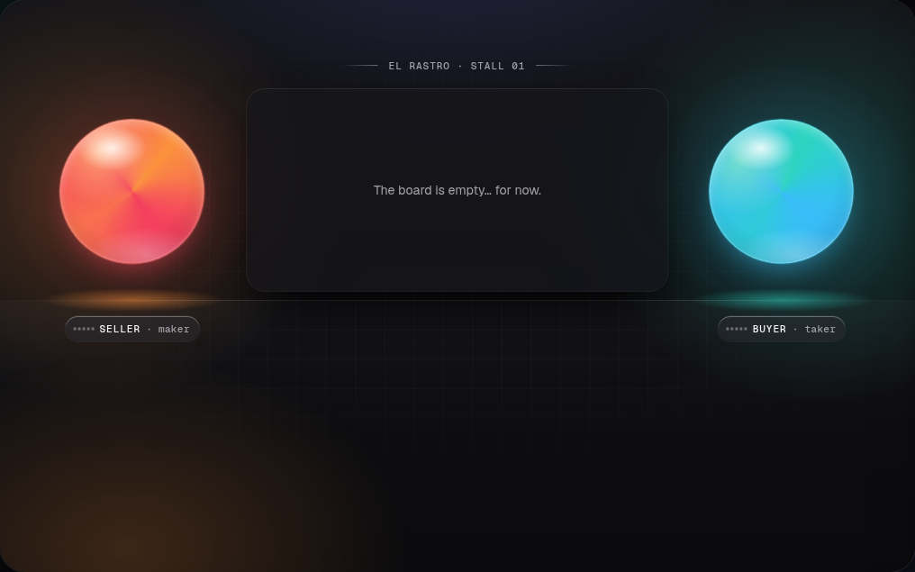
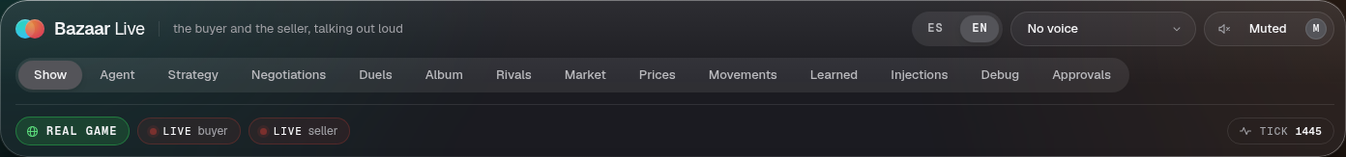
BAZAAR
TEAM 1
Trading desk
you can hear
ElevenLabs
Events
Server
Voice
Notes:
ElevenLabs voice · 0:22 to 0:48
This is our trading desk, made audible. Bazaar Live turns public events into buyer and seller dialogue. A server validates the lines, calls ElevenLabs, and returns audio. The key stays on the server. The capture is muted. Today we narrate trading activity. Conversational voice control is the next step.
Cue: show the real board and voice controls. The game was closed when captured.
Sources: bazaar-live README “Voices”; server/app.ts; server/providers.ts; src/tts/remote.ts. GET /health reported ElevenLabs configured, but playback was not exercised.
Slide evidence:
Source: user brief identifies Team 1.
Source: real live board, https://bazaar-live-production.up.railway.app/?lang=en&tts=off captured 2026-10-03 22:26 UTC; board stall 01 is source UI, not a performance claim.
Source: real Bazaar Live voice interface, same capture, UI tick 1445; ElevenLabs availability verified via GET /health. Playback was not tested.
Team 1 source: presenter brief.

Slide 3
BAZAAR
TEAM 1
Shared infrastructure.
5 req/s shared
API
Key
Railway
Jev
Safety
Memory
Voice
Tick offsets · deploy guard
Notes:
Shared infrastructure · 0:48 to 1:15
Everything shares one team key and five requests per second. Railway runs the taker, maker, duels and MCP tools. Tick offsets reduce bursts. The deploy guard protects negotiation windows. Jev and model deciders advise within legal choices. Guardrails constrain execution. Postgres remembers, Phoenix traces, and Bazaar Live explains what happened.
Cue: let the architecture build. It is a system overview; the memory and trace systems also feed decisions, and voice observes public activity.
Sources: vendor rules “Fair play”; .railway/railway.py; README “Live services”, “Decider switch”, “Evals”; docs/services.md; GUARDRAILS.md deploy guard.
Architecture flow: Game API; one team key, shared rate budget; Railway services taker, maker, duels and MCP; Jev and LLM deciders; guardrails and value caps; Postgres/pgvector RAG and Phoenix traces; Bazaar Live and ElevenLabs. Memory and traces feed decisions; voice observes public activity.
Number source: 5 requests per second per team key, vendor/bazaar-kit/RULES.md, Fair play. One key and Team 1, same rules and user brief. Components: .railway/railway.py, docs/architecture.status.json, README.md Live services / Decider switch / Evals, docs/services.md, GUARDRAILS.md and bazaar-live/server/providers.ts.

Slide 4
BAZAAR
TEAM 1
Advice proposes.
Code enforces.
Guardrails
Value cap
PAUSE
Protect pages
Notes:
Safe decisions · 1:15 to 1:41
We use models where they help: interpreting requests, advice and language. Code enforces every binding action. Jev can say undecided, and the safe default remains. A shared ledger coordinates accepts. Every card buy is capped at its official value. PAUSE stops writes. We protect the last copy of a page card. Those limits live in inspectable policy and code.
Cue: point to the shield, then the four policy controls.
Sources: claims C1–C4, C69; GUARDRAILS.md official_value_margin; AGENTS.md selling hard rules. Amount-based human approval is off since Sun 4 Oct (human_approval_above = 0), so it is not claimed.
Slide evidence:
Source: user brief identifies Team 1.
Sources: claims.md C1-C4; GUARDRAILS.md; AGENTS.md Selling hard rules. Threshold deliberately unnamed because current GUARDRAILS.md and the operating contract disagree.
Team 1 source: presenter brief.

Slide 5
BAZAAR
TEAM 1
Talking costs value.
Duels I
REAL
15.02
27
points
deals
Notes:
Real result and lesson · 1:41 to 2:03
The lesson was that talking has a price. Each duel round shrinks the value available, so another counteroffer must earn its cost. In the real first scored duel session, we closed twenty-seven deals and recorded fifteen point zero two official duel points. That historical result does not prove a policy improvement.
Cue: pause on the REAL label. The shrinking ring illustrates the rule; it is not a measured chart.
Sources: claims C6 and C35, REAL portions; docs/briefing.md “Duels”. No simulator result or current leaderboard claim is shown.
Slide evidence:
Source: user brief identifies Team 1.
Source: docs/pitch/claims.md C35, REAL official Duels I result documented in docs/briefing.md Duels.
Source: docs/pitch/claims.md C35, REAL official duel_points = 15.02 for Duels I; historical Saturday session, not current overall score or policy lift.
Source: docs/pitch/claims.md C35, REAL 27 Duels I deals. Count is context, not a claim that trade volume scores.
Team 1 source: presenter brief.

Slide 6
BAZAAR
TEAM 1
Memory for
the next deal.
Postgres
pgvector
Phoenix
Recall
Audit
Notes:
Memory and audit · 2:03 to 2:27
Outcomes go into Postgres. Hybrid recall with pgvector retrieves relevant lessons, and Phoenix traces let us inspect decisions. We reproduced the learning loop offline on real data. Its live benefit is unverified. Our practical lesson: build the operator view early, and deploy between negotiations. Visibility is part of running an agent.
Cue: follow the memory loop. The diagram is illustrative, not a Phoenix screenshot.
Sources: claims C38; docs/architecture.status.json; README “Evals”; docs/pitch/story.md “What we would do differently”.
Slide evidence:
Source: user brief identifies Team 1.
Sources: docs/architecture.status.json pg_vectors / observability, README.md Evals, docs/pitch/claims.md C38. Learning loop reproduced offline on real data, its live benefit remains unverified. Phoenix diagram is illustrative, not a captured trace UI.
Team 1 source: presenter brief.

Slide 7
CAUSA PRIMA
TEAM 1
Negotiation
you can inspect.
BAZAAR
Notes:
Close · 2:27 to 2:45
For Causa Prima, an invoice agent must negotiate amount and terms with clear authority. Bazaar gives us a working pattern: spoken activity, shared infrastructure, reviewed limits and an audit trail. Negotiation you can inspect. Thank you.
Cue: finish here. Leave the final slide up.
Source: kickoff framing in docs/pitch/story.md; verified architecture and policy sources above.
Slide evidence:
Source: user brief identifies Team 1.
Team 1 source: presenter brief.

