Slide 1
Detecting unusual changes
in movement around the city
Problem 05 Impact Lab Wellington · Team 7
One working prototype — a single map of corroborated movement signals, fed by four sources.
WCC Emergency Management × Claude Code Community NZ · 8 August 2026

Slide 2
The problem, and who feels it
Who feels it
“How might we identify and map sudden changes in pedestrian or vehicle movement that could indicate disruption, unsafe conditions, evacuation or loss of access?”
EM duty officers
triaging a fast-moving event on thin information
Communities
in disruption, evacuation, or loss of access
Today the Council leans on individual reports — slow, patchy, one voice at a time.
We add an early, corroborated signal of where movement has changed — before the phones start ringing.
The shared operating picture
ten team prototypes feeding one live map

Slide 3
Four movement sources, one grain
WCC transport sensors
Metlink public transport
Hourly pedestrian & vehicle counts at 400+ countlines.
Bus, train & ferry — 9 robust detectors over an April timetable replay.
34.7M ROWS · REAL
9 DETECTORS · SYNTHETIC
NZTA state highways
Wellington Airport flights
TMS daily counts, de-duplicated and expanded to hourly.
Arrivals + departures combined into total movements per hour.
119 SITES · REAL
5,492 MOVEMENTS · REAL
All conformed to the same ~1 km cell × hour grain, so anomalies from different sources line up.

Slide 4
How it works — raw → anomaly → conformed
1
2
3
4
Ingest
→
Detect
→
Conform
→
See it
Every source lands in local DuckDB — one file, no server.
Robust median / MAD z-score vs each entity's usual level for that hour and day type.
Roll up to ~1 km cell × hour; count how many sources agree.
Streamlit + pydeck: multi-layer map, corroboration slider, hourly playback.
Technical stack
Built with Claude Code
Data engineering, the anomaly SQL and five Streamlit apps — generated and verified in one working session.
DuckDB · Python · robust statistics · Streamlit · pydeck · CartoDB basemaps
Data: WCC Open Data · Metlink GTFS · NZTA TMS · OpenSky

Slide 5
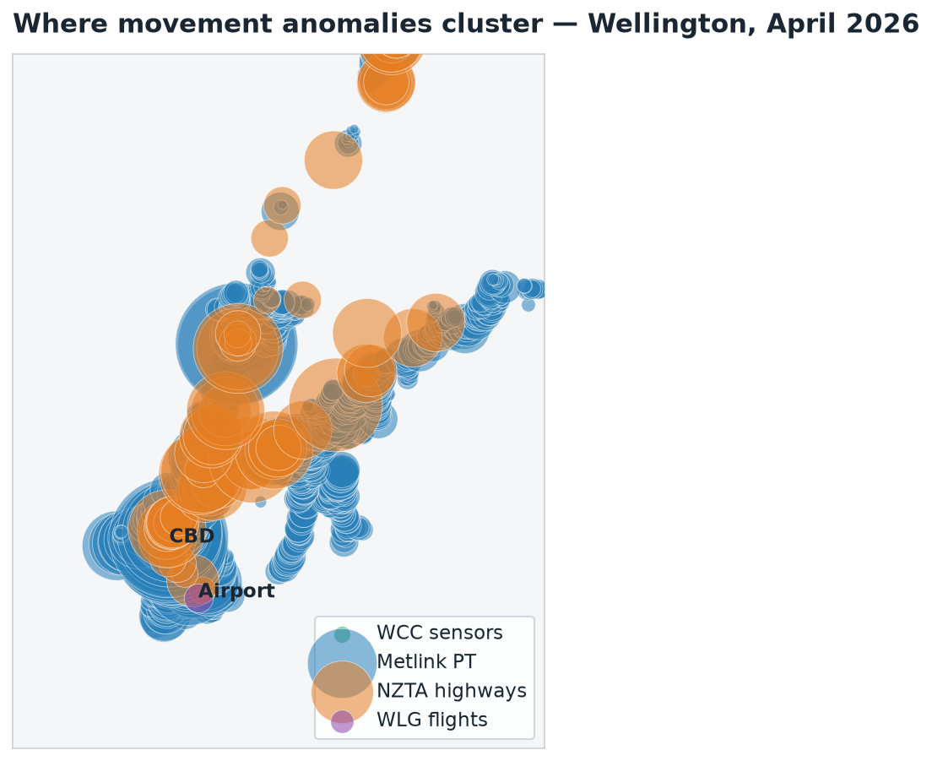
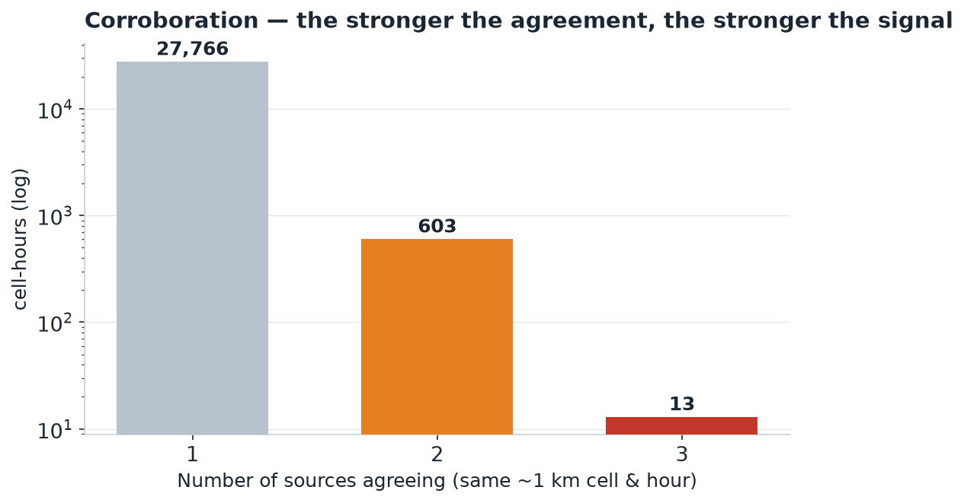
The result — corroborated anomalies
Corroboration = confidence
More than one source flagging the same place & hour is a stronger signal to investigate.
78,343
MEDIUM+ anomaly records unified
599
cell-hours with ≥ 2 sources agreeing
13
cell-hours where 3 sources agree

Slide 6
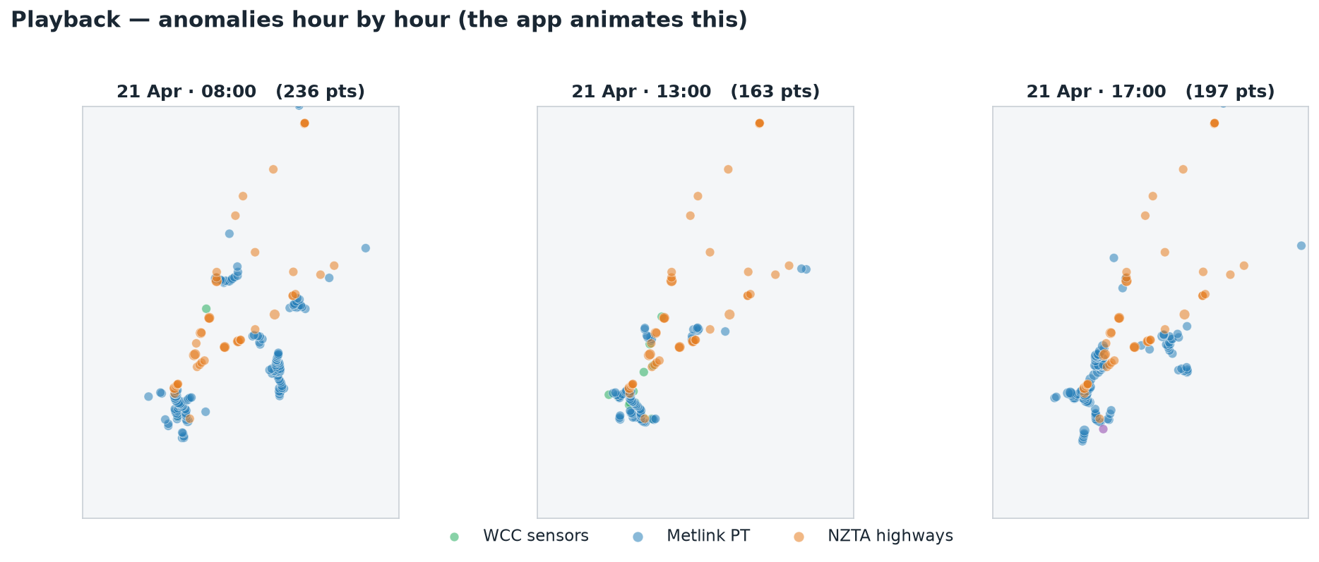
Play it back over the disruption window
The Playback tab animates every hour from 19 Apr 13:00 → 23 Apr 13:00. The 20–21 April drop shows across road, PT and flights at once.

Slide 7
What WCC could do next
Feed the common operating picture
Publish corroborated cells as GeoJSON into the shared live map.
Alert on agreement
Notify duty officers when ≥ 2 sources flag the same cell and hour.
Go live
Swap replays for live feeds — GTFS-Realtime and camera capture are already prototyped.
Deepen the baseline
Move beyond one month; keep synthetic vs real clearly labelled.

Slide 8
One map. Four sources.
Signals where they agree.
Signals mean investigate, not confirmed events. Synthetic layers are labelled. In an emergency, 111.
Team 7 · Problem 05 · data © WCC / Metlink-GWRC / NZTA Waka Kotahi / OpenSky

