Slide 1

Pōneke Pulse
The day the city went quiet →
Wellington has a heartbeat — and 128 cameras are enough to see it beat.
TEAM 8 · PROBLEM 05 — DETECT UNUSUAL CHANGES IN MOVEMENT · IMPACT LAB WELLINGTON
Notes:
Pōneke Pulse — Team 8, Problem 05. Wellington has a heartbeat; 128 cameras see it beat. The trace flatlines on the storm day.

Slide 2
Duty controllers lack data to make decisions
Handovers are verbal and ad hoc
Information passed on is what they think is important.
There is no view of what normal people movement and distribution looks like
Controllers lack empirical data to inform decisions
Individual reports
Slow · patchy · one place at a time
Movement data
DESIRED OUTCOME
WCC receives another early indication of where an event may affect people, rather than relying on individual reports.
Citywide · every hour · every mode
An always-on baseline that notices the change on its own.
Notes:
Today WCC learns where people are affected from individual reports — slow and patchy. We want an early, automatic signal.

Slide 3


README
LIVE SITE
Notes:
Today WCC learns where people are affected from individual reports — slow and patchy. We want an early, automatic signal.

Slide 4
Try the live demo
Explore the working interface behind the deck.
See the Week, Streets and Areas views in one place.
LIVE DEMO
Open the deployed prototype →
WHAT TO EXPLORE
WHY IT MATTERS
A hands-on way to see the duty officer brief move from forecast to action.
Week · Streets · Areas
Static snapshot · no credentials required
Notes:
Use this slide to invite the audience to open the working prototype.
[Sources]
- Demo URL supplied by the user: https://claudecommunity-nz.github.io/impact.lab.wlg.team-8.2026-08-08/

Slide 5
AI Opportunity Canvas
Your idea: __Detect unusual changes in movement around the city that could indicate disruption, unsafe conditions evacuations or loss of access
________________________________________________________________________________________
The who Human Lens | The why Business Lens | The what Solution Lens | The how Feasibility Lens
Customer / User Duty controller, EM team | Business Domain Emergency Management | AI Idea / Solution Our tool predicts baseline traffic, measures actual traffic and deviation from baseline and presents events that may cause deviations and provides data to estimate the risk impact based on population change and risk zones e.g.(Tsunami, flood zones) | Data Feasibility What data is required? How ready is it for availability, quality, access and sensitivity? Computer vision data
Customer Problem We don’t have visibility of data or a model to predict population movement so can’t accurately estimate risk impact | Business Goal / KPI / OKR Improve risk estimation for planning, response and retrospectives | Status Quo / Workaround Individuals try and make sense of disparate data sets and think what is important to hand over | Technical Feasibility Set up to run as a static bundle. One map layer and access to existing data sources. We have turned point source data into edge information
Desired Outcome An accurate real-time view of people movement – predicted, actual and anomalies | Problem / Gap / Need Managers don’t know what to expect, no real-time people movement data to make evidence based decisions | First Test / Prototype Demonstrates real-time people movement data, highlights anomalies and provides data for risk assessment | Legal, Compliance & Trust Risk Publicly available information. No private information, no bias identified.

Slide 6
ICE Prioritisation
Score each item from 1 to 10.
Metric | Guidance | Scale | Score
Impact | How valuable would this be if it works? 1 = nice to have, 10 = game changer. | 1 – 10 | 10
Confidence | How sure are we that this can work? 1 = not sure, 10 = very confident. | 1 – 10 | 10
Effort / Ease | How easy is it to test or deliver? 1 = hard, 10 = easy. | 1 – 10 | 9.5
Overall score | Impact × Confidence × Ease | 950/ 1000

Slide 7
Forecast the normal. Measure the actual. Score the gap.
1
BASELINE
2
ACTUAL
3
RISK
→
→
What a normal day looks like, by mode — modelled as an 84-day same-weekday median (up to 12 recent occurrences).
What happened today, per mode, per edge — measured against that expected rhythm.
The size of the gap × where it sits × how many people the area holds.
EVENTS RESHAPE WHAT TO EXPECT
Cruise ships in port · a test at the stadium · MetService warnings · Civil Defence alerts — hand-entered or fed in, they lift or suppress the baseline before we judge the day.
100% = baseline (expected). Below 100% = fewer people than a normal day. Above = more.
Modular Population Forecast & Risk Estimation — one platform, extensible with more feeds and derived risks.
Notes:
Three moves: model the baseline by mode, measure the actual per edge, score the gap by location and population. Events reshape the expectation.

Slide 8
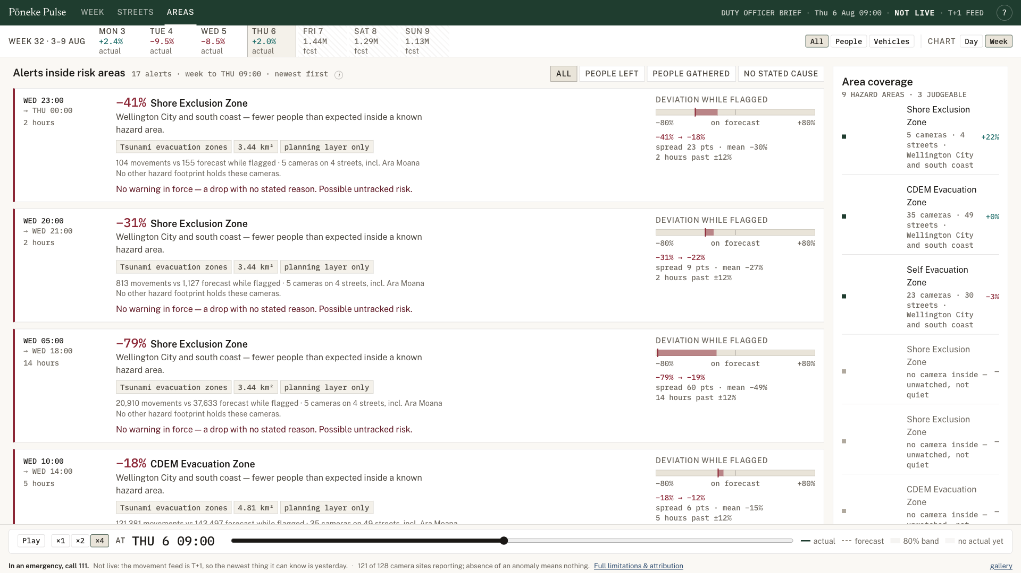
The trick: sensors become edge weights, not dots
A single camera counts one spot. We spread its count along the road or path it watches — so coverage becomes a network, not a scatter of points.
398
128
147
countlines (raw point counters)
camera sites (grouped by viewpoint)
edges carry a value · 94 judged
A closure between two cameras still shows up.
Notes:
The derived data product: point counters become weights along edges, so coverage becomes a network. 398 countlines -> 128 sites -> 147 edges. A closure between cameras still shows.

Slide 9
The ratio between modes is the diagnosis
We never type a site by how big the drop is — only by which mode fell. That is what turns a number into a cause worth investigating.
↓
EXPOSURE HAZARD
↓
ROAD CLOSURE
people collapse ≫ cars
cars collapse ≫ people
People stopped walking first — conditions on the street.
Street still walkable; something is blocking traffic.
↓↓
LOSS OF ACCESS
↑↓
OPEN TO PEOPLE
both collapse together
people up, cars down
The whole corridor emptied — nobody is moving through.
Closed to traffic, opened to people — an event or march.
Not enough multi-mode coverage? It returns “cannot type” — a counted, first-class verdict, never a guess.
Notes:
We type each site by the ratio between modes, not the size of the drop. People-first fall = exposure hazard; cars-first = road closure; both = loss of access; people up cars down = open to people. Cannot type is a first-class verdict.

Slide 10
23 October 2025 — the day it fired
−41%
16 Oct · normal
23 Oct · storm
citywide movement vs a normal Thursday
MetService RED severe-wind warning
Gusts to 140 km/h at Mount Kaukau
Every Wellington train cancelled
Headline is the 11-Thursday robust baseline — a sceptic can redo it by hand.
■ people ▲ vehicles · bars show actual against the expected level, by mode
You don’t read a z-score. Actual falls far below what a normal Thursday expects — and the gap is the emergency.
Notes:
Proof: 23 Oct 2025, red wind warning, trains cancelled, -41% citywide. Actual bars fall far below the expected level; the gap is the emergency. Headline uses the 11-Thursday robust baseline.

Slide 11
It refuses to panic — and it’s built to extend
HONEST BY DESIGN
BUILT TO EXTEND
Not live. The feed is T+1 — a next-morning and after-action tool, never present tense.
Modular platform. Add causation feeds — weather, cruise ships, road closures, warnings — as they arrive.
Missing ≠ zero. A silent sensor draws as a break in the line, never as a low value.
Derived risks. Score new risks on top of the same baseline-vs-actual spine.
Guarded baselines. Public holidays and broken ingests are excluded from every comparison.
Outputs compose. GeoJSON, a feed or an API — it slots into the shared common operating picture.
It admits blindness. When it cannot see, it greys the map rather than calling a false −65%.
“A tool that visibly declines to panic is worth more to an emergency manager than one that only fires correctly.”
Movement: WCC / VivaCity via Pōneke Travel Insights. Hazard-planning material, not live emergency information — in an emergency, call 111.
Notes:
Honest by design: T+1, missing != zero, guarded baselines, admits blindness. Built to extend: modular feeds, derived risks, composable outputs into the common operating picture.

Slide 12
APPENDIX — WEEK VIEW
The duty brief: citywide movement against forecast, with the map, risk read and ranked edges moving together.
Notes:
Week view — citywide movement against forecast, with the map, risk read and ranked edges moving together.
[Sources]
- Screenshot: team8/poc_1/web/e2e/shots/readme/week.png
- Description paraphrased from README.md in the repository.

Slide 13
APPENDIX — STREET TABLE
Street-level read: ranked camera sites with 24-hour traces and explicit refusal states.
Notes:
Streets view — camera sites ranked against baseline, with per-site traces and explicit refusal states.
[Sources]
- Screenshot: team8/poc_1/web/e2e/shots/readme/streets.png
- Description paraphrased from README.md in the repository.

Slide 14
APPENDIX — AREAS VIEW
The consequence read: movement deviation crossed with hazard geography, with coverage limits shown alongside the alerts.
Notes:
Areas view — movement deviation crossed with hazard geography, with coverage limits alongside the alerts.
[Sources]
- Screenshot: team8/poc_1/web/e2e/shots/readme/areas.png
- Description paraphrased from README.md in the repository.

