Slide 1
Scenarios POT
Field Operations
Digital workplace
Facility Management
Data valorization
Process Improvement
Business Relationship Management
Claude Fauconnet/Cienova Juin 2016

Slide 2
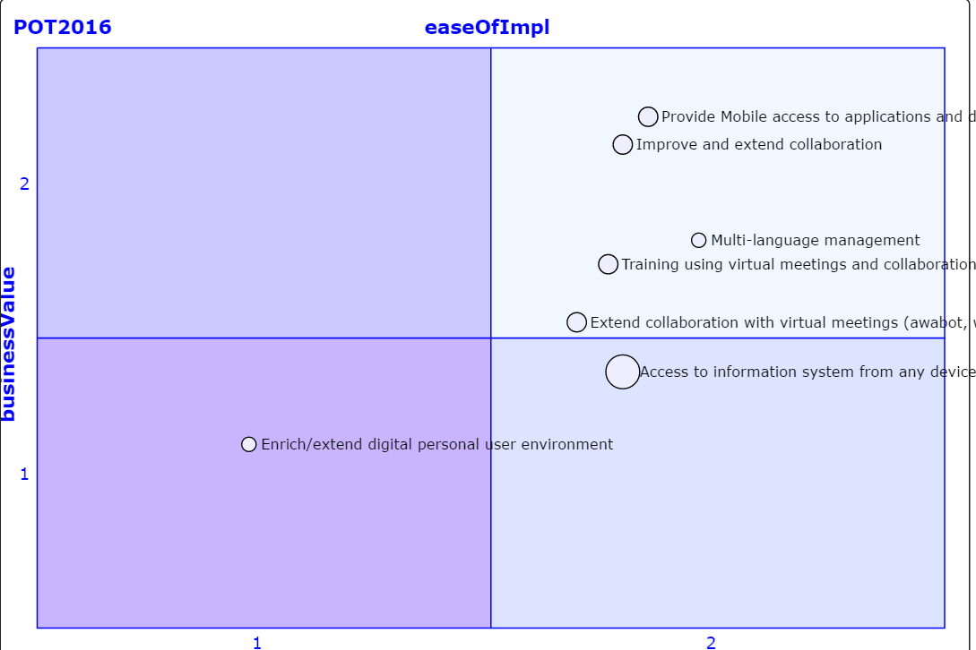
Digital Workplace
Claude Fauconnet/Cienova Juin 2016

Slide 3
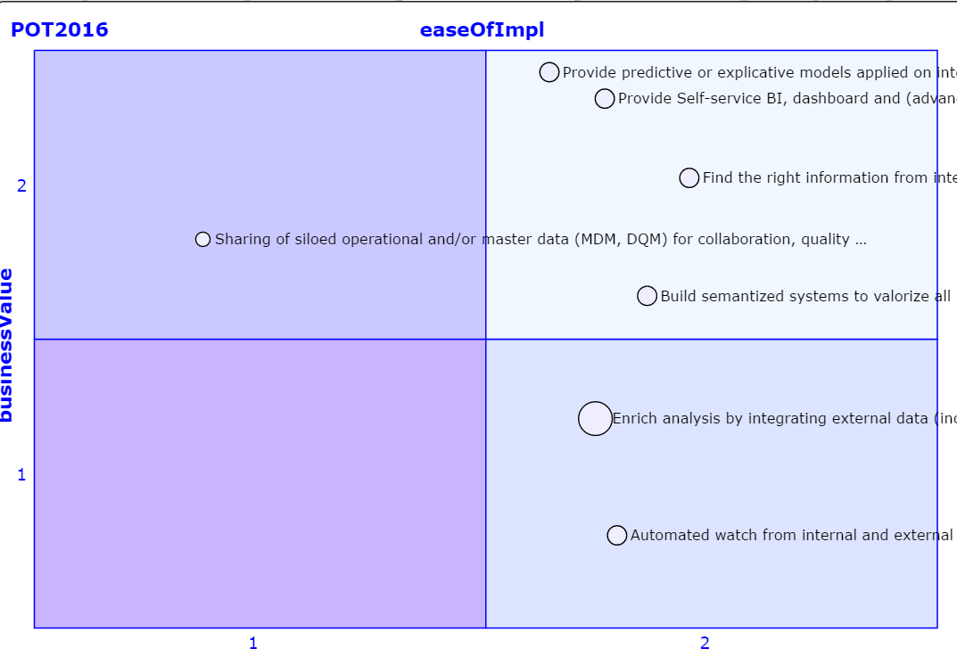
Data Valorization
Claude Fauconnet/Cienova Juin 2016

Slide 4
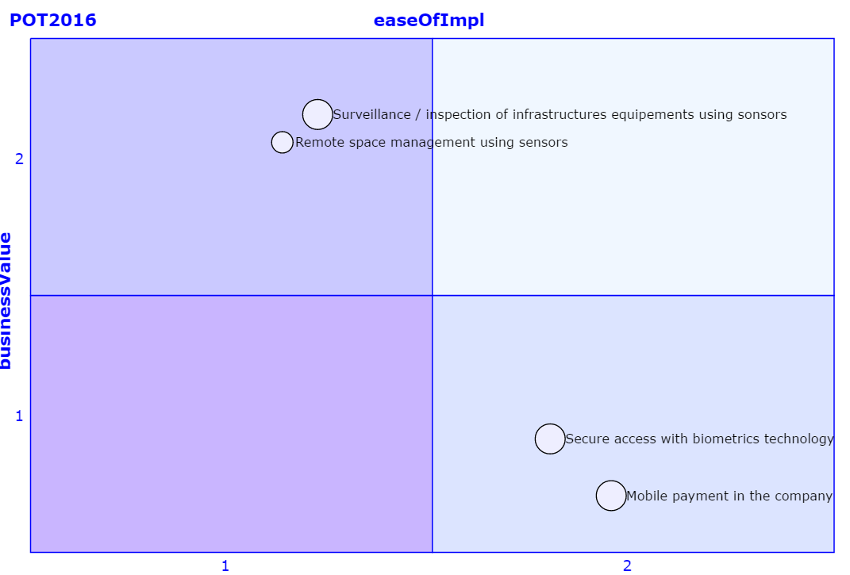
Facility Management
Claude Fauconnet/Cienova Juin 2016

Slide 5
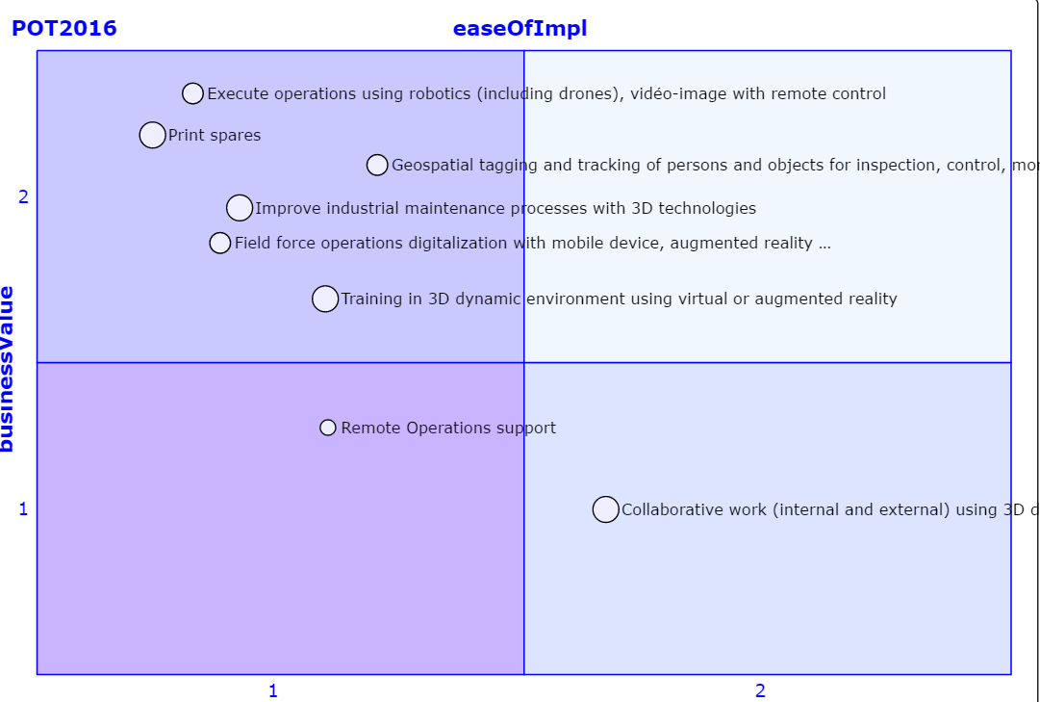
Field Operations
Claude Fauconnet/Cienova Juin 2016

Slide 6
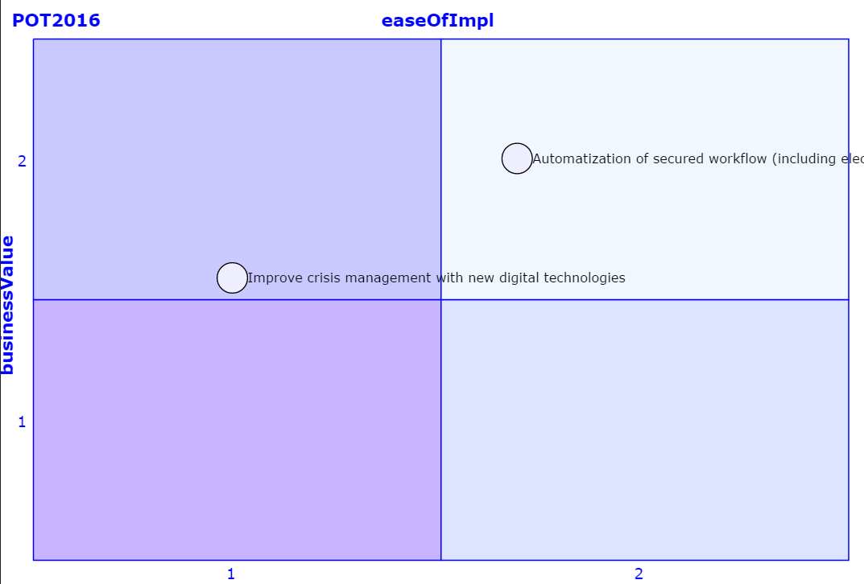
Process improvement
Claude Fauconnet/Cienova Juin 2016

Slide 7
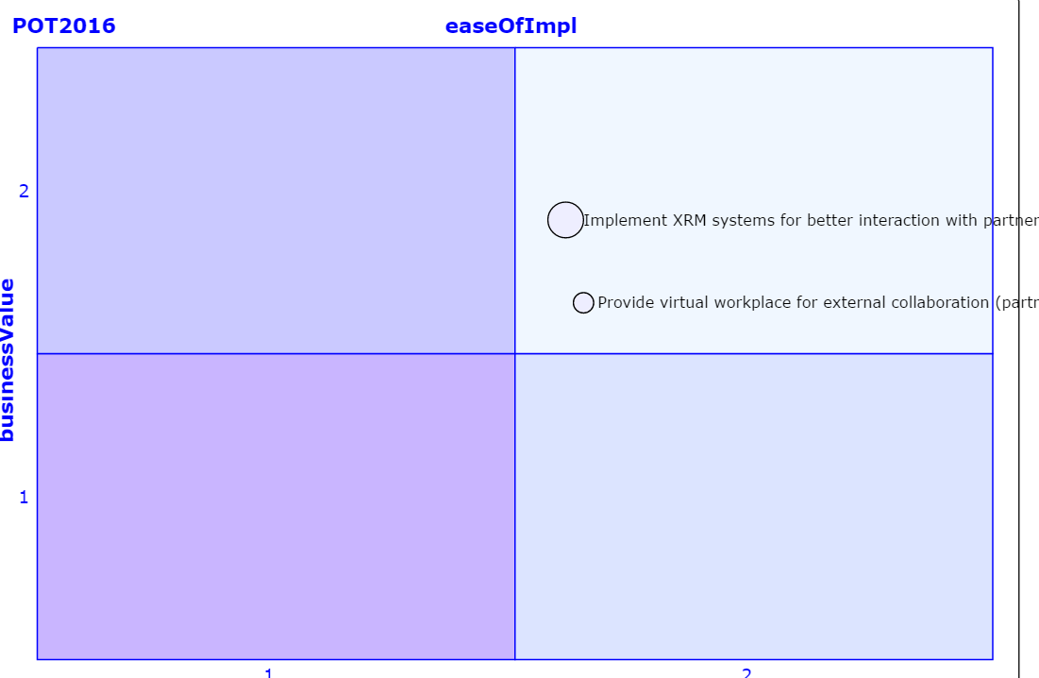
Business RelationShip Improvement
Claude Fauconnet/Cienova Juin 2016

