Slide 1
Module Title:
MACHINE LEARNING
Module Code:ITLML801
Competence:
MACHINE LEARNING MODULE DESCRIPTION
Learning hours:100
Trainer: IRABARUTA Emmanuel

Slide 2
Learning outcome 2:
Apply Machine Learning Techniques
I. Machine learning algorithms and applications
Supervised Learning Algorithms
Unsupervised Learning Algorithms
Deep Learning Algorithms

Slide 3
Introduction to Supervised Learning
Overview
Supervised learning is a type of machine learning algorithm that uses a known set of input data and known responses to the data to predict future responses.
Supervised learning algorithms can be used for both classification and regression tasks.

Slide 4
I. CLASSIFICATION IMPLEMENTATION
Objectives
To understand the classification problems.
To implement the K-Nearest Neighbours Algorithm for classification problems.
To implement the Support Vector Machine Algorithm for classification problems.
To understand the usages of different kernels in Python Code.
To implement the logistic regression algorithm for classification problems.

Slide 5
INTRODUCTION
Many machine-learning algorithms are available for performing classification tasks not only binary classification but also multiclass classification.
Few are, Logistic Regression, k-Nearest Neighbors, Decision Trees, Support Vector Machines, Naïve Bayes, Random forest and Artificial Neural Networks. In this unit, we will try to understand k-nearest neighbor algorithm, support vector machine algorithm and logistic regression algorithm in detail

Slide 6
GENERALIZATION, OVERFITTING, AND UNDERFITTING
In supervised learning, we want to build a model on the training data and then be able to make accurate predictions on new, unseen data that has the same characteristics as the training set that we used.
If a model is able to make accurate predictions on unseen data, we say it is able to generalize from the training set to the test set
Overfitting occurs when you fit a model too closely to the particularities of the training set and obtain a model that works well on the training set but is not able to generalize to new data. On the other hand, if your model is too simple—say, “Everybody who owns a house buys a boat”—then you might not be able to capture all the aspects of and vari‐ ability in the data, and your model will do badly even on the training set. Choosing too simple a model is called underfitting.

Slide 7
TYPES OF SUPERVISED LEARNING
Classification: Classification is a type of supervised learning where the goal is to categorize data into distinct groups.
Classification algorithms take a set of labelled data and attempt to predict the class of an unlabeled data point.
Examples of classification algorithms include logistic regression, decision trees, support vector machines, and naive Bayes.

Slide 8
2. Regression: Regression is a type of supervised learning where the goal is to predict a continuous outcome. Regression algorithms take a set of labelled data and attempt to approximate the relationship between the inputs and the outputs.
Examples of regression algorithms include linear, polynomial, and support vector regression.

Slide 9
APPLICATIONS OF SUPERVISED LEARNING
1. Image Classification: Image classification is used for automated image tagging, for example by Facebook or Google Photos to detect objects in an image and automatically tag them.
2. Speech Recognition: Speech recognition is used for automated voice command processing and understanding, such as with Apple's Siri or Amazon Alexa.
3. Fraud Detection: Banks and payment services use supervised learning algorithms to detect suspicious activity on customer accounts and detect potentially fraudulent transactions.

Slide 10
4. Medical Diagnosis: Supervised learning algorithms are used in healthcare to diagnose diseases based on patient data, such as symptoms, laboratory results, and medical images.
5. Recommender Systems: Recommender systems are used to make personalized recommendations based on previous user data, such as in Netflix and Amazon.

Slide 11
CHALLENGES IN SUPERVISED LEARNING
1. Data Bias: Data bias is a phenomenon in which the data used in supervised learning systems is skewed or unrepresentative of the actual population.
This can lead to incorrect results and inaccurate predictions.
2. Imbalanced Datasets: An imbalanced dataset is one in which the number of samples from one class is significantly greater than the number of samples from other classes.
This can lead to over-fitting and inaccurate results.
3. Limited Labeled Data: Labeled data is data that has been labelled with the correct responses. Limited labelled data can lead to incorrect models and inaccurate predictions.

Slide 12
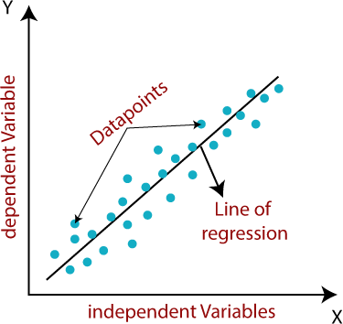
Linear regression:
Linear regression algorithm shows a linear relationship between a dependent (y) and one or more independent (y) variables, hence called as linear regression.
The linear regression model provides a sloped straight line representing the relationship between the variables. Consider the below image:

Slide 13
Mathematically, we can represent a linear regression as: y= a0+a1x+ ε
Here,
Y= Dependent Variable (Target Variable)
X= Independent Variable (predictor Variable)
a0= intercept of the line (Gives an additional degree of freedom)
a1 = Linear regression coefficient (scale factor to each input value). ε = random error
The values for x and y variables are training datasets for Linear Regression model representation.

Slide 14
Regression Models
Linear regression can be further divided into two types of the algorithm:
Simple Linear Regression:
If a single independent variable is used to predict the value of a numerical dependent variable, then such a Linear Regression algorithm is called Simple Linear Regression.
Multiple Linear regression:
If more than one independent variable is used to predict the value of a numerical
dependent variable, then such a Linear Regression algorithm is called Multiple Linear Regression.

Slide 15
GRADIENT DESCENT
It is known as one of the most commonly used optimization algorithms to train machine learning models by means of minimizing errors between actual and expected results. Further, gradient descent is also used to train Neural Networks.

Slide 16
ADVANTAGES OF BATCH GRADIENT DESCENT:
  It produces less noise in comparison to other gradient descent.
  It produces stable gradient descent convergence.
  It is Computationally efficient as all resources are used for all training samples.

Slide 17
TYPES OF GRADIENT DESCENT
Based on the error in various training models, the Gradient Descent learning algorithm can be divided into Batch gradient descent, stochastic gradient descent, and mini-batch
gradient descent. Let's understand these different types of gradient descent:
1. Batch Gradient Descent:
Batch gradient descent (BGD) is used to find the error for each point in the training set and update the model after evaluating all training examples. This procedure is known as the training epoch. In simple words, it is a greedy approach where we have to sum over all examples for each update.

Slide 18
2. STOCHASTIC GRADIENT DESCENT
Stochastic gradient descent (SGD) is a type of gradient descent that runs one training example per iteration.
it processes a training epoch for each example within a dataset and updates each training example's parameters one at a time.
Advantages of Stochastic gradient descent:
In Stochastic gradient descent (SGD), learning happens on every example, and it consists of a few advantages over other gradient descent.
It is easier to allocate in desired memory.
It is relatively fast to compute than batch gradient descent.
It is more efficient for large datasets.

Slide 19
3. MINIBATCH GRADIENT DESCENT:
Mini Batch gradient descent is the combination of both batch gradient descent and stochastic gradient descent.
It divides the training datasets into small batch sizes then performs the updates on those batches separately.
Splitting training datasets into smaller batches make a balance to maintain the computational efficiency of batch gradient descent and speed of stochastic gradient descent.

Slide 20
ADVANTAGES OF MINI BATCH GRADIENT DESCENT:
It is easier to fit in allocated memory.
It is computationally efficient.
It produces stable gradient descent convergence.

Slide 21
KEY TAKEAWAYS
1. Supervised learning is a type of machine learning algorithm that uses labelled data to learn how to predict future outcomes.
2. Supervised learning models can be used for both classification and regression tasks.
3. Supervised learning algorithms require labelled data to learn from.
4. Feature engineering is an important part of supervised learning, as the quality of the features used to train the model can greatly influence the accuracy of the model.
5. Commonly used supervised learning algorithms include k-nearest neighbors, decision trees, linear regression, and support vector machines.

Slide 22
DECISION TREES IN MACHINE LEARNING
Decision Trees are supervised learning algorithms used for classification and regression problems.
They work by creating a model that predicts the value of a target variable based on several input variables.
The model is a tree-like structure, with each internal node representing a "test" on an attribute, each branch representing the outcome of the test, and each leaf node representing a class label.

Slide 23
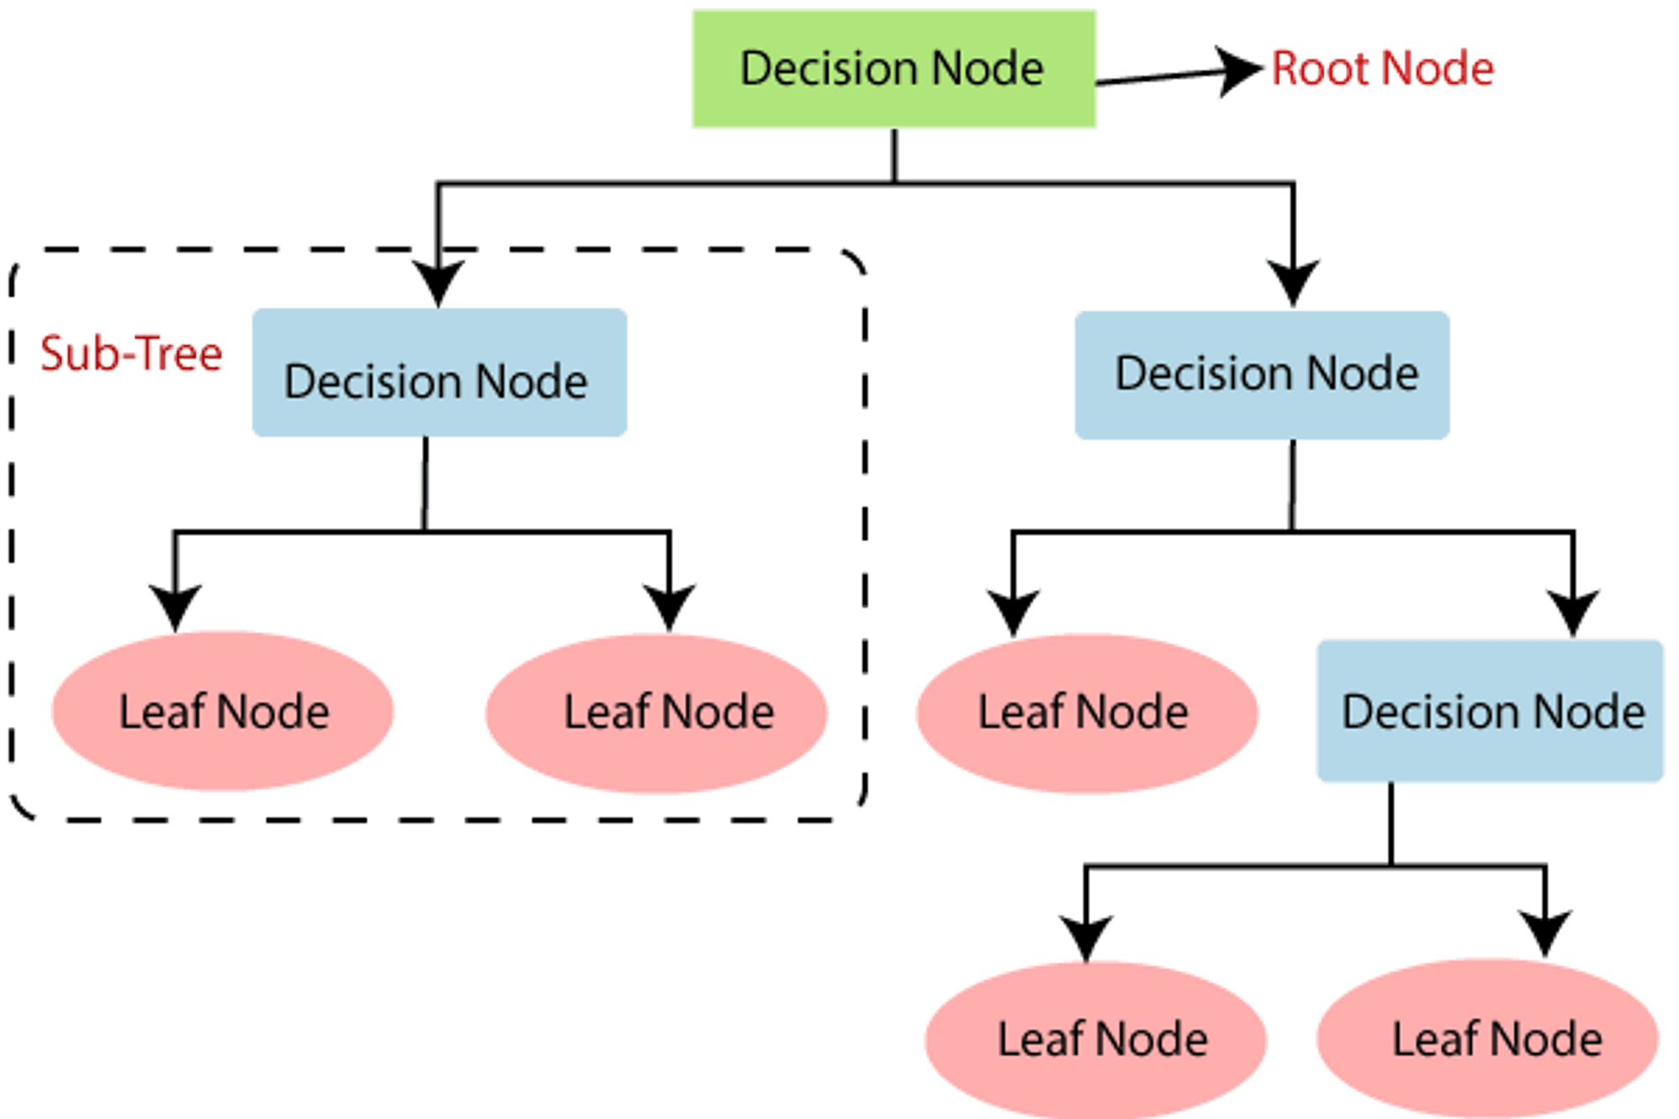

Slide 24
The picture above depicts a decision tree that is used to classify whether a person is Fit or Unfit.
The decision nodes here are questions like ‘’‘Is the person less than 30 years of age?’, ‘Does the person eat junk?’, etc. and the leaves are one of the two possible outcomesviz. Fit and Unfit.
Looking at the Decision Tree we can say make the following decisions: if a person is less than 30 years of age and doesn’t eat junk food then he is Fit, if a person is less than 30 years of age and eats junk food then he is Unfit and so on.
The initial node is called the root node (colored in blue), the final nodes are called the leaf nodes (colored in green) and the rest of the nodes are called intermediate or internal nodes.
The root and intermediate nodes represent the decisions while the leaf nodes represent the outcomes.

Slide 25
INTRODUCTION TO DECISION TREES
An example of how decision trees are used in industry is in the banking sector. Banks use decision trees to help them determine which loan applicants are most likely to be responsible borrowers.
They can use the applicant’s data, such as income, job history, credit score, and other factors, to create a decision tree that will help them determine which applicants are most likely to pay back the loan.
The decision tree can then be used to make decisions about loan applications and help the bank decide which applicants should receive the loan.

Slide 26
Decision Tree is a Supervised learning technique used for Classification and Regression problems.
It consists of Decision Nodes and Leaf Nodes, where Decision Nodes make decisions based on given features and Leaf Nodes give the output of these decisions.
It is a graphical representation for getting all the possible solutions to a problem/decision based on conditions.
It uses the CART algorithm (Classification and Regression Tree algorithm) to build the tree.
It starts with the root node and splits into sub-trees based on the answer to questions posed.

Slide 27
TREE CONSTRUCTION
In a decision tree, the algorithm begins at the root node and works its way up to predict the class of a given dataset.
This algorithm checks the values of the root property with the values of the record (actual dataset) attribute and then follows the branch and jumps to the next node depending on the comparison.

Slide 28
The algorithm checks the attribute value with the other sub-nodes and moves on to the next node. It repeats the procedure until it reaches the tree's leaf node. The following algorithm will help you better understand the entire process:
1. Step 1: Begin the tree with the root node S, which includes the whole dataset.
Step 2: Using the Attribute Selection Measure, find the best attribute in the dataset .
Step 3: Subdivide the S into subsets containing potential values for the best qualities.
Step 4: Create the decision tree node with the best attribute.
Step 5: Create new decision trees recursively using the subsets of the dataset obtained in step3. Continue this procedure until you reach a point where you can no longer categorize the nodes and refer to the last node as a leaf node.

Slide 29
Example:
Assume an applicant receives a job offer and must decide whether to take it or decline it.
Hence, in order to address this problem, the decision tree begins at the root node (Salary attribute by ASM).
Based on the labels, the root node divides further into the next decision node (distance from the workplace) and one leaf node.
The following decision node is further subdivided into one decision node (Cab facility) and one leaf node.
After that, the decision node divides into two leaf nodes (Accepted offers and Declined offer). Consider the diagram below:

Slide 30
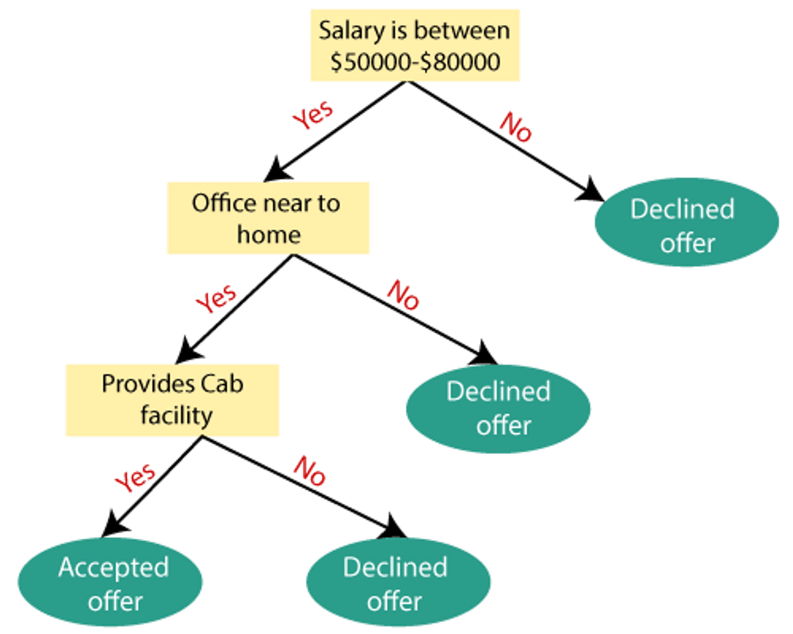

Slide 31
ATTRIBUTE SELECTION MEASURES
The biggest challenge that emerges while developing a Decision tree is how to choose the optimal attribute for the root node and sub-nodes.
To deal with such challenges, a technique known as Attribute selection measure, or ASM, is used.
We can simply determine the best characteristic for the tree's nodes using this measurement.
ASM is commonly performed using two techniques:

Slide 32
1. Information Gain:
Information gain is the assessment of changes in entropy following attribute-based segmentation of a dataset.
It computes the amount of information a feature offers about a class.
We divided the node and build the decision tree based on the importance of information obtained.
A decision tree algorithm will always try to maximise the value of information gain, and the node/attribute with the most information gain will be split first.
Notes:
entropy is a measure of impurity used to evaluate the homogeneity of a dataset.

Slide 33
It may be computed using the formula below:
Information Gain= Entropy(S)- [(Weighted Avg) * Entropy(each feature).
2. Entropy: Entropy is a metric to measure the impurity in a given attribute. It specifies randomness in data.
Entropy can be calculated as:
Entropy(s)= -P(yes)log2 P(yes)- P(no) log2 P(no)
Where,
S= Total number of samples
P(yes)= probability of yes
P(no)= probability of no

Slide 34
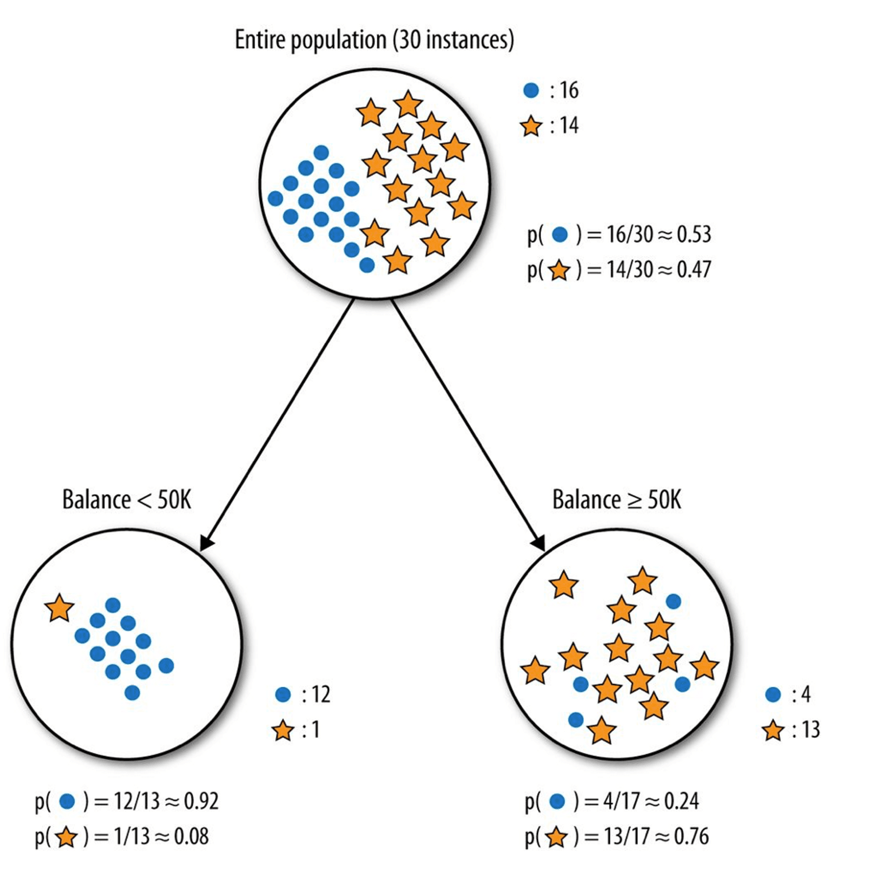

Slide 35
3. Gini Index
The Gini index is a measure of impurity or purity utilised in the CART (Classification and Regression Tree) technique for generating a decision tree.
. It only generates binary splits, whereas the CART method generates binary splits using the Gini index.
The Gini index may be computed using the formula below:
Gini Index= 1- ∑jPj2

Slide 36
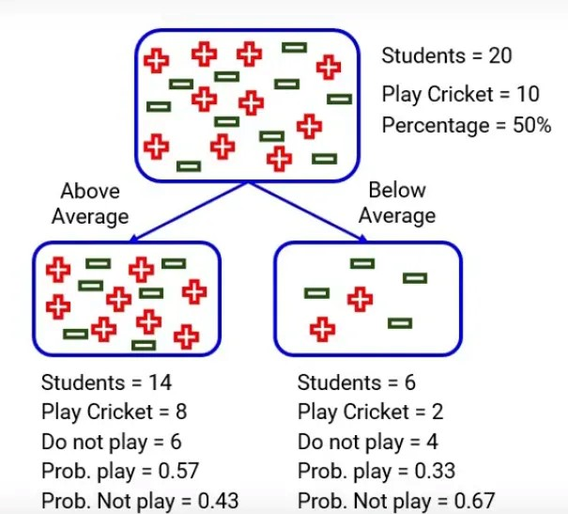

Slide 37
Examples:
1. To find information gain
Let’s say we have a sample of 30 students with three variables Gender (Boy/Girl), Class(IX/X) and Height (5 to 6 ft). 15 out of these 30 play cricket in leisure time. Now, I want to create a model to predict who will play cricket during leisure period? In this problem, we need to segregate students who play cricket in their leisure time based on highly significant input variable among all three.
This is where decision tree helps, it will segregate the students based on all values of three variable and identify the variable, which creates the best homogeneous sets of students (which are heterogeneous to each other). In the snapshot below, you can see that variable Gender is able to identify best homogeneous sets compared to the other two variables.

Slide 38
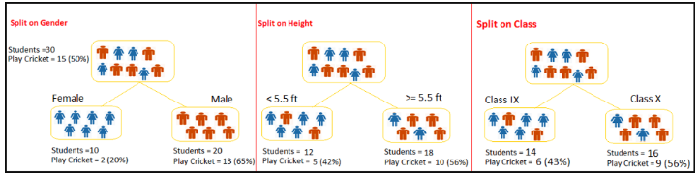

Slide 39
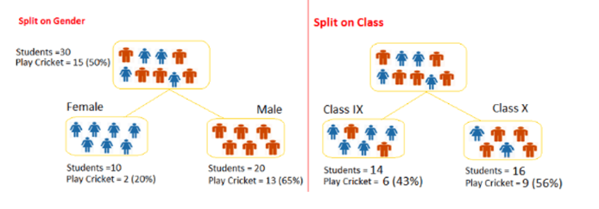
Now we want to segregate the students based on target variable ( playing cricket or not ). In the snapshot below, we split the population using two input variables Gender and Class. Now, I want to identify which split is producing more homogeneous sub-nodes using Information Gain.
Entropy for parent node = - (15/30) log(15/30) – (15/30) log(15/30) = 1.

Slide 40
Split on Gender:
Entropy for Female node = -(2/10) log(2/10) – (8/10) log(8/10) = 0.72 and for male node, -(13/20) log(13/20) – (7/20) log(7/20) = 0.93
Entropy for split Gender = Weighted entropy of sub-nodes = (10/30)*0.72 + (20/30)*0.93 = 0.86
Information Gain for split Gender = Entropy before split - Entropy after split = 1 - 0.86 = 0.14
Split on Class:
Entropy for Class IX node, -(6/14) log(6/14) – (8/14) log(8/14) = 0.99 and for Class X node, -(9/16) log(9/16) – (7/16) log(7/16) = 0.99.
Entropy for split Class = (14/30)*0.99 + (16/30)*0.99 = 0.99

Slide 41
Decision:
Above, we can see that Information Gain for split on Gender is the highest among all, so the tree will split on Gender.
To find the Gini Index
Let’s use Gini method to identify best split for student example.
Split on Gender:
Calculate, Gini for sub-node Female = (0.2)(0.2)+(0.8)(0.8)=0.68
Gini for sub-node Male = (0.65)(0.65)+(0.35)(0.35)=0.55
Calculate weighted Gini for Split Gender = (10/30)*0.68+(20/30)*0.55 = 0.59
Similar for Split on Class:
Gini for sub-node Class IX = (0.43)(0.43)+(0.57)(0.57)=0.51
Gini for sub-node Class X = (0.56)(0.56)+(0.44)(0.44)=0.51
Calculate weighted Gini for Split Class = (14/30)*0.51+(16/30)*0.51 = 0.51

Slide 42
Above, you can see that Gini score for split on Gender is higher than split on Class, hence, the node split will take place on Gender.
You might often come across the term ‘Gini Impurity’ which is determined by subtracting the gini value from 1. So mathematically we can say,
Gini Impurity = 1 – Gini
Pruning
Pruning is a process of reducing the size of a decision tree by deleting unnecessary nodes in order to obtain an optimal tree. It is used to reduce the risk of overfitting on a too-large tree, as well as to capture all important features of a dataset on a small tree. Two main types of tree pruning techniques are cost complexity pruning and reduced error pruning.

Slide 43
HANDLING MISSING VALUES
Missing values can have a negative impact on the performance of a decision tree.
To handle them, there are several techniques that can be used.
One of the most common techniques is imputation, which involves replacing missing values with estimates derived from the existing data.
This can be done using various methods, such as mean, median, or mode imputation.

Slide 44
Another option is to use advanced techniques such as k-nearest neighbors or multiple imputation.
K-nearest neighbors looks for similar data points in the training set and uses those to estimate the missing values.
Multiple imputation creates multiple versions of the dataset, each with different versions of the missing values, and then averages the results

Slide 45
HANDLING CONTINUOUS ATTRIBUTES
Binning is a technique used to handle continuous attributes in decision tree construction.
It works by dividing the range of values for a given attribute into intervals, or bins.
Each bin is then converted into a single categorical value, allowing the attribute to be used in the decision tree.
Regression is another technique used to handle continuous attributes in decision tree construction.
Both binning and regression can be used to handle continuous attributes in decision tree construction, and both can be used to improve the accuracy of the tree.

Slide 46
OVERFITTING
Overfitting occurs when a model is too complex, meaning it has too many parameters compared to the data available. This can lead to the model memorizing the data instead of generalizing the patterns, resulting in poor prediction performance on unseen data. To avoid this, cross-validation and regularization can be used.
Cross-validation involves splitting the data into training and test sets, and using the test set to assess the accuracy of the model.
Regularization involves introducing a penalty to prevent overly complex models from forming, by limiting the magnitude of the parameters.

Slide 47
APPLICATIONS OF DECISION TREES
1. Business: Decision trees are used in different fields in the business world such as finance, marketing, operations, and strategy.
2. Healthcare: Decision trees are used to predict diseases, evaluate treatments, and improve patient care.
3. Education: Decision trees are used for educational data mining, classification of student data, and prediction of student performance.
3.Data Mining: Decision trees are used for data mining tasks such as clustering and classification.

Slide 48
5. Robotics: Decision trees are used in robot navigation and control.
6. Computer Vision: Decision trees are used in object recognition and image classification.
7. Natural Language Processing: Decision trees are used to classify text and identify patterns in text.
8. Manufacturing: Decision trees are used in predictive modeling and forecasting in manufacturing processes.
9. Gaming: Decision trees are used in computer games and artificial intelligence.

Slide 49
ADVANTAGES AND LIMITATIONS OF DECISION TREES
Advantages:
1. Decision trees can be used for both classification and regression problems.
2. It is easy to interpret and understand.
3. It is one of the most popular machine learning algorithms.
4. It can handle both categorical and numerical data

Slide 50
Limitations:
1. Decision trees can easily overfit the data.
2.It is sensitive to small changes in the data.
3. It can create overly complicated trees that do not generalize well.
4. It is not suitable for large datasets.

Slide 51
This example uses the Iris dataset, splits it into training and testing sets, trains a decision tree classifier, makes predictions on the test set, and evaluates the accuracy of the model.
Note: Visualizing the decision tree requires Graphviz. If you don't have it installed, you can download it from https://graphviz.gitlab.io/download/

Slide 52
# Importing necessary libraries
from sklearn.datasets import load_iris
from sklearn.model_selection import train_test_split
from sklearn.tree import DecisionTreeClassifier
from sklearn import metrics
# Load the Iris dataset (a famous dataset for classification)
iris = load_iris()
X = iris.data
y = iris.target

Slide 53
# Split the dataset into training and testing sets
X_train, X_test, y_train, y_test = train_test_split(X, y, test_size=0.2, random_state=42)
# Create a decision tree classifier
clf = DecisionTreeClassifier()
# Train the classifier on the training set
clf.fit(X_train, y_train
# Make predictions on the test set
y_pred = clf.predict(X_test)
# Evaluate the accuracy of the model
accuracy = metrics.accuracy_score(y_test, y_pred)
print(f"Accuracy: {accuracy}")

Slide 54
# You can also visualize the decision tree (optional, requires graphviz)
# Uncomment the following lines if you have graphviz installed
# from sklearn.tree import export_graphviz
# import graphviz
# dot_data = export_graphviz(clf, out_file=None, feature_names=iris.feature_names, class_names=iris.target_names, filled=True, rounded=True)
# graph = graphviz.Source(dot_data)
# graph.render("iris_decision_tree")
# graph.view("iris_decision_tree")

Slide 55
RANDOM FOREST ALGORITHM IN
MACHINE LEARNING
Random Forest is a type of supervised machine learning algorithm based on ensemble learning.
It is a collection of decision trees, where each tree is trained using a randomly selected subset of the data.
The random forest algorithm combines multiple decision trees in order to reduce the risk of overfitting.
The result is a much more accurate and stable prediction.
It can be used for both regression and classification tasks.
It is also used for feature selection and to identify important variables in a dataset.

Slide 56
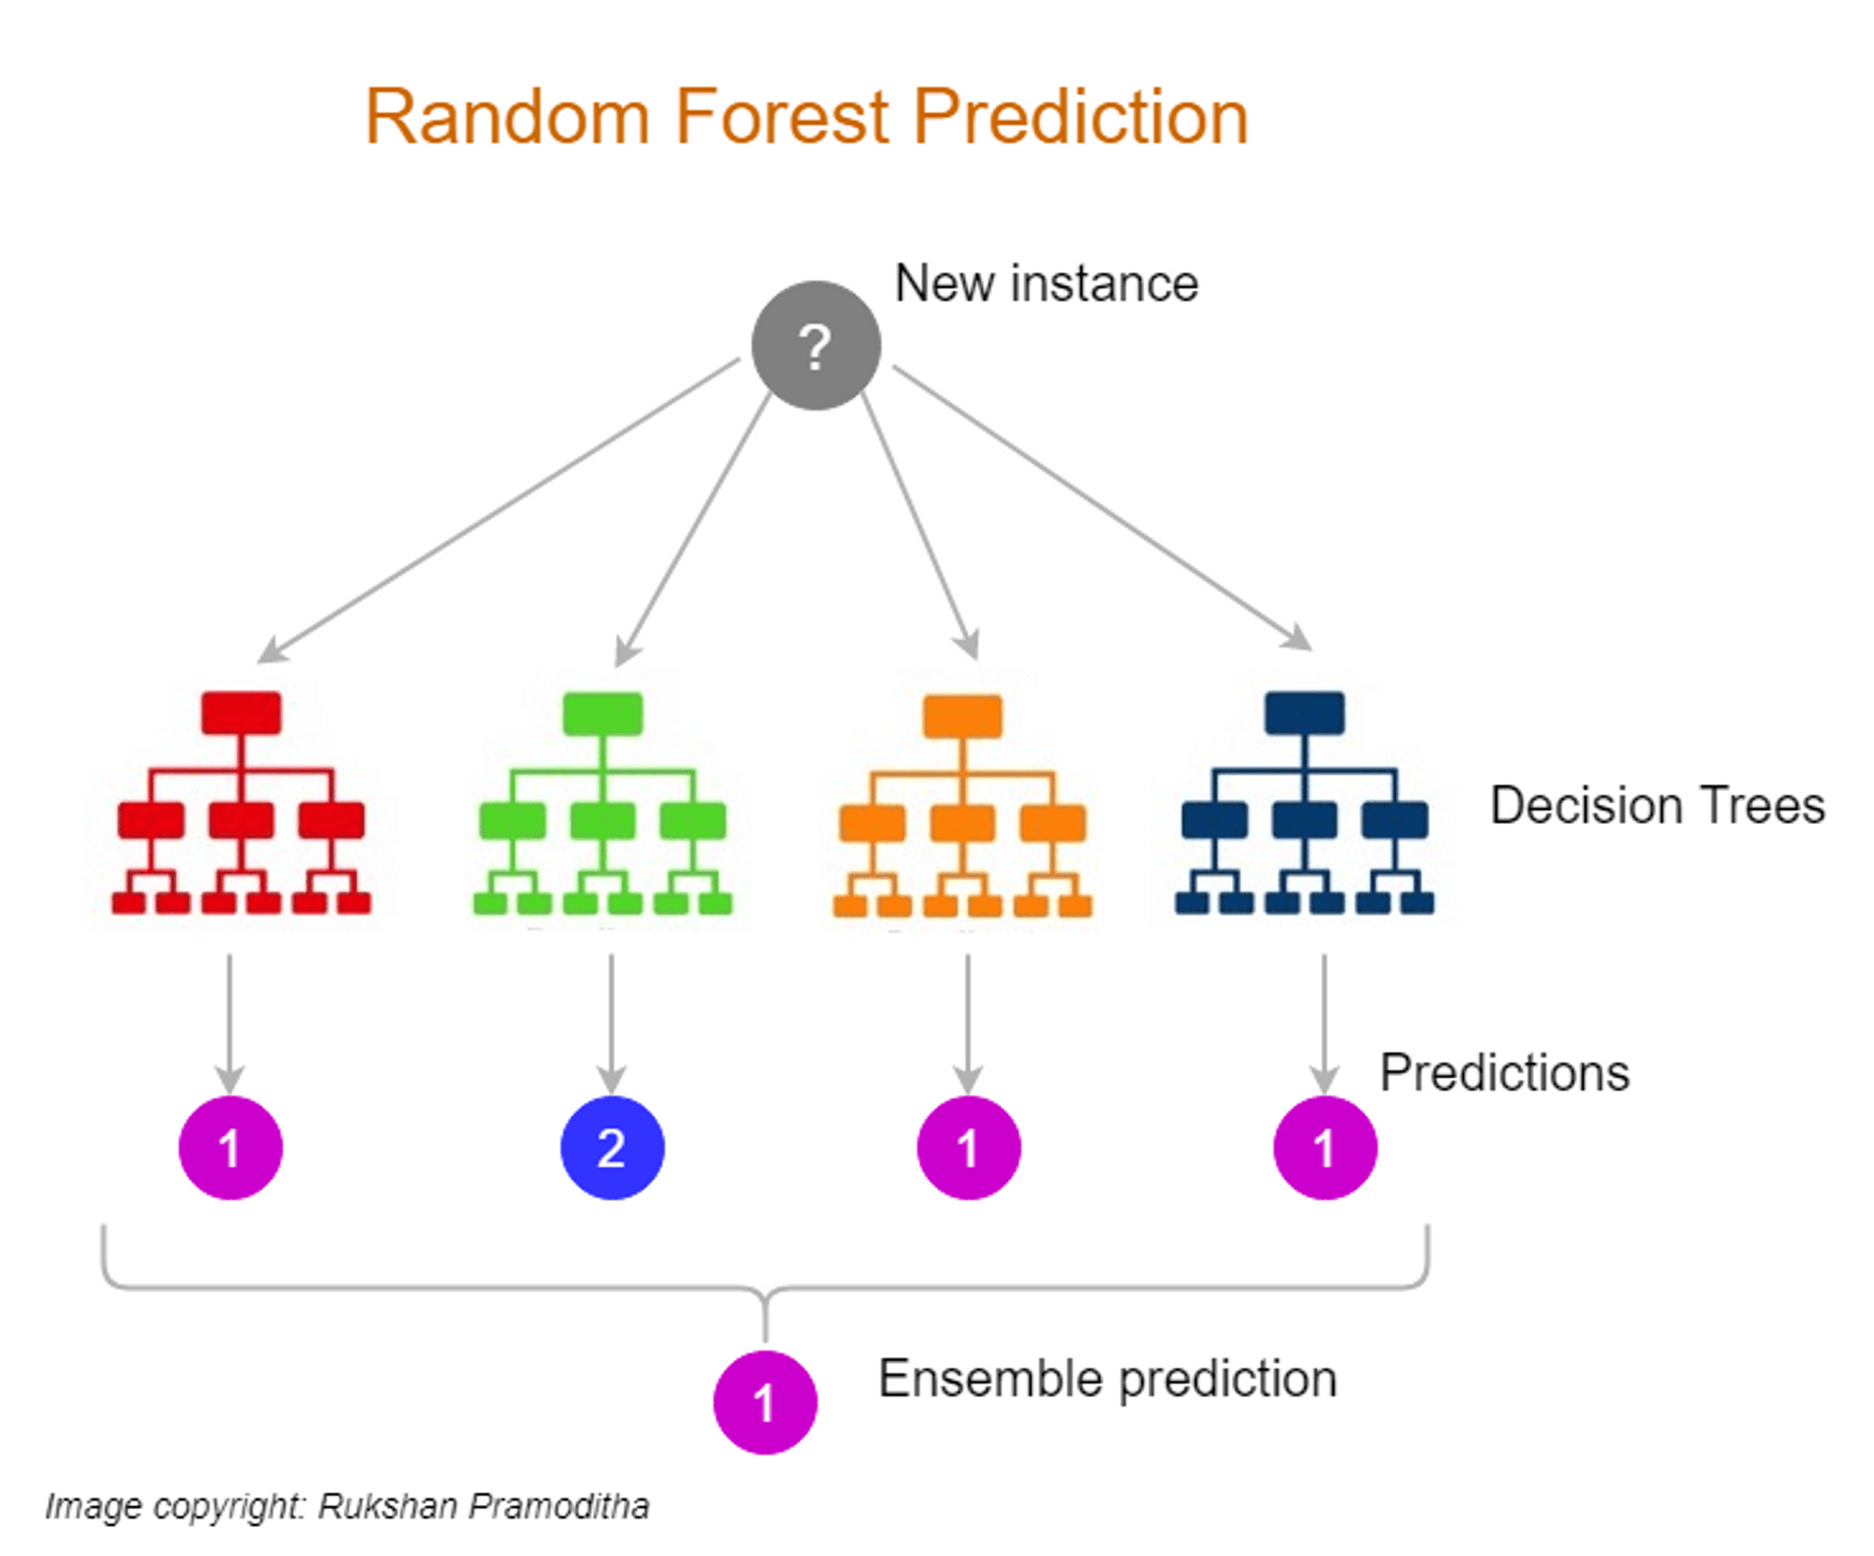

Slide 57
It is built on the notion of ensemble learning, which is a method that involves integrating several classifiers to solve a complicated issue and enhance the model's performance.
Instead of depending on a single decision tree, the random forest collects the predictions from each tree and predicts the final output based on the majority vote of predictions.

Slide 58
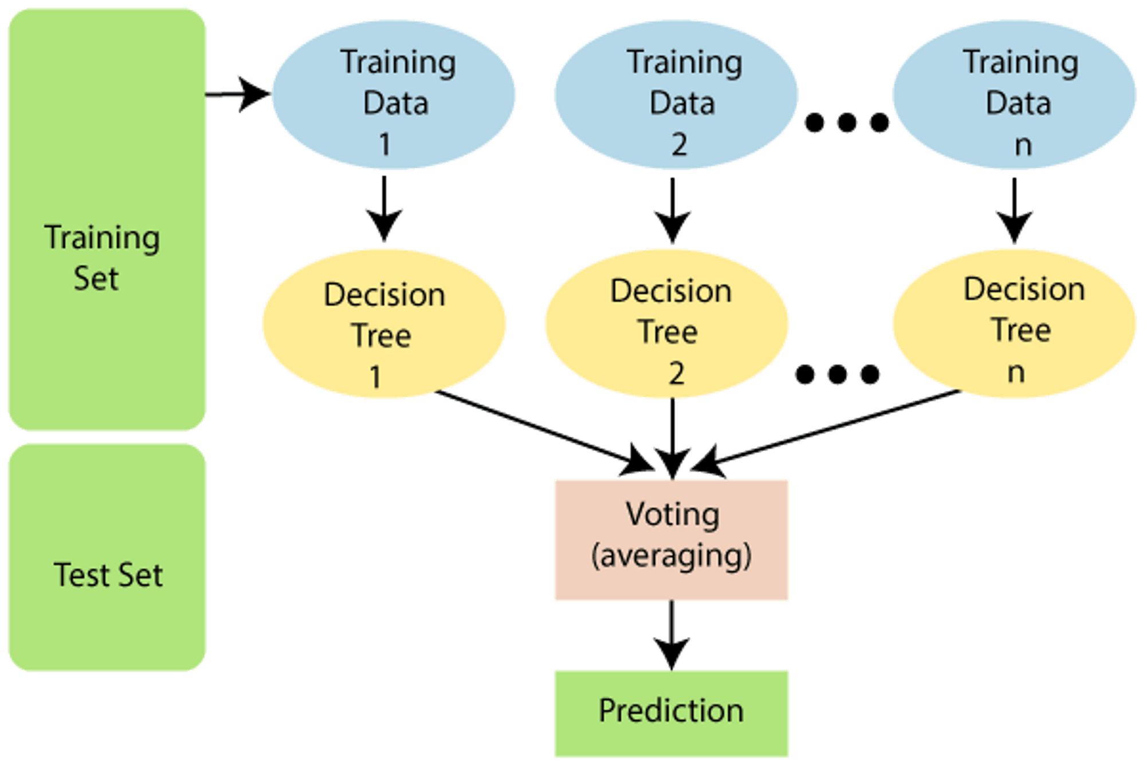

Slide 59
WHY USE RANDOM FOREST?
Here are some reasons why we should utilize the Random Forest algorithm:
It requires shorter training time than other algorithms.
It predicts output with great accuracy, and it works efficiently even on big datasets.
It can also retain accuracy when a significant amount of data is absent.

Slide 60
HOW DOES THE RANDOM FOREST ALGORITHM WORK?
Random Forest operates in two stages: the first is to generate the random forest by mixing N decision trees, and the second is to make predictions for each tree generated in the first phase.
Step 1: Choose K data points at random from the training set.
Step 2: Create decision trees for the specified data points (Subsets).
Step 3: Determine the number N for the number of decision trees you wish to construct.
Step 4: Repeat Steps 1 and 2.
Step 5: Find the predictions of each decision tree for new data points and assign the new data points to the category with the most votes.

Slide 61
APPLICATIONS OF RANDOM FOREST
Credit Card Fraud Detection: Random Forest has been used to detect fraudulent credit card transactions.
Stock Market Prediction: Random Forest has been used to predict the stock market prices. It can identify patterns in the data and make predictions about future prices.
Image Recognition: Random Forest has been used in image recognition. It can be used to classify objects in images and identify patterns in the data.
Diabetes Prediction: Random Forest has been used to predict the onset of diabetes. It can analyze a variety of features such as age, lifestyle, diet and medical history to predict the risk of developing diabetes.

Slide 62
ADVANTAGES OF RANDOM FOREST
Random Forest is capable of performing both Classification and Regression tasks
Random forests are easy to use, interpret and visualize
3. The training time of a random forest is fast compared to many other techniques.
4. They are resistant to overfitting and can be used to estimate missing data.
5. Random forests are highly accurate and powerful. They can handle large amounts of data and are robust to outliers.

Slide 63
DISADVANTAGES OF RANDOM FOREST
1. Random forests are prone to overfitting if the data contains a large number of features.
2. Random forests are very slow in making predictions when compared to other algorithms.
3. They are not suitable for real-time applications as they require the entire dataset to be stored in memory.
4. They require a lot of hyperparameters to be tuned for optimal performance.
5. Random forests are not good for tasks that require precise predictions as they are only able to provide an estimate of the outcome.

Slide 64
K-NEAREST NEIGHBOR(KNN) ALGORITHM
Overview
K-Nearest Neighbors (KNN) is a supervised machine learning algorithm that is used for both classification and regression. The algorithm is based on the idea that the data points that are closest to a given data point are the most likely to be similar to it.
KNN works by finding the k-nearest points in the training data set and then using the labels of those points to predict the label of the given data point.
KNN is considered an instance-based learning algorithm, since it stores the training data and makes predictions based on the stored data points.

Slide 65
INTRODUCTION TO K-NEAREST NEIGHBORS (KNN)
K-nearest neighbors (kNN) is a supervised machine learning algorithm that can be used to solve both classification and regression tasks.
kNN as an algorithm seems to be inspired from real life.
It works in a similar fashion to humans as our behaviour is guided by the friends we grew up with or from our surroundings.
Our parents also shape our personality in some ways. There are of-course exceptions.
The value of a data point is determined by the data points around it. If you have one very close friend and spend most of your time with him/her, you will end up sharing similar interests and enjoying same things. That is kNN with k=1.

Slide 66
If you always hang out with a group of 5, each one in the group has an effect on your behavior and you will end up being the average of 5. That is kNN with k=5.
kNN classifier determines the class of a data point by majority voting principle. If k is set to 5, the classes of 5 closest points are checked. Prediction is done according to the majority class. Similarly, kNN regression takes the mean value of 5 closest points.

Slide 67
HOW DOES K-NN WORK?
The K-NN working can be explained on the basis of the below algorithm:
Step-1: Select the number K of the neighbors
Step-2: Calculate the Euclidean distance of K number of neighbors
Step-3: Take the K nearest neighbors as per the calculated Euclidean distance.
Step-4: Among these k neighbors, count the number of the data points in each category.
Step-5: Assign the new data points to that category for which the number of the neighbor is maximum.
Step-6: Our model is ready.

Slide 68
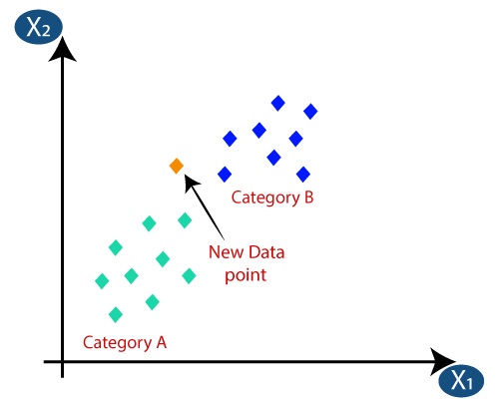

Slide 69
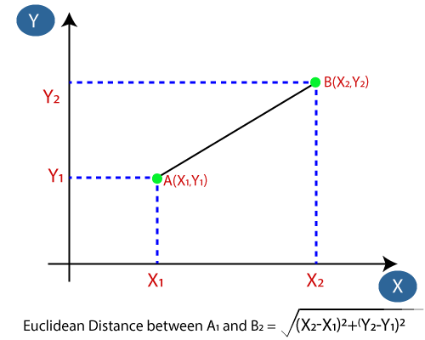
we will calculate the Euclidean distance between the data points. The Euclidean distance is the distance between two points, which we have already studied in geometry.

Slide 70
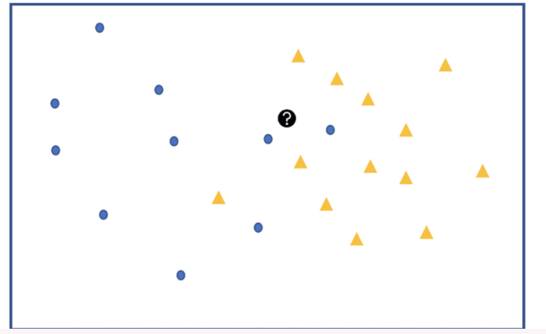
EXAMPLE:
Let’s say we have two groups of points —blue-circles and orange-triangles.
We want to classify the Test Point = black circle with a question mark, as either a blue circle or an orange triangle.

