Slide 1
HealthConnect Rwanda
AI-Powered Clinical Risk Prediction and Healthcare Intelligence System
Week 6 Machine Learning Project
An educational prototype using synthetic project data
HealthConnect Rwanda | Educational prototype

Slide 2
Project objectives
Integrate and prepare available healthcare datasets.
Build baseline classification and regression models where targets are available.
Explore patient/facility clustering and unusual billing records.
Communicate model performance, explainability, ethics and limitations.
HealthConnect Rwanda | Educational prototype

Slide 3
Data preparation
Integrated appointment-level analytical dataset: approximately 5,000 rows and 49 columns.
Project tables include patient, clinical transaction, billing, feedback and insurance information.
Saved reusable outputs include cleaned data, model results, clusters and anomaly flags.
Only fields and targets supported by available data were used.
HealthConnect Rwanda | Educational prototype

Slide 4
Classification results
Insurance claim status: Logistic Regression accuracy approximately 49.8%.
Patient satisfaction: Logistic Regression accuracy approximately 36.6%.
Both results indicate limited predictive performance on the evaluated test sets.
These models require improvement and should not guide individual decisions.
HealthConnect Rwanda | Educational prototype

Slide 5
High-risk screening proxy
The target was generated from a simple rule, not an observed clinical outcome.
Random Forest reported 88.5% accuracy, but predicted every test case as higher priority.
The model failed to distinguish the lower-priority test cases.
This result is not evidence of clinical risk-prediction ability.
HealthConnect Rwanda | Educational prototype

Slide 6
Billing regression
Target: appointment-level BillingAmount.
Reported Random Forest R²: approximately 0.941; reported MAE: approximately 8,535.
Possible leakage from related billing/claim variables has not been ruled out.
Treat these metrics as preliminary, not as a reliable forecast of future hospital revenue.
HealthConnect Rwanda | Educational prototype

Slide 7
Clustering and anomaly screening
Patient and facility cluster assignments were saved for exploratory analysis.
Isolation Forest flagged 150 of 5,000 billing records as unusual (3%).
Anomaly flags require investigation and do not prove fraud or billing errors.
Clusters are exploratory groups, not diagnoses or facility quality rankings.
HealthConnect Rwanda | Educational prototype

Slide 8
Explainability
Feature-importance outputs were generated from logistic-regression coefficients.
Department identifiers appeared among the strongest coefficient magnitudes.
Coefficient magnitude does not establish causation or a reliable explanation for an individual.
SHAP/LIME analyses remain incomplete.
HealthConnect Rwanda | Educational prototype

Slide 9
Key data gaps
No explicit reliable hospital-admission outcome identified.
No suitable length-of-stay target identified.
No laboratory-results table identified in the reviewed data inventory.
These tasks must remain documented gaps rather than fabricated model results.
HealthConnect Rwanda | Educational prototype

Slide 10
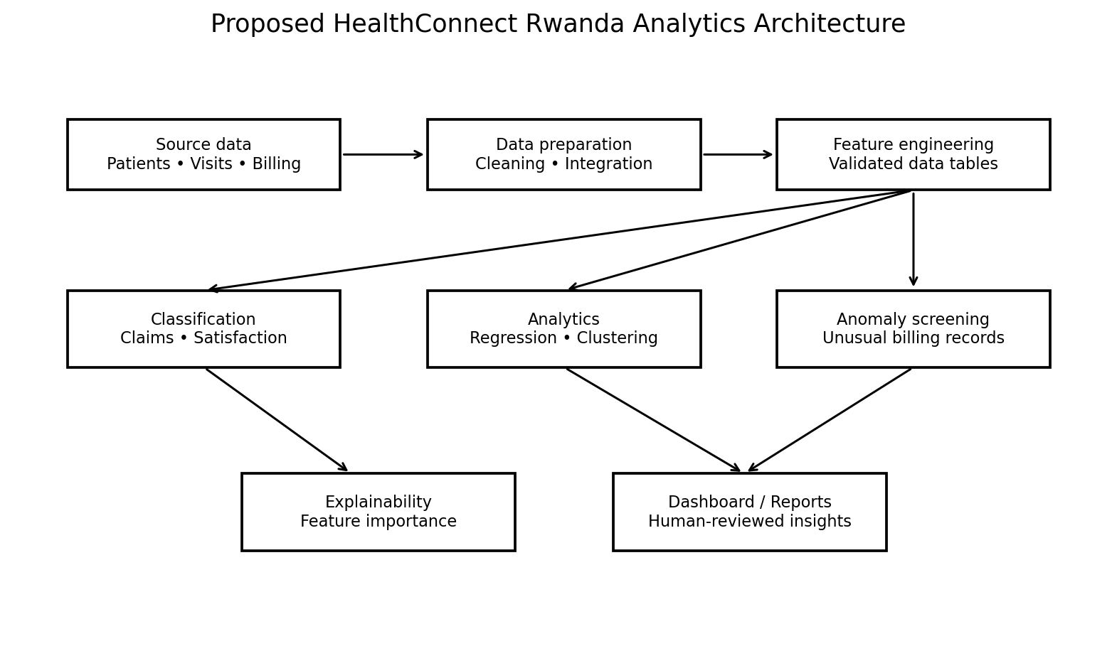
Proposed architecture
HealthConnect Rwanda | Educational prototype

Slide 11
Ethics and responsible use
The dataset is synthetic/educational; findings are not clinical evidence.
Protect sensitive data and limit access by role.
Review fairness and performance across relevant groups.
Keep human oversight and communicate uncertainty.
Do not use this prototype alone for treatment, eligibility or patient-access decisions.
HealthConnect Rwanda | Educational prototype

Slide 12
Recommendations and conclusion
Prioritize leakage-free evaluation and improve weak classification models.
Obtain valid admission and length-of-stay outcomes before modelling those targets.
Complete explainability and domain-expert review before any real-world pilot.
The project provides an analytical foundation, not a validated clinical decision system.
HealthConnect Rwanda | Educational prototype

