Slide 1
Programs for the Event Grammar
9th August 2007
Aude Rebotier
09/08/2007

Slide 2
Plan
Our aim and the output of the Polrisk Grammar
Three existing programs that use this output
  The Demo Program
  Conceptual Graphs
  The Java Program

Slide 3
Our aim
Events : predicate + coordinates ( actor(s), target(s), place(s), time )
Who says that ?
What are the relations between the events ?
Iran and the IAEA announce that Mohamed El Baradei will visit Iran on 9 July.
Iran and the IAEA announce that Mohamed El Baradei will visit Iran on 9 July.

Slide 4
The output of the Polrisk grammar
Events are described through a set of dependencies :
The CORE dependency : CORE(Core)
The dependencies between a core and another entity:
  COORDINATE[actor/target/time/loc](Core, coordinate)
  SRC[factual/possible/counter-factual](Core, Speaker)
The dependencies between two cores:
  CORE-DRIVE(Core1, Core2)
  CORE-ANNEX(Core1, Core2)
The Event dependency:
  EVENT(Speaker(s), Driver, Core, Actor(s), Target(s), location(s), time)

Slide 5
1. The demo program
What for ?
  for highlighting the events in the texts and building a table in order to show the results
how ?
  Perl that produces html files
Problems
  not easy to adapt
  It cannot show all the information that is detected
  It does not yield a semantic representation of events

Slide 6
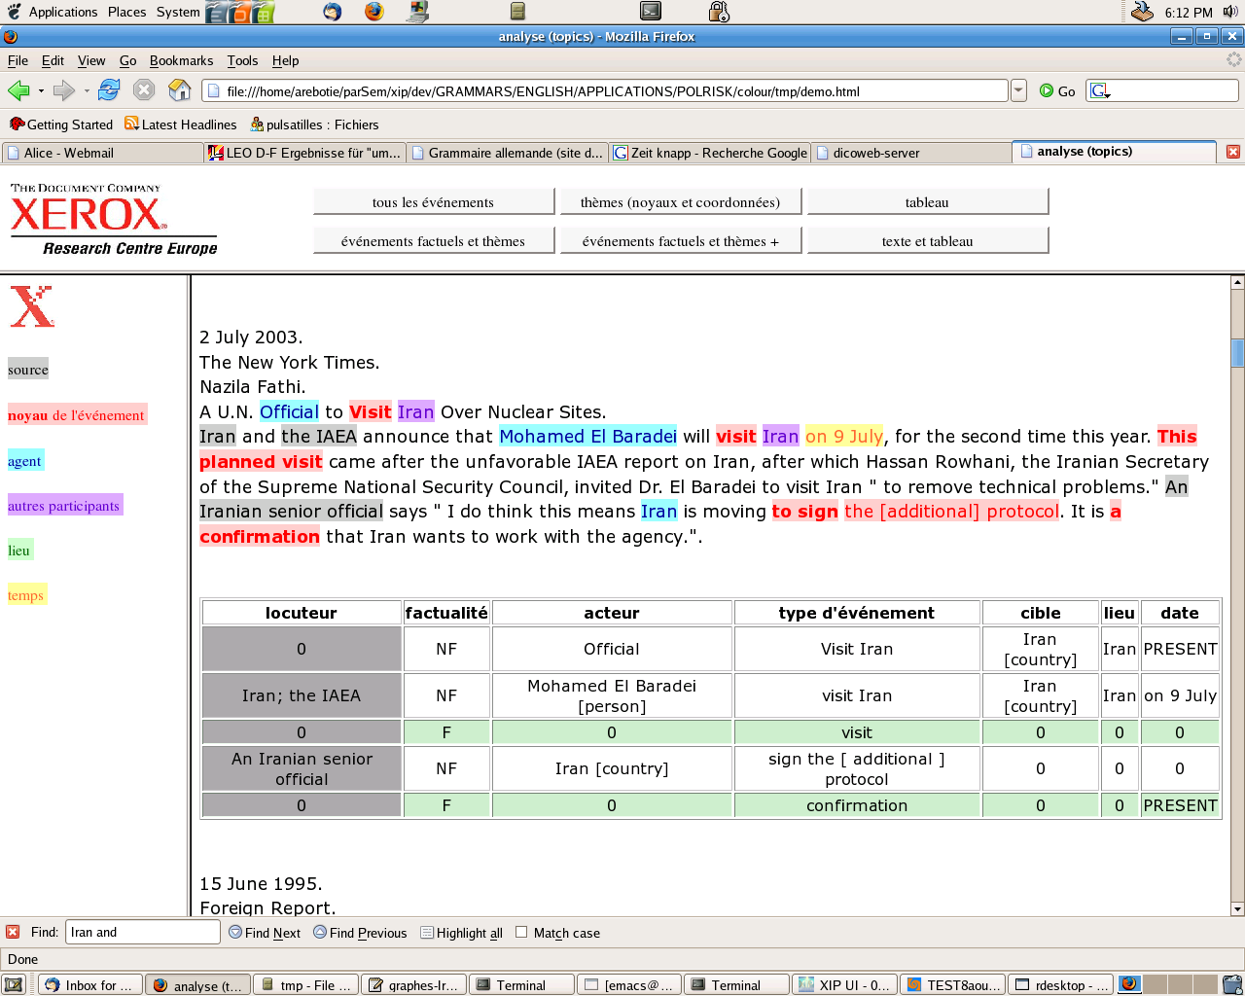
1. The demo program

Slide 7
2. Conceptual Graphs (Xip)
What for ?
  to describe an Event as an object of concepts and relations
  possibility of queries about the events without running again the grammar
how ?
  Xip rules
Problems
  no adaptation for a demo up to now

Slide 8
2. Conceptual Graphs (Xip)
Concepts
  event
  core
  entity
    human
    location
    time
  name
  set
Relations
  hascore
  hasactor
  hastarget
  hasplace
  hastime
  hasplace
  speaker
    factual_after
    possible_after
    counter-factual_after
  hassource
  author
  time
  identical
  drive
  annex
  name

Slide 9
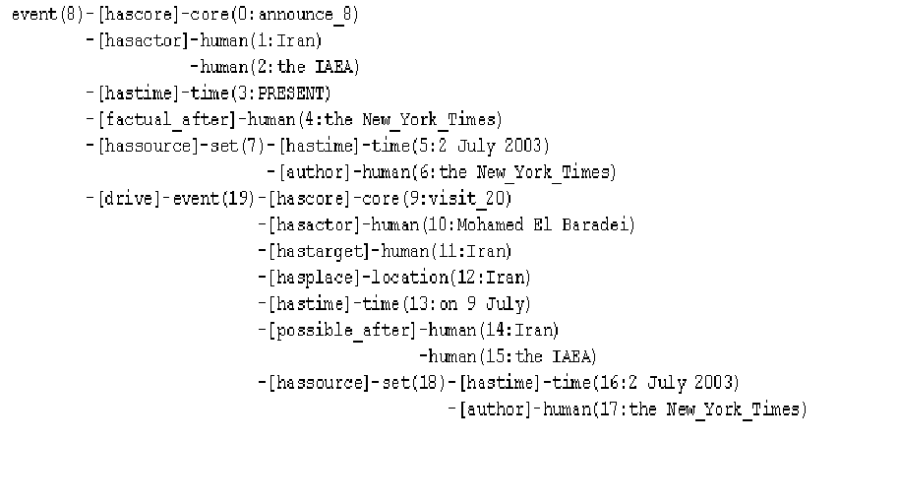
2. Conceptual Graphs (Xip)
Iran and the IAEA announce that Mohamed El Baradei will visit Iran on 9 July (New York Time, 2 July 2003).

Slide 10
3. Java
What for ?
  An easier support for building a visual interface than the output of Xip
  A possibility of merging the results with those of other grammars (Time, Named entities, Coreference) that are already in java
how ?
  Java
Problems
  No adaptation for a demo up to now
  How will it be merged with other grammars ?

Slide 11
3. Java
The objects in the java program for events
Object
Relation
Element
Event
Event
HasCore
Core
Entity
HasActor
HasTarget
HasTime
HasLoc
HasSource

Slide 12
3. Java
Iran and the IAEA announce that Mohamed El Baradei will visit Iran on 9 July (New York Time, 2 July 2003).
Xip Nodes
Xip Nodes
HasCore
HasCore
Core
Core
Visit
Visit
Mohammed El Baradei
HasActor
Mohammed El Baradei
HasActor
Entity
Entity
HasTarget
HasTarget
Entity
Entity
Iran
Iran
Event
Event
HasLoc
HasLoc
Entity
Entity
Iran
Iran
HasTime
HasTime
Entity
Entity
on 9 July
on 9 July
HasSource
HasSource
Entity
Entity
Iran
Iran
HasSource
HasSource
Entity
Entity
the IAEA
the IAEA
HasSource
Entity
New York Time

