Slide 1




Xerox Incremental Parsing
Salah Aït-Mokhtar
Jean-Pierre Chanod
Claude Roux

Slide 2
Introduction
What is Xerox Incremental Parser (X.I.P) ?
  Syntactic Analysis of Unrestricted Text
  In-depth Parsing vs. Shallow Parsing
  No limitation of length of Linguistic Unit (sentence, paragraph or even whole text)
  A multi-input parser: XML input/output format
  Language Independent
Base of X.I.P
  Incremental organization of linguistic processes
  Contextual selection and marking (e.g. for POS disambiguation)
  Chunking (from a list of word to a chunk tree)
  Dependency Calculus (From a Tree to Dependencies)

Slide 3
Overview of the presentation
Data representation
Different types of rules
  Contextual selection (disambiguation)
  Chunking and reshuffling
  Marking
  Dependency calculus

Slide 4
Overview of the presentation
Data representation
Different types of rules
  Contextual selection (disambiguation)
  Chunking and reshuffling
  Marking
  Dependency calculus

Slide 5
Data representation
The elementary data representation is a node:
  category
  feature-value pairs
  sister nodes
Examples:
Dog : noun[lemma:dog, surface:Dog, uppercase:+, sing:+] .
  chases : verb[lemma:chase, surface:chases, pres:+, person:3,sing:+].

Slide 6
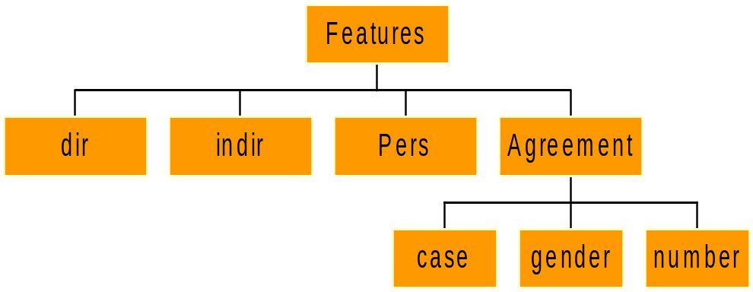
Data representation: Declaration
Every Node Category and every Feature must be declared in declaration files
Features must be declared with their domain of possible values
[ Features:
  [ dir:{+},
  indir:{+},
  agreement:[gender:{fem,masc,neut},
  number:{sing,plur,dual},
  case:{nom, acc, gen, dat, loc}],
  pers:{1-3}
  ]
]

Slide 7
Data representation: Declaration
Categories are declared with at least one initial feature-value pair.
Categories:
  adj=[adj=+].
    verb=[verb=+] .
    np=[noun=+].

Slide 8
Data representation: initialization
XIP initial data structure may be instantiated by:
  Lexical lookup (Xerox FST standard output + conversion)
  XIP XML standard input stream (XIP DTD)
    Sequence of morphologically analyzed tokens
    Chunks

Slide 9
Data representation: Internal lexicons
Lexical readings can also be (re)defined in XIP internal lexicons:
    dog : noun += [animate=+].
    Mr = noun[human=+,title=+].
    Xerox += verb[transitive=+].
    in\ silico = adv.

Slide 10
Data representation: terminal sets
A lexical reading is represented as an elementary node: one category , one lemma and a set of feature-value pairs
A terminal set describes a set of one (or possibly more) lexical readings associated with a given token
Node expressions within rules match lexical readings based on criteria bearing on category and feature values

Slide 11
Data representation: constituent nodes
Constituent nodes are represented by tree structures
The tree nodes include:
  category,
  feature-values pairs,
  pointers to daughter nodes

Slide 12
Data representation: sequence of nodes and sub-trees
Sequences of nodes and sequence of sub-trees are central to most rules.
Sequences are defined by basic operators:
  Concatenation (noted ,): det, adj
  Optionality (noted ( ) ), Kleene * and +: adj*, (adv), noun+
  Any category (noted ?): det, ?*, noun
  Disjunction ( noted ; ): adv;adj
  Sub-tree exploration (noted {…}) NP{?*, noun}
  (adv,?*, adj) ; noun , verb

Slide 13
Data representation: processing unit
The input stream is split into core processing units (representing e.g. sentences or paragraphs)
The boundaries of the core processing units are defined by selected sequences of nodes in the input stream (e.g. |SENT| )
The initial processing unit is represented as a sequence of terminal sets (in the absence of constituent structure) or as a sequence of constituent nodes.

Slide 14
Overview of the presentation
Data representation
Different types of rules
  Contextual selection (disambiguation)
  Chunking
  Marking and reshuffling
  Dependency calculus

Slide 15
Different types of rules
Different types of rules operate on the initial processing unit:
  Contextual selection (disambiguation)
  Chunking
  Marking and reshuffling
  Dependency calculus
The processing stream is incrementally updated through ordered layers of rules
After all rule layers have applied, the processing stream is represented as a tree (under virtual TOP node)

Slide 16
Basic operations on features
Features can be instantiated, tested, or deleted within all types of rules.
  Instantiated: [gender = fem]
  Tested: [gender:fem]
    [gender:~]
    [gender:~fem]
    [acc:+]
    [acc]
  Deleted: [acc = ~]

Slide 17
Percolation
Free features percolate to upper nodes, bounded features do not.
Feature status (free vs. bounded) can be specified during category declaration:
  // feature verbcat is set to + and is free in all VERBs
  // feature transitive is free whatever its value in all VERBs
  VERB = [!verbcat=+, !transitive:!].
  // feature transitive is bounded in all FV
  FV =[transitive:!].
Status can be enforced within rules:
PP = Prep, NP[!animate:!] .

Slide 18
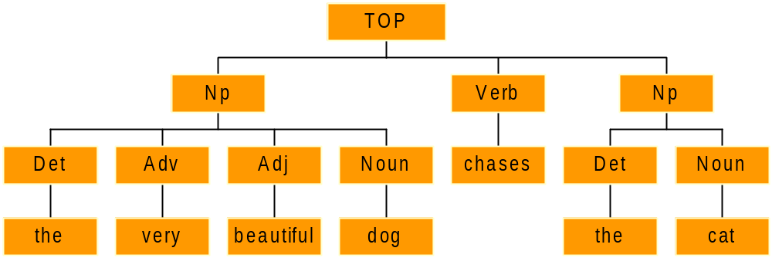
Features : Example
Every Node Category is associated with a list of features.
A node can be referred to in a rule with the sole mention of its features.
The lexicon may also provides its own features
Rules may also instantiate new features on a node.
Lexicon:
The : det[det:+,definite:+]
Very : adv[adv:+]
Beautiful : adj[adj:+]
Dog : noun[noun:+,singular:+]
Cat : noun[noun:+,singular:+]
Chases : verb[verb:+, person:3,singular:+]
  Np = det,?*[verb:~] ,noun.
This rule states that no verb can occur between the determiner and the noun.

Slide 19
Overview of the presentation
Data representation
Different types of rules
  Contextual selection (disambiguation)
  Chunking and reshuffling
  Marking
  Dependency calculus

Slide 20
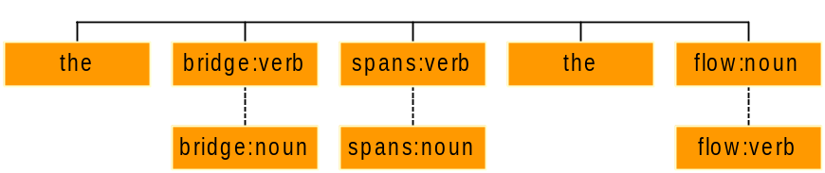
Contextual selection (Disambiguation)
Lexicon:
the : det[det:+,definite:+]
Two readings
  bridge : noun[noun:+,singular:+]
  bridge : verb[verb:+]
Two readings
  spans : noun[noun:+,plural:+]
  spans : verb[verb:+]
Two readings
  flow : noun[noun:+,singular:+]
  flow : verb[verb:+]
Disambiguation rules:
  Noun,Verb = verb |det|.
  Noun,verb = |det| noun.

Slide 21
Contextual selection over terminal sets: generic rule
Readings = |Left_context | Selected_Readings | Right_context | .
A terminal set typically covers multiple lexical readings.
Readings is an expression that subsumes a terminal set (i.e. a set of lexical readings), by specifying a subset of constraints bearing on its categories and features:
    noun, verb
    noun<sing:+>, verb<pres:~>
    ?<thatcomp:+>
    (noun,adj)[verb:~]
    noun<*case:acc>, verb

Slide 22
Contextual selection over terminal sets: generic rule
Readings = |Left_context | Selected_Readings | Right_context | .
Selected_Readings skims readings in the terminal set defined by Readings :
Noun,verb = |det, (adv;adj)*| ?[verb:~].
If the rule pattern matches some segment in the current input stream, the terminal set is updated: only readings that match Selected_Readings are kept

Slide 23
Contextual selection over terminal sets: generic rule
Readings = |Left_context | Selected_Readings | Right_context |.
where Left_context and right_context are sequences of nodes

Slide 24
Contextual selection over terminal sets: generic rule
Readings = |Left_context | Selected_Readings | Right_context | .
Nodes in sequences can be further specified by conditions on features:
noun[thatcomp:+,verb:~], ?[conj:~], adj;adv
Features in Readings may refer to a single category or to the overall features in the terminal set (i.e.. features from all lexical readings are merged)
noun<sing:+>
(noun,verb)[thatcomp:+]
noun[verb:~]
noun<*case:acc>, verb
Contexts can be negated with the ~ operator: ~| Context |

Slide 25
Contextual selection over terminal sets: generic rule
Readings = |Left_context | Selected_Readings | Right_context | .
Besides selecting readings in Selected_Readings, the rule may enforce selection of lexical readings for the nodes mentioned in the left or right context (% operator)
noun,verb = |det%, adj*%| noun.
Rules can also enforce replacement of a terminal set by a new lexical reading:
verb[cap] %= |det| noun[cap=+, proper=+].

Slide 26
Contextual selection over terminal sets: examples
Readings = |Left_context | Selected_Readings | Right_context | .
/prefer DET if followed by NOUN: does not apply to quantifiers \
det[quant:~] = ?[noun:~,pron:~] |adj*,noun|.
/ if DET is quantifier,
select DET if followed by a noun (which is neither ADV nor VERB)\
det<quant>,pron = det |adj*,noun[verb:~,adv:~]|.

Slide 27
Contextual selection over terminal sets: examples
Readings = |Left_context | Selected_Readings | Right_context | .
/coordinated numerals\
num = num |coord*, num%|.
/ remove numeral reading if also DET reading\
num, det = ?[num:~].
/ French de is a PREP if preceded by PRON and followed by ADJ : quelqu'un de bien \
det,prep<masc:~> = |pron[rel];pron[dem];pron[indef];pron[int]| prep |adv*%,adj%|.

Slide 28
Overview of the presentation
Data representation
Different types of rules
  Contextual selection (disambiguation)
  Chunking
  Marking and reshuffling
  Dependency calculus

Slide 29
Chunking Rules
Rules are organized in layers.
The application of a rule is definitive.
Rules never backtrack: once a rule has applied, the resulting chunk(s) are never dismissed and are passed to the next layers. The chunk tree is updated accordingly.
Non Recursive Rules: Limited recursivity is induced from layering

Slide 30
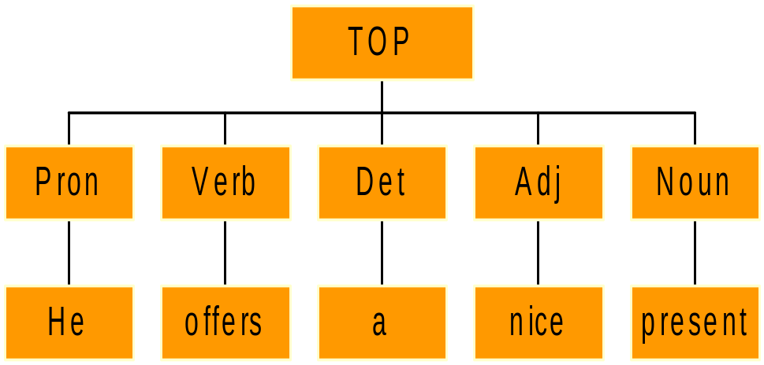
Chunking: Input
He offers a nice present

Slide 31
Chunking: Grammar is organized through layers
    Layer 1
      NP = (Det), Adj*, Noun.
      NP = Pron.
    Layer 2
      VP = adv*,Verb.
    Layer 3
      SC = NP,VP.

Slide 32
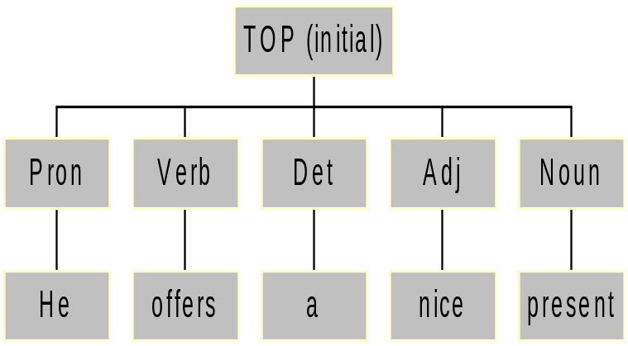
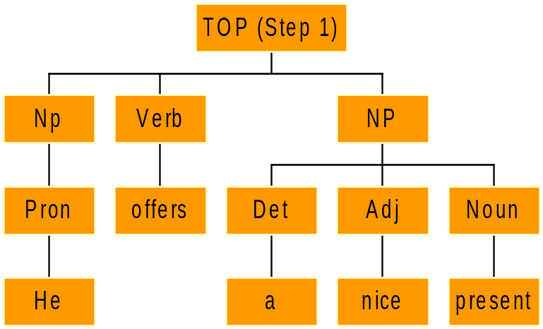
Chunking: Processing (Layer 1)
Layer 1
NP = (Det), Adj*, Noun.
NP = Pron.

Slide 33
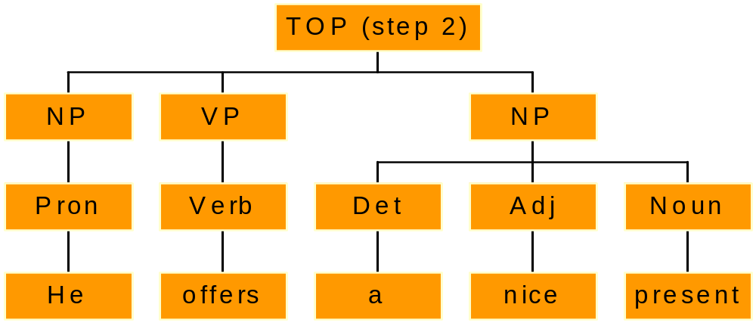
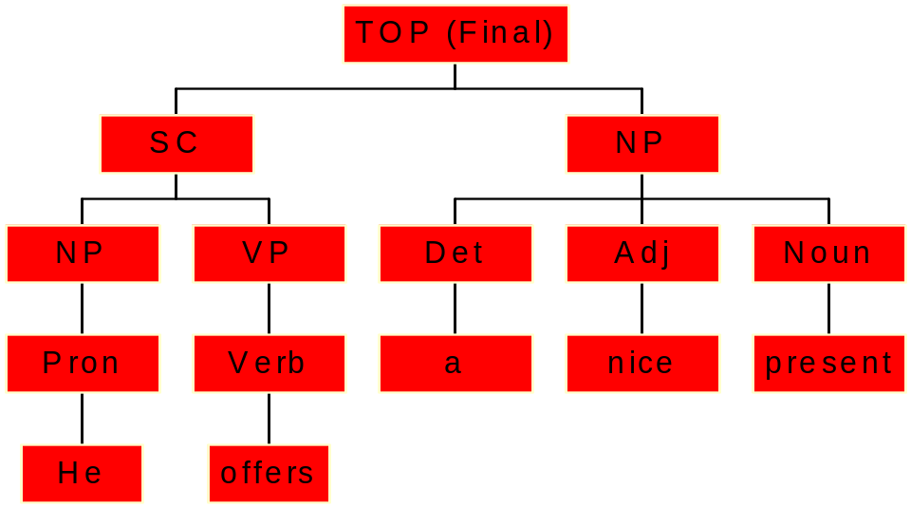
Chunking: Processing (Final)
Layer 2
VP = adv*,Verb.
Layer 3
SC = NP,VP.

Slide 34
Three types of Chunking Rules
Different types of chunking rules are available:
  ID-rules describe unordered sets of nodes
  Sequence rules describe a ordered sequence of nodes.

Slide 35
Immediate Dominance rules/Linear Precedence (1)
Example: NP is described as an unordered bag of nodes:
  NP -> det[first], noun[last], noun*,adj*, adv*.
a) Features last and first are automatically appended to the first and last nodes of the chunk.
b) No order is imposed on how those different categories occur.
c) Linear Precedence rules can be used for a given layer (or for all layers if no layer number is specified):
[det] < [noun] .
d) The longest sequence from right to left determines which rule applies in a given layer

Slide 36
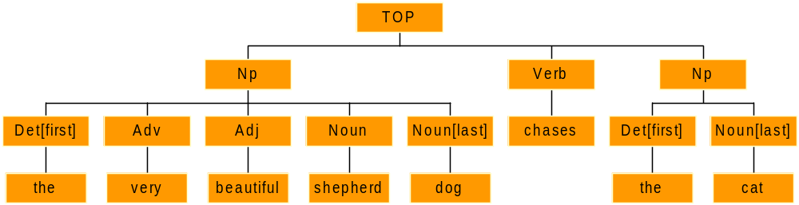
Immediate Dominance rules/Linear Precedence (1)
NP described as an unordered bag of nodes:
  NP -> det[first], noun[last], noun*,adj*, adv*.
  [det] < [noun] .
The above rule applies on both NPs in the example below:

Slide 37
Immediate Dominance rules/Linear Precedence (2)
The parsing algorithm functions as follows in the active layer:
First, the longest possible sequence of valid nodes is isolated in the input unit.
    A valid node is a node whose category belongs to the right-side of a rule within the active layer.
    1> NP -> Det,Noun.
    1> NP -> Pron.
    In the above example, only nodes with the categories Det, Noun and Pron are valid.
Second, rules from the layer are tested against this sequence.
The longest sequence from right to left determines which rule applies in a given layer
In case of competing longest match, the first rule in the layer applies

Slide 38
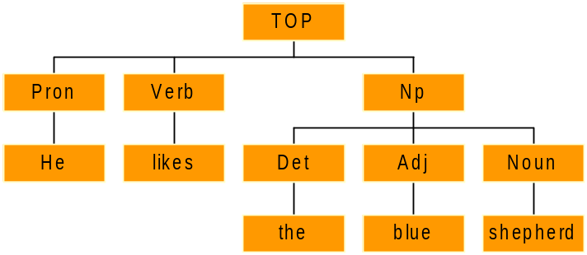
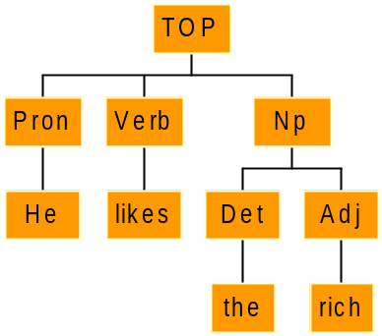
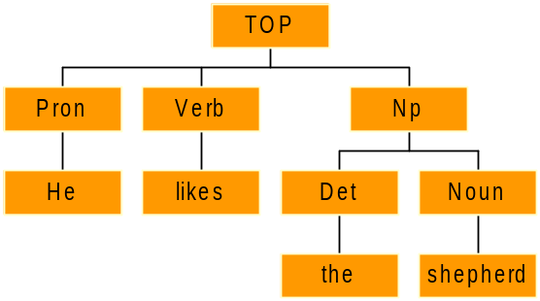
Immediate Dominance rules/Linear Precedence (3)
Example:
2> NP -> Det,Noun.
2> NP -> Det,Adj,Noun.
2> NP -> Det,Adj.
In this layer, only Det,Noun,Adj are valid nodes. Verb and Pron do not belong to this layer. They cannot be selected in a sequence.
NP->Det,Adj,Noun.
NP->Det,Adj.
NP->Det,Noun.
The input is scanned from right to left

Slide 39
Immediate Dominance rules/Linear Precedence (4)
The Where keyword
Nodes can be associated with a variable of the form: #number. These variables are local to a rule application. They allow one to specify constraints on features across different nodes of a given rule.
2> NP -> Det#1[first], (Ap), noun#2[last,proper:~], where (#1[gender]::#2[gender]).
The above rule reads: the rule applies if the gender for det and noun is the same.
We use the operator “::” which is the common operator for comparison in XIP.
The expression can be a Boolean expression mixing more than one test, using the operators “|” (or) and “&” (and).

Slide 40
Immediate Dominance rules/Linear Precedence (5)
The Where keyword can also be used for assigning feature values to selected nodes:
2> NP -> Det#1[first], (Ap), noun#2[last,proper:~],
    where (#0[gender] = (#1 & #2) ).
    where (#0[gender=fem]) .

Slide 41
Sequence Rules (1)
A sequence rule defines an ordered sequence of nodes.
- The rules apply sequentially in a given layer according to the order defined by the linguist.
- The input stream is scanned from left to right until the whole input stream is traversed
- Each rule applies from left to right (operator =) or from right to left (operator <=) starting from the current node under scope in the input stream.
The where keyword is also available.

Slide 42
Sequence Rules (2)
Basic sequence operators:
  Concatenation: det, adj
  Optionality, Kleene * and +: adj*, noun+, (adv), (det,adj,noun)
  Any category (noted ?): det, ?*, noun
  Disjunction: adv;adj

Slide 43
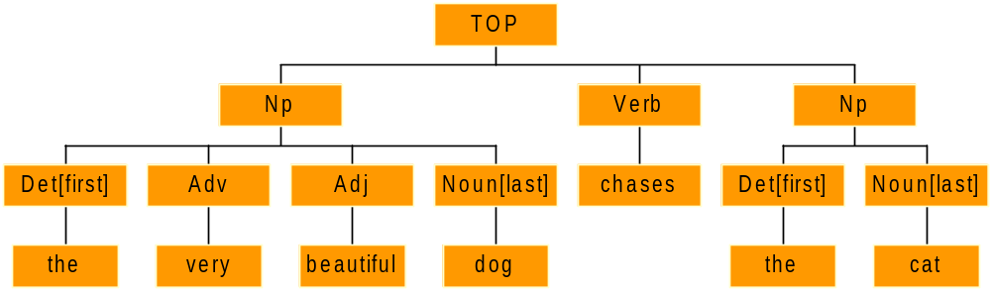
Sequence Rules (3)
Example:
NP is described as a sequence of nodes:
  1> NP = det, ?*[verb:~],noun.

Slide 44
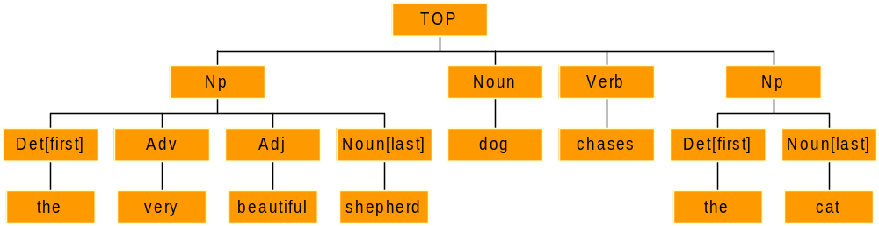
Sequence Rules (4)
Sequence Rules
- In a given layer, the first rule to match a sequence starting with the active node applies
- A sequence rule may apply according to the the shortest match ( = , <=) or to the longest match (@= , @<=)
-
Example of shortest match: 1> NP = det, ?*[verb:~],noun.

Slide 45
Sequence Rules (5)
Example of longest Match
NP is described as a sequence of nodes:
  1> NP @= det, ?*[verb:~],noun.
The @ indicates that the sequence spanned by this rule is maximum (longest match)
The rule applies on both NP below:

Slide 46
Sequence Rules (6)
The parsing algorithm functions as follows for a given layer:
  First, the input unit is traversed until a node that bears a valid category is found.
  A valid category is a category that starts a sequence rule in a given layer
    1> NP = Det,?*,Noun.
    In the layer above, only Det is a valid category
  Second, rules that start with the category of the valid node are tested one after the other, starting at that node. The first rule to match a sequence is selected and the input stream is updated accordingly.

Slide 47
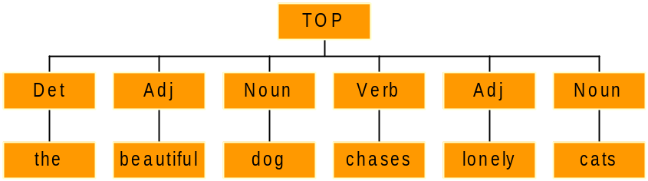
Sequence Rules (7)
Example:
a) 1> NP = Det, Adj, Noun.
b) 1> NP = Adj, Adv,Noun.
c) 1> NP = Adj,Noun.
In that layer, Det and Adj are valid categories. They both can start a sequence rule. Noun is not a valid category.
We try:
first, rule b)
then rule c)
The input unit is scanned from left to right
We apply the rule here
And here!!!

Slide 48
Sequence Rules (8) : lexically indexed rules
Sequence rules can be indexed on the lemma of the first or last node in the sequence
This provides an efficient way to define lexical rules, e.g. for describing multiword expressions
Example:
\\ as long as is a conjunction at beg. of sentence
As : CONJ = Prep[start], adj[lemma:long], prep[form:f_as] .

Slide 49
Contexts in rules
Contexts
A rule of any type can be associated with a context that restricts its application according to sequences of categories on the left or on the right of the selected nodes. A context is defined as a sequence of sub-trees.
2> NP -> |?[noun:~]| AP[first:+], noun[last:+,proper:~].
The context is always written between pipes.
The above rule reads: a NP is built if the category on the left of the AP is not a noun
A context can be negated with a “~” before the first “|”.
2> NP -> ~| noun, adv*| AP[first:+], noun[last:+,proper:~].

Slide 50
Overview of the presentation
Data representation
Different types of rules
  Contextual selection (disambiguation)
  Chunking
  Marking and reshuffling
  Dependency calculus

Slide 51
Marking Rules
Those rules are used to mark specific nodes configuration with feature-value pairs
They explore sequences of sub-trees
Marking rules must be defined within specific layers
Example:
The rule below marks a verb node as passive when the auxiliary is “be” and the next node is a PP introduced by the preposition “by”.
15> FV[passive=+]{Vaux[aux:be], Verb[pastpart]}, PP{Prep[by]} .
The FV node is then marked with the feature passive.

Slide 52
Reshuffling Rules
Their purpose is to locally rebuild the chunk tree.
A reshuffling rule consists of a left side which describes an initial sequence of sub-trees (as used in marking rules) and a right side where the modification of the tree is specified.
The left side defines the configuration of a sub-tree where nodes are attached to variables. The right side defines a new sub-tree reshuffled on the basis of the nodes referred to by those variables.
A same variable may represent a list of nodes (unlike in other rules)

Slide 53
Reshuffling Rules
Example:
2> SC{NP#1,?*#2,VP#3}, SC{Coord#4,VP#5} = SC{#1,#2,VP{#3,#4,#5}}.
This rule merges two SCs into one SC, if the second initial SC starts with a coordination.
TOP{SC{ NP{The man} VP{drinks}}, SC{and VP{smokes}}}
is reshuffled as:
TOP{SC{NP{The man} VP{VP{drinks} and VP{smokes}}}}

Slide 54
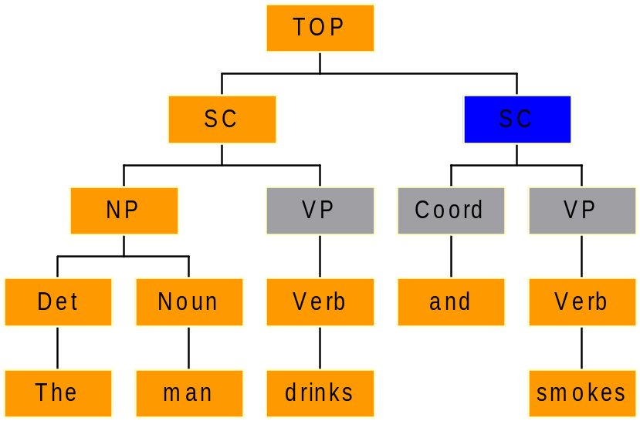
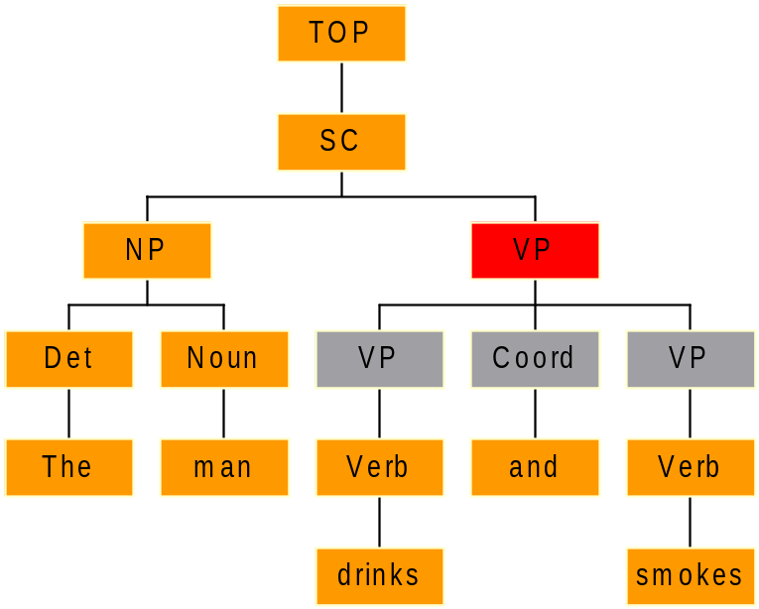
Reshuffling Rules

Slide 55
Overview of the presentation
Data representation
Different types of rules
  Contextual selection (disambiguation)
  Chunking
  Marking and reshuffling
  Dependency calculus

Slide 56
Dependency Rules
A dependency is an n-ary relation that connects nodes according to a specific relationship, such as:
  standard syntactic dependencies (e.g. subject or object)
  even broader relations including inter-sentencial relations (e.g. coreference).
The dependency calculus takes as input a sequence of constituent or lexical nodes
Dependency rules are processed sequentially

Slide 57
Dependency Rules: generic rule
| pattern | if <conditions> <d_term₁> , …, <d_term_{k}> .
<d_term> is a dependency term of the form name[f_list](a₁, a₂,…,a_{n}), where name is the name of the dependency relation, [f_list] is a list of features, and a₁, a₂,…, a_{n} are the arguments.
<conditions> is any Boolean expression built up from dependency terms, linear order statements and the operators & (conjunction), | (disjunction) and ~ (negation).
<pattern> is a tree matching expression that describes structural properties of parts of the input tree.

Slide 58
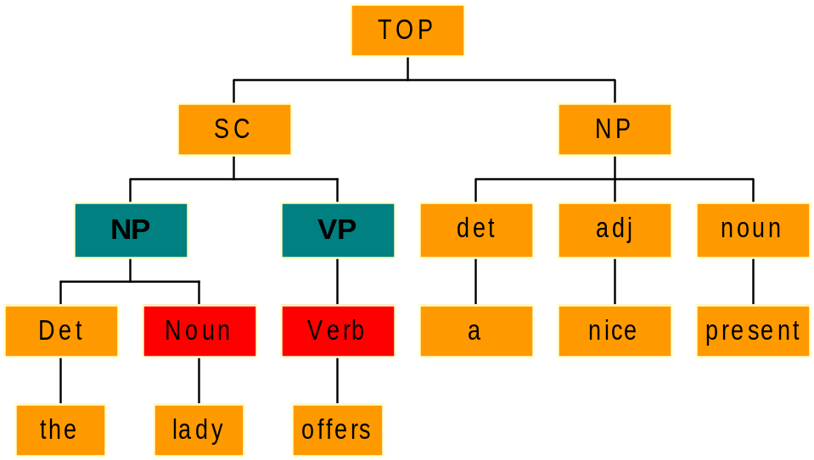
Dependency rules: example
The primary input is a chunk Tree
We want to extract the subject relation between lady and offer
Subject(offer,lady)
On the basis of the above chunk tree

Slide 59
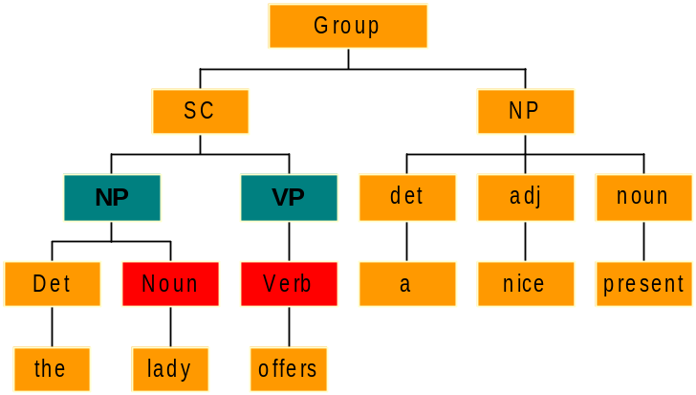
Dependency rules
|NP{?*,#1[last]}, VP{?*,#2[last]}| Subj(#2,#1) .
The head is the last element of a chunk, it bears the feature last
Nodes separated by a comma are “sister nodes”
The “{…}” denotes sub-nodes.
Features can be tested or modified on nodes
Start here

Slide 60
Dependency rules: example
Pattern and conditions
  |NP{?*,#1[last]}, VP{?*,#2[last]}| if (~Subj(#2, #)) Subj(#2,#1) .
This rule imposes that no other subject dependency be previously extracted for the current verb.

Slide 61
Dependency rules
Dependencies can bear Features
  a) |NP{?*,#1[last]}, VP{?*,#2[last]}| Subj(#2,#1) .
  b) |NP{?*,#1[last]}, VP[passive]{?*,#2[last]}| Subj[passive=+](#2,#1) .
The second rule appends the feature passive to the dependency itself.
More than one dependency can be defined in a single rule
  |SC {NP{?*,#1[last]}, VP{?*,#2[last]}}, NP{?*,#3[last]} |
  Subj(#2,#1), Obj(#2,#3) .

Slide 62
Dependency rules
Dependencies can be renamed
  // change VMOD to VARG if subcat compatible with prep
  If (^vmod#1,#2) & prep(#3,#2) & #1[fsubcat]:#3[fsubcat]) varg(#1,#2) .
Dependencies can be deleted
  // eliminate right subject if left subject available
  If (subj[left](#1,#2) & ^subj[right](#1,#3)) ~ .

Slide 63
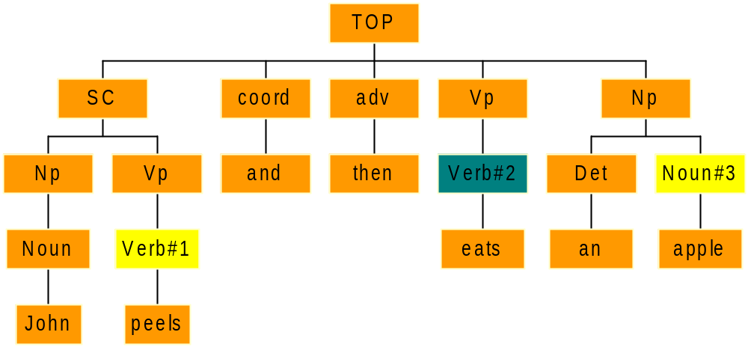
Dependency rules: example
Example:John peels and then eats an apple
if ( coorditems(#1[npomp:+],#2) &
vcomp[dir:+](#2,#3) &
~vcomp [dir](#1,?)) vcomp[dir=+](#1,#3) .
→ Result: vcomp[dir](peels,apple)
Coorditems(peels,eats)
Vcomp[dir](eats,apple)

Slide 64
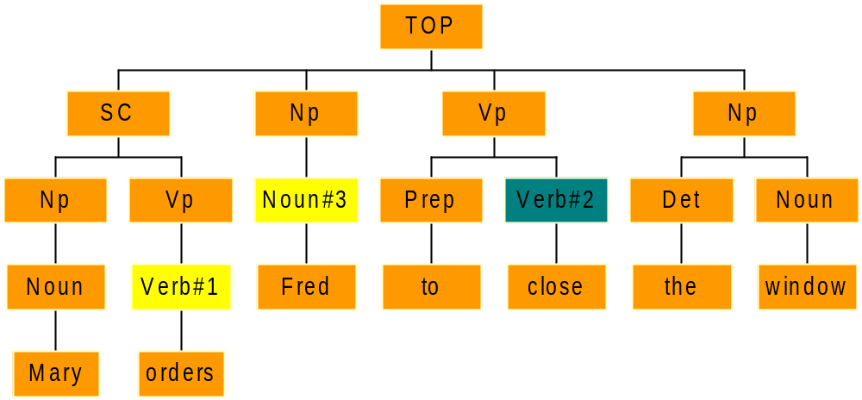
Dependency rules
Example: Mary orders Fred to close the window
if ( vcomp[inf](#1[infctrl:obj],#2) &
vcomp([inf:~]#1,#3) )
subj(#2,#3) .
→ Result: subj(close,Fred)
Vcomp[inf](orders,close)
Vcomp(orders,Fred)

Slide 65
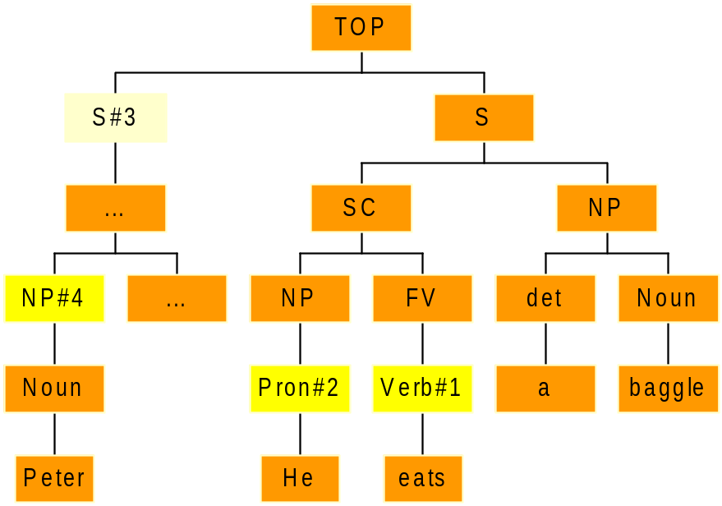
Co-reference
Co-reference extraction
  Non bounded-node extraction : Cat⬇
Coref(He,Peter)
a) Connecting every Noun with a S
|S#2{ ?*,Noun⬇#1 | NwithinS(#2,#1) .
b) Extraction of a possible pronoun co-reference
| S#3, S{SC{?*,FV{?*,#1VERB[last]}}} |
if (subj[imperso:~](#1,#2[pron,clit,p3,indef:~])
& NwithinS(#3,#4) )
coref(#2,#4) .

Slide 66
Memento
Lexical files (dedicated to lexical rules)
Keyword : LexicalRules
LexicalRules:
dog : noun += [animate=+].
    Mr = noun[human=+,title=+].
    Xerox += verb[transitive=+].
    in\ silico = adv.

Slide 67
Memento
Split rules:
they break the input stream into processing units;
they are defined as sequences of nodes
they are processed from right to left (they define the breaking point and potentially its left context)
those rules are processed sequentially (after lexical analysis)
Keyword: SplitRules
SplitRules:
// break input after colon if a verb is found on the left side of colon
| VERB, ?*[punct:~], punct[form:fcolon] | .
//otherwise, split whenever a SENT tag occurs
| SENT |.

Slide 68
Memento
Contextual disambiguation
Keyword: DisambiguationRules
  DisambiguationRules:
  1> det<quant>,pron = det |adj*,noun[verb:~,adv:~]|.

Slide 69
Memento
Chunking (ID rules & LP rules)
Keyword: IDRules
Keyword: LPRules
  IDRules:
  2> NP -> det[first], noun[last], noun*,adj*, adv*.
LPRules:
2> [det] < [noun] .

Slide 70
Memento
Chunking (Sequence rules)
Keyword: SequenceRules
  SequenceRules:
3> NP -> Det#1, AP*, noun#2, where (#0[gender] = (#1 & #2) ).
  4> NP = ~| noun, adv*| AP, noun[proper:~].
  5> NP = det, ?*[verb:~,noun:~],noun.

Slide 71
Memento
Chunking (indexed rules)
Keyword: IndexedRules
  IndexedRules:
  6> As: CONJ = Prep[start], adj[lemma:long], prep[form:f_as] .

Slide 72
Memento
Chunking (Marking rules)
Keyword: MarkingRules
  MarkingRules:
  15> FV[passive=+]{Vaux[aux:be], Verb[pastpart]}, PP{Prep[by]} .

Slide 73
Memento
Chunking (Reshuffling rules)
Keyword: ReshufflingRules
  ReshufflingRules:
  2> SC{NP#1,?*#2,VP#3}, SC{Coord#4,VP#5} = SC{#1,#2,#3,#4,#5} .

Slide 74
Memento
Dependency rules
Keyword: DependencyRules
DependencyRules:
  20> |NP{?*,#1[last]}, VP{?*,#2[last]}| if (~Subj(#2, #)) Subj(#2,#1) .

Slide 75
Configuration Files
XIP behaves as a programming language in which every single feature or category must be declared.
Declaration of Features
Keyword: Features
Features:
Root: [
a1:{v1,v2},
a2:[
a3:{v3,v4},
a4: {v5,v6}
]
]

Slide 76
Configuration Files
Declaration of Categories
Keyword: Categories
Categories:
noun = [cat=noun].
verb = [cat=verb].

Slide 77
Configuration Files
Translation of External Features
This section is only available for the XIP version that is connected to NTM. This section specifies the list of rules that translate a given string in a category+feature according to the feature and category declarations.
Keyword: Translation
Translation:
NounProper = noun[proper=+].
Sg = [sg=+].
Pl = [pl=+].

Slide 78
Configuration Files
Declaration of Dependencies
Keyword: Functions
Functions:
subj.
obj.
vmod.

Slide 79
Configuration Files
Hiding dependencies
This declaration is used in two ways:
a) It does not display the dependencies that are declared here.
b) When using XIP as a library, the dependencies that declared here are not store in a XipDependency object.
Keyword: Hidden
Hidden:
subj,obj.
N.B. Those dependencies must be declared in the dependency section.

Slide 80
Configuration Files
Declaration of Function Features
This declaration is used in two ways:
a) It displays those features together with the dependency name.
b) When using XIP as a library, only the features declared in that section will be available in the XipDependency result.
Keyword: FunctionDisplay
FunctionDisplay:
[right, left, passive].
N.B. Those features must be declared in the features section.

Slide 81
Configuration Files
Displaying Features
This declaration is used in two ways:
a) It allows those features to display in the indented file or in the trace file. It reduces the display to those features only.
b) When using XIP as a library, only the features declared in that section will be available in XipFeatures objects.
Keyword: Display
Display:
[gender,number].
N.B. Those features must be declared in the features section.

Slide 82
Configuration Files
Displaying Node Features
This declaration is only used to display nodes with specific features on screen.
Keyword: NodeDisplay
NodeDisplay:
[gender,number].
For instance, the node Pronoun associated to the word « she » displays as:
Noun_Fem on screen.
N.B. Those features must be declared in the features section.

Slide 83
Configuration Files
Lemma
This declaration is used to declare the lemma attribute that is used to test a specific lemma value.
Keyword: Lemma
Lemma:
[lem:?]
Lem is the name of the attribute that is used to test a specific lemma value for a given lexical node.
Example: Noun[lem:dog]

Slide 84
Configuration Files
Surface
This declaration is used to declare the surface attribute that is used to test a specific surface form.
Keyword: Surface
Surface:
[surf:?]
Surf is the name of the attribute that is used to test a specific surface form for a given lexical node.
Example: Noun[surf:dogs]

Slide 85
Configuration Files
Uppercase/Alluppercase
Those two sections contain the declaration of the automatic features that are set when a word starts with an uppercase character or comprises only uppercase characters.
Keyword: Uppercase: or AllUpperCase:
Uppercase:
[upper:?]
AllUpperCase:
[allupper:?]
N.B. Those features must be declared in the features section.

Slide 86
Configuration Files
Default-Feature Specification (DFS)
Those rules are used to define the default behaviour of certain groups of features during the chunking process. The pre-DFS apply before the percolation of features on the mother node that is being built by a chunking rule (sequence or ID). The post-DFS apply after that percolation.
Keyword: PreDFS or PostDFS
PreDFS:
[start:+] > [!start:!]
This rule states that if a start feature is instanciated on a given node, this start feature becomes a free feature, for that same node.

Slide 87
Configuration Files
Split on Sub-string
This section defines the sub-string that is used to split a sequence of categories into a sentence. The sub-string is tested againt each word. When this sub-string is found then the parser analyses the sequence that has been isolated so far, including the word that comprises that sub-string.
Keyword: Boundaries
Boundaries:
+SENT
N.B. Splitting the input is based on solely that sub-string, or in combination with split rules, or only on split rules. In the last case, that section can be omitted.

Slide 88
Configuration Files
XML Coding
Certain characters, such as " or & or < are forbidden in XML fields and must be replaced with a specific encoding. This section specifies which XML coding should be chosen for those specific characters. If those characters cannot be displayed, their internal code can be used instead. The internal code is then preceded with a ‘#’. If a character is a unicode character (comprising more than one code), then a list of internal code can be provided, separated by a comma. Those characters will be automatically changed, if the XML display is requested.
Keyword: XMLCoding
XMLCoding:
" = &#34;
< = &#60;
#160,#134 = &#860; we provide a list of internal codes.

