Slide 1
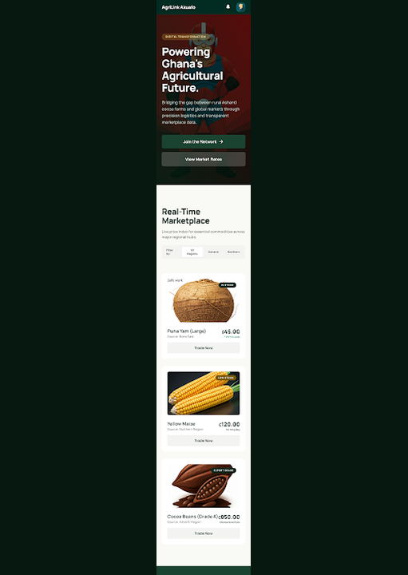
CS 415 Software Engineering · Final Presentation · April 2026
AgriLink Ghana
Ghana's Agricultural Marketplace — Live & Complete
✅ All 3 Sprints Done
🌾 4 User Roles
🏆 34 Stories Shipped
🌐 Live Deployed
Tomoh Ikfingeh · claudetomoh/agrilink

Slide 2
TODAY'S AGENDA
Final Presentation Outline
01
02
03
Platform Summary
Sprint 3 Jira Board
Matching Engine
04
05
06
Architecture
Test Results
Engineering Docs
07
08
09
Live Demo
Velocity & Retrospective
Roadmap & Q&A

Slide 3
PLATFORM SUMMARY
AgriLink Ghana — Complete
34
83
User Stories Shipped
Story Points Delivered
12
43
Produce Listings
Tests Passing
7
6
Demo Accounts — Live Server
🌾 Farmer: kofi.boateng@agrilink.gh / Pass@1234
🛒 Buyer: kwame.mensah@agrilink.gh / Pass@1234
🚛 Transport: kojo.logistics@agrilink.gh / Pass@1234
🛡️ Admin: admin@agrilink.gh / Admin@1234
Kofi Boateng
Kwame Mensah
Kojo Logistics
Admin
Registered Users
Orders Placed

Slide 4
JIRA SPRINT BOARD
Sprint 3 — All Items Complete
Done ✓ (16)
Sprint 4 Backlog (7)
✓
Auth System (Register/Login)
Infra
✓
Order Tracking (Full Lifecycle)
Buyer
✓
Smart Matching Score UI
Buyer
SMS Notification Gateway
Infra
✓
Farmer Produce Listings CRUD
Farmer
✓
Admin User Management
Admin
✓
Security Hardening (OWASP)
Infra
Ghana Card OCR Verification
Farmer
✓
Buyer Marketplace + Filters
Buyer
✓
Review & Rating System
Buyer
✓
Full Test Suite — 43 Tests Pass
Infra
Mobile Money (MoMo) Payments
Infra
✓
Price Bidding System
Buyer
✓
AI Demand Matching Refinement
Buyer
✓
Engineering Documentation Suite
Infra
PWA Mobile Wrapper
Infra
✓
Real-time Notification System
Infra
✓
Admin Analytics Dashboard
Admin
Multi-language: Twi / Ga
Infra
✓
Transport Job Board
Transport
✓
Delivery Timeline View
Transport
Dispute Resolution Workflow
Admin
API Layer for Integrations
Infra
Sprint Velocity: Sprint 1: 22 pts · Sprint 2: 27 pts · Sprint 3: 34 pts → Total: 83 story points delivered

Slide 5
AI SUPPLY–DEMAND MATCHING
Smart Score-Based Matching Engine
+40
Same Region
Produce and buyer in same Ghana region
+30
Category Match
Produce category matches buyer request
+20
Quantity Met
Available qty ≥ buyer requested amount
+10
Budget Match
Price per unit ≤ buyer budget threshold
$score = 0; if ($region === $buyerRegion) { $score += 40; } if ($category === $requested) { $score += 30; } if ($qty >= $buyerQty) { $score += 20; } if ($price <= $buyerBudget) { $score += 10; }
Max score: 100 pts · Displayed as match % on each listing card · Top-scored results shown first

Slide 6
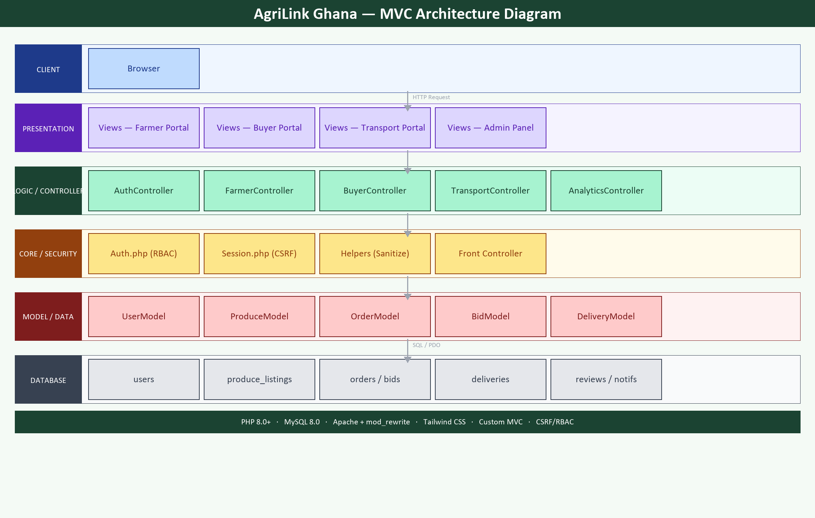
SYSTEM ARCHITECTURE — MVC LAYERS

Slide 7
QUALITY ASSURANCE
Test Results — 43 / 43 Passing
43
Authentication (8)
Farmer Module (9)
Buyer Module (8)
✓ Login/Logout flow
✓ Listing CRUD operations
✓ Marketplace filters
✓ CSRF token validation
✓ Image upload validation
✓ Order placement
Tests Passing
✓ Role-based redirects
✓ Order accept/reject
✓ Bid counter-offer
0 failures
✓ bcrypt verify
✓ Profile edit
✓ Review submission
100% pass rate
Transport Module (6)
Analytics & Admin (6)
Security (OWASP) (6)
✓ Job board listing
✓ Dashboard metrics
✓ SQL injection (PDO)
✓ Delivery status update
✓ User toggle active
✓ XSS output escaping
✓ Timeline view
✓ Order/delivery views
✓ Auth guards
✓ File upload rules

Slide 8
PROJECT DOCUMENTATION
Engineering Documentation Suite
📋
README.md
Project overview, setup guide, architecture map, credential table, all 7 engineering docs index
📄
PROJECT_PROPOSAL.md
Problem statement, objectives & success metrics, tech stack, 7-week timeline, team Scrum roles (Week 3)
🏃
SPRINT.md
3-sprint log — Jira board state, daily standups, velocity chart (22→27→34 pts), retrospectives, DoD
📑
FINAL_REPORT.md
11-section report: overview, methodology, architecture, OWASP table, defect log, 43-test results, learnings
🗄️
schema.sql
7-table MySQL schema with FK constraints, ENUMs, indexes — production-ready
🌱
seed.sql
Ghana-context demo data: Ghanaian names, produce, 16 regions, test accounts
📐
DESIGN.md
Design system — Verdant Archive palette, typography, component library, spacing tokens

Slide 9
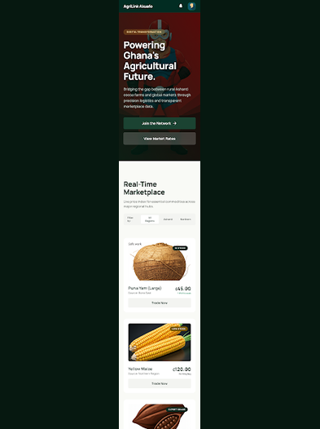
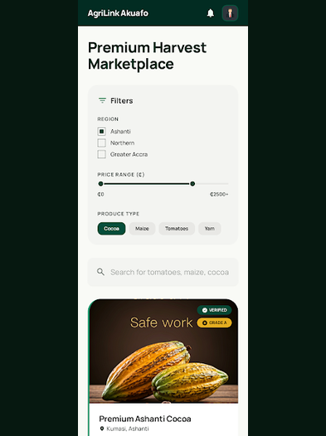

LIVE APPLICATION — PORTAL SCREENS
Homepage · Buyer Marketplace · AI Matching
● ● ●
● ● ●
● ● ●
AgriLink Homepage
Buyer Marketplace
AI Supply-Demand Matching

Slide 10
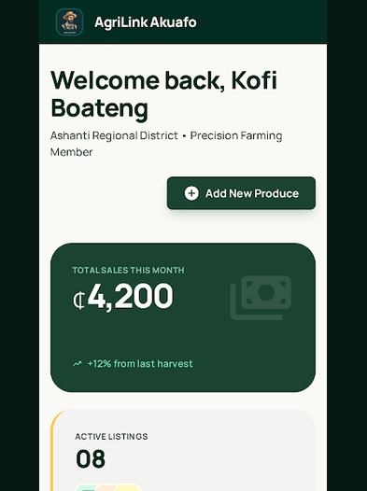
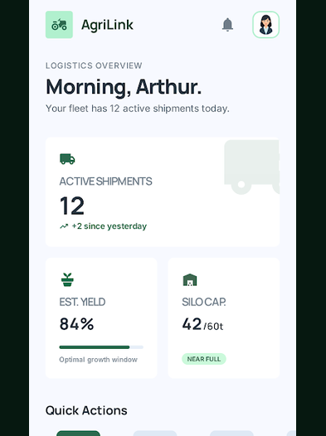
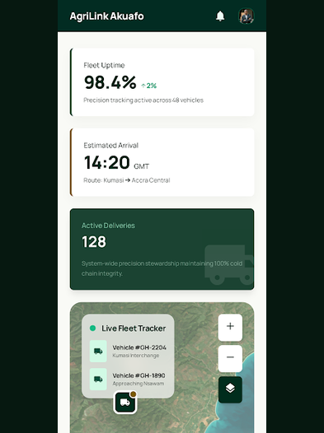
LIVE APPLICATION — PORTAL SCREENS
Farmer Dashboard · Admin Dashboard · Transport Dashboard
● ● ●
● ● ●
● ● ●
Farmer Dashboard
Admin Dashboard
Transport Dashboard

Slide 11
AGILE PROCESS — RETROSPECTIVE
Sprint Velocity & Key Learnings
Sprint 1
Sprint 2
Sprint 3
Sprint 1
22 story points
✅ Went well: Auth, CSRF, listings — clean separation of concerns
✅ Went well: Order lifecycle, bidding, transport job board
✅ Went well: Matching engine, analytics, full 43-test suite
Sprint 2
27 story points
🔧 Improved: PHP lint gate + deploy script replaced manual FTP
🔧 Improved: CSS contrast audit fixed 3 accessibility failures
🔧 Improved: Documentation written alongside code, not after
Sprint 3
34 story points
📌 Action: Define DoD before sprint start; review design tokens
📌 Action: Add unit tests from Sprint 3 start — not at the end
📌 Carry forward: SMS gateway + OCR to Sprint 4 with spec ready
Velocity trend: +23% Sprint 1→2, +26% Sprint 2→3

Slide 12
SECURITY — OWASP TOP 10
Security Implementation
A01 Broken Access Control
Auth::requireRole() guard on every controller action
A02 Cryptographic Failures
password_hash(BCRYPT) — no plain text ever stored
A03 Injection
PDO prepared statements on all DB queries
A04 Insecure Design
Dedicated Auth, Session, CSRF token classes
A05 Security Misconfiguration
DB credentials in config.php excluded from version control
A07 Auth Failures
Session::verifyCsrf() on every POST; session_regenerate_id()
A08 Integrity Failures
File upload: MIME + ext + size checks; store outside webroot
A09 Logging Failures
PHP error_log; future: audit log table for admin actions

Slide 13
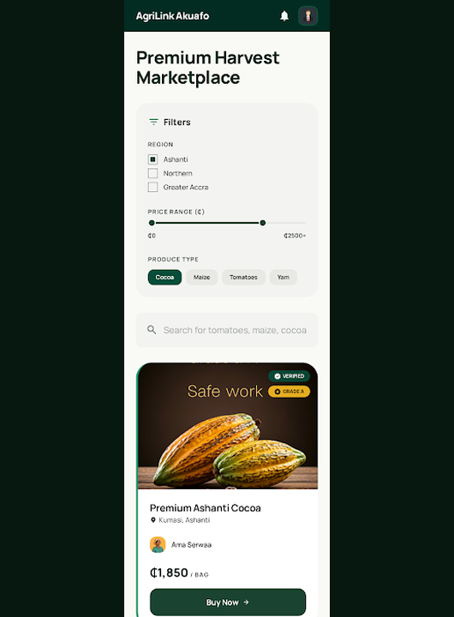
LIVE DEPLOYMENT
Application Demo
🌐 169.239.251.102:280/~tomoh.ikfingeh/agrilink/public/
🌾 Farmer
🛒 Buyer
kofi.boateng@agrilink.gh
kwame.mensah@agrilink.gh
pwd: Pass@1234
pwd: Pass@1234
🚛 Transport
🛡️ Admin
kojo.logistics@agrilink.gh
admin@agrilink.gh
pwd: Pass@1234
pwd: Admin@1234
📂 github.com/claudetomoh/agrilink

Slide 14
ROADMAP
Deferred Backlog — Jira Sprint 4 Queue
Sprint 4 — Trust & Verification
Sprint 5 — Growth
Future — Scale
Ghana Card OCR auto-verification
Mobile Money (MoMo) payment integration
PWA mobile wrapper
SMS alerts via Twilio
Market price index dashboard
Multi-language: Twi / Ga / Hausa
Email notification system
Bulk order management
API layer for third-party integrations
Dispute resolution workflow
Farmer cooperative groups
ML demand forecasting model
All Sprint 4 items are tracked as 'To Do' tickets on the Jira sprint board — backlog-ready with acceptance criteria

Slide 15
🌿
AgriLink Ghana · CS 415 Software Engineering · Final Presentation · April 2026
Thank You
Questions?
34
83
43/43
3
4
Live
Stories
Pts
Tests
Sprints
Portals
Deployed
🌐 169.239.251.102:280/~tomoh.ikfingeh/agrilink/public/
📂 github.com/claudetomoh/agrilink
Tomoh Ikfingeh · Student · CS 415 Software Engineering

