Slide 1
01 TURING COLLEGE · AI CAPSTONE · CASE 3
A11yAudit
AI-assisted accessibility and health-literacy
screening for digital health content
The AI proposes. Deterministic rules dispose.
Claudia Bassier · August 2026
01 / 13
Notes:
Do not read this slide aloud. Go straight to the BD sentence. If someone asks about the name: a11y is the standard numeronym for accessibility, the same construction as i18n for internationalisation, and it is pronounced ally. That reading is deliberate in the field: being an ally to disabled people.

Slide 2
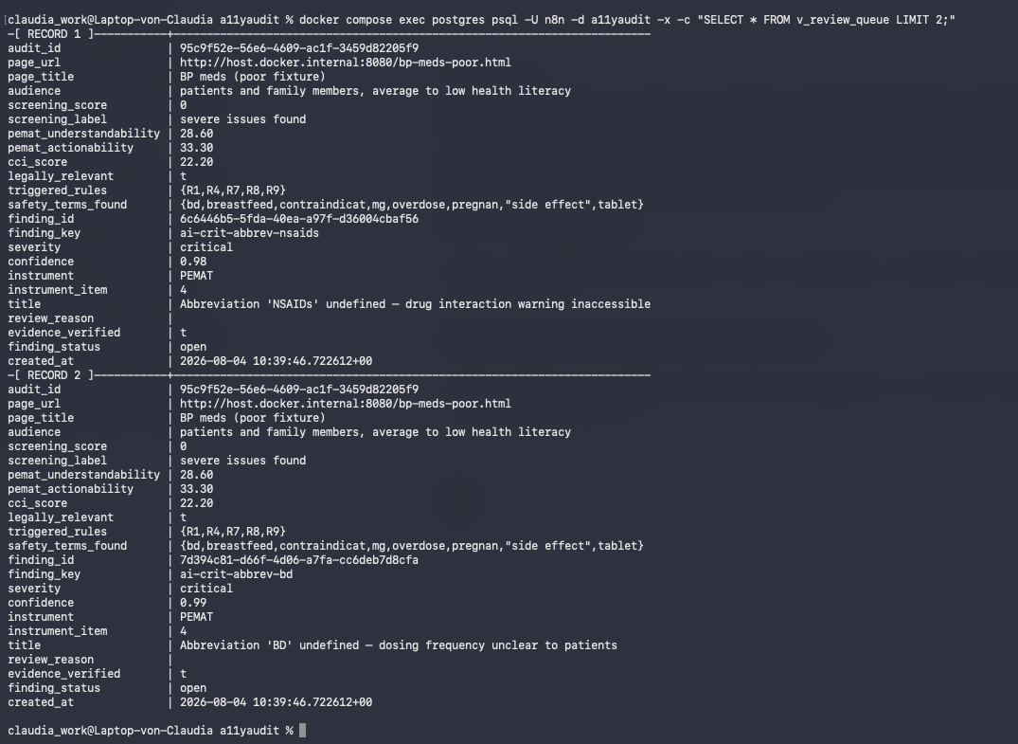
02 THE PROBLEM, IN ONE LINE OF A LEAFLET
“Take 1 tablet BD.”
Latin: bis die, twice a day. Nothing on the page says so.
63% of patients with low literacy, and 38% with adequate literacy, misunderstood ordinary prescription dosing instructions. One of six named causes: implicit rather than explicit dosing intervals.
Wolf et al. 2007, Patient Educ Couns 67(3):293–300 · 395 patients
An accessibility checker finds real faults here. Mine found eight. But none of them is the sentence that could get someone hurt. Checkers read markup, not meaning.
The finding this system produced, in the review queue.
CRITICAL · CONFIDENCE 0.99 · PEMAT ITEM 4 · EVIDENCE VERIFIED
02 / 13
Notes:
The hook. Say the sentence, pause, then the number. Name the eight faults aloud (no image description, no page language, a heading level skipped) because the slide only says eight. Do NOT say patients read BD as bedtime. That claim is unsupported and inverted relative to ISMP; see decision_log D-43.

Slide 3
03 TWO FAMILIES OF TOOLS. NEITHER CLOSES THE GAP
Nothing joins markup to meaning.
ACCESSIBILITY CHECKERS
HEALTH-LITERACY INSTRUMENTS
A11YAUDIT
axe · WAVE · Lighthouse
PEMAT-P (AHRQ) · CDC Clear Communication Index
This project
Test markup well. Reduce language to a readability grade. Cannot see that “BD” is a dosing instruction.
Assess language properly, item by item. Manual rubrics: a trained human rater, one document at a time.
Both in one automated pass, stored in Postgres so results can be compared across pages over time.
A report, not accessible content. · The literacy demand of the material, not anyone’s health literacy. · No conformance claim.
03 / 13
Notes:
The bottom line repeats slide 11. If you are running long, say it here OR there, not both.

Slide 4
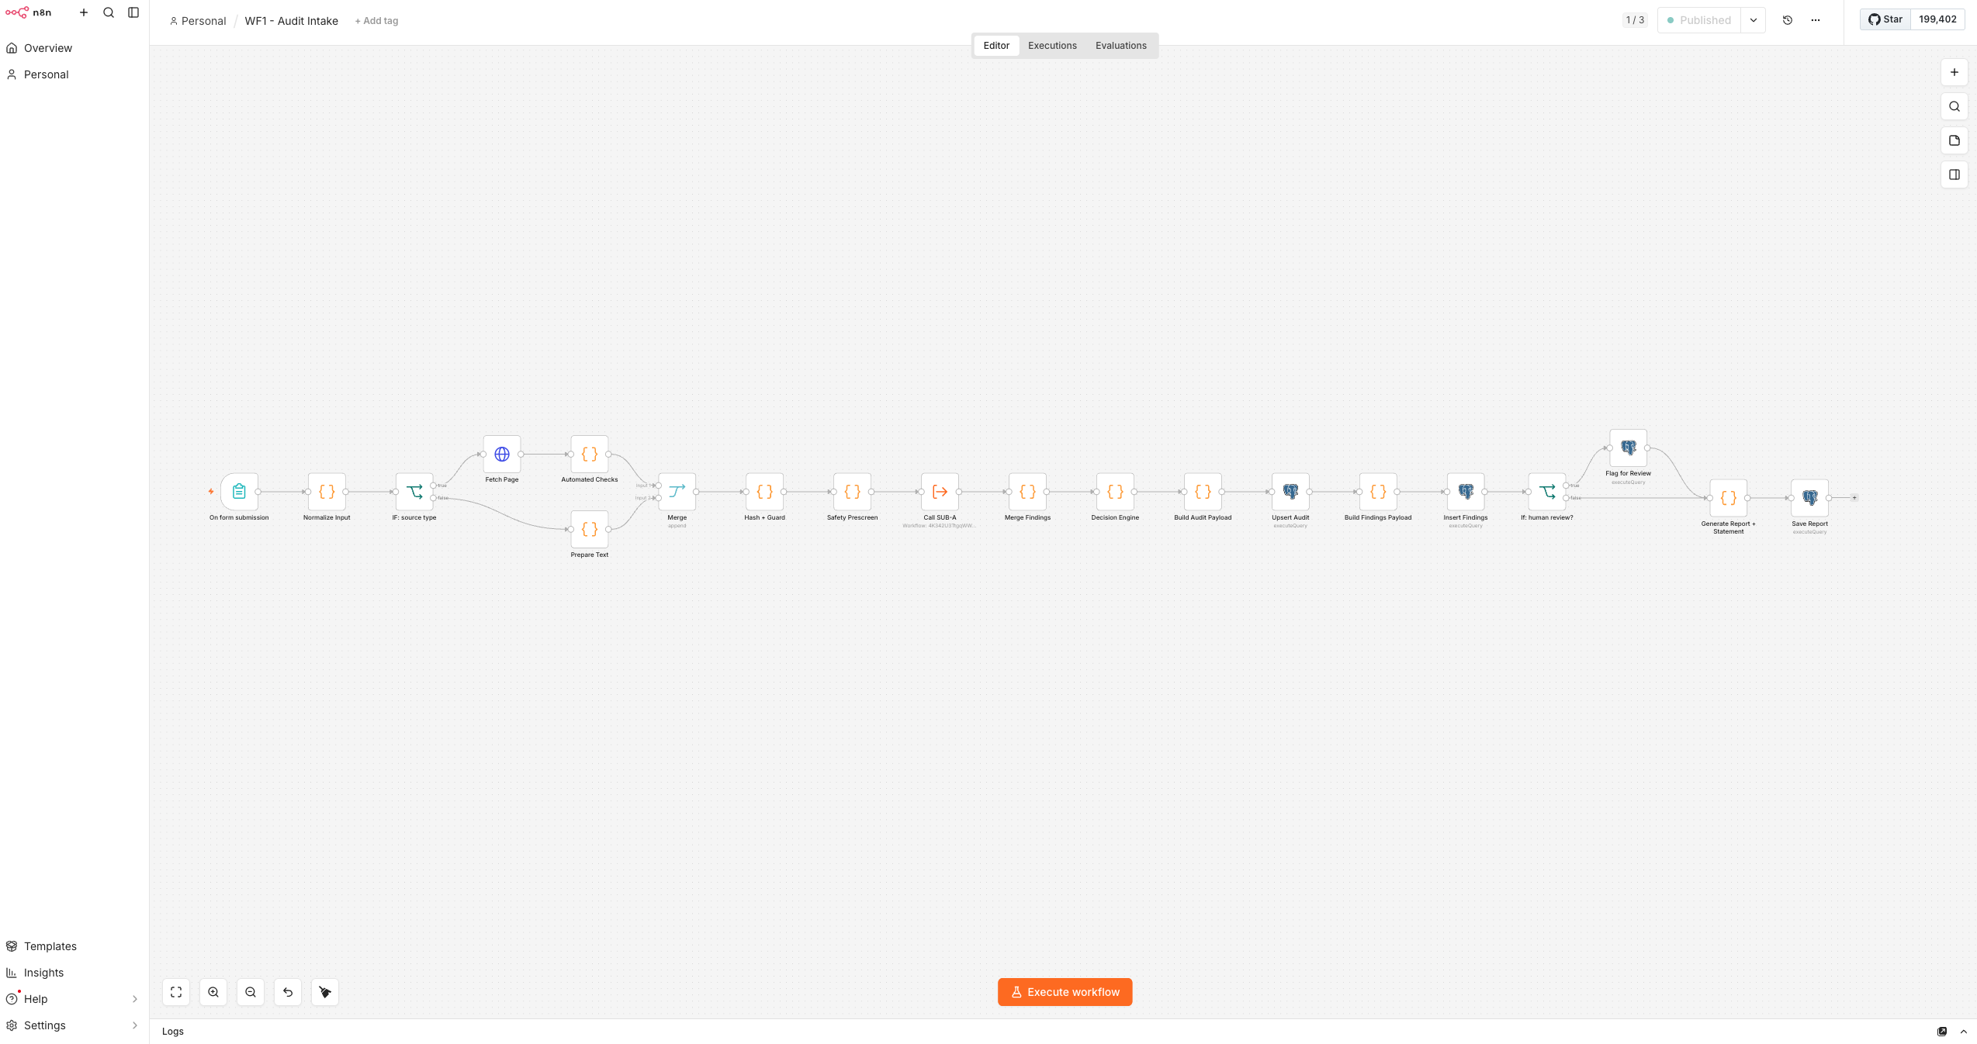
04 HOW IT WORKS
Twenty nodes. One AI call.
1
FORM
URL or pasted text
2
DETERMINISTIC CHECKS
9 WCAG criteria · no AI
3
SAFETY PRESCREEN
regex · dosing, emergency, risk
4
AI ANALYSIS
one call · temp 0 · schema-validated
5
DECISION ENGINE
4 scores · 9 hard rules
WF1 - Audit Intake. Self-hosted n8n + Postgres 16 in Docker,
on local hardware. 20 nodes here, 12 in the AI subworkflow, 3 in the error handler.
6
POSTGRES → REPORT
audits · findings · statement
Evidence verification: every finding must quote the page verbatim, and the quote is checked in code. A finding whose evidence cannot be located is discarded before the database, with no retry.
04 / 13
Notes:
Trace the pipeline with the cursor while you speak. Land hard on this: the checks and the safety search run BEFORE the AI. That ordering is what makes slides 7 and 8 possible.

Slide 5
05 THE DESIGN PRINCIPLE
The AI proposes.
Deterministic rules dispose.
Scoring, escalation and the routing of safety-critical content to a human reviewer are fixed rules. They fire whether or not the AI answers at all. Nothing on the safety path depends on the AI being correct.
05 / 13
Notes:
Slow down. This is the sentence the whole system is built to earn.

Slide 6
06 RESULT: THE DEMO PAIR
Same clinical content, rewritten.
52
→
100
 | POOR | CORRECTED
Automated findings | 8 | 0
Deterministic instrument items | 5 of 8 fail | 8 of 8 pass
PEMAT-informed understandability | 28.6 | 92.9
PEMAT-informed actionability | 33.3 | 100
CCI-informed | 22.2 | 88.2
DETERMINISTIC SCREENING SCORE · REPRODUCIBLE
Verified byte-identical across runs. Both values were written down on 31 July from standalone engine runs, before the pipeline existed; the assembled system reproduced them exactly.
The AI-dependent subscores move with it: reported, but not called reproducible.
06 / 13
Notes:
Quote the deterministic score: 52 to 100. Never quote the combined score's verbal label.

Slide 7
07 THE RESULT THAT MATTERS
It scores 100. It is well written.
It still goes to a human.
The corrected page’s database row: understandability 92.9, actionability 100, CCI-informed 88.2, and status needs_review anyway.
Because it is still medication content. Rule R7 fires from the safety prescreen, which is regular expressions, and which runs before the AI is ever called. A good score cannot buy a page out of review.
The tool discriminates on quality, and does not trade safety for quality.
07 / 13
Notes:
Never cut this slide. It is the single best moment in the talk.

Slide 8
08 FAILURE PATH: E11, AI UNREACHABLE
I made the AI unreachable.
The audit completed anyway.
732
MILLISECONDS, INVALID API KEY
R2 and R7 firing with the AI dead · instrument subscores null · completed_at empty.
It recorded that the AI had failed, fired R2, and routed to human review. It also fired R7, because the prescreen runs before the AI and identified the dosing and emergency language by itself. With the model entirely dead, the system still refused to pass medication content through unreviewed.
08 / 13
Notes:
Two runs on one slide: the AI killed (732 ms, still escalated), then the three-run variation on slide 9. Do not rush the second one. It is the honesty.

Slide 9
09 THE MEASUREMENT THAT COST ME A CLAIM
Same page. Three runs. Temperature 0.
42
72
65
WHAT DID NOT MOVE
Deterministic score: 100, all three runs.
Safety prescreen returned the same terms.
Routed to a human every single time.
RUN 1
RUN 2
RUN 3
COMBINED SCREENING SCORE · BYTE-IDENTICAL CONTENT
Rule R4 fires below 70. It fired, did not fire, then fired again. The drift is large enough to move a page across a deterministic threshold.
So I cannot claim reproducible AI analysis, and I don’t.
The measurement weakened the claim and improved the system: the score is now reported as two numbers, one reproducible and one not, labelled as such in every report.
09 / 13
Notes:
Never cut. This is the honesty the whole project rests on.

Slide 10
10 WHAT I LEARNED
Every test passed. Three defects
turned up anyway.
All three were found by reading the output, not by a test failing.
01
A misclassified error label
DECISION LOG: 45 ENTRIES
n8n discards everything before the first colon in a Code-node error message.
D-02 Deterministic checks in addition to AI
D-06 Safety prescreen runs before the AI call
D-11 Claims corrected during design
D-18 Pre-build review: 8 defects in my own code
D-20 Schedule slip: all Tier 2 scope cut
D-30 Two identical runs are not identical
D-32 The headline score was mostly AI opinion
D-34 The documents described a feature never built
D-36 Score said 100 for an unassessed page
D-37 Reading the report found a gap no test had
D-39 What a full sweep of the folder found
D-41 A claim that was one word too strong
D-43 The opening line was wrong, and inverted
D-45 A fourth false claim, and a check to catch the next
…and 31 more
02
A score of 100 on an unexamined page
No markup to check, AI dead: zero checks found zero problems.
03
A prescreen that knew 112 and 911
But not the UK’s 999 and 111. Invisible to every test I had written.
Tests confirm what you thought to specify. They are silent about what you didn’t.
10 / 13
Notes:
The panel on the right replaces scrolling the decision log live. The point is how dense it is, not reading it. Red entries are claims I had to correct. Say: 'forty-three entries; the ones in red are claims I had to take back.'

Slide 11
11 THE LIMITS, STATED PLAINLY
What it is not.
No conformance claim
An unvalidated adaptation
A listed subset of WCAG 2.2. Colour contrast, keyboard operation, focus order, media and JavaScript-rendered content are out of scope.
PEMAT-informed and CCI-informed, never a PEMAT score. Built for trained human raters. Neither AHRQ nor CDC endorses this tool.
Accuracy: one data point, not a validation
The intake form has no authentication
One rater hand-scored two fixtures blind and compared against the AI: 74.5% agreement. One rater, two fixtures - not PEMAT’s own two-rater design, and not a substitute for a false-positive rate from routine use.
Anyone reaching the form URL can trigger a paid AI call. Not a risk while unpublished; a hard gate before any public exposure.
Raised here rather than left to be found. These limits are part of the design, not gaps in it.
11 / 13
Notes:
Never cut. Naming your own limits first is what makes the rest credible.

Slide 12
12 ITERATION 2: TESTED AGAINST REAL PAGES
Two fixtures became
twenty-four real pages.
Rebuilt in Claude Code. Every defect below was found on markup nobody wrote for this tool, not on a hand-built fixture.
01
A real page broke content extraction
DECISION LOG: 75 ENTRIES
The first live page submitted had its navigation and breadcrumbs read as article content - invisible on every fixture, since none had surrounding page chrome.
D-62 Prompt-injection mitigation added
D-63 audit_runs: one row per execution
D-64 instrument_items write path finally built
D-66 Least-privilege Postgres role switched on
D-67 Hand-scoring: 74.5% AI/human agreement
D-68 First real page found a real extraction bug
D-69 Unused fallback engine retired, not resynced
D-71 A SQL comment that evaluates, found and fixed
D-72 Corpus closed at 24 pages, not 50–100
D-73 A correction that itself needed correcting
D-01 Postgres over Sheets, from day one
D-52 A golden-test harness pins the AI’s answer
D-55 One shared validation subworkflow, not two
D-61 An overclaim about a prior project, corrected twice
…and 61 more
02
The fix itself had a gap
Nested navigation inside <main> still leaked through. Found by a synthetic test built to check the fix, not by luck.
03
A documentation comment broke the database
A live n8n expression sat inside a SQL comment. An AI finding with an embedded newline turned the comment into executable SQL and crashed the write.
Fixtures prove the logic. Real pages prove it survives markup nobody wrote for it.
12 / 13

Slide 13
13 CLOSE
The prompt is the least
important part.
What matters is the layering around an unreliable component: prescreen before, evidence verification after, deterministic rules that hold when the AI is absent. So that when the clever part fails, the system is still correct.
Thank you.
readme.md · decision_log.md, 75 entries · demo_output/ · screenshots/
13 / 13
Notes:
Mention: the AI is in the product AND in the build; the system prompt is published in meta/. Then stop and take questions.

Slide 14
APPENDIX GLOSSARY
Glossary
Not presented. The health and accessibility terms only, since the rest needs no introduction here.
a11y
EAA · BFSG
Accessibility. The letter a, eleven letters, then y. Pronounced ally.
European Accessibility Act, and the German law implementing it. Why this content has to be accessible at all.
AHRQ · CDC
PEMAT-P
US Agency for Healthcare Research and Quality · US Centers for Disease Control and Prevention.
Patient Education Materials Assessment Tool, Printable. A scored checklist from AHRQ, applied by trained human raters.
BD
R1 to R9
bis die. Latin for twice a day. The abbreviation on slide 2, and the reason this project exists.
My nine hard rules. R2 the AI failed · R4 score under 70 · R7 safety content found.
CCI
WCAG 2.2
Clear Communication Index, from the CDC. A scored checklist for health information. CDC reads 90 or above as good.
Web Content Accessibility Guidelines, from the W3C. The standard this screens a listed subset of.
APPENDIX
Notes:
Appendix. Do not present it. It is here so the deck can be read without you, and so you never have to define PEMAT or CCI out loud.

