Slide 1
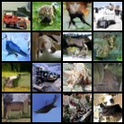
Computer Vision — Project 5 · A.A. 2025/2026
Parameter-Efficient Few-Step Distillation of Diffusion Models via LoRA
Lightweight Diffusion Models for Resource-Constrained Environments
Claudia Giuseppini 2069387 Benedetta Conti 2045621 Fabio Falconi 2048079
Generated samples · CIFAR-10
Professor: Irene Amerini
Dip. di Ingegneria Informatica, Automatica e Gestionale — Sapienza Università di Roma
1 / 14

Slide 2

Outline
01
Problem statement
05
Experimental setup
Diffusion models are slow: ~1000 sequential steps
Attention U-Net, single-GPU budget, metrics
02
State of the art
06
Model evaluation
DDPM · DDIM · Distillation · LoRA
Quality/speed trade-off & ablations
03
Proposed method
07
Conclusions
LoRA few-step distillation with trajectory matching
~10–19× faster at matched quality
04
Dataset
CIFAR-10, 60k images 32×32
2 / 14

Slide 3

Problem Statement
DDPMs generate images by removing noise step by step and they need up to 1000 sequential network evaluations per image. This is slow and expensive on limited hardware.
~1000
sequential steps for one DDPM image
DDIM speeds this up by taking fewer, larger jumps but each jump adds discretization error that accumulates, so quality collapses at very few steps.
325
FID of plain DDIM at a single step
Our goal
Reduce sampling time while keeping generation quality
Fix the error that hurts few-step DDIM, not the per-step prediction
Keep the extra training cheap enough for limited GPU
0.1%
of weights we will train to fix this
3 / 14

Slide 4

State of the Art
DDPM
DDIM
Denoising Diffusion Probabilistic Models — our baseline generator.
Deterministic sampler that skips levels, enabling fewer steps.
Limitation: ~1000 sequential steps → very slow sampling.
Limitation: quality collapses under strong step reduction.
Distillation
LoRA
Trains a student to reproduce a teacher in fewer steps.
Low-rank adapters for cheap adaptation of a frozen model.
Limitation: re-trains the whole network at each stage; very costly.
Enables distillation with trajectory matching at ~0.1% cost.
Distillation can be used in State-of-the-Art in some of the references. LoRA is the State-of-the-Art for distillation in LLMs
4 / 14

Slide 5

Proposed Method 1
EMA – Exponential Moving Average
Baseline Improvements
Our first implementation follows the basic DDPM setup. This had difficulties producing clear images with resources we had (Kaggle/Colab).
Therefore, we decided to add some optimization to improve the baseline efficiently.
TEACHER · frozen DDPM (EMA)
We keep a second averaged copy of the weights
Because the optimizer makes the weights oscillate around a good configuration this average is more stable .
This also produces better images at no extra cost.
Mixed Precision
Some computations are done in reduced (16-bit) precision which makes training faster and lighter on memory.
There is no visible loss of quality.
Data Augmentation
We apply a random horizontal flip to the training images
A mirrored dataset image is still a plausible image, so this enriches the data without distorting its distribution, unlike crops and rotation.
5 / 14

Slide 6
Proposed Method 2
Parameter-efficient few-step distillation via LoRA
Freeze the trained DDPM (EMA weights) as the teacher, add small low-rank adapters into the attention layers as the student.
The teacher refines a state with m small DDIM sub-steps, the student must reach the same point in a single step.
This teaches the student to compensate the error of large jumps: the student achieves few steps without the DDIM drop.
Only A and B (adapters) are trained (start B = 0 ⇒ student = teacher); at inference they merge back: W′ = W + BA, no overhead.
TEACHER · frozen DDPM (EMA)
xₜ → m small DDIM sub-steps → xₜ′ (target)
careful multi-step path
must match
STUDENT · DDPM + LoRA adapter
xₜ → ONE DDIM step → xₜ′ (student)
one large jump, error compensated
Distillation objective
L = ‖ xstudent − xteacher ‖² + λ ‖ εθ − εφ ‖²
16,384 trainable params · 0.107% of 15.3M
trajectory matching + noise-consistency (stabiliser)
Adapters merge into the weights
6 / 14

Slide 7

Experimental Setup
Model
Training
Attention U-Net, base_channels = 64, time_dim = 256
≈ 15.3M parameters; T = 1000 diffusion steps
Linear noise schedule; ε-prediction objective
Self-attention + LoRA
AdamW, batch size 128, 80 epochs (baseline)
EMA teacher, AMP mixed precision, grad clipping
Distillation: one student per K ∈ {8,4,2,1}, 10 epochs
Only LoRA adapters trained (16,384 params)
Dataset – CIFAR 10
Hardware & reproducibility
60,000 colour images, 32×32, 3 channels (RGB), across 10 classes.
Split : 50,000 train / 10,000 test
Pre-processing: pixels rescaled, so the data is zero-centered to match the zero-centered Gaussian noise of the diffusion process.
Single GPU — NVIDIA T4 (Kaggle)
All metrics on 10,000 generated images
Fixed seed = 42, deterministic algorithms
Shared seeded noise bank → fair comparisons
7 / 14

Slide 8

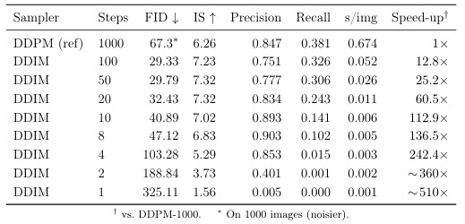
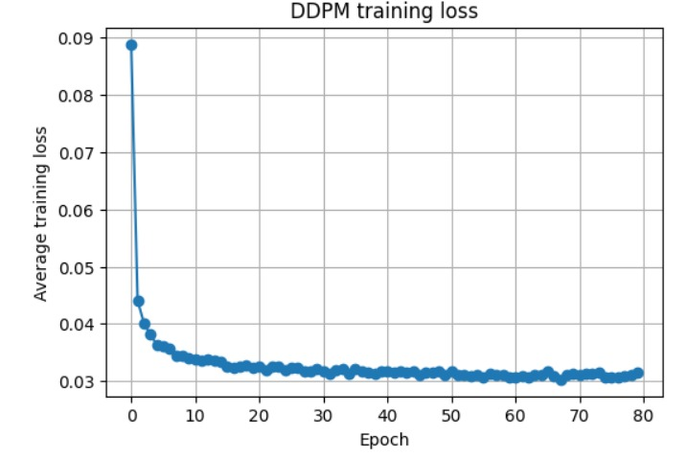
METRICS
Model Evaluation – Baseline
FID — image fidelity
Inception Score — sharpness
Precision & Recall — fidelity vs diversity
Samples of DDIM - 100 steps.
DDPM loss stabilizes after 40 epochs
8 / 14

Slide 9
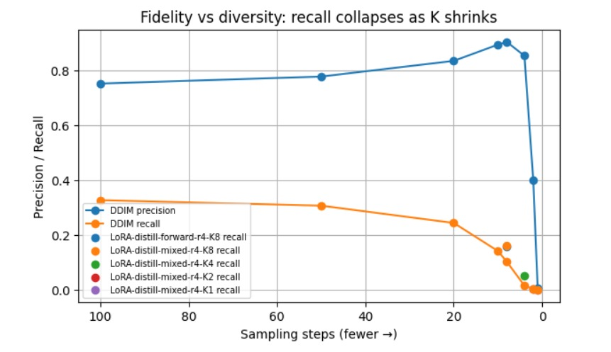
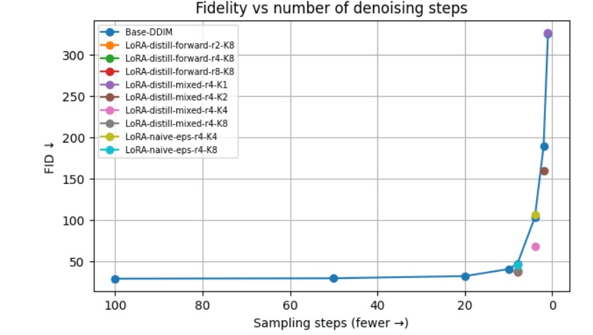
Model Evaluation – Speed vs Quality
Few steps degradation
DDIM degrades sharply below
10 steps; the distilled LoRA students sit below the DDIM curve at the same step
count.
The real casualty is diversity
As steps drop 100 → 8, precision even rises (0.75 → 0.90) — single images stay realistic.
But recall drops (0.33 → 0.10 → 0): the model covers less and less of the data and produces less variety.
FID mixes quality and variety; Precision/Recall separate them.
9 / 14

Slide 10

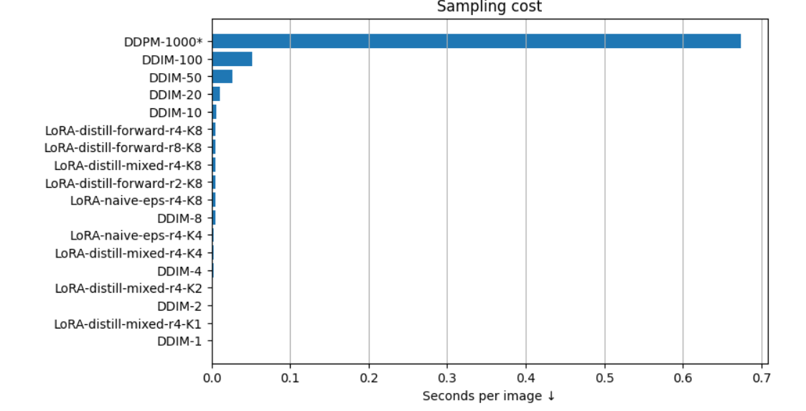
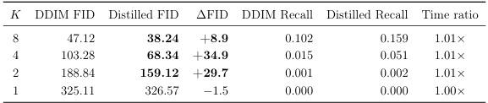
Model Evaluation — LoRA vs. DDIM
Same steps, same noise, same weights — only the LoRA adapter differs.
LoRA obtains at most the same execution time as DDIM at matched steps but with higher quality.
The distilled K=8 model is 10.6× faster than DDIM-100, and K=4 is 18.9× faster but at a fraction of DDIM's quality loss and with no inference overhead.
10 / 14

Slide 11
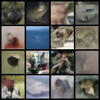
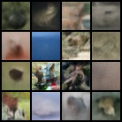
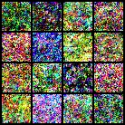
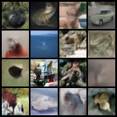
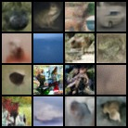
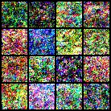
Model Evaluation — LoRA vs. DDIM (matched steps)
DDIM-8
DDIM-4
DDIM-1
LoRA-k8
LoRA-k4
LoRA-k1
11 / 14

Slide 12

Model Evaluation — Ablations
Objective
LoRA rank
State source
Distillation vs naive ε-loss
r = 2 / 4 / 8
forward vs mixed
FID ↓
FID ↓
FID ↓
Naive-eps LoRA
46.16
rank 2
38.32
forward only
38.48
Distilled LoRA
38.24
rank 4
38.48
mixed states
38.24
rank 8
37.67
The gain comes from the trajectory-matching objective, not the extra parameters.
Rank barely matters: even rank 2 captures the benefit → truly parameter-efficient.
Essentially tied: a negative result. We do not rely on trajectory-state mixing. K = 8
K = 1 fails (FID 326): a single denoising step is not enough for this adapter setup. K = 8 and K = 4 are the meaningful models.
12 / 14

Slide 13




Conclusions
We presented a parameter-efficient few-step distillation of a DDPM using LoRA adapters and a trajectory-matching objective, evaluated on CIFAR-10.
10–19× faster
Better few-step FID
than the DDIM-100 baseline, at matched quality
+8.9 for K=8 and +34.9 for K=4 over plain DDIM
Diversity restored
No inference overhead
recall partially recovered (+0.057 for K=8)
adapters merge back; only ~0.1% of weights trained
Limitations: single-step (K=1) sampling is not recovered on this baseline; absolute quality is hardware-limited (FID≈29). Confirming the smaller K=8 gain would need multiple seeds.
13 / 14

Slide 14

References
[1]
J. Ho, A. Jain, P. Abbeel. Denoising Diffusion Probabilistic Models. NeurIPS 2020.
[2]
J. Song, C. Meng, S. Ermon. Denoising Diffusion Implicit Models. ICLR 2021.
[3]
T. Salimans, J. Ho. Progressive Distillation for Fast Sampling of Diffusion Models. ICLR 2022.
[4]
E. Hu, Y. Shen, P. Wallis, et al. LoRA: Low-Rank Adaptation of Large Language Models. 2021.
[5]
T. Kynkäänniemi, T. Karras, S. Laine, J. Lehtinen, T. Aila. Improved Precision and Recall Metric for Assessing Generative Models. NeurIPS 2019.
14 / 14

