Slide 1
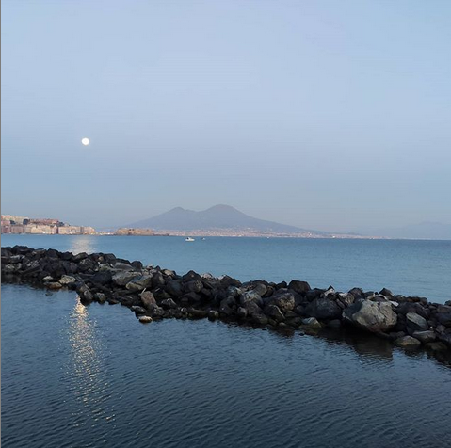

A beautiful city
for a good
investment
Dr. Claudio Calamita – Physicist – Data Scientist

Slide 2
Table of contents
Introduction
Data Requirments
Data Collection and Understanding
Economy of the city
Climate data
Build dataframe
Descriptive analysis
Foursquare data collection
Model Clustering
Best value for kMeans
Model evaluation
Results

Slide 3
Introduction

Slide 4
Data Requirements

Slide 5
Data Collection and Understanding

Slide 6
Model Clustering

Slide 7
Results

Slide 8
Conclusion

