Slide 1
Data Prefetch and Software Pipelining

Slide 2
Agenda
Data Prefetch
Software Pipelining

Slide 3
Why Data Prefetching
Increasing Processor – Memory “distance”
Caches do work !!! … IF …
  Data set cache-able, accesses local (in space/time)
Else ? …

Slide 4
Data Prefetching
What is it ?
  Request for a future data need is initiated
  Useful execution continues during access
  Data moves from slow/far memory to fast/near cache
  Data ready in cache when needed (load/store)

Slide 5
Data Prefetching
When can it be used ?
  Future data needs are (somewhat) predictable
How is it implemented ?
  in hardware: history based prediction of future access
  in software: compiler inserted prefetch instructions

Slide 6
Software Data Prefetching
Compiler scheduled prefetches
Moves entire cache lines (not just datum)
  Spatial locality assumed – often the case
Typically a non-faulting access
  Compiler free to speculate prefetch address
Hardware not obligated to obey
  A performance enhancement, no functional impact
  Loads/store may be preferentially treated

Slide 7
Software Data Prefetching Use
Mostly in Scientific codes
  Vectorizable loops accessing arrays deterministically
    Data access pattern is predictable
    Prefetch scheduling easy (far in time, near in code)
  Large working data sets consumed
    Even large caches unable to capture access locality
Sometimes in Integer codes
  Loops with pointer de-references

Slide 8
Selective Data Prefetch
do j = 1, n
do i = 1, m
A(i,j) = B(1,i) + B(1,i+1)
enddo
enddo
E.g. A(i,j) has spatial locality, therefore only one prefetch is required for every cache line.
j
A
i
B
1
m
1

Slide 9
Formal Definitions
Temporal locality occurs when a given reference reuses exactly the same data location
Spatial locality occurs when a given reference accesses different data locations that fall within the same cache line
Group locality occurs when different references access the same cache line

Slide 10
Prefetch Predicates
If an access has spatial locality, only the first access to the same cache line will incur a miss.
For temporal locality, only the first access will incur a cache miss
If an access has group locality, only the leading reference incurs cache miss.
If an access has no locality, it will miss in every iteration.

Slide 11
Example Code with Prefetches
do j = 1, n
do i = 1, m
A(i,j) = B(1,i) + B(1,i+1)
if (iand(i,7) == 0)
prefetch (A(i+k,j))
if (j == 1)
prefetch (B(1,i+t))
enddo
enddo
j
A
i
B
1
m
1
Assumed CLS = 64 bytes and data size = 8 bytes
k and t are prefetch distance values

Slide 12
Spreading of Prefetches
If there is more than one reference that has spatial locality within the same loop nest, spread these prefetches across the 8-iteration window
Reduces the stress on the memory subsystem by minimizing the number of outstanding prefetches

Slide 13
Example Code with Spreading
j
do j = 1, n
do i = 1, m
C(i,j) = D(i-1,j) + D(i+1,j)
if (iand(i,7) == 0)
prefetch (C(i+k,j))
if (iand(i,7) == 1)
prefetch (D(i+k+1,j))
enddo
enddo
C, D
i
Assumed CLS = 64 bytes and data size = 8 bytes
k is the prefetch distance value

Slide 14
Prefetch Strategy - Conditional
Example loop
  L:
  Load A(I)
  Load B(I)
  ...
  I = I + 1
  Br L, if I<n
Conditional Prefetching
  L:
  Load A(I)
  Load B(I)
  Cmp pA=(I mod 8 == 0)
  if(pA) prefetch A(I+X)
  Cmp pB=(I mod 8 == 1)
  If(pB) prefetch B(I+X)
  ...
  I = I + 1
  Br L, if I<n
Code for condition generation
Prefetches occupy issue slots

Slide 15
Prefetch Strategy - Unroll
Example loop
  L:
  Load A(I)
  Load B(I)
  ...
  I = I + 1
  Br L, if I<n
Unrolled
  Unr_Loop:
  prefetch A(I+X)
  load A(I)
  load B(I)
  ...
  prefetch B(I+X)
  load A(I+1)
  load B(I+1)
  ...
  prefetch C(I+X)
  load A(I+2)
  load B(I+2)
  ...
  prefetch D(I+X)
  load A(I+3)
  load B(I+3)
  ...
  prefetch E(I+X)
  load A(I+4)
  load B(I+4)
  ...
  load A(I+5)
  load B(I+5)
  ...
  load A(I+6)
  load B(I+6)
  ...
  load A(I+7)
  load B(I+7)
  ...
  I = I + 8
  Br Unr_Loop, if I<n
Code bloat (>8X)
Remainder loop

Slide 16
Software Data Prefetching Cost
Requires memory instruction resources
  A prefetch instruction for each access stream
Issues every iteration, but needed less often
  If branched around, inefficient execution results
  If conditionally executed, more instruction overhead results
  If loop is unrolled, code bloat results

Slide 17
Software Data Prefetching Cost
Redundant prefetches get in the way
  Resources consumed until prefetches discarded!
Non redundant need careful scheduling
  Resources overwhelmed when many issued & miss

Slide 18
Desirable Characteristics
Uses minimal instruction resources
  One prefetch instruction for multiple streams
Minimizes redundant prefetches
  No code bloat, no prefetch branches
Issues prefetches spaced in time
  Machine resources utilized evenly
Solution: rotating register prefetch if there is HW support.

Slide 19
Rotating Registers
Register rotation provides an automatic renaming mechanism.
Instructions contain a “virtual” register number
32 33 34 35 36 37 38 39
Iteration 1
r32r33r34r35r36r37r38r39
Iteration 2
r33r34r35r36r37r38r39r32
Iteration 3
r34r35r36r37r38r39r32r33

Slide 20
Rotating Reg Prefetch Illustrated
Example loop
  Orig_loop:
  Load A(I)
  Load B(I)
  Load C(I)
  Load D(I)
  Load E(I)
  ...
  I = I + 1
  Br Orig_loop, if I<n
Rotating Register Prefetching
  r33 = address of E(1+X)
  r34 = address of D(1+X)
  r35 = address of C(1+X)
  r36 = address of B(1+X)
  r37 = address of A(1+X)
  Method1Loop:
  prefetch [r37]
  r32 = r37 + INCR
  . . .
  load A(I)
  load B(I)
  load C(I)
  load D(I)
  load E(I)
  . . .
  I = I + 1
  Br Method1Loop, if I<n
Single prefetch inst
No loop unrolling
At most 1 miss/iter

Slide 21
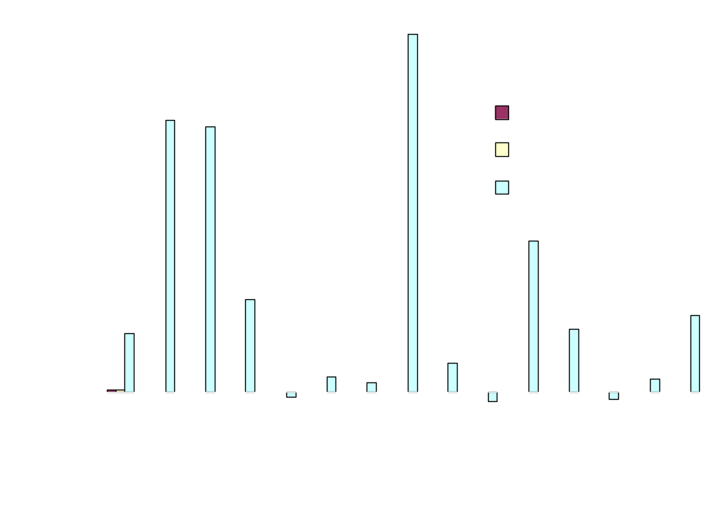
Measurements – SPECfp2000

Slide 22
Agenda
Data Prefetch
Software Pipelining

Slide 23
Software Pipelining
Obtain parallelism by executing iterations of a loop in an overlapping way.
We’ll focus on simplest case: the do-all loop, where iterations are independent.
Goal: Initiate iterations as frequently as possible.
Limitation: Use same schedule and delay for each iteration.

Slide 24
Machine Model
Timing parameters: LD = 2, others = 1 clock.
Machine can execute one LD or ST and one arithmetic operation (including branch) at any one clock.
  I.e., we’re back to one ALU resource and one MEM resource.

Slide 25
Example
for (i=0; i<N; i++)
B[i] = A[i];
r9 holds 4N; r8 holds 4*i.
L: LD r1, a(r8)
nop
ST b(r8), r1
ADD r8, r8, #4
BLT r8, r9, L
Notice: data dependences
force this schedule. No
parallelism is possible.

Slide 26
Let’s Run 2 Iterations in Parallel
Focus on operations; worry about registers later.
LD
nop LD
ST nop
ADD ST
BLT ADD
BLT
Oops --- violates
ALU resource
constraint.

Slide 27
Introduce a NOP
LD
nop LD
ST nop
ADD ST
nop ADD
BLT nop
BLT
LD
nop
ST
ADD
nop
BLT
Add a third iteration.
Several resource
conflicts arise.

Slide 28
Is It Possible to Have an Iteration Start at Every Clock?
Hint: No.
Why?
An iteration injects 2 MEM and 2 ALU resource requirements.
  If injected every clock, the machine cannot possibly satisfy all requests.
Minimum delay = 2.

Slide 29
A Schedule With Delay 2
LD
nop
nop
ST
ADD
BLT
Initialization
LD
nop
nop
ST
ADD
BLT
LD
nop
nop
ST
ADD
BLT
Identical iterations
of the loop
LD
nop
nop
ST
ADD
BLT
Coda

Slide 30
Assigning Registers
We don’t need an infinite number of registers.
We can reuse registers for iterations that do not overlap in time.
But we can’t just use the same old registers for every iteration.

Slide 31
Assigning Registers --- (2)
The inner loop may have to involve more than one copy of the smallest repeating pattern.
  Enough so that registers may be reused at each iteration of the expanded inner loop.
Our example: 3 iterations coexist, so we need 3 sets of registers and 3 copies of the pattern.

Slide 32
Example: Assigning Registers
Our original loop used registers:
  r9 to hold a constant 4N.
  r8 to count iterations and index the arrays.
  r1 to copy a[i] into b[i].
The expanded loop needs:
  r9 holds 12N.
  r6, r7, r8 to count iterations and index.
  r1, r2, r3 to copy certain array elements.

Slide 33
The Loop Body
Each register handles every
third element of the arrays.
To break the loop early
Iteration i
Iteration i + 1
Iteration i + 2
L: ADD r8,r8,#12 nop LD r3,a(r6)
BGE r8,r9,L’ ST b(r7),r2 nop
LD r1,a(r8) ADD r7,r7,#12 nop
nop BGE r7,r9,L’’ ST b(r6),r3
nop LD r2,a(r7) ADD r6,r6,#12
ST b(r8),r1 nop BLT r6,r9,L
Iteration i + 3
Iteration i + 4
L’ and L’’ are places for appropriate codas.

Slide 34
Cyclic Data-Dependence Graphs
We assumed that data at an iteration depends only on data computed at the same iteration.
  Not even true for our example.
    r8 computed from its previous iteration.
    But it doesn’t matter in this example.
Fixup: edge labels have two components: (iteration change, delay).

Slide 35
Example: Cyclic D-D Graph
(A)
LD r1,a(r8)
<1,1>
<0,2>
(A) must wait at
least one clock
after the (C) from
the previous
iteration.
(B)
ST b(r8),r1
<0,1>
(C) must wait at
least one clock
after the (B) from
the same iteration.
(C)
ADD r8,r8,#4
<0,1>
(D)
BLT r8,r9,L

Slide 36
Matrix of Delays
Let T be the delay between the start times of one iteration and the next.
Replace edge label <i,j> by delay j-iT.
Compute, for each pair of nodes n and m the total delay along the longest acyclic path from n to m.
Gives upper and lower bounds relating the times to schedule n and m.

Slide 37
Example: Delay Matrix
A
B
C
D
A
B
C
D
A
2
A
2
3
4
B
1
B
2-T
1
2
C
1-T
1
C
1-T
3-T
1
D
D
Edges
Acyclic Transitive Closure
Note: Implies T ≥ 4 (because only
one register used for loop-counting).
If T=4, then A (LD) must be 2 clocks
before B (ST). If T=5, A can be 2-3
clocks before B.
S(B) ≥ S(A)+2
S(A) ≥ S(B)+2-T
S(B)-2 ≥ S(A) ≥ S(B)+2-T

Slide 38
Iterative Modulo Scheduling
Compute the lower bounds (MII) on the delay between the start times of one iteration and the next (initiation interval, aka II)
  due to resources
  due to recurrences
Try to find a schedule for II = MII
If no schedule can be found, try a larger II.

Slide 39
Summary
References for compiler data prefetch:
  Todd Mowry, Monica Lam, Anoop Gupta, “Design and evaluation of a compiler algorithm for prefetching”, in ASPLOS’92, http://citeseer.ist.psu.edu/mowry92design.html.
  Gautam Doshi, Rakesh Krishnaiyer, Kalyan Muthukumar, “Optimizing Software Data Prefetches with Rotating Registers”, in PACT’01, http://citeseer.ist.psu.edu/670603.html.

