Slide 1

From Photo to Payout: A Gemini-Native Multi-Agent System for Real-Time Auto Claims
Claudio Giorgio Giancaterino
10/10/2026

Slide 2
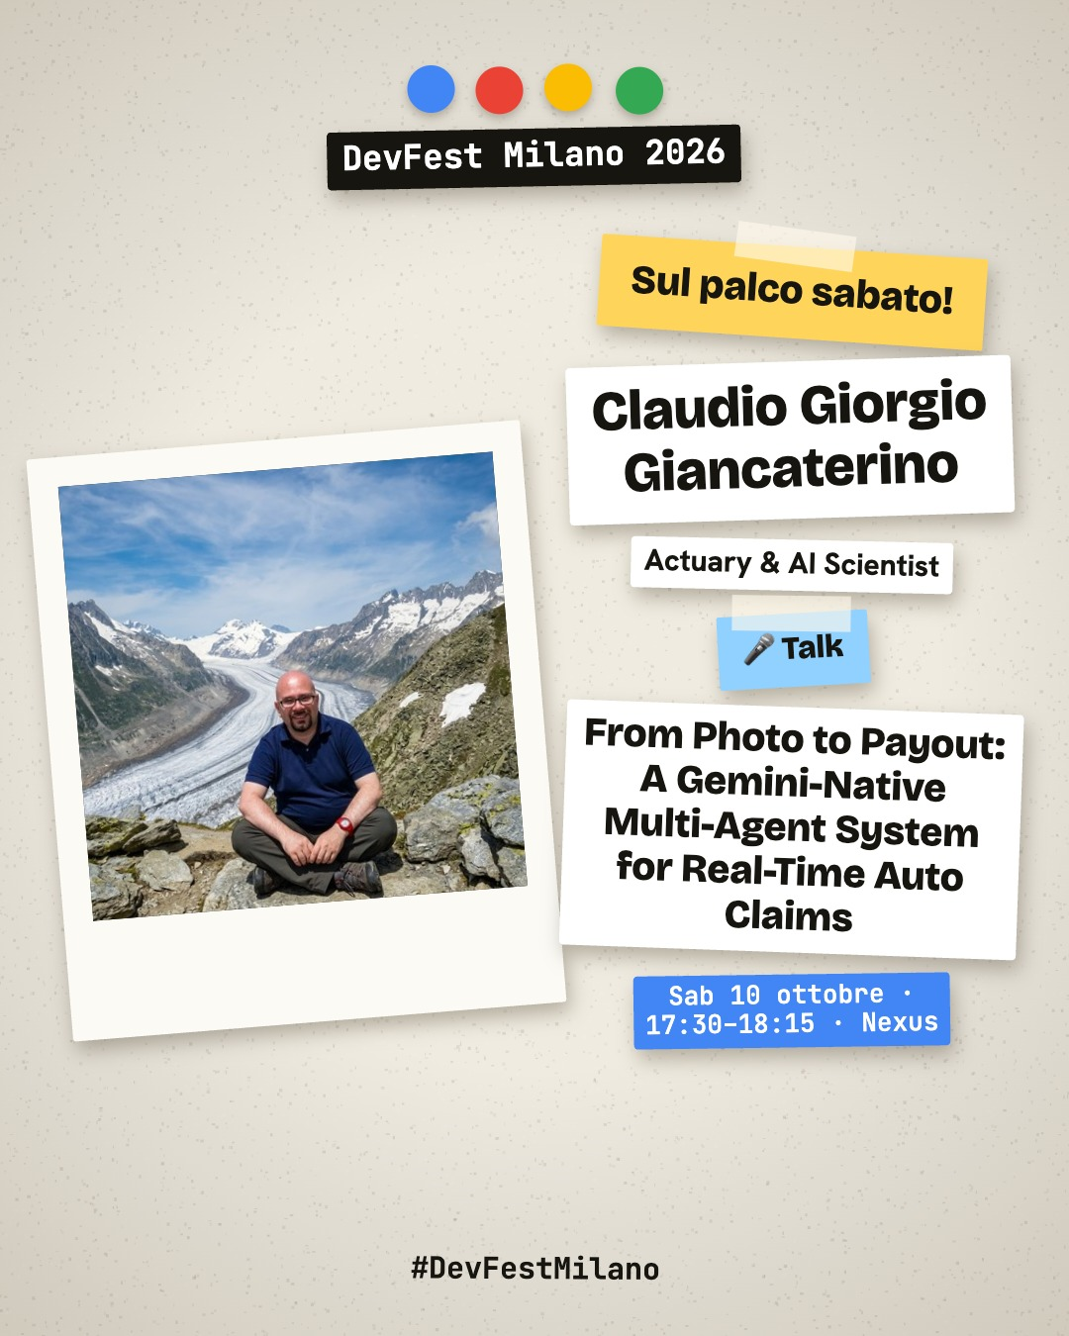
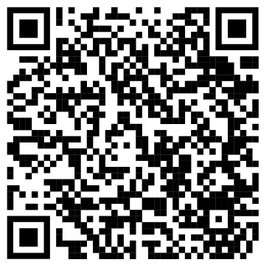
MySelf:
Actuary during the day &
AI Scientist in the free time
Reach Me:
MyLinks

Slide 3

Agenda
Motivations
Use case
introduction
From Transformers to Vision Transformers
Agentic AI
A Multi-Agent System from Scratch for the Car Damage Evaluation
Comparison & Challenges
Conclusions

Slide 4
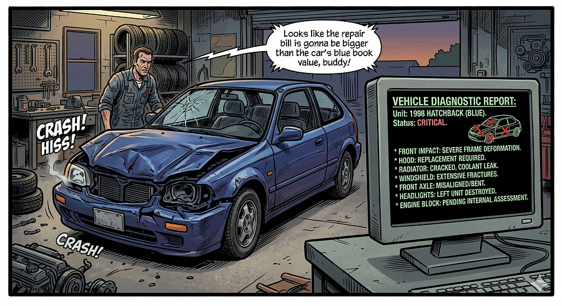
Motivations
Improve the old idea of a car damage classifier
Employ a Multi-Agent System
Google Nano Banana

Slide 5
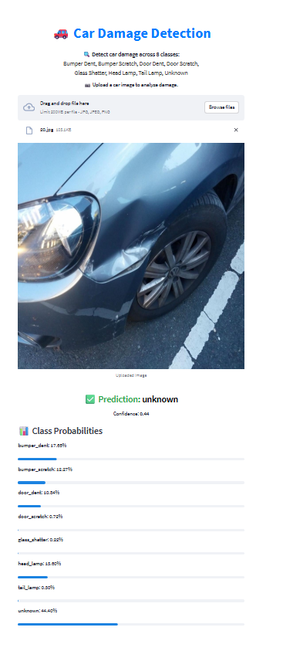
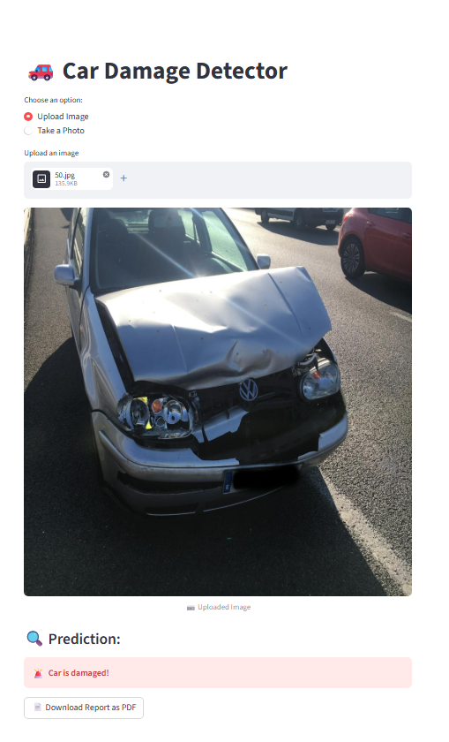
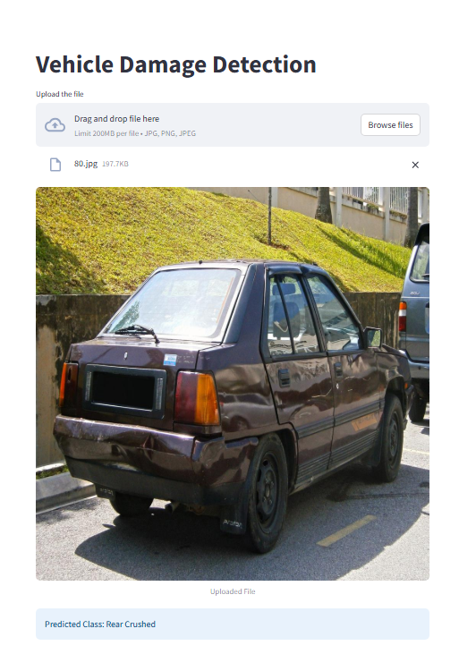
The State of the Art around 2020
https://cardamagedetector.streamlit.app
https://moksh-dl-car-damage-detection.streamlit.app
https://car-damage-detect.streamlit.app

Slide 6
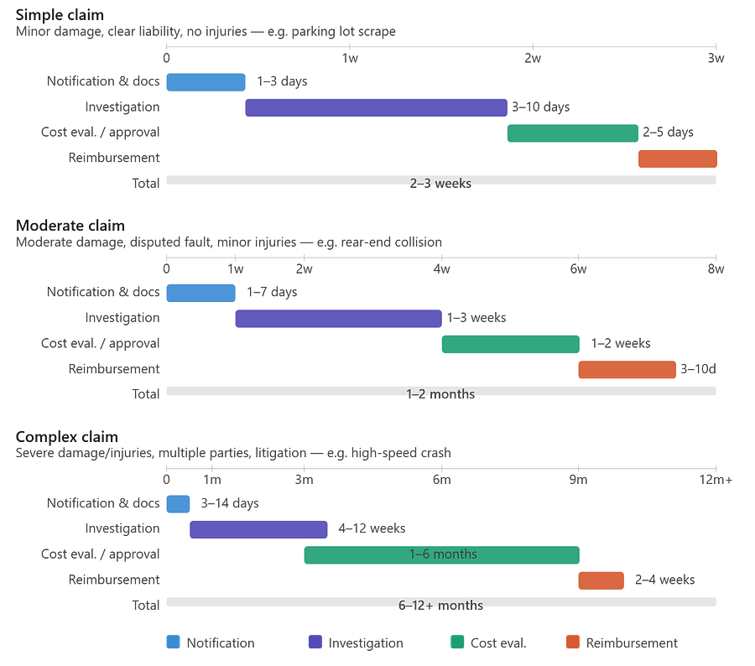
Typical timeline of claims processing for a car accident
-Reference 1
-Reference 2
-Reference 3

Slide 7
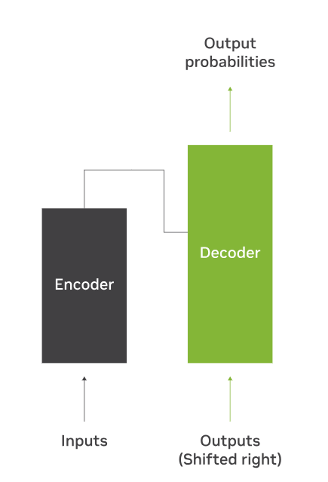
The Revolution coming from Transformers
The Transformer is a neural network architecture that uses self-attention mechanisms to process entire sequences of data simultaneously, enabling highly parallelizable and scalable training for tasks like language modeling and translation.
🔹 Encoder-Only (Understanding)
Example: BERT
Use case: classification, sentence similarity
🔹 Decoder-Only (Generation)
Example: GPT
Use case: text generation
🔹 Encoder–Decoder (Seq2Seq)
Example: T5
Use case: translation, summarization
www.nvidia.com/en-eu/glossary/large-language-models/

Slide 8
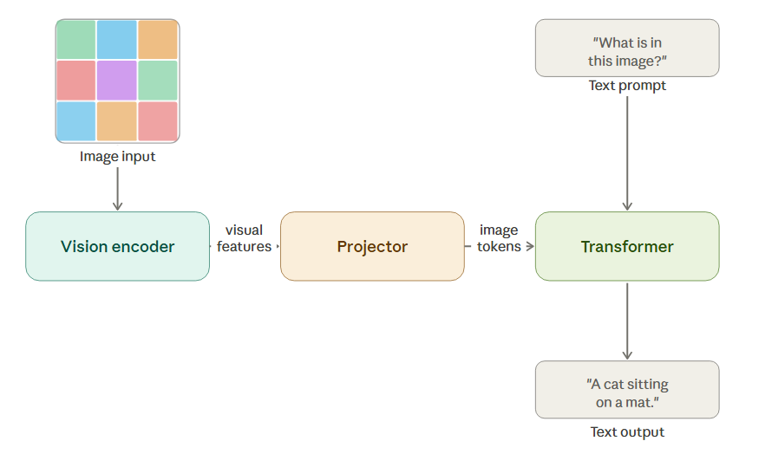
The Revolution coming from Transformers
A Vision-Language Model (VLM) combines a Vision Encoder with a Transformer LLM, bridging image understanding and language generation to enable multimodal reasoning across text and images.
🔹 Encoder-Only (Understanding)
Example: CLIP
Use case: image-text retrieval, zero-shot classification
🔹 Decoder-Only (Generation)
Example: Gemini
Use case: image captioning, Visual Q&A
🔹 Encoder–Decoder (Seq2Seq)
Example: Flamingo, PaLI
Use case: OCR, document understanding, translation
claude.ai

Slide 9
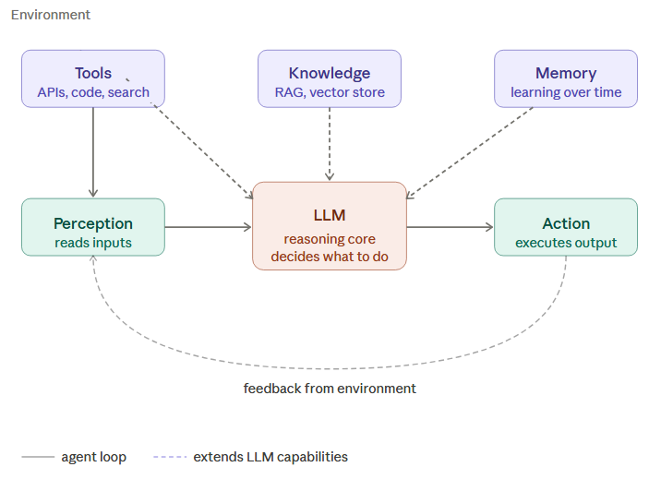
From seeing to acting
A new era in which AI systems not only understand language but also reason, plan, and interact with their environment to perform complex tasks.
claude.ai

Slide 10
Reasoning
Collaborating
Why AI Agents?
-> Autonomously Perform Tasks
-> Adapt and Learn
-> Increase Productivity and Efficiency
-> Enable Personalisation and Scalability
Acting
Observing
Self-Refining
Planning

Slide 11
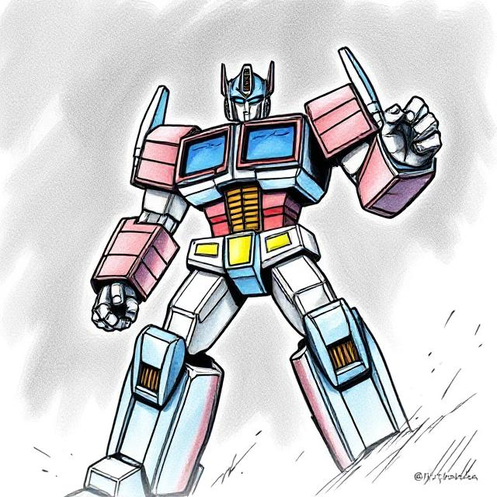
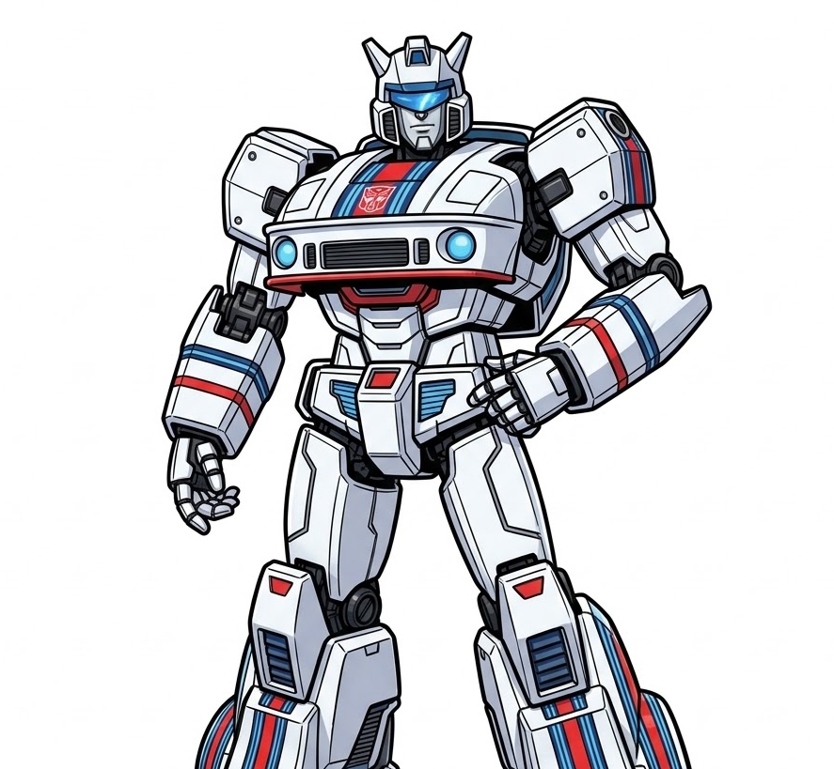
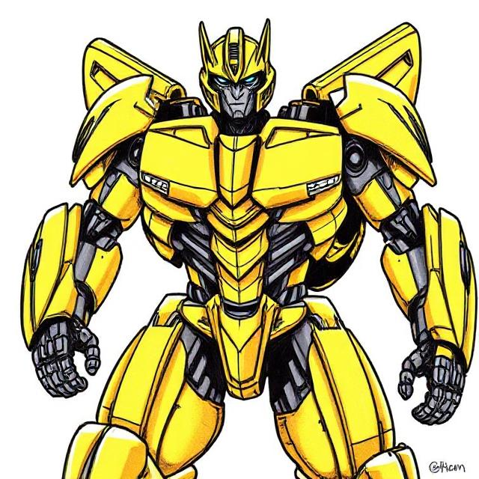
AI Agents Architecture
Multi-Agent System (MAS): Multiple agents work together, enabling parallel processing and specialisation. More scalable and robust, but introduces coordination challenges
Single-Agent: One AI agent handles all tasks.
Simple to design and maintain, but less scalable
for complex tasks.
https://deepai.org/machine-learning-model/text2img

Slide 12
Tech Stack
From Python & Streamlit to TypeScript & React
Google AI Studio
Gemini
Google Cloud

Slide 13
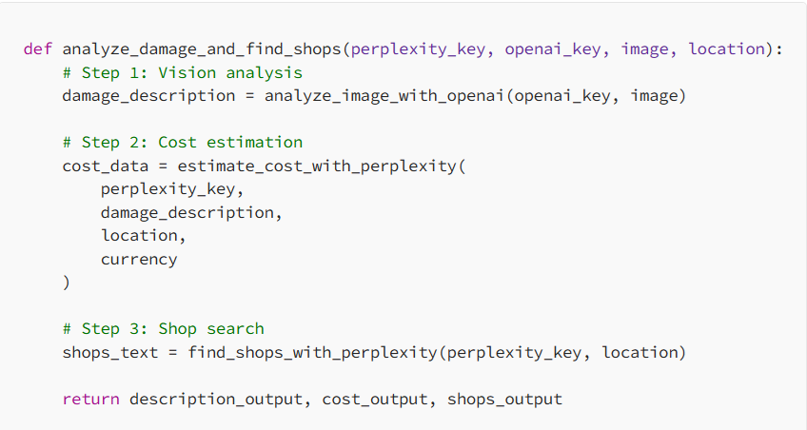
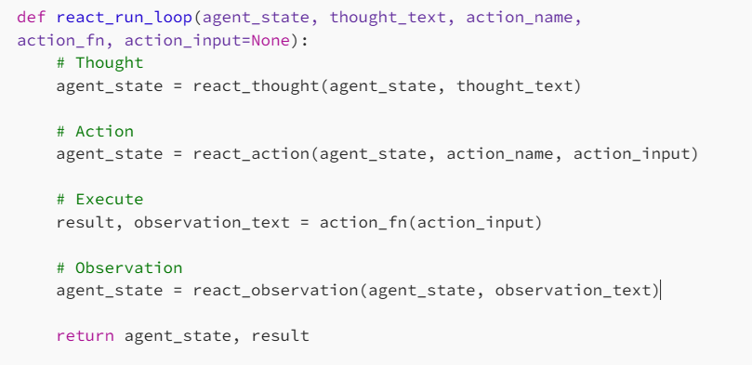
A Multi-Agent System from Scratch for the Car Damage Evaluation
At the end, a Multi-Agent System with a ReAct loop is achieved
At the beginning, the project started with a simple APIs pipeline

Slide 14
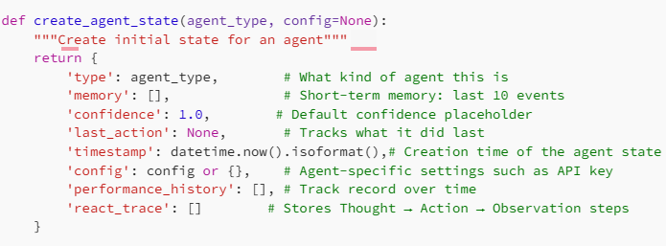
A Multi-Agent System from Scratch for the Car Damage Evaluation
Each agent is stateful, explainable, and self-tracking, enabling autonomous and auditable decision-making.

Slide 15
A Multi-Agent System from Scratch for the Car Damage Evaluation
Input
Results
Orchestrator Agent
Photo Quality Agent
Vision Agent
Cost Primary Agent
Cost Alternative Agent
Shop Finder Agent
Aggregator
Output
Each agent runs ReAct loop
Execution plan: each agent runs sequentially with priority

Slide 16
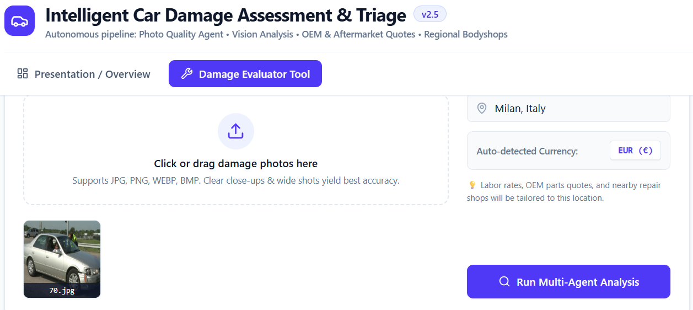
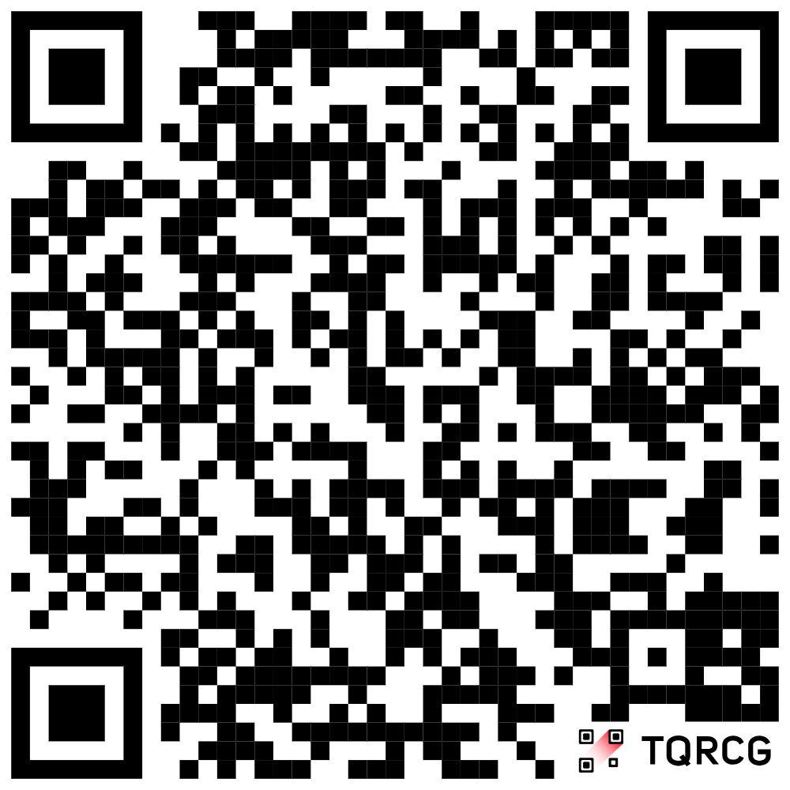
A Multi-Agent System from Scratch for the Car Damage Evaluation
Input data
Go to the App

Slide 17
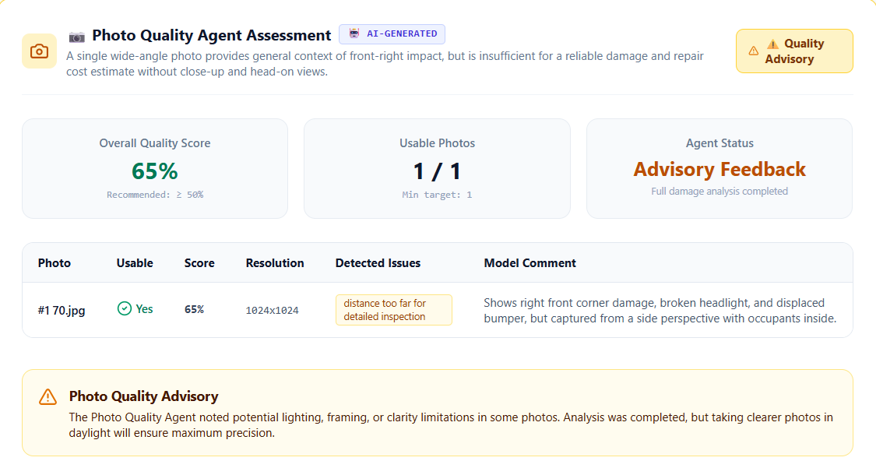
A Multi-Agent System from Scratch for the Car Damage Evaluation
Photo Quality Agent

Slide 18
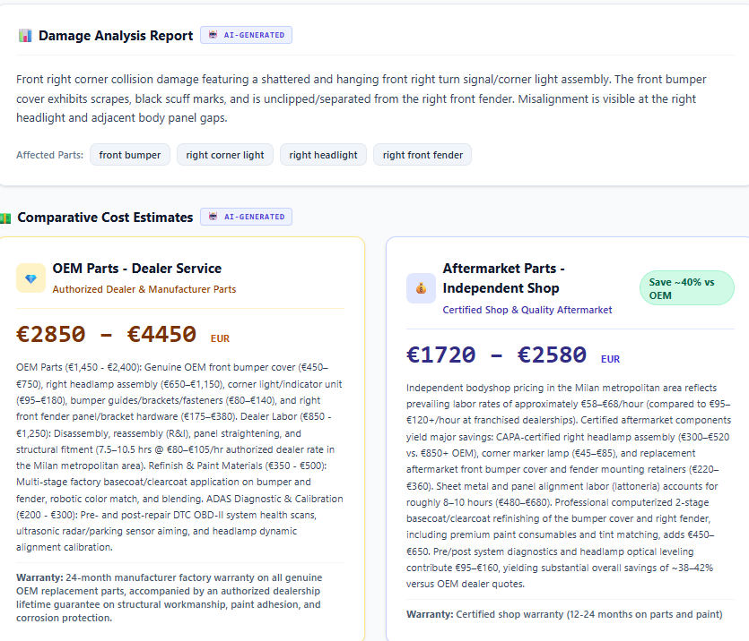
A Multi-Agent System from Scratch for the Car Damage Evaluation
Damage Analysis from Vision Agent
Cost estimation from Cost Agents

Slide 19
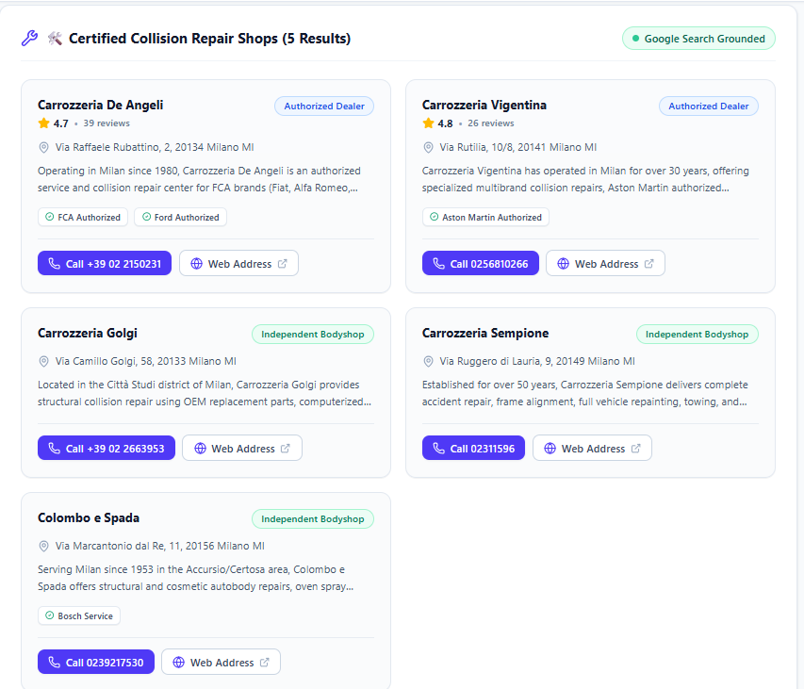
A Multi-Agent System from Scratch for the Car Damage Evaluation
Repair shops from Shop Finder Agent

Slide 20
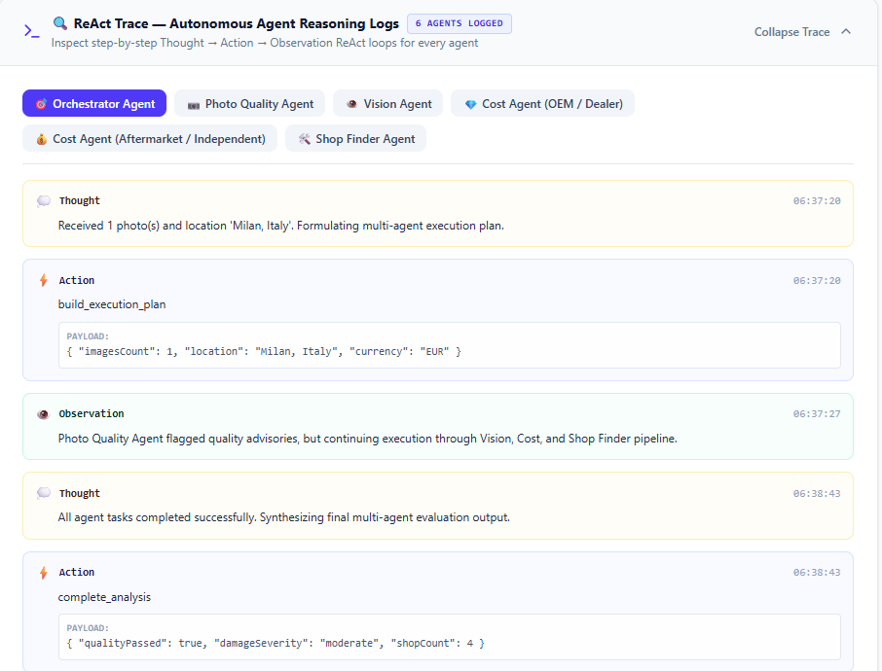
A Multi-Agent System from Scratch for the Car Damage Evaluation
ReAct log from the Orchestrator

Slide 21
Dimension | Computer Vision Deep Learning (CNN) | Multi-Agent System (MAS)
Generalization | Limited to inputs similar to training data | Reasons about unseen damage patterns: produces novel, context-aware descriptions
Objective | Answer one question at a time | End-to-end assessment: in a single run photo quality, damage, severity, cost, and repair locations
Adaptability | Static: requires manual updates or model retraining to reflect market changes | Dynamic: retrieves live market data at query-time via search-powered agents
Explainability | Black - Box Classification: produces an output without justification or logic path | Transparent at agent layer: explanation with ReAct trace; black-box on underlying VLM/LLM
Modularity | Monolithic Scripts: the entire pipeline often needs retraining if one part changes | Swappable modules: allows for hybrid mix of GenAI and deterministic/proprietary tools
What about a comparison between
Multi-Agent System and Traditional Tools?

Slide 22
Risk Category | Constraint Detail | Mitigation/Requirement
Financial Accuracy | Estimates provided are approximations and AI generated ranges | Must be verified by a qualified professional before settlement
Regulatory Compliance | ReAct traces provide auditability but do not equal legal compliance | Requires human oversight and documentation (EU AI Act Alignment)
Uncalibrated Confidence | Vision confidence is a value self-reported by the model in its JSON output, not a measured probability | Calibrate against labelled claims before using it as a decision threshold
Output Variability | Same photos can return different severity and cost ranges (sampling + live search results) | Repeat runs and report a range; log model and app version, case inputs and grounding sources
Technical Constraints & Risk Management

Slide 23
Conclusions
What I’ve learned
✅Building a Multi-Agent System from scratch is possible without using a strict framework.
✅ A Multi-Agent System gives the opportunity to simplify complex dynamics in a valuable automation process for insurance claims.
✅With a Multi-Agent System, you can employ the same model with different roles and tools.

Slide 24
References
Web app
GitHub Repository
Car Damage Dataset
From Pixel to Payouts: A Multi-Agent System for Real-Time Insurance Claims Processing
Step-by-Step Guide to Car Insurance Claim Timelines
How Long Does It Take For Insurance To Investigate A Car Accident?
How Long Does A Road Traffic Accident Claim Take?
Jay Alammar, The Illustrated Transformer
Transformer, Google Research, 2017
Large Language Models, NVIDIA
Ashish Vaswani, Noam Shazeer, Niki Parmar, Jakob Uszkoreit, Llion Jones, Aidan N. Gomez, Lukasz Kaiser, Illia Polosukhin, Attention is All You Need, Arxiv, 2017
Tianyang Lin, Yuxin Wang, Xiangyang Liu, Xipeng Qiu, A Survey of Transformers, Arxiv, 2021
Shervin Minaee, Tomas Mikolov, Narjes Nikzad, Meysam Chenaghlu, Richard Socher, Xavier Amatriain, Jianfeng Gao, Large Language Models: A Survey, Arxiv, 2024
Vision Language Models, NVIDIA
Yang Liu, Yao Zhang, Yixin Wang, Feng Hou, Jin Yuan, Jiang Tian, Yang Zhang, Zhongchao Shi, Jianping Fan, Zhiqiang He, A Survey of Visual Transformers, Arxiv, 2021

Slide 25
References
Clayton Fields, Casey Kennington, Vision Language Transformers: A Survey, Arxiv, 2023
Autonomous AI Agents, NVIDIA
Stuart J. Russell, Peter Norvig, “Artificial Intelligence: A Modern Approach”, Pearson, 2020
A practical guide to building agents, OpenAI
Jungjun Hur, Younghee Song, Build an AI Agent (From Scratch), Manning, 2026
Shunyu Yao, Jeffrey Zhao, Dian Yu, Nan Du, Izhak Shafran, Karthik Narasimhan, Yuan Cao, ReAct: Synergizing Reasoning and Acting in Language Models, Arxiv, 2023
Vipra Singh, AI Agents, Medium, 2025
McKinsey & Company. The Future of AI for the Insurance Industry. July 2025. Available at: mckinsey.com/industries/financial-services/our-insights/the-future-of-ai-in-the-insurance-industry
Generative-AI-in-Insurance-A-Game-Changer

Slide 26
?
?
?
?
Thank you
?
?
?
Keep in touch:
Linkedin
Newsletter
Medium
Website

