Slide 1


Boost Climate Risk Modelling with Large Language Models Data Augmentation
Insurance Data Science Conference, Stockholm
17th June, 2024
Claudio G. Giancaterino

Slide 2
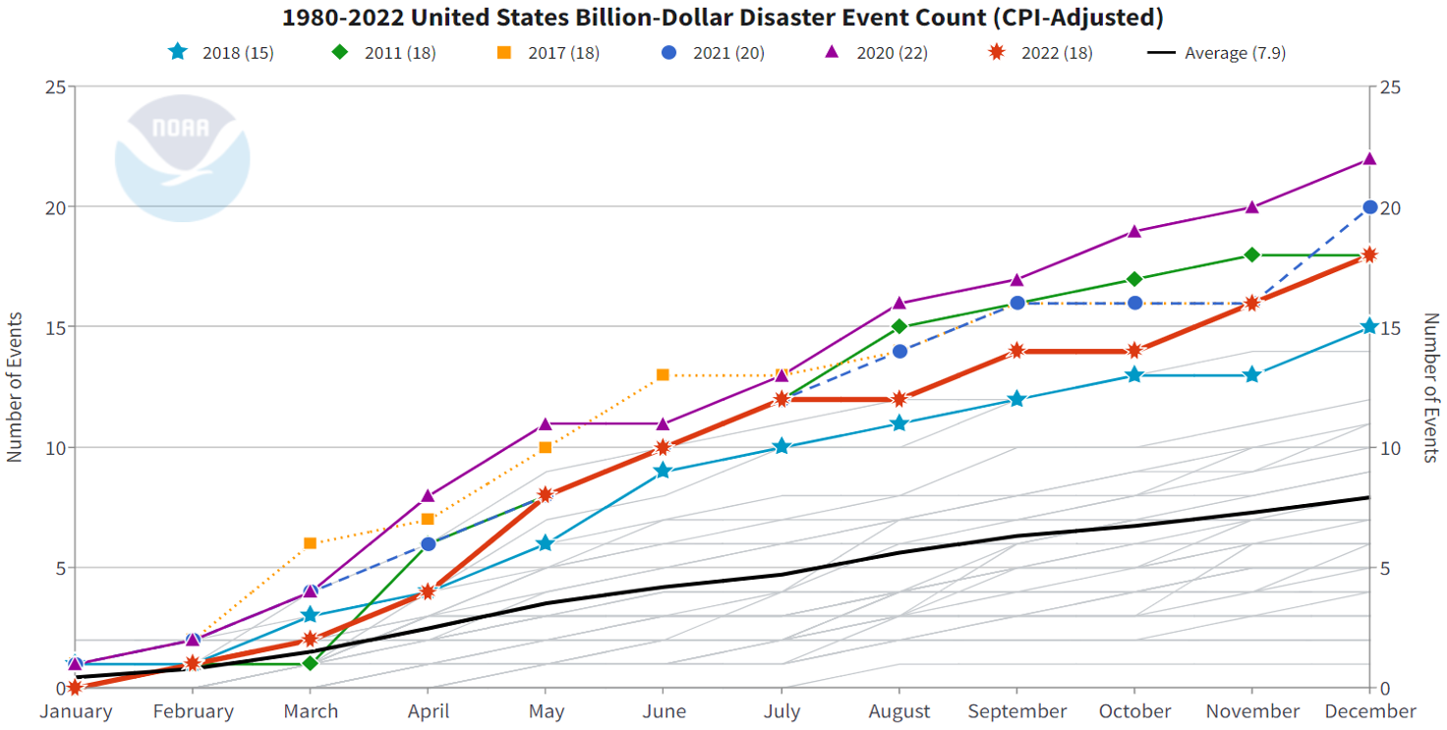
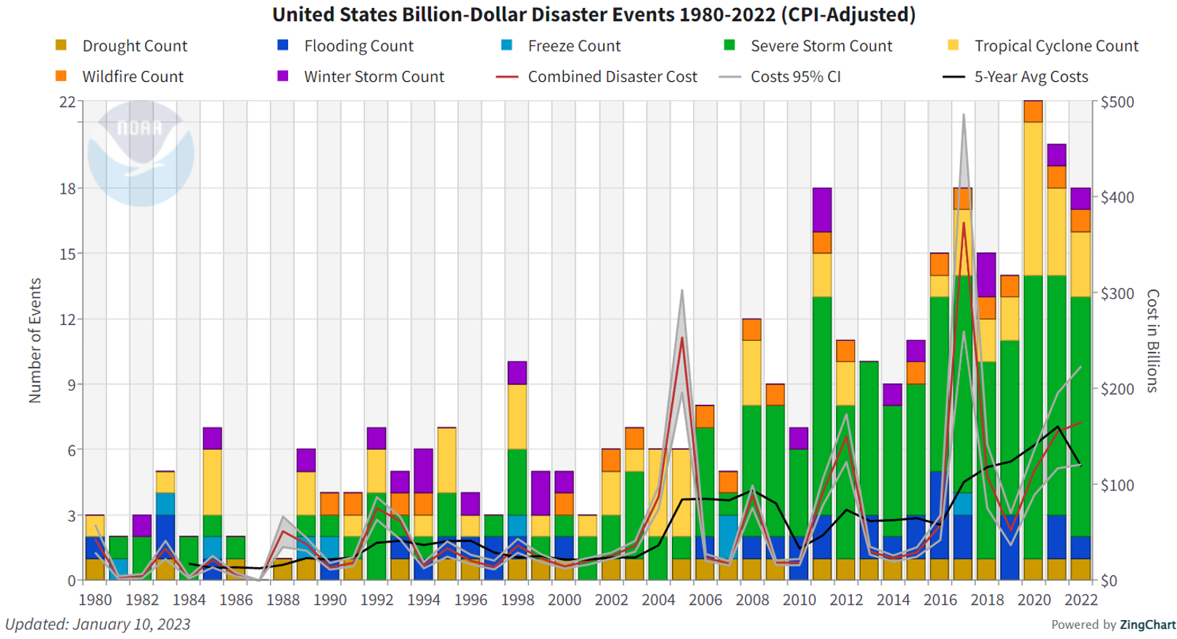
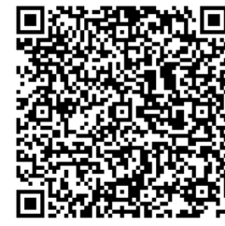
Climate Change
In 2023, the NOAA National Centers for Environmental Information (NCEI) released the 2022 U.S. weather and climate disasters report. Since 1980, the U.S. has experienced 341 weather and climate disasters where overall damages/costs reached or exceeded $1 billion, with a cumulative cost exceeding $2.475 trillion. Mitigating future risks requires addressing the compounding hazards driven by our changing climate.
https://www.climate.gov/news-features/blogs/beyond-data/2022-us-billion-dollar-weather-and-climate-disasters-historical

Slide 3


Data Flow Chart
Data Cleaning
Data Augmentation with Gen AI
Feature Engineering
Data Collection
ExploratoryData Analysis
Pre-Processing
Risk Modelling
Single-Step
Forecasting
Multi-Step
Forecasting

Slide 4
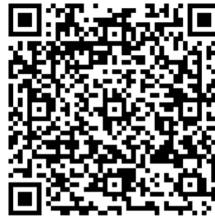
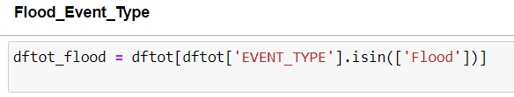
Data Collection & Data Cleaning
Data have been collected from the open source NCDC Storm Events Database.
Storm Data is provided by the National Weather Service (NWS) and contain statistics on personal injuries and damage estimates.
Storm Data covers the United States of America. The data collected began as early as 1950 through to the 2022.
The data contain a chronological listing, by state, of hurricanes, tornadoes, thunderstorms, hail, floods, drought conditions, lightning, high winds,
snow, temperature extremes and other weather phenomena.
From the website has been downloaded dataset for each year and then merged into one big dataset.
The data collected contains 51 columns included 2 text columns, and 1.794.914 rows.
The job has been done on “flood” event type, so firstly the database was realized selecting rows with the interested event type, then removing all missing values, and redundant columns or not related to the topic.
Last step involved the monetary conversion from string to numbers for the damage columns.
The final shape of the dataset: 31 columns x 38.398 records.
NCDC Storm Events Database (noaa.gov)

Slide 5
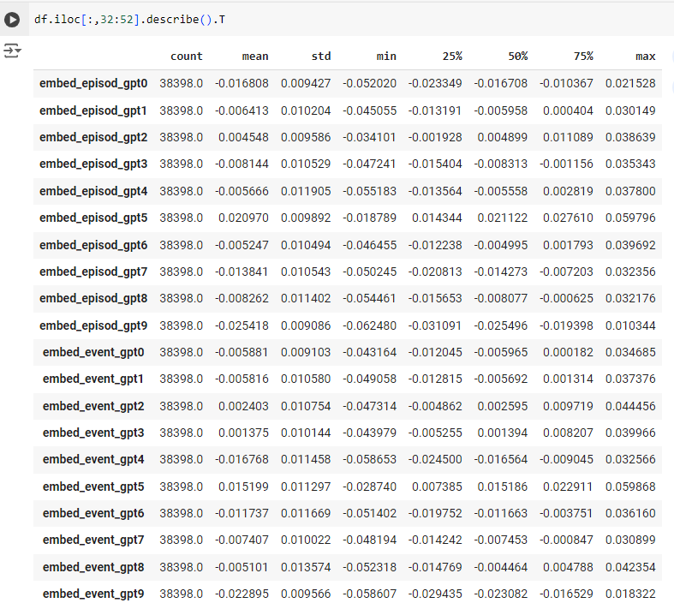
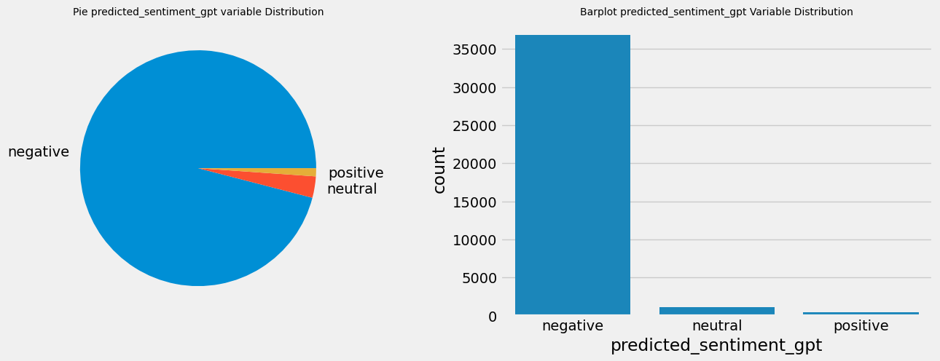
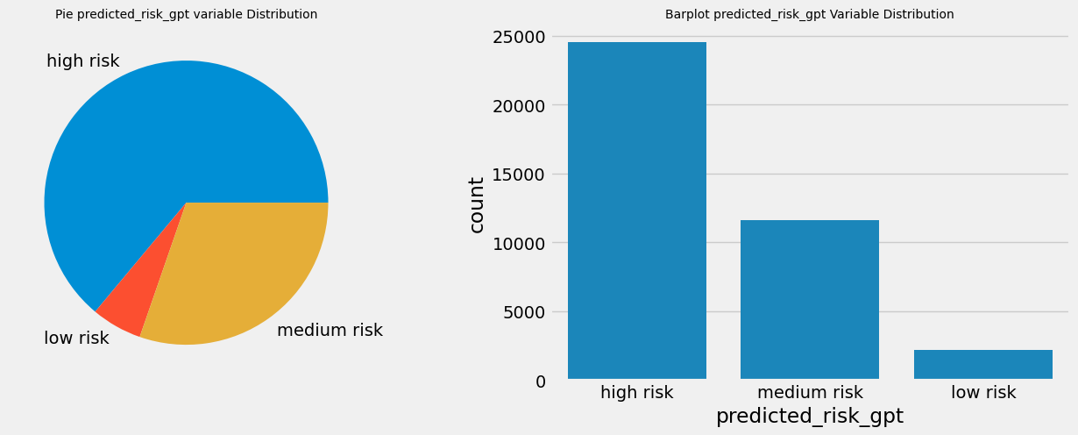
Data Augmentation with Gen AI
Scikit-LLM is a Python library that incorporates large language models into the scikit-learn framework.
It’s a tool to perform Natural Language Processing (NLP) tasks all within the Scikit-Learn pipeline.
It started integrating OpenAI models.
In this role, GPT-3.5 turbo (ChatGPT engine) has been used for data augmentation by constructing features using zero-shot text classification and text vectorization.

Slide 6
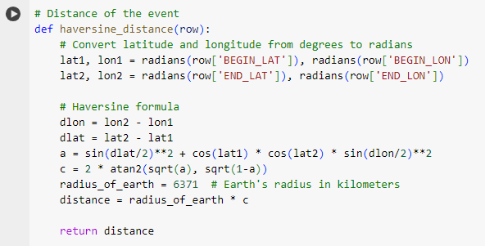
Feature Engineering
In this process, new features were created by extracting the year, month, day, and time from the beginning and end of each event.
The difference between dates was extrapolated in days and hours, origin and destination names were merged, categorical features were encoded, grouping less relevant classes. New target variables and the distance between the starting and ending points of the event were calculated using the haversine distance.
Target Variables
Injuries Direct
Deaths Direct
Damage Property
Injuries Indirect
Deaths Indirect
Damage Crops
New Target Variables
Injuries Direct
Deaths Direct
Damage Property
Whole Injuries
Whole Deaths
Whole Damage

Slide 7
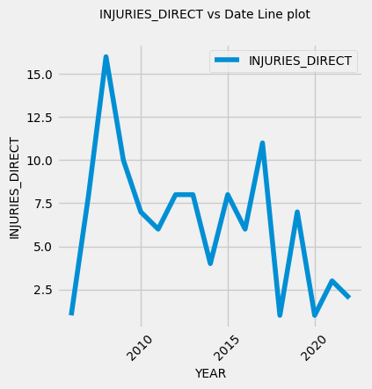
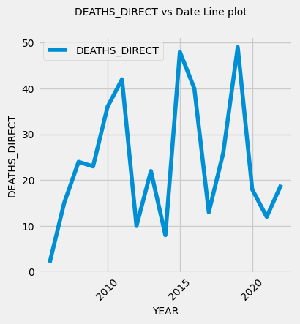
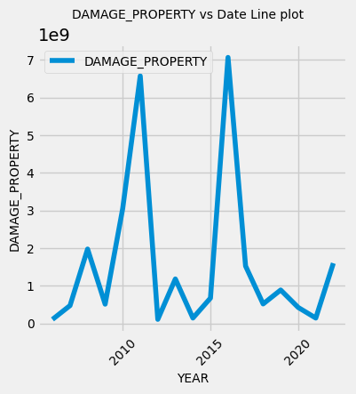
Exploratory Data Analysis
After data cleaning and data augmentation, the dataset reached the following shape:
53 columns and 38398 rows. The observations span from 2006 to 2022.
-The Injuries Direct target variable shows a peak of injuries in 2006, followed by a decreasing number in the subsequent years with a second peak in 2017. California had the highest number of injuries registered.
-The Deaths Direct target variable shows fluctuating behaviour, with peaks in mortality observed in 2011, 2015, and 2019. Kentucky, Missouri, and North Carolina had the highest number of deaths observed.
-The Damage Property target variable indicates two peaks of disasters in 2011 and 2016, with Lousiana having the highest level of damage.

Slide 8
Pre-Processing
Removed outliers and large damage
Removed zero variance predictors and correlated predictors
Features scaling for linear models and neural networks

Slide 9
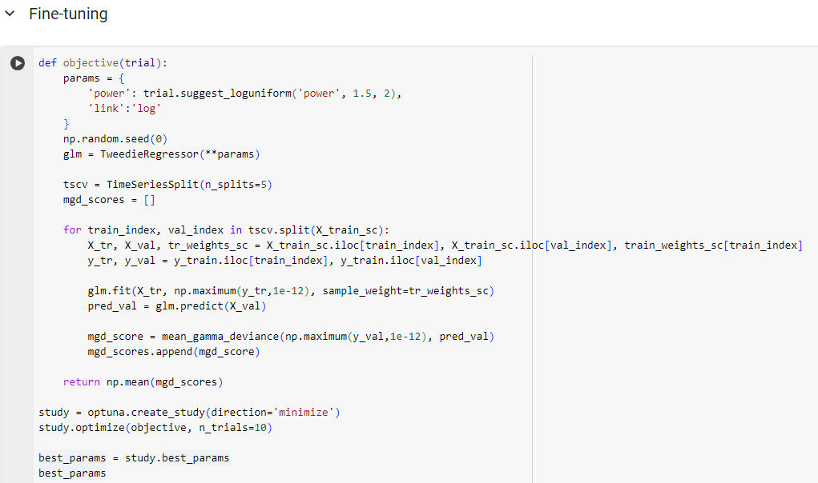
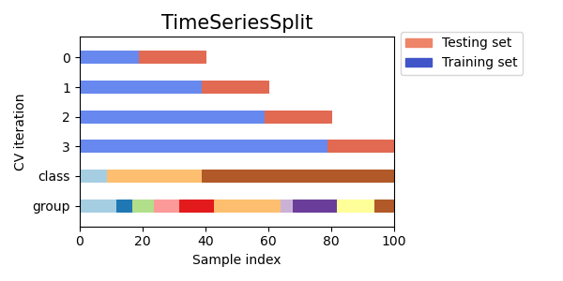
Risk Modelling
Naive Forecasting as benchmark
Generalized Linear Models (GLM) using Tweedie distribution
Gradient Boosting Machine by LightGBM
Feed-Forward Deep Networks with 3 hidden layers
To fine-tuning models have been employed a time series cross validation with optuna, an automatic hyperparameter optimization software framework, which uses bayesian optimization.

Slide 10
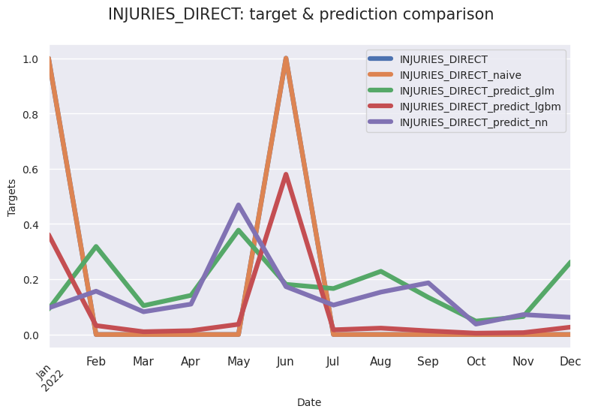
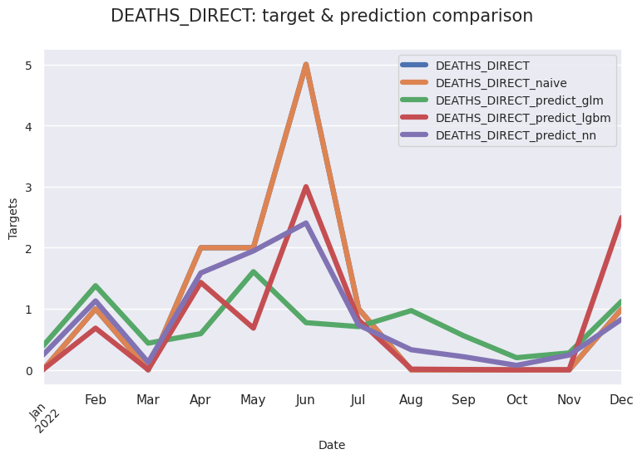
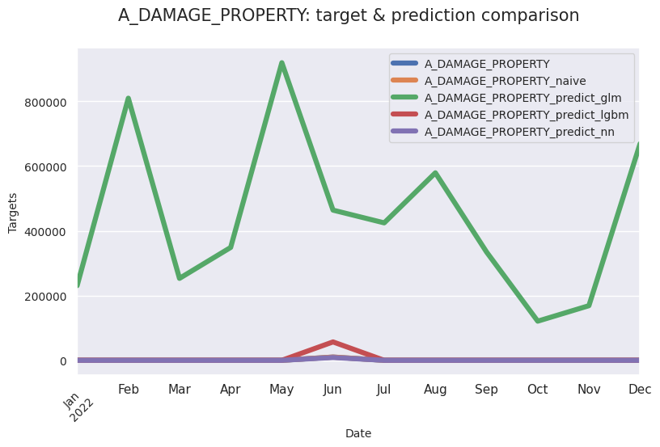
Single-Step Forecasting (Predictions)
Injuries Direct
Train:
2006-2021
Test:
2022
Deaths Direct
A Damage Property
LightGBM is able to generalize well observations for the all outcomes.

Slide 11
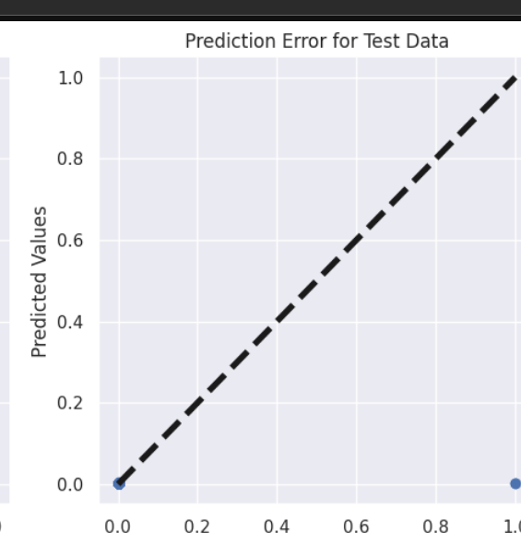
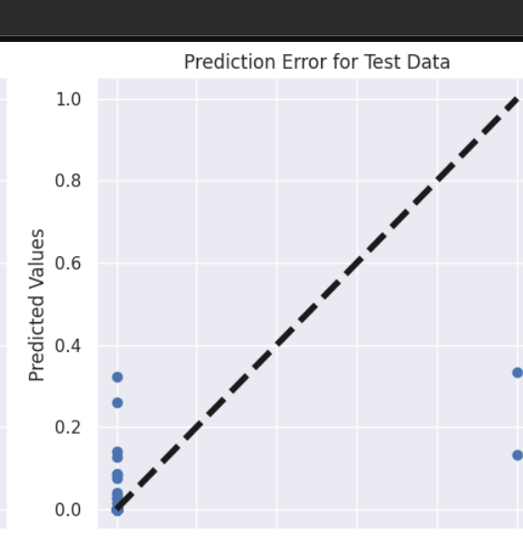
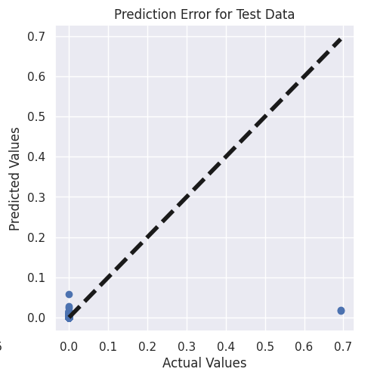
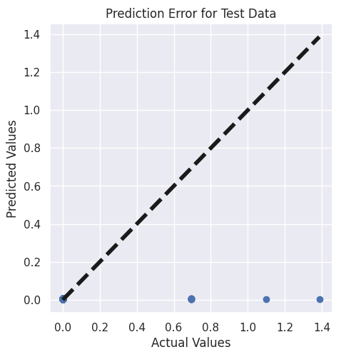
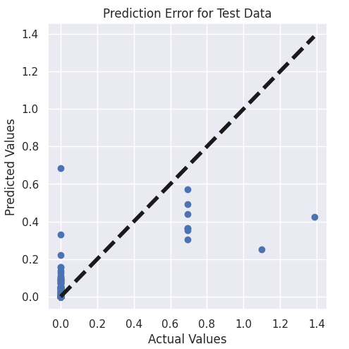
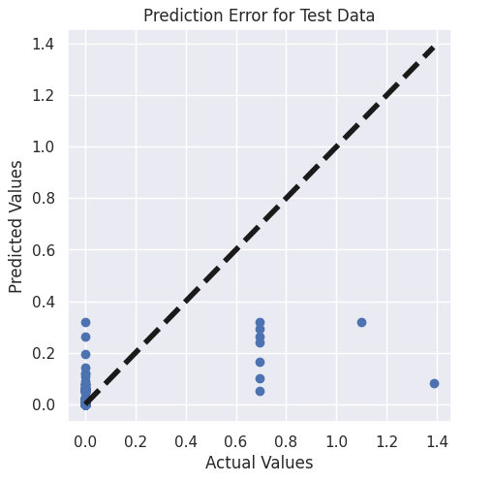
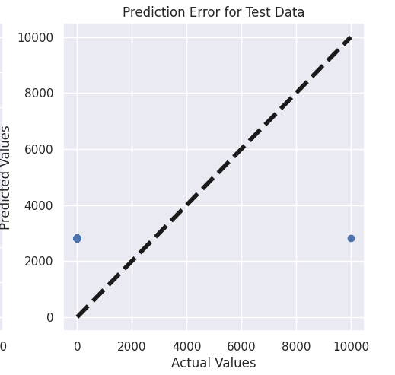
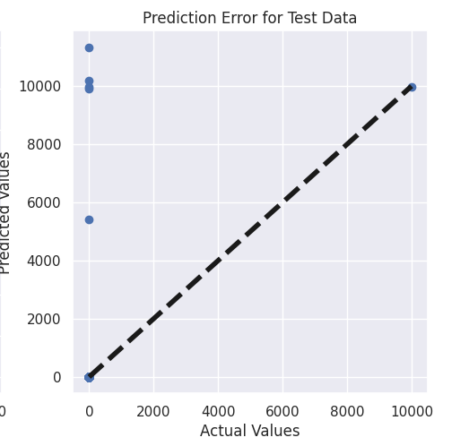
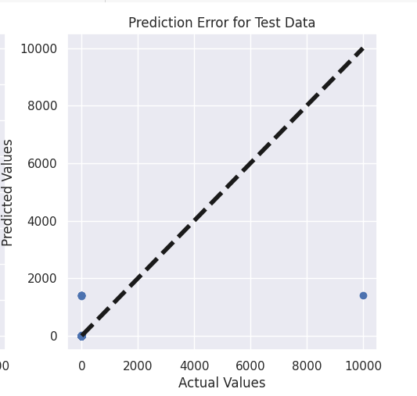
Single-Step Forecasting (Residuals on Test data)
GLM
LightGBM
Neural Networks
InjuriesDirect
Deaths Direct
A Damage
Property

Slide 12
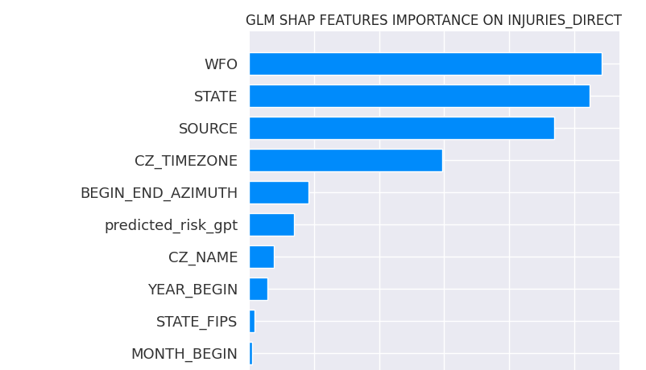
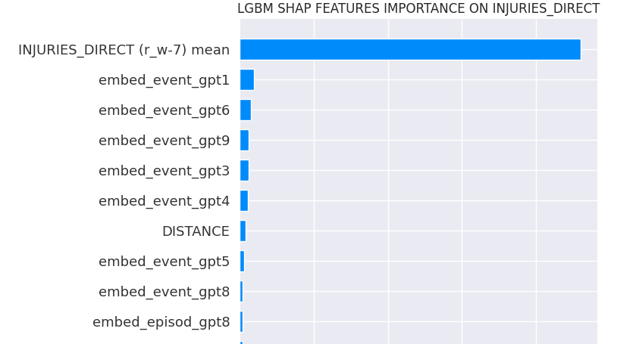
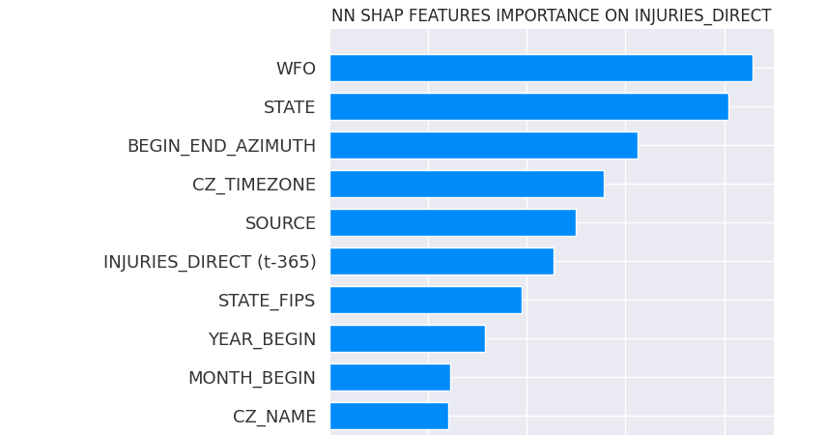
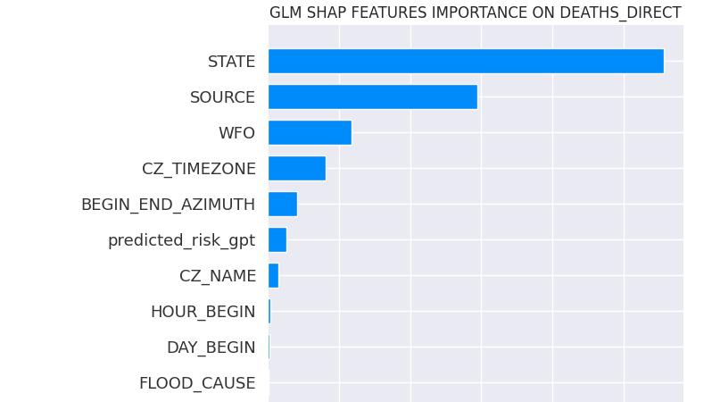
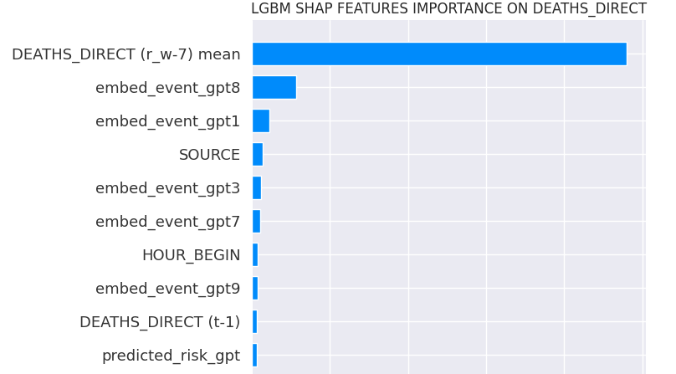
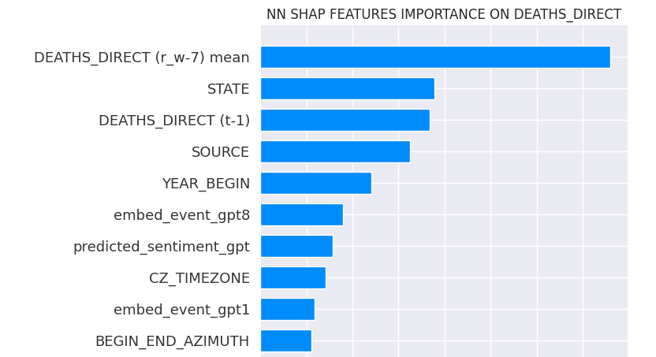
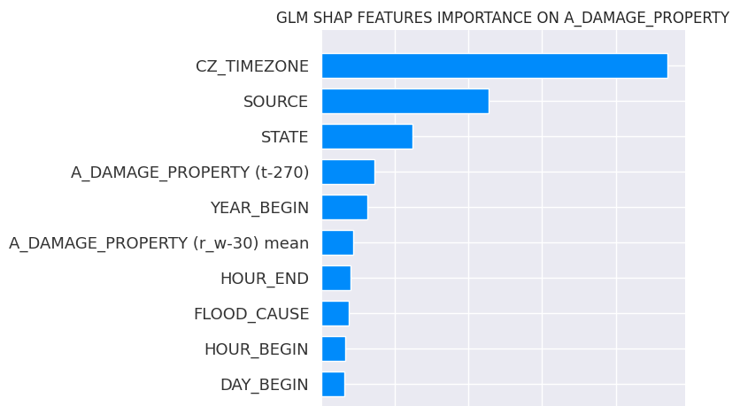
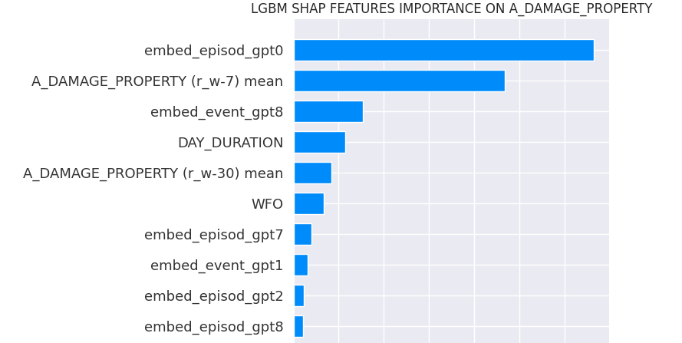
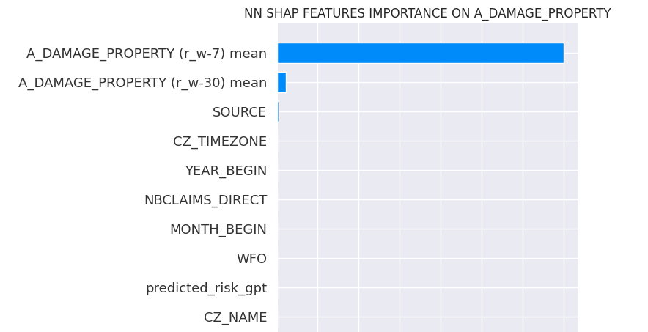
Single-Step Forecasting (Features Importance)
LightGBM is the model that exploits feature engineering and data augmentation more than the others
GLM
LightGBM
Neural Networks
InjuriesDirect
Deaths Direct
A Damage
Property

Slide 13
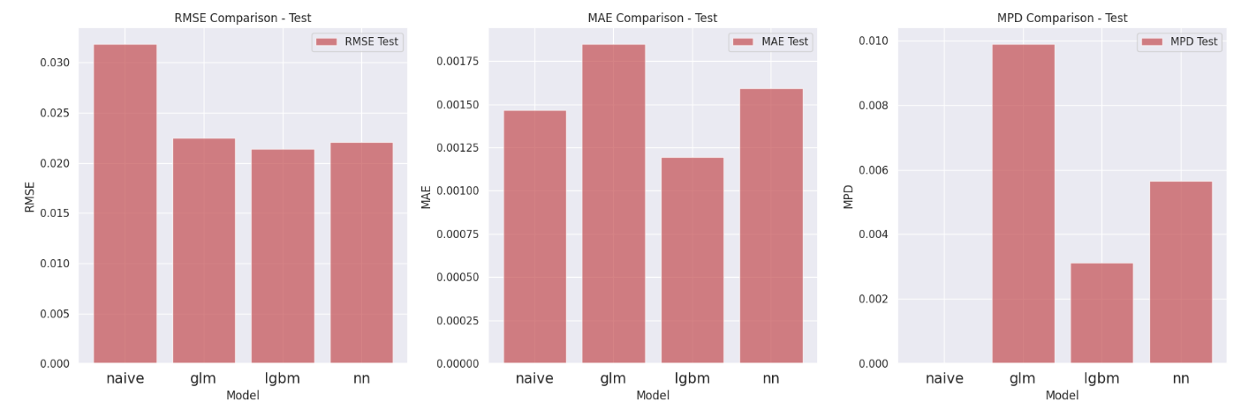
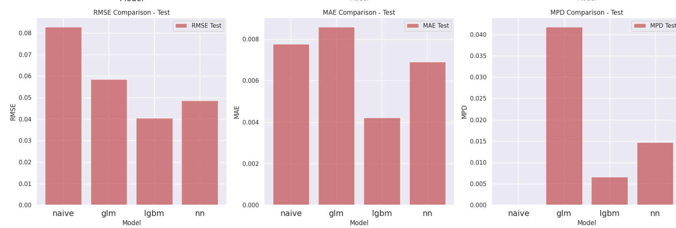
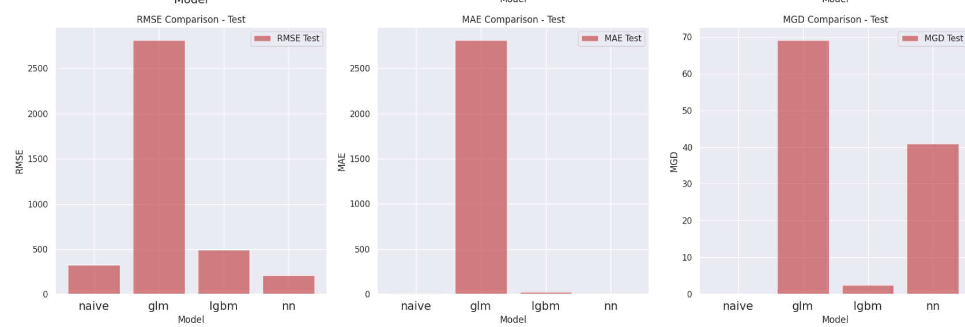
Single-Step Forecasting
(Performance on Test)
Injuries Direct
Deaths Direct
A Damage
Property
LightGBM is outstanding in performance.

Slide 14
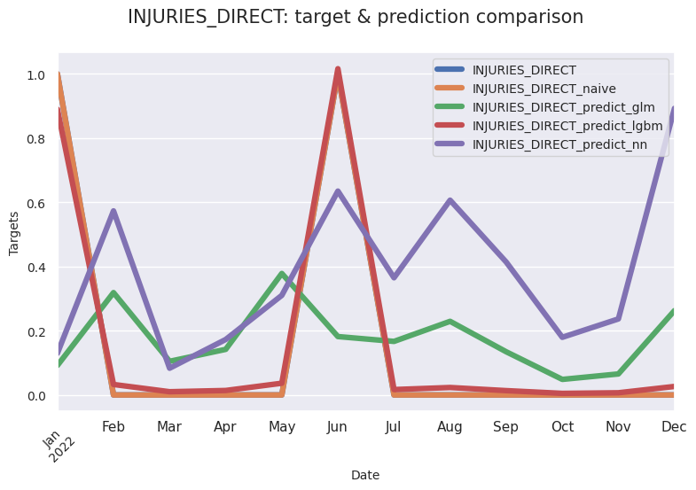
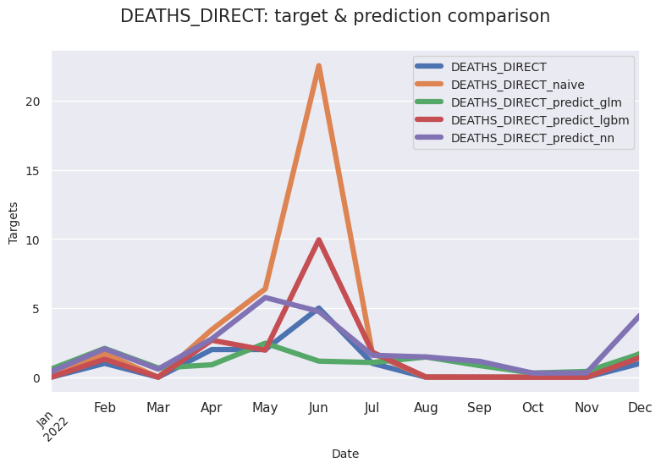
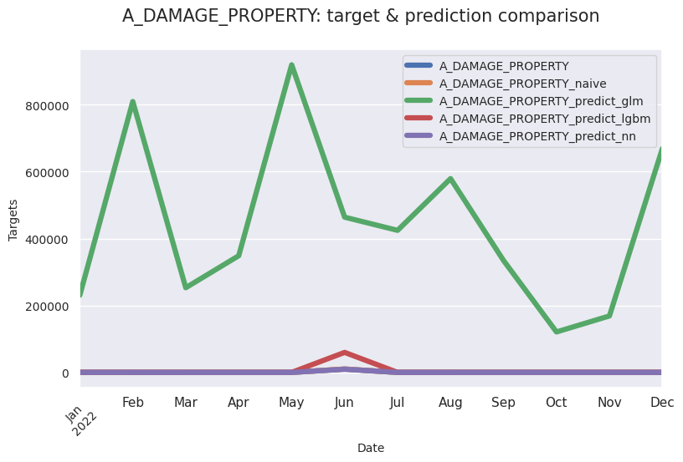
Single-Step Forecasting
(augmentation vs no augmentation)
LightGBM and Neural Networks benefit from data augmentation in all predictions.
InjuriesDirect
Deaths Direct
A Damage
Property

Slide 15
Multi-Step Forecasting
In single step forecasting, the goal is to predict just the next time point: t -> t+1
In multi-step forecasting the goal is to predict the next horizon time points into the future, with h>1 and predict t+1, t+2, t+3…
One technique is the Recursive Forecasting: train one model and use it recursively for each step of the horizon.
Train:
2006-2019
T+1:
2020
T+2:
2021
T+3:
2022

Slide 16
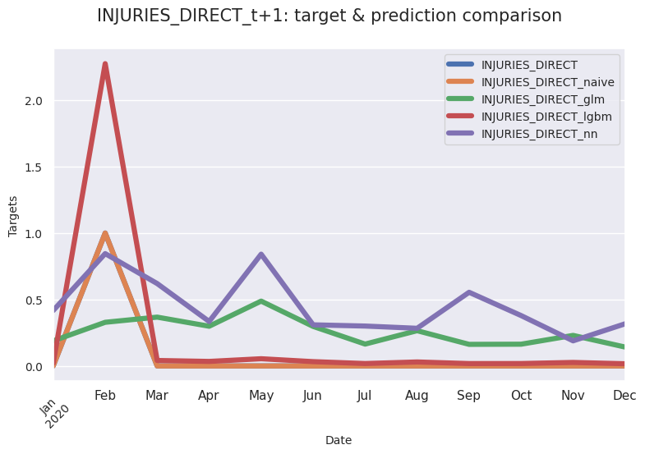
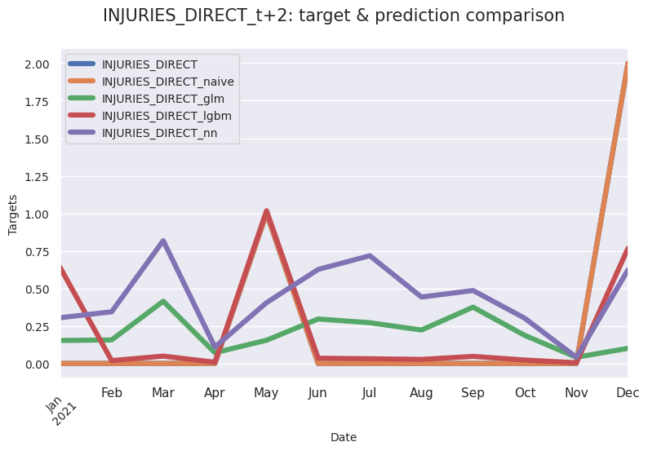
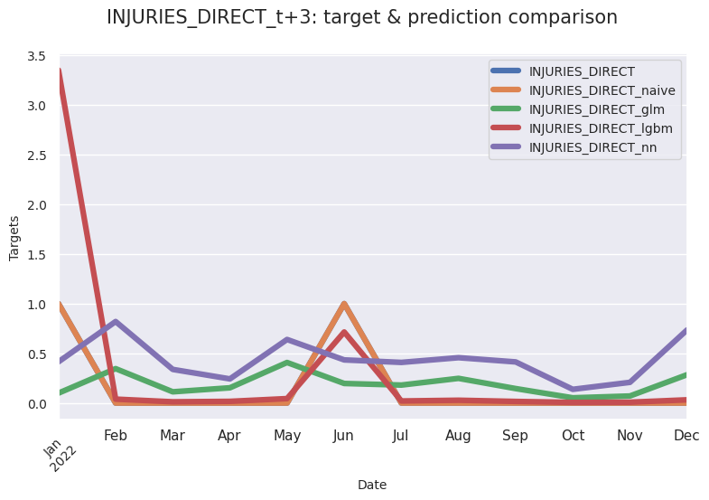
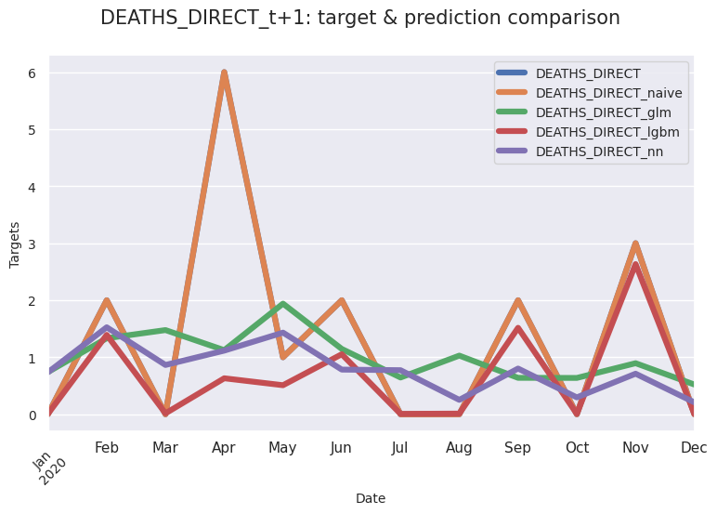
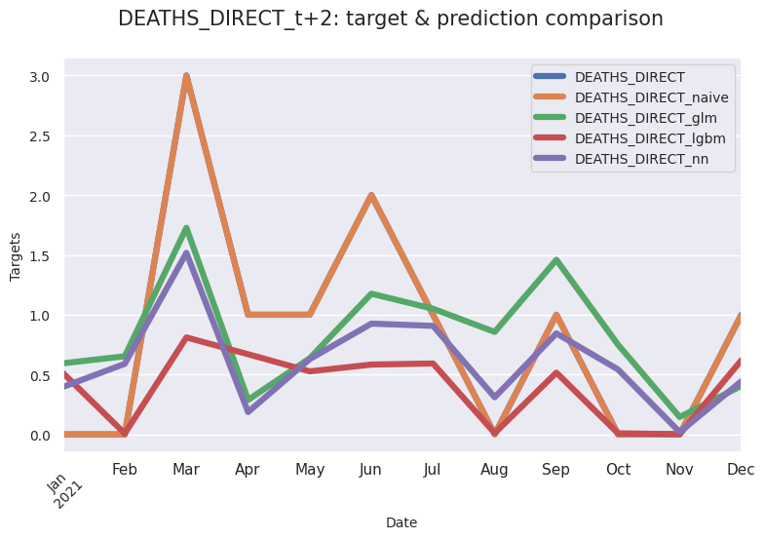
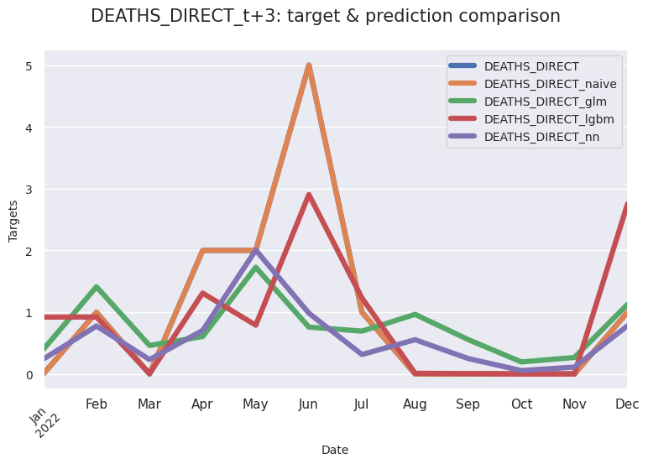
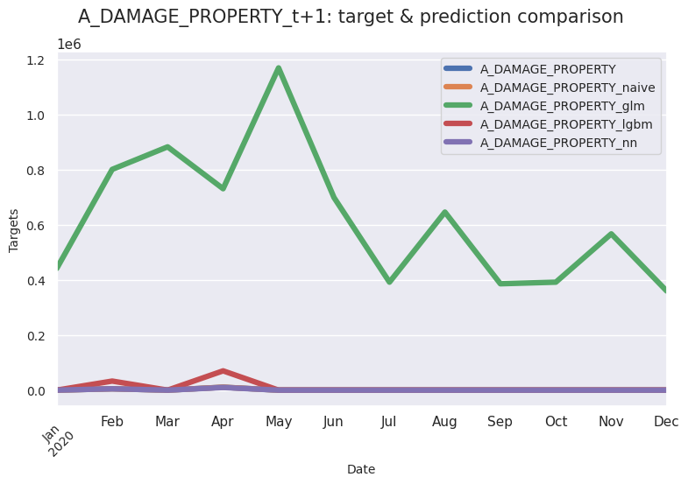
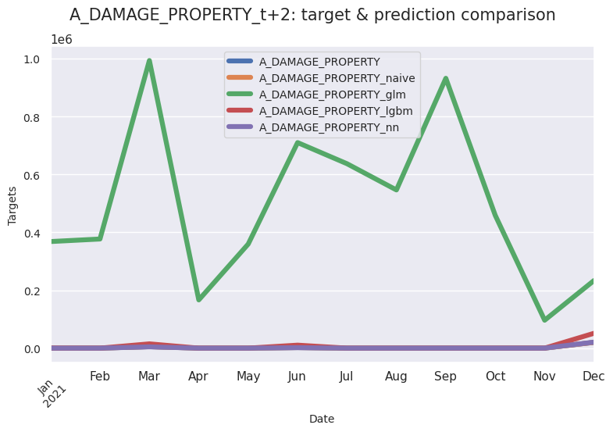
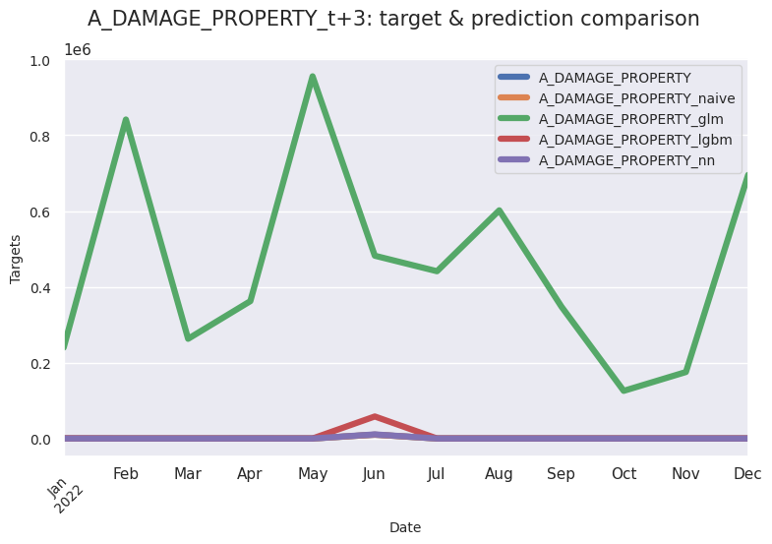
Multi-Step Forecasting (Predictions)
T+1
T+2
T+3
LightGBM generalizes well across different time series and forecasting horizons.
Injuries Direct
Deaths Direct
A Damage
Property

Slide 17
Conclusions
Fighting climate risk events requires big data to improve prediction and understanding features involved in these events.
This study showcases the potential of integrating modern Machine Learning and Generative AI to enhance climate change modelling and prediction. The results highlight the importance of feature engineering in general and the role of features extracted and generated by LLMs.
Modern Machine Learning and Generative AI can be used to improve the mapping of high-risk zones providing more accurate quotes.

Slide 18
References
P.J. Brockwell, R.A. Davis (2016). *Introduction to Time Series and Forecasting*, Springer.
J. Birkmann, T. Welle (2015). *Assessing the risk of loss and damage: exposure, vulnerability and risk to climate-related hazards for different country classifications*, International Journal of Global Warming.
Dineva Snezhana, (2023). *Applying Artificial Intelligence (AI) for Mitigation Climate Change Consequences of the Natural Disasters*, SSRN .
Adam B. Smith (2022). *2022 U.S. billion-dollar weather and climate disasters in historical context*, NOAA National Centers for Environmental Information.
Data: Index of /pub/data/swdi/stormevents/csvfiles (noaa.gov)
Github Repository: claudio1975/Climate_Risk_Modelling_with_LLMs (github.com)

Slide 19
?
?
?
?
Thank you
?
?
?
Keep in touch:
Linkedin
Newsletter
Medium
Website

