Slide 1
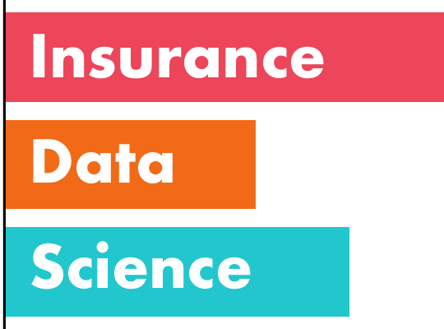
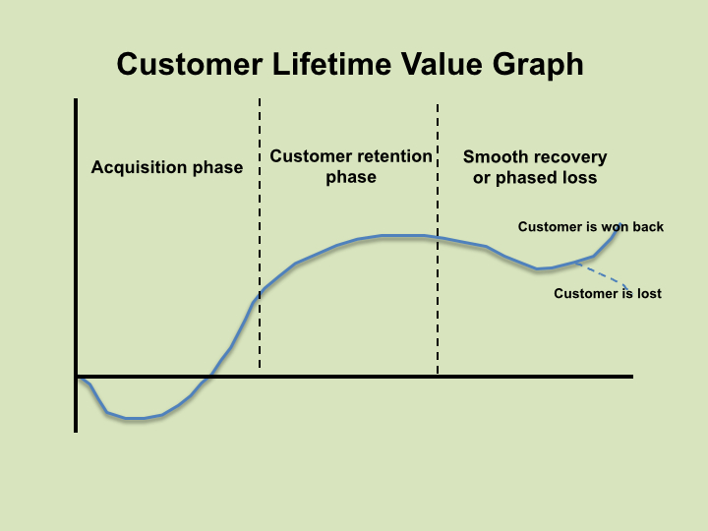
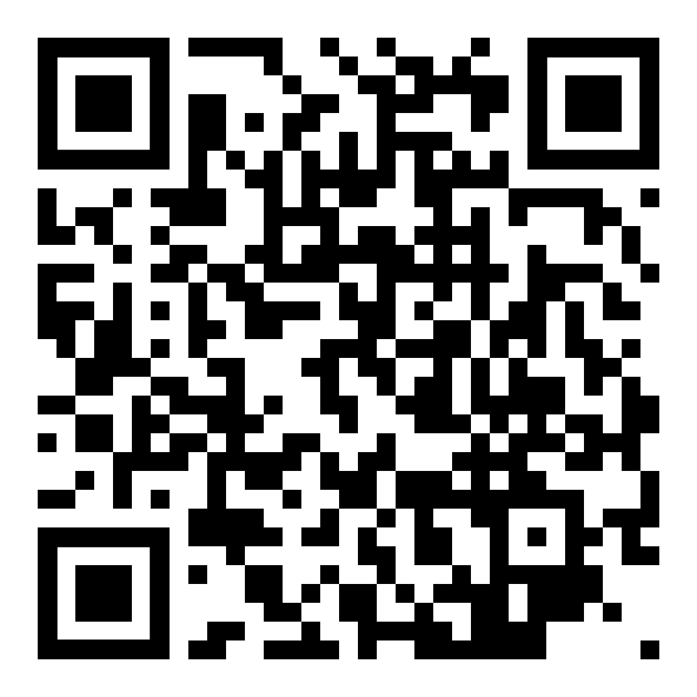
Unsupervised Learning applied to the Customer Lifetime Value (CLV)
SPREAD PREDICTIVE ANALYTICS TOWARDS INSURANCE MARKETING FIELD
A key tool: Customer Lifetime Value.
It’s the value of a customer for a Company over the span of their lifetime relationship
Github repository: https://github.com/claudio1975/Customer_Lifetime_Value
Claudio G. Giancaterino: «Unsupervised Learning applied to the Customer Lifetime Value (CLV)»

Slide 2
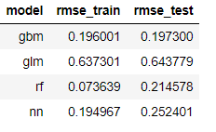
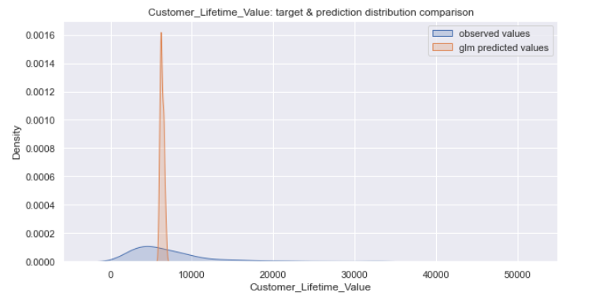
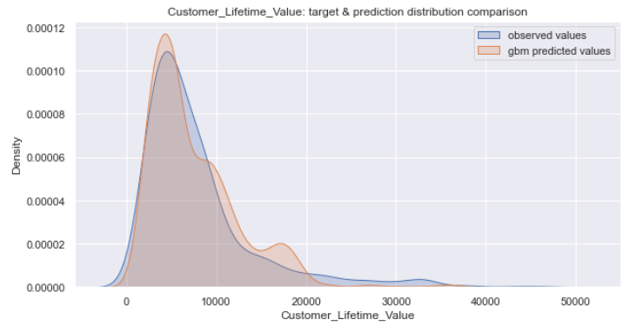
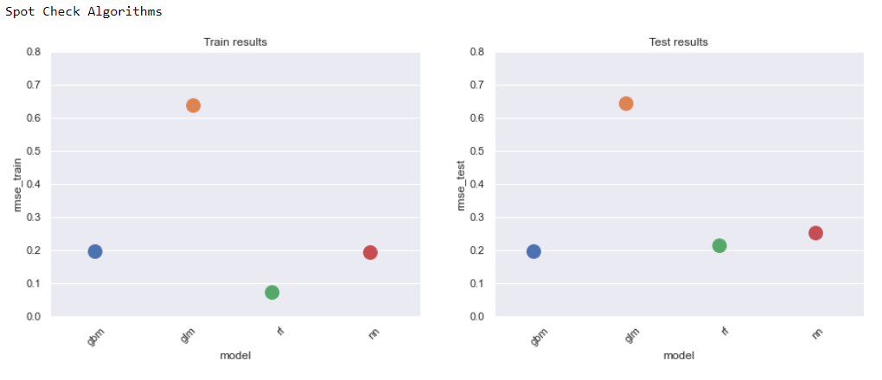
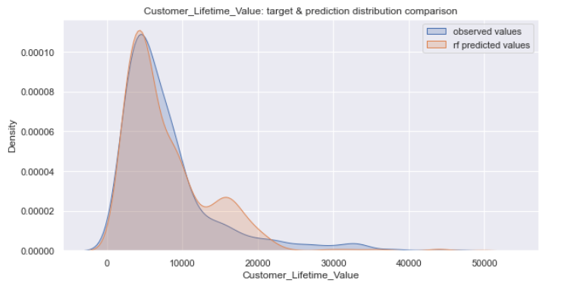
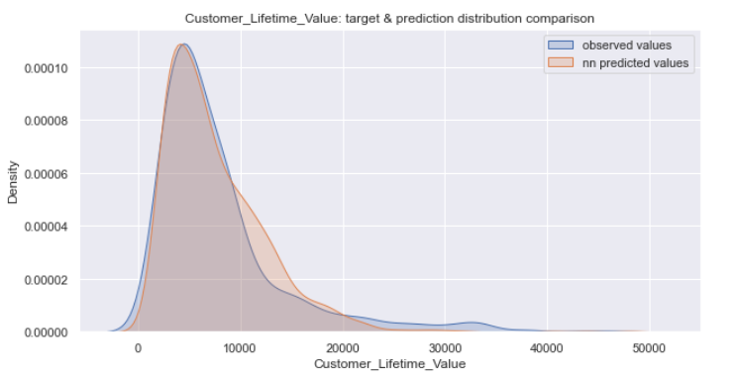
Which model can I use to predict CLV?
USE CASE: AUTOINSURANCE DATA SET
-Generalized Linear Model (GLM); -Random Forest (RF);
-Gradient Boosting Machine (GBM); -Neural Networks (NN)
GLM
GBM
RF
NN
....and the winner is…..GBM!!!...Used as flat (baseline) model for
next experiments!!!
Claudio G. Giancaterino: «Unsupervised Learning applied to the Customer Lifetime Value (CLV)»

Slide 3
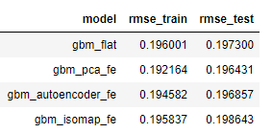
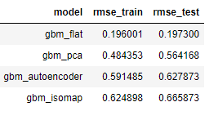
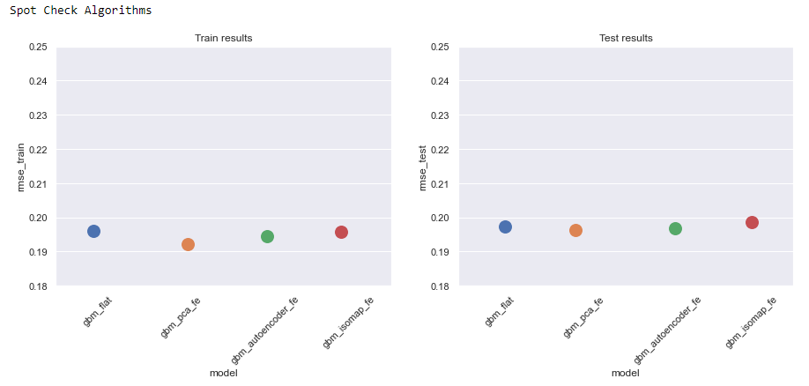
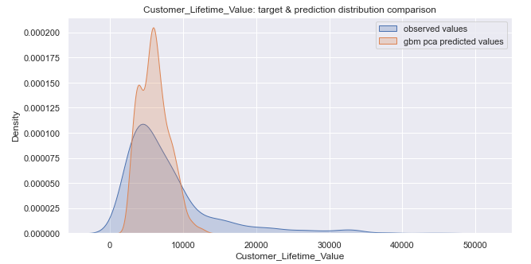
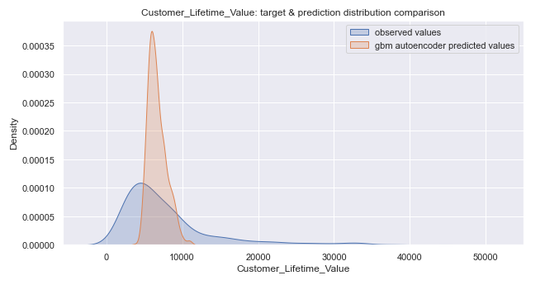
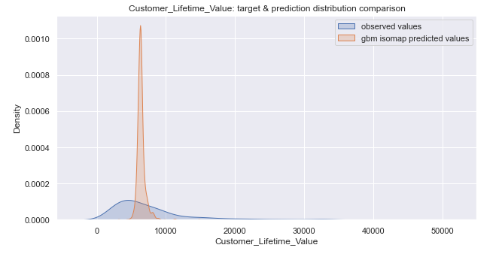
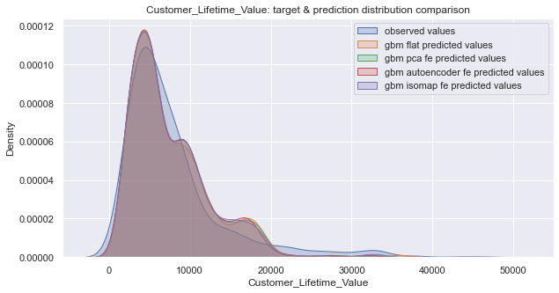
Dimensionality reduction as feature engineering
CLV prediction using features from dimensionality reduction tools: worst performences compared with flat (baseline) model
Data augmentation of flat (baseline) model with features extracted by dimensionality reduction tools: improved performences with PCA and Autoencoder features
Flat (Baseline)
PCA
Autoencoder
Isomap
Claudio G. Giancaterino: «Unsupervised Learning applied to the Customer Lifetime Value (CLV)»

Slide 4
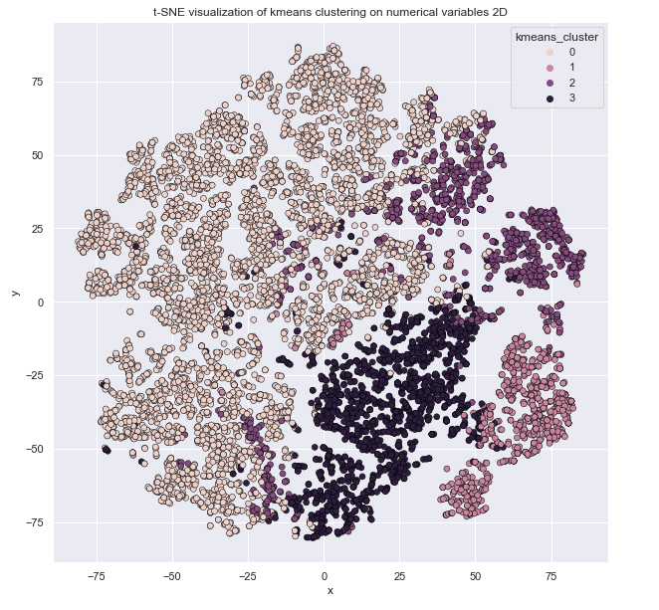
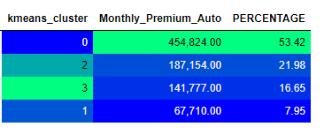
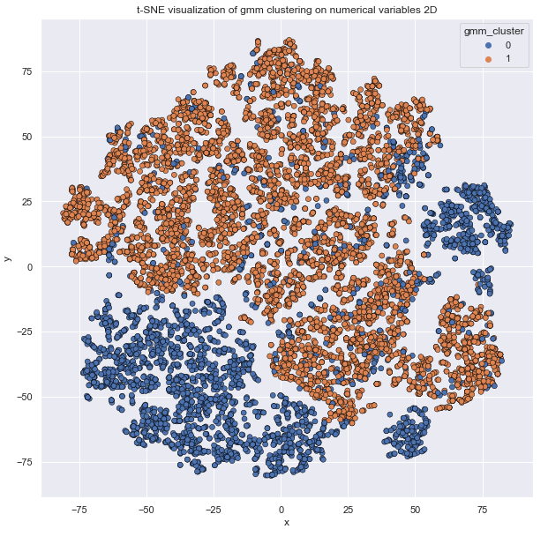
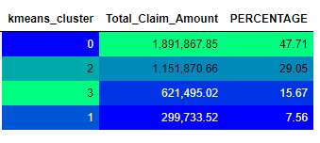
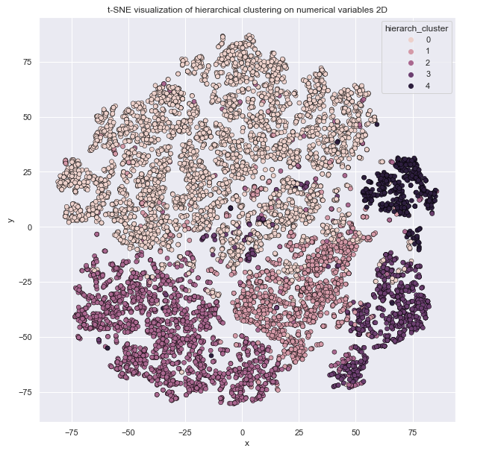
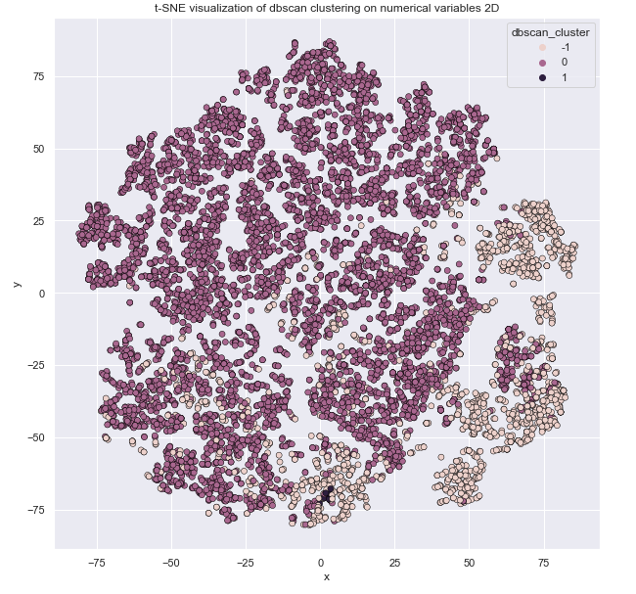
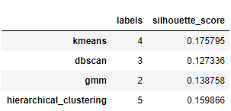
Clustering as portfolio analysis
Improve portfolio analysis by the combination of t-SNE and Clustering tools on numerical features
K-Means cluster analysis shows «0» cluster as region with greater density and with greater percentage both of Claim Amount and Monthly Car Premium (around 50%)
t-SNE with GMM
t-SNE with K-Means
Visualization as helpful tool driving porftolio queries
t-SNE with Hierarchical Clustering
t-SNE with DBSCAN
From silhouette score comparison of clustering tools, K-Means seems to be more suitable
Claudio G. Giancaterino: «Unsupervised Learning applied to the Customer Lifetime Value (CLV)»

