Slide 1
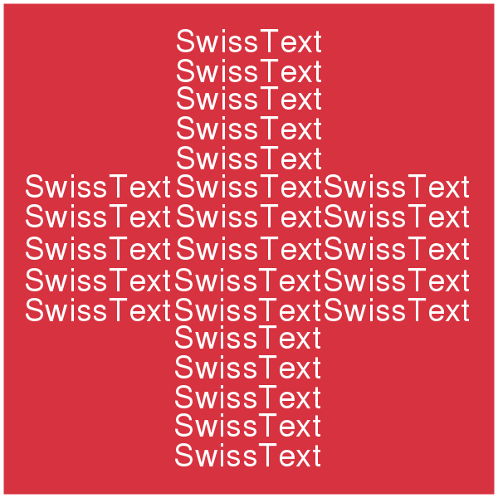
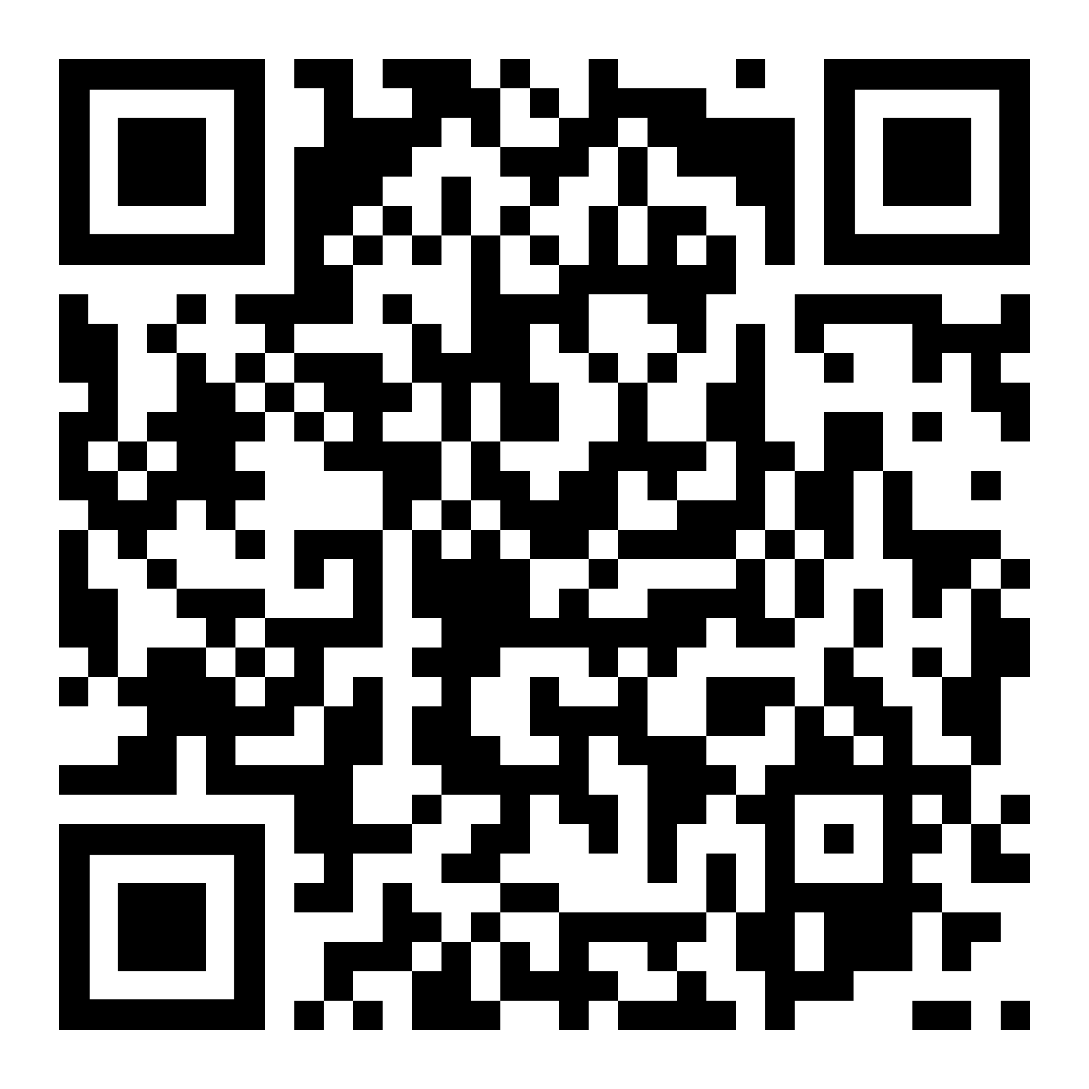
NLP and Insurance Workshop
June 8th, 2022
claudio1975/SWISSTEXT_2022 (github.com)
Claudio G. Giancaterino: «NLP and Insurance»

Slide 2
Roadmap:
NLP Introduction
NLP application on Insurance World
Exploratory Data Analysis
Text Analysis
Text Classification
Claudio G. Giancaterino: «NLP and Insurance»

Slide 3
What is NLP ?

Slide 4
NLP world
Tokenization
Bag-of-Words and Tf-Idf
Word embedding
Sentence embedding
Contextual embedding
NLP (Natural Language Processing)
NLP is an area that combines linguistics, computer science and artificial intelligence to study interactions between computers and human language. The goal of NLP is to be able to design models to allow computers to understand natural language in order to perform some tasks.
Claudio G. Giancaterino: «NLP and Insurance»

Slide 5
NLP application on Insurance world

Slide 6
Opportunities of NLP in the Insurance Industry
Marketing
Underwriting
Claims
Reserving
Risk
Claudio G. Giancaterino: «NLP and Insurance»

Slide 7
Exploratory Data Analysis
SWISSTEXT_2022/NLP_EDA.ipynb at main · claudio1975/SWISSTEXT_2022 (github.com)

Slide 8
Language Detection
Length Analysis
WordCloud
Exploratory Data Analysis
Claudio G. Giancaterino: «NLP and Insurance»

Slide 9
Text Analysis
SWISSTEXT_2022/NLP_text_analysis.ipynb at main · claudio1975/SWISSTEXT_2022 (github.com)

Slide 10
Text Analysis
NER & POS
Text cleaning
N-grams
Topic modelling
Word embedding
Claudio G. Giancaterino: «NLP and Insurance»

Slide 11
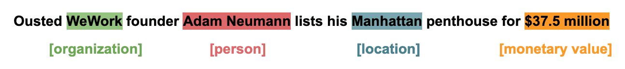
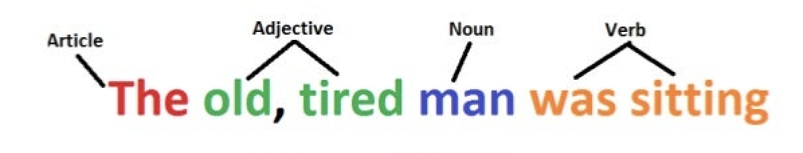
Named Entity Recognition (NER)
A named entity is a proper noun that refers to a specific entity like location, person, organization...
Part of Speech tagging (POS) Tagging
The part of speech tagging is the process of marking a word in the text to a particular part of speech based on both its context and definition like as nouns, verbs, adjectives, adverbs...
Claudio G. Giancaterino: «NLP and Insurance»

Slide 12
Basic steps on text cleaning
Normalize text
Remove unicode characters
Remove stopwords
Stemming/
Lemmatization
Claudio G. Giancaterino: «NLP and Insurance»

Slide 13

N-grams
N-gram is a contiguous sequence of n items generated from a given sample of text where the items can be words.
Using numerical prefixes, an n-gram of size equal 1 is referred to a one word, an n-gram of size equal 2 is referred to two words, and so on.
Given the sentence: “Either my way or no way” it can be split in different n-grams.
Claudio G. Giancaterino: «NLP and Insurance»

Slide 14
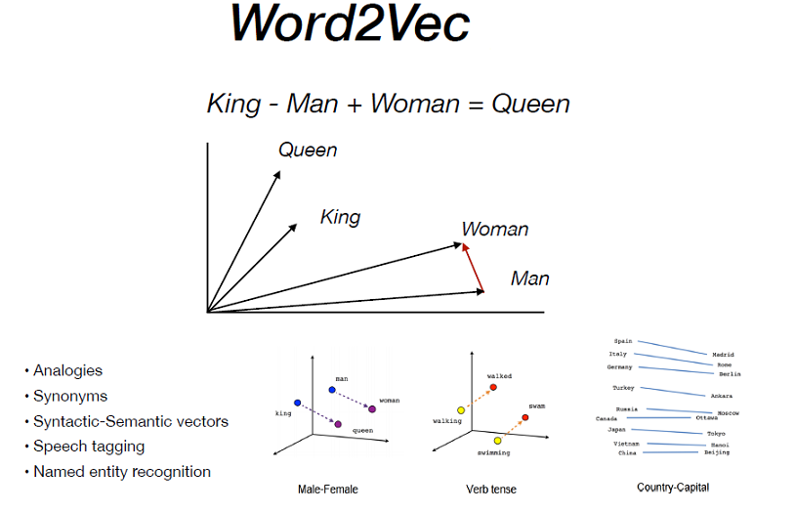
Word embedding
Claudio G. Giancaterino: «NLP and Insurance»

Slide 15

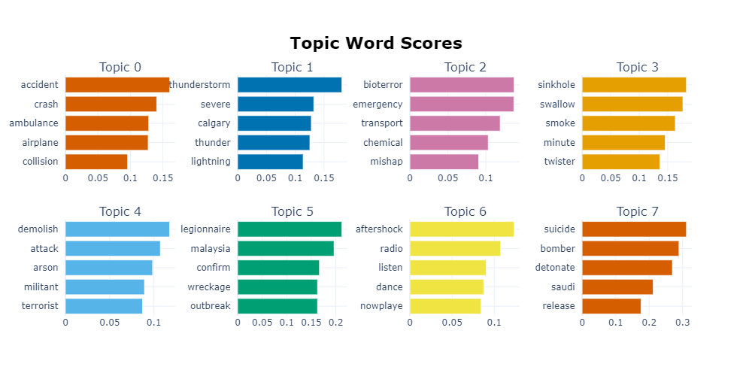
Topic modelling
Topic modelling is a form of unsupervised learning that identifies hidden relationships in text.
Claudio G. Giancaterino: «NLP and Insurance»

Slide 16
Text Classification
SWISSTEXT_2022/NLP_text_classification.ipynb at main · claudio1975/SWISSTEXT_2022 (github.com)

Slide 17
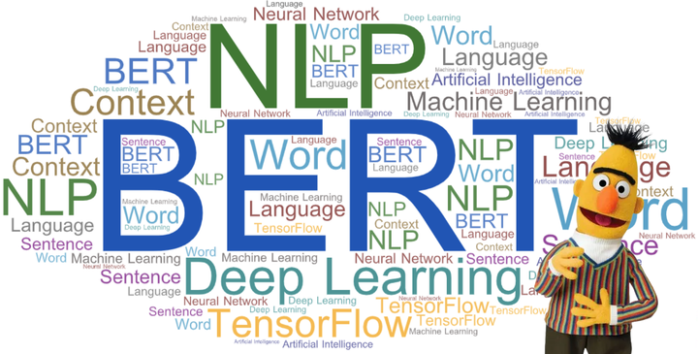
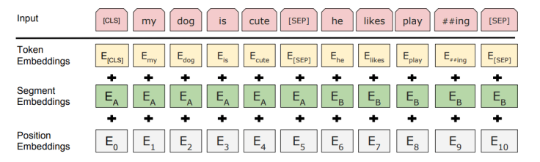
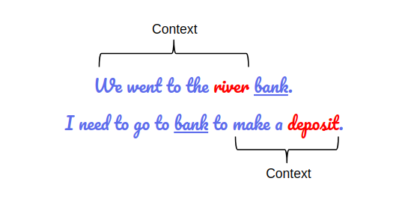
Claudio G. Giancaterino: «NLP and Insurance»

Slide 18
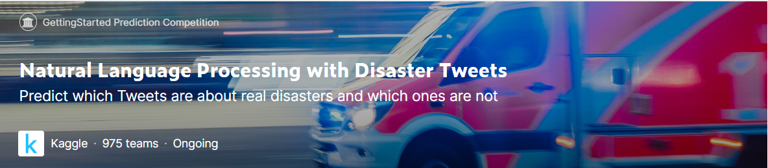
References:
claudio1975/SWISSTEXT_2022 (github.com)
https://www.kaggle.com/competitions/nlp-getting-started
[2010.00462] A survey on natural language processing (nlp) and applications in insurance (arxiv.org)
[1706.03762] Attention Is All You Need (arxiv.org)
[1810.04805] BERT: Pre-training of Deep Bidirectional Transformers for Language Understanding (arxiv.org)
[2203.05794] BERTopic: Neural topic modeling with a class-based TF-IDF procedure (arxiv.org)
[2004.10703] ktrain: A Low-Code Library for Augmented Machine Learning (arxiv.org)
Claudio G. Giancaterino: «NLP and Insurance»

Slide 19
???
Contacts:
claudio1975 (claudio) (github.com)
Claudio Giorgio Giancaterino | LinkedIn
c.giancaterino@gmail.com
Claudio G. Giancaterino: «NLP and Insurance»

