Slide 1
Home Credit Default Risk: Kaggle Competition using Blending and H2O
Kaggle Munich – September 2018
My experience: Claudio G. Giancaterino

Slide 2
Description
Home Credit Default Risk
Can you predict how capable each applicant is of repaying a loan?
Featured by Home Credit Group
7.198 teams in the competition
$ 70.000 Prize Money

Slide 3
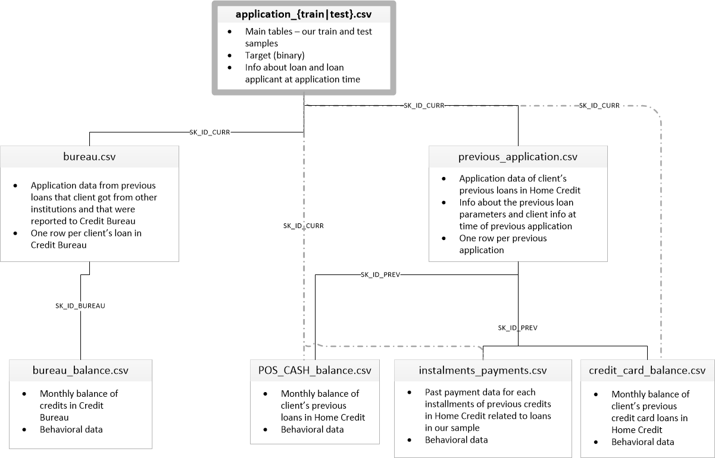
Data
Sources
7 tables
Several dimensions
Variables
> 200 variables
> 30 categorical variables

Slide 4
Evaluation
Target variable
Binary
Supervised Classification Task
Metric
AUC
Used for unbalanced classes

Slide 5
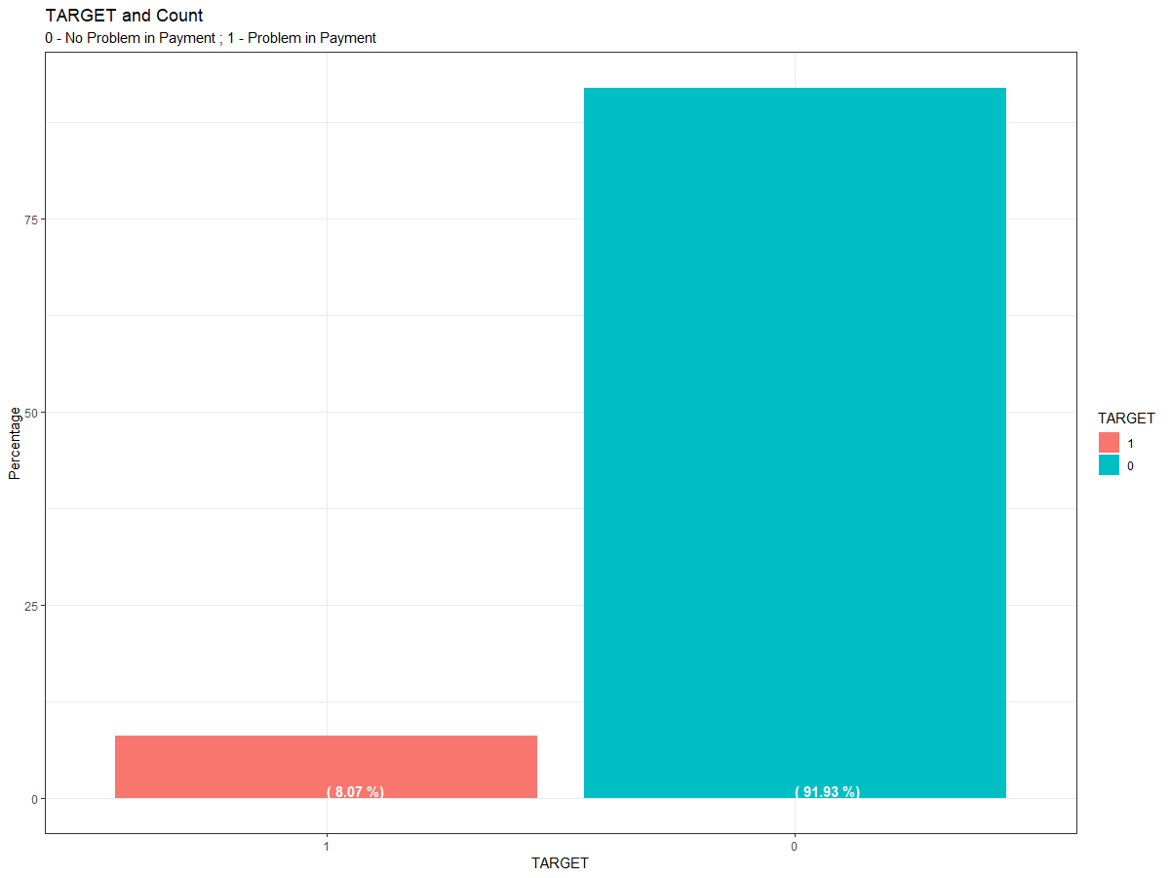
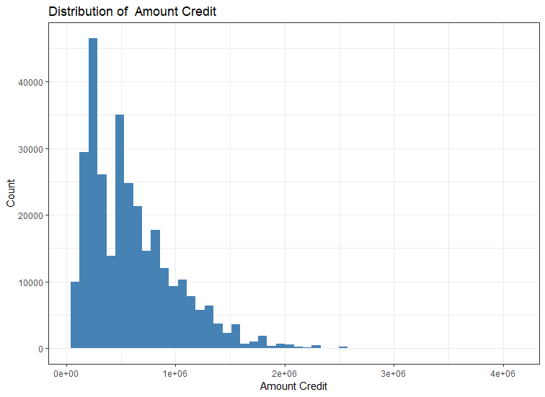
Exploratory Data Analysis

Slide 6
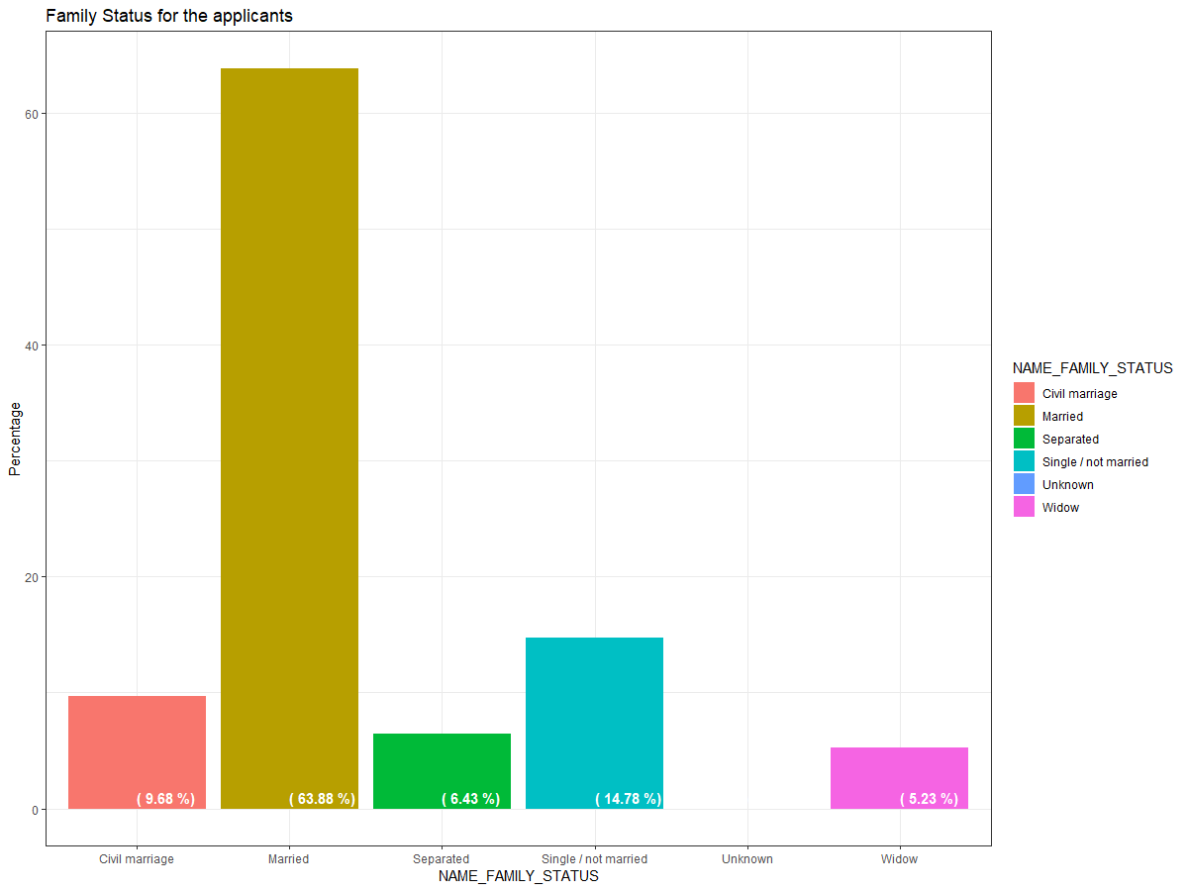
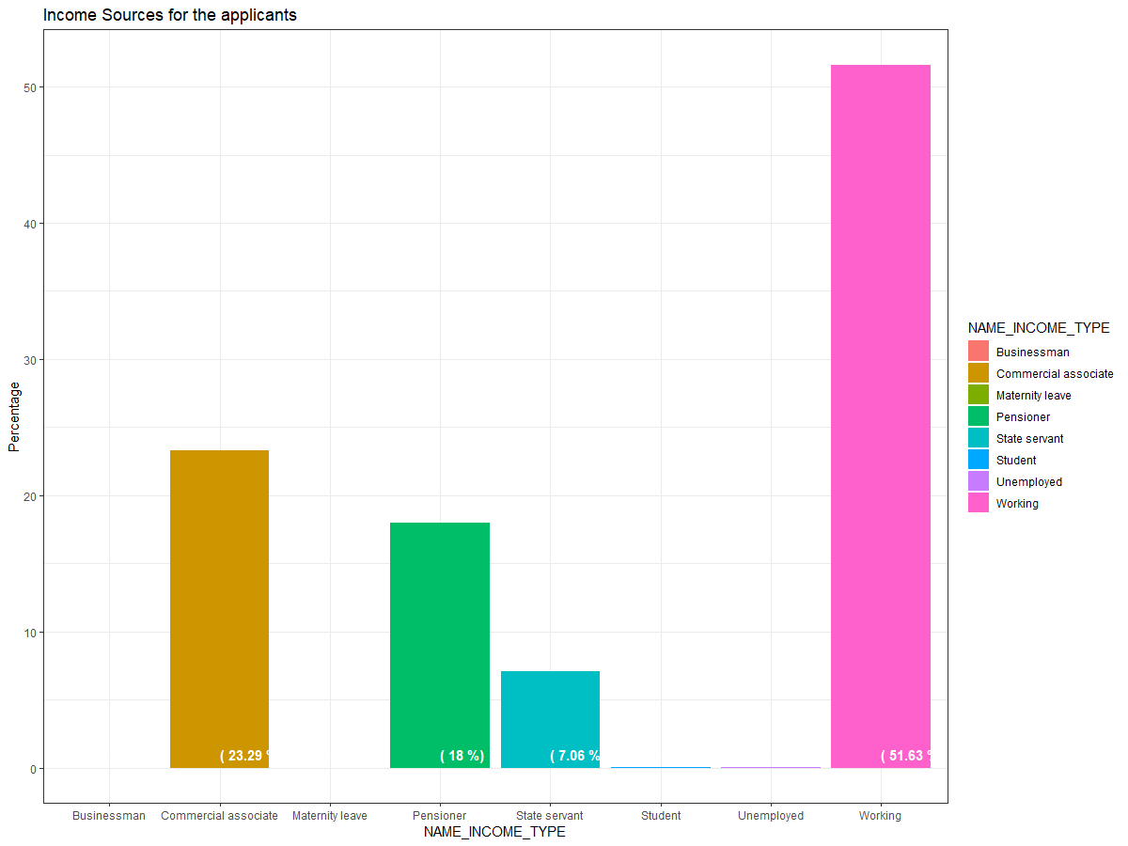

Slide 7
Pre-Processing
Bureau_Balance
Added_Features
Merging Datasets with left_join operator
Handled Missing Values
Step 1
Bureau
Added_Features
Credit_Card_Balance
Added_Features
Installments_
Payments
Added_Features
POS_CASH_Balance
Added_Features
Previous_Application
Added_Features
Application_
Train|Test
Added_Features

Slide 8
Further Feature Engineering with H2O
AUTOENCODER
PCA
Step 2

Slide 9
PCA strengths:
Reduces dimensionality
Interpretable
Fast run time
PCA weakness:
Incapable of learning non-linear feature representations
Autoencoder strengths:
Able to learn non-linear feature representations
Reduce dimensionality
Autoencoder weakness:
Computationally expensive to train
Extremely uninterpretable
The underlying math is more complicated
Prone to overfitting, though this can be mitigated via regularization
With both: keep ONLY sensitivity to variations ON the manifold

Slide 10
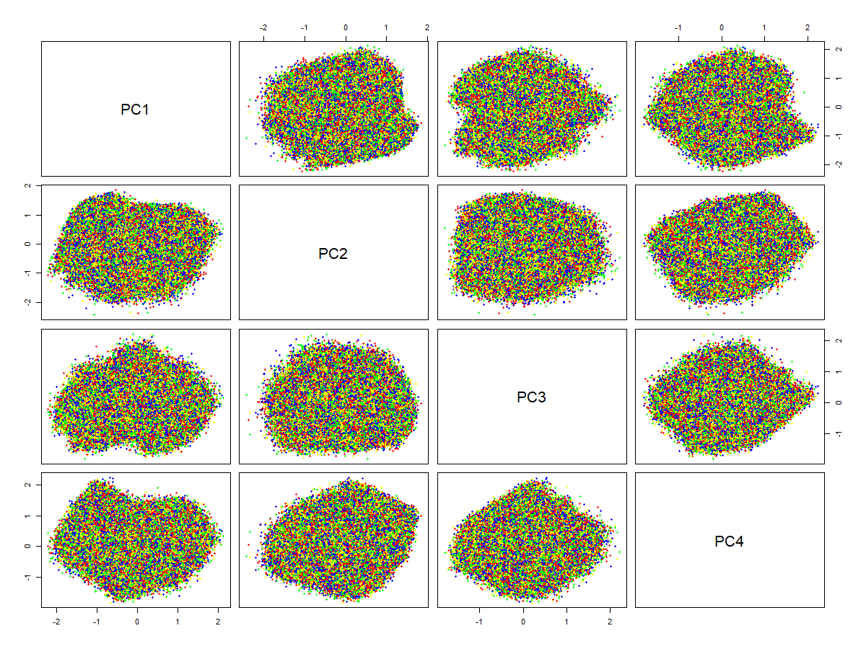
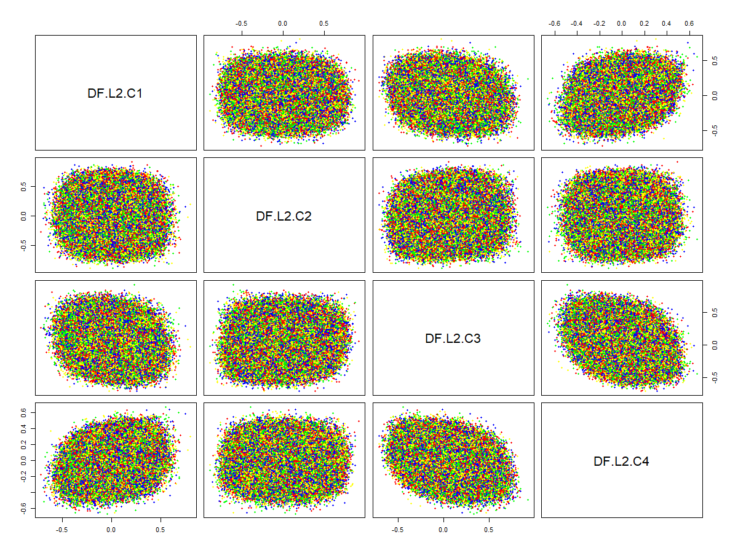
Scatterplot PCA and Autoencoder
PCA
Autoencoder

Slide 11
Blending 1 - score: 0.799
Weight Average Rank Blend from kernel
Score: 0.800
Blend from kernel
Score: 0.798
Tidy_xgb from kernel
Score: 0.796
Blending solution by Weigth Average of these 9 models
Step 1
Ensembling with LigthGBM and XGboost on Kernel
Score: 0.793
Step 1
Added further features
Modeling XGboost
Score: 0.792
Step 1
Modeling LigthGBM on Kernel
Score: 0.788
Step 2
Modeling XGboost
Score: 0.778
Step 2
Modeling GBM with H2O
Score: 0.705
Step 2
Modeling Random Forest with H2O
Score: 0.672

Slide 12
Blending 2 - score: 0.800
Weight Average Rank Blend from kernel
Score: 0.800
Blending solution by Weigth Average of these 5 models
Score: 0.798
Blend from kernel
Tidy_xgb from kernel
Score: 0.796
Ensembling with LigthGBM and XGboost on Kernel
Score: 0.793
Step 1
Step 1
Added further features
Modeling XGboost
Score: 0.792

Slide 13
What I’ve learned
Strength
Feature engineering is essential to perform a model
Kernels are helpful but not enough, have a critical exploring
Weakness
Before training a model is essential a good understanding of your data
Categorical features need to be transformed by one-hot encoding
There is a lot job to run if you want to be competitive alone in Kaggle
H2O framework helpful also for unsupervised learning than supervised learning
Blending is the easiest solution than stacking, anyway it requires a model with the highest score

Slide 14
Many thanks for your attention!!!
???
Contact:
Claudio G. Giancaterino
c.giancaterino@gmail.com
https://github.com/claudio1975/Kaggle

