Slide 1

Stock Market Forecasting with Nixtla Conformal Prediction and Stock Agent Analysis
Claudio Giorgio Giancaterino
17/06/2025

Slide 2
Agenda
Uncertainty Quantification
Conformal Prediction
NIXTLA Conformal Prediction
Agents with pyautogen
Stock Market Forecasting and Agents Analysis App

Slide 3
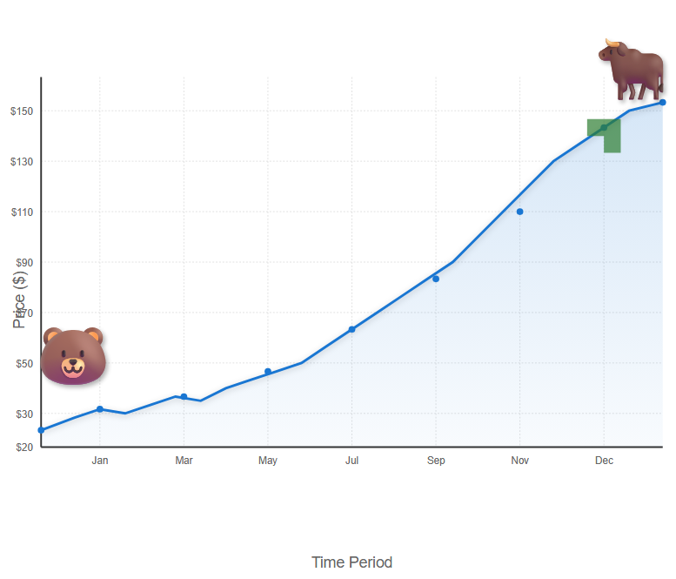
Why does uncertainty quantification matter?
Stock Investment Risk
https://deepai.org/machine-learning-model/text2img

Slide 4
Why does uncertainty quantification matter?
Uncertainty quantification is a crucial aspect of predictive modelling. Traditional predictions typically produce a single-point output for a given input because they rely on models that provide only the most likely outcome. These models either cannot capture the full complexity of the real world or are based on incomplete data.
Uncertainty can be broken into:
Aleatoric Uncertainty. This type of uncertainty arises from inherent randomness in the data. It is also known as statistical or irreducible uncertainty. In machine learning, aleatoric uncertainty can result from noise in the data or measurement errors.
Epistemic Uncertainty. This type of uncertainty arises from a lack of knowledge or information. It is also known as systematic or reducible uncertainty. Epistemic uncertainty can be reduced by gathering more data or improving the model.

Slide 5
Why Conformal Prediction ?
Uncertainty Quantification
Conformal Prediction
Certainty Quantification
Conformal prediction is a powerful machine learning framework used to evaluate the uncertainty of predictions. It turns point predictions into prediction sets/intervals.
Some advantages of using conformal prediction for uncertainty quantification:
-distribution-free;
-guaranteed coverage;
-model-agnostic;
-easy implementation

Slide 6
Conformal Prediction Properties
Validity
ensures that predictions are reliable and meet predefined coverage levels, making it crucial for applications where trust in predictions is relevant.
Efficiency
Exchangeability
ensures that predictions are consistent regardless of data order.
focuses on producing accurate and concise predictions, which is vital for practical implementation and resource management.

Slide 7
Confidence Intervals vs Prediction Intervals
The Confidence Interval shows the uncertainty of a population parameter, such as the mean.
The Prediction Interval shows the uncertainty of a specific value.
The Confidence Interval focuses on past or current events.
The Prediction Interval focuses on future events.
A Prediction Interval is generally wider than a Confidence Interval, because the Prediction Interval must account for the additional uncertainty of a single observation compared to the mean.
https://medium.com/data-science/confidence-interval-vs-prediction-interval-a6b0c4816a92

Slide 8
Conformal Prediction Methods
Full Conformal Prediction (Trasductive) leverages the entire dataset for training and requires model retraining for each new prediction. This approach ensures that each prediction is made with the most up-to-date information. It‘s the most general and computationally intensive approach.
Split Conformal Prediction (Inductive) splits the data into training and calibration sets. The model is trained once on the training set, and the calibration set is used to adjust the prediction intervals. It‘s the computationally efficient variant.
Cross-Conformal prediction is a resampling-based method that generalises the split conformal prediction. Data is split into K folds; for each fold, the model is trained on the remaining K-1 folds, and the prediction interval is computed on the left-out fold. The final prediction interval is built by aggregating results across all partitions.

Slide 9
Conformal Prediction as a Recipe
Non Conformity Score
Miscoverage rate/Coverage
Data Splitting (optional but common)
Train the model
Calibrate the model
Prediction on unseen data
https://medium.com/data-science/all-you-need-is-conformal-prediction-726f18920241

Slide 10
Conformal Prediction as a Recipe: numerical example on Time Series
🎯 Goal
Build a 90% prediction interval for time series forecasting using conformal prediction.
✅ Assumptions
-15 consecutive timestamps of data.
-Predict the next value in the series using some forecasting model.
Split dataset:
-First 10 timestamps as the training set
-Next 5 timestamps as the calibration set
The conformal prediction goal is 90% coverage, so alpha = 0,1.
✅ Split Time Series
Time 1 2 3 4 5 6 7 8 9 10 11 12 13 14 15
Value 80 82 83 92 94 85 88 94 98 96 99 91 96 90 89
Train a model on timestamps 1–10
Predict timestamps 11–15 and compute non-conformity scores

Slide 11

Conformal Prediction as a Recipe: numerical example on Time Series
✅ Train the Forecasting Model and get errors
Time 11 12 13 14 15
True outcome 99 91 96 90 89
Predicted outcome 97 95 94 91 90
Non-conformity scores 2 4 2 1 1
✅ Sort the non-conformity scores (in ascending order): [1,1,2,2,4]
✅ Compute the quantile $\hat{q}$ (with finite sample correction) for the n samples
$k=min⁡(n,\left[\left(1−α\right)\left(n+1\right))\right]=\left[0,9×6\right]=\left[5,4\right]=5$
Set $\hat{q}$=kth largest score => $\hat{q}$=5th largest score=4
✅ Build the prediction Interval
Given a prediction at the 16 timestamps $\hat{y}$=92
The 90% conformal prediction interval is: [$\hat{y}$- $\hat{q}$, $\hat{y}$+ $\hat{q}$]=[92-4,92+4]=[88,96]

Slide 12
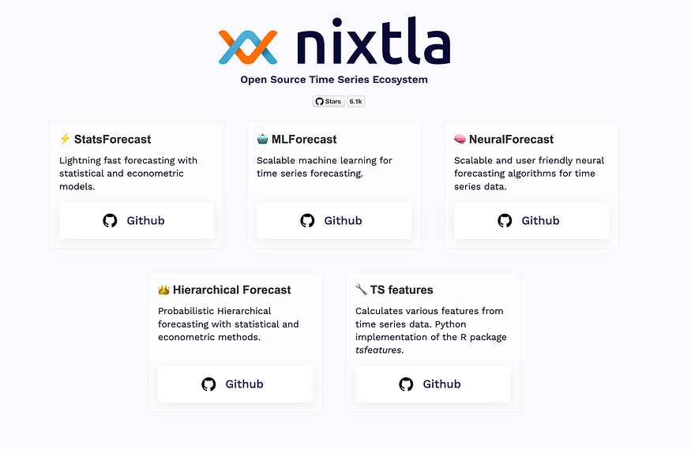
Conformal Prediction with NIXTLA
Nixtla is an open-source framework dedicated to time series forecasting, and it is helpful for low-code.
Approached the following libraries:
-StatsForecast,
-MLForecast,
-NeuralForecast,
-TimeGPT
-UtilsForecast
https://www.nixtla.io/open-source

Slide 13
Conformal Prediction with NIXTLA
Library | Method Options | Interval Calibration
Statsforecast | N/A | Rolling window errors
MLForecast | Conformal distribution, Conformal error | Rolling window errors
NeuralForecast | Conformal distribution, Conformal error | Rolling window errors
TimeGPT | N/A | Rolling window errors

Slide 14

pyautogen framework for agent development
AutoGen (pyautogen), now as AG2, is an open-source programming framework originally developed by Microsoft. It is designed for building AI agents and sophisticated cooperation among multiple agents in order to solve complex tasks.
https://deepai.org/machine-learning-model/text2img

Slide 15
What are AI Agents?
An AI agent is an application designed to achieve a goal by observing the world and acting upon it using the tools at its disposal. These agents are autonomous and can act independently of human intervention when given proper goals. In the context of Generative AI, an agent is a program that enables Large Language Models (LLMs) to perform actions by extending their capabilities through access to tools and knowledge.
LLMs
Action
Knowledge
Tools

Slide 16
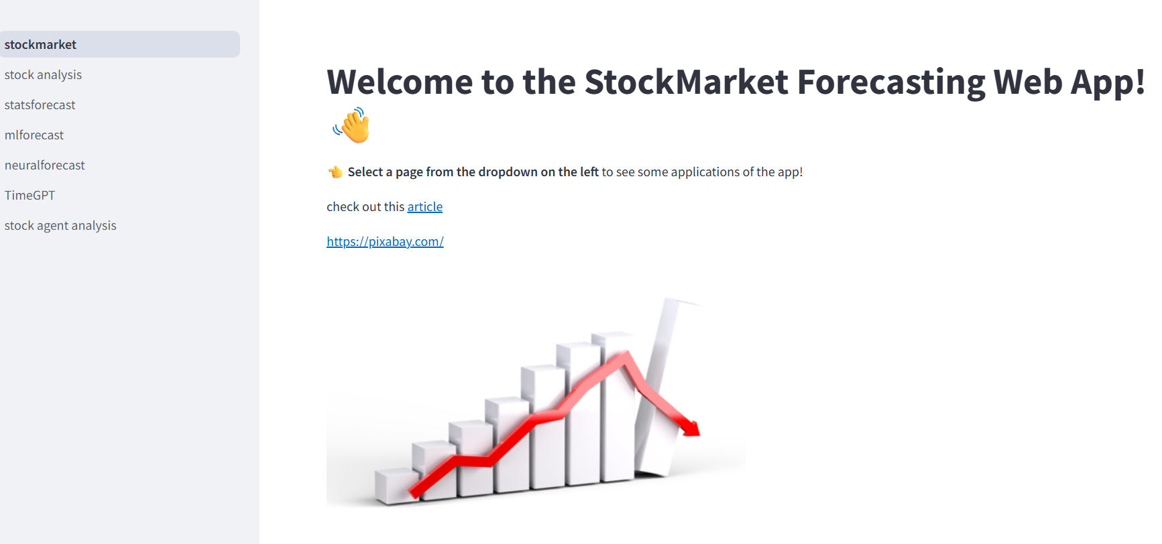
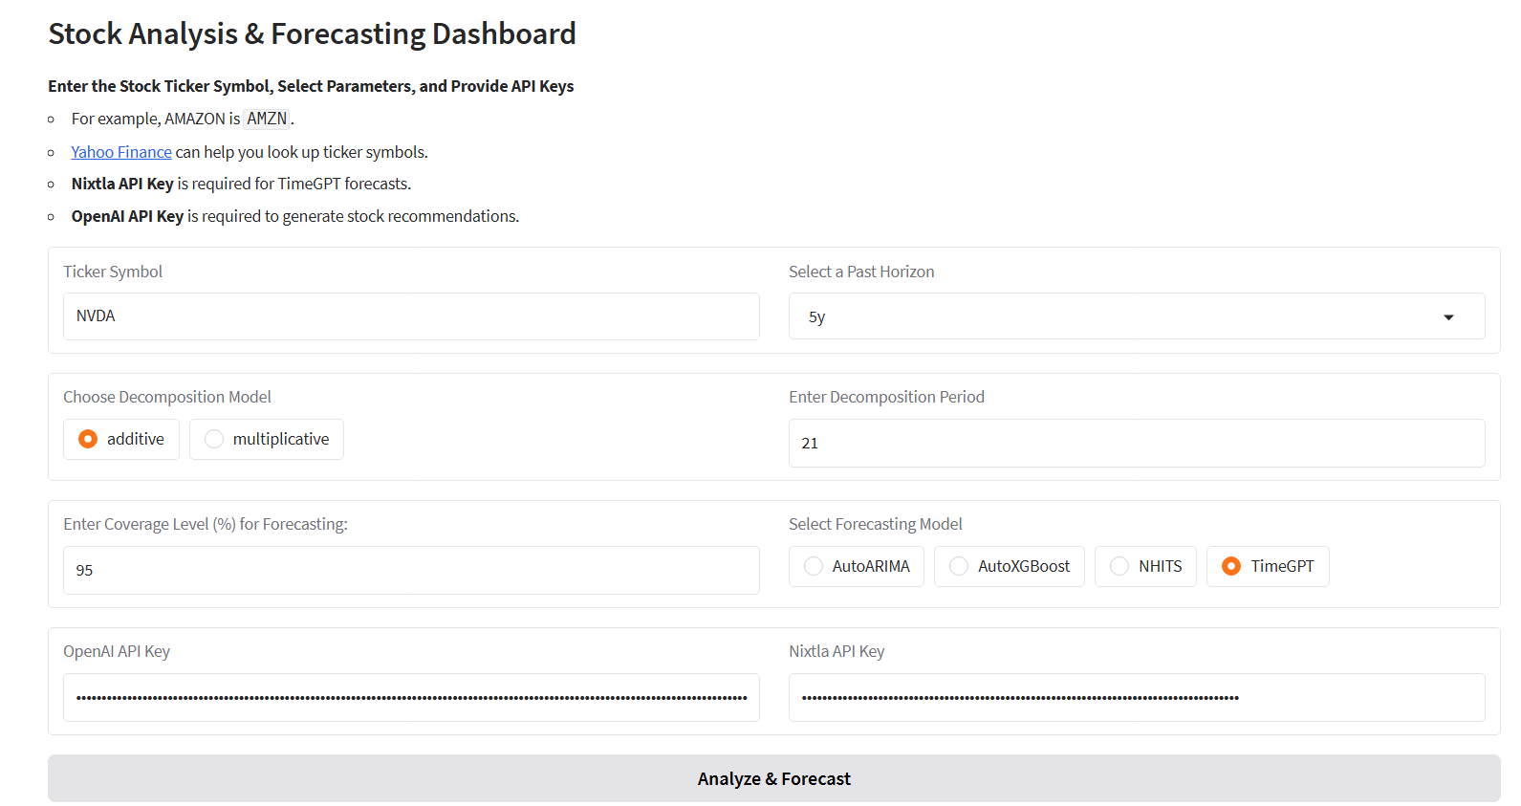

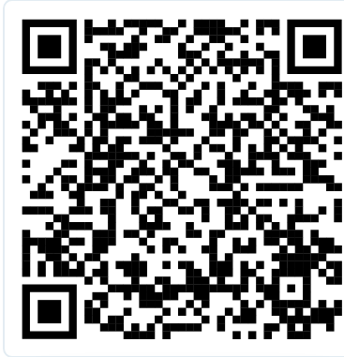
Build the App
Streamlit app
Hugging Face app

Slide 17
Conclusions
NIXTLA strengths and weaknesses
✅Good open-source framework projected for use cases with low code, and the opportunity for scalable solutions.
✅Broad framework with conformal prediction solutions for different models: from statistical to foundation models.
❌Different libraries for all models with no common approach (for instance, lag features, train history as in MLForecast, not available in all libraries).
❌Lack of detrending by linear model and Fourier series for seasonality.
❌ Lack of metrics for conformal prediction evaluation, like in MAPIE.
❌Documentation can be improved.

Slide 18
References
A Gentle Introduction to Conformal Prediction and Distribution-Free Uncertainty Quantification
Theoretical Foundations of Conformal Prediction
A Tutorial on Conformal Prediction
Conformal Prediction: A Unified Review of Theory and New Challenges
Conformal Prediction Guide
Practical Guide to applied Conformal Prediction in Python
Introduction to Conformal Prediction in Python
Awesome Conformal Prediction
Forecasting: Principles and Practice, the Pythonic Way
pyautogen · PyPI
Tutorials - Streamlit Docs
Gradio Documentation
Introduction - TimeGPT Foundational model for time series forecasting and anomaly detection
StatsForecast ⚡️ - Nixtla
mlforecast – Nixtla
About NeuralForecast – Nixtla
claudio1975/PyDataMilano
stock-market-forecasting-with-nixtla-conformal-prediction

Slide 19
?
?
?
?
Thank you
?
?
?
Keep in touch:
Linkedin
Newsletter
Medium
Website

