Slide 1

Stock Market Forecasting with Conformal Prediction and Stock Analysis with AI Agent Recommendations
Claudio Giorgio Giancaterino
30/10/2025

Slide 2


MySelf:
Actuary during the day &
AI Scientist in the free time
Reach Me:
MyLinks

Slide 3
Motivations
Uncertainty Quantification & Conformal Prediction
NIXTLA Conformal Prediction
AI Agent
Pyautogen AI Agent
Web App in Action
Agenda

Slide 4

Motivations
Build a Predictive AI use case
Experiment Conformal Prediction with stocks
Try to merge Predictive AI with the power of Generative AI
Google Banana

Slide 5
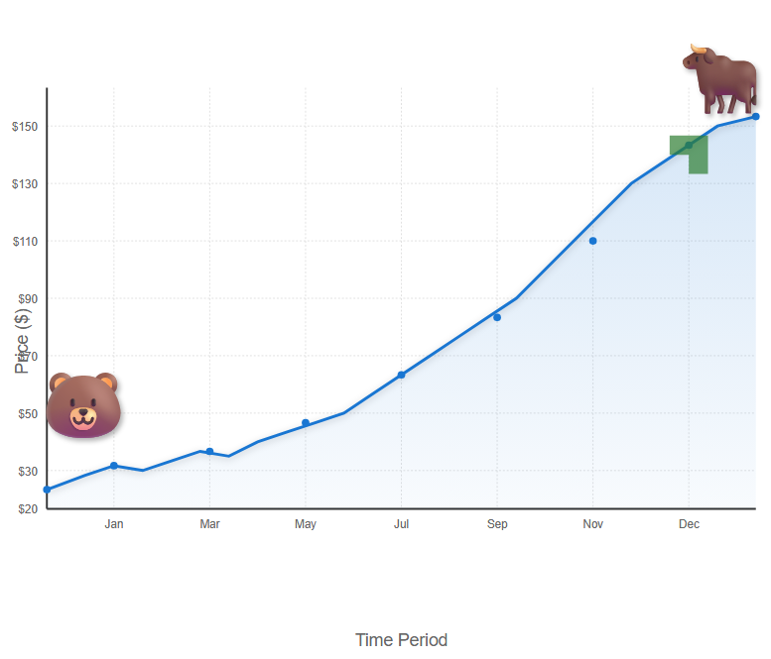
Why does uncertainty quantification matter?
Stock Investment Risk
https://deepai.org/machine-learning-model/text2img

Slide 6
Why does uncertainty quantification matter?
Uncertainty quantification is a crucial aspect of predictive modelling. Traditional predictions typically produce a single-point output for a given input because they rely on models that provide only the most likely outcome. These models either cannot capture the full complexity of the real world or are based on incomplete data.
Uncertainty can be broken into:
Aleatoric Uncertainty. This type of uncertainty arises from inherent randomness in the data. It is also known as statistical or irreducible uncertainty. In machine learning, aleatoric uncertainty can result from noise in the data or measurement errors.
Epistemic Uncertainty. This type of uncertainty arises from a lack of knowledge or information. It is also known as systematic or reducible uncertainty. Epistemic uncertainty can be reduced by gathering more data or improving the model.

Slide 7
Why Conformal Prediction ?
Uncertainty Quantification
Conformal Prediction
Certainty Quantification
Conformal prediction is a powerful machine learning framework used to evaluate the uncertainty of predictions. It turns point predictions into prediction sets/intervals.
Some advantages of using conformal prediction for uncertainty quantification:
-distribution-free;
-guaranteed coverage;
-model-agnostic;
-easy implementation

Slide 8
Conformal Prediction Properties
Validity
ensures that predictions are reliable and meet predefined coverage levels, making it crucial for applications where trust in predictions is relevant.
Efficiency
Exchangeability
ensures that predictions are consistent regardless of data order. For time series data, some mitigation approaches are required.
focuses on producing accurate and concise predictions, which is vital for practical implementation and resource management.

Slide 9
Confidence Intervals vs Prediction Intervals
The Confidence Interval shows the uncertainty of a population parameter, such as the mean.
The Prediction Interval shows the uncertainty of a specific value.
The Confidence Interval focuses on past or current events.
The Prediction Interval focuses on future events.
A Prediction Interval is generally wider than a Confidence Interval, because the Prediction Interval must account for the additional uncertainty of a single observation compared to the mean.
https://medium.com/data-science/confidence-interval-vs-prediction-interval-a6b0c4816a92

Slide 10
Full Conformal Prediction (Trasductive) leverages the entire dataset for training and requires model retraining for each new prediction. This approach ensures that each prediction is made with the most up-to-date information. It‘s the most general and computationally intensive approach.
Split Conformal Prediction
(Inductive) splits the data into training and calibration sets. The model is trained once on the training set, and the calibration set is used to adjust the prediction intervals. It‘s the computationally efficient variant.
Cross-Conformal prediction
is a resampling-based method that generalises the split conformal prediction. Data is split into K folds; for each fold, the model is trained on the remaining K-1 folds, and the prediction interval is computed on the left-out fold. The final prediction interval is built by aggregating results across all partitions.
Conformal Prediction Methods

Slide 11
Conformal Prediction as a Recipe
Non Conformity Score
Miscoverage rate/Coverage
Data Splitting (optional but common)
Train the model
Calibrate the model
Prediction on unseen data
https://medium.com/data-science/all-you-need-is-conformal-prediction-726f18920241

Slide 12

Conformal Prediction as a Recipe: numerical example on Time Series
🎯 First Goal
Build a 90% prediction interval for time series forecasting using conformal prediction.
✅ Assumptions
-15 consecutive timestamps of data.
-Predict the next value in the series using some forecasting model.
Split dataset:
-First 10 timestamps as the training set
-Next 5 timestamps as the calibration set
The conformal prediction goal is 90% coverage, so alpha = 0,1.
✅ Split Time Series
Time 1 2 3 4 5 6 7 8 9 10 11 12 13 14 15
Value 80 82 83 92 94 85 88 94 98 96 99 91 96 90 89
Train a model on timestamps 1–10
Predict timestamps 11–15 using the model trained on 1-10
Compute non-conformity scores for 11-15 (calibration) -> s= | $y −\hat{y}$|
Use those scores to form intervals for the future timestamp (16)

Slide 13

Conformal Prediction as a Recipe: numerical example on Time Series
✅ Train the Forecasting Model and get errors:
Time 11 12 13 14 15
True outcome 99 91 96 90 89
Predicted outcome 97 95 94 91 90
Non-conformity scores 2 4 2 1 1
✅ Sort the non-conformity scores (in ascending order): [1,1,2,2,4]
✅ Compute the quantile index (with finite sample correction) for the n samples
$k=min⁡(n,\left[\left(1−α\right)\left(n+1\right))\right]=\left[0,9×6\right]=\left[5,4\right]=5$
Set the threshold value from the sorted non-conformity scores => $\hat{q}$=5kth=4
✅ Build the prediction Interval
Given a prediction at the 16 timestamps $\hat{y}$=92
The 90% conformal prediction interval is: [$\hat{y}$- $\hat{q}$, $\hat{y}$+ $\hat{q}$]=[92-4,92+4]=[88,96]

Slide 14

Conformal Prediction as a Recipe: numerical example on Time Series
🎯 Second Goal
Build a 90% prediction interval for timestamp 17 using a rolling window approach. This preserves temporal order and allows the non-conformity scores to reflect the most recent data distribution, partially mitigating the non-exchangeability issue that violates standard conformal prediction assumptions.
✅ Split Time Series
Time 2 3 4 5 6 7 8 9 10 11 12 13 14 15 16
Value 82 83 92 94 85 88 94 98 96 99 91 96 90 89 97
Train a model on timestamps 2–11
Predict timestamps 12–16 using the model trained on 2-11
Compute non-conformity scores for 12-16 (calibration) -> s= | $y −\hat{y}$|
Use those scores to form intervals for the future timestamp (17)

Slide 15

Conformal Prediction as a Recipe: numerical example on Time Series
✅ Train the Forecasting Model and get errors
Time 12 13 14 15 16
True outcome 91 96 90 89 97
Predicted outcome 95 94 91 90 92
Non-conformity scores 4 2 1 1 5
✅ Sort the non-conformity scores (in ascending order): [1,1,2,4,5]
✅ Compute the quantile index (with finite sample correction) for the n samples
$k=min⁡(n,\left[\left(1−α\right)\left(n+1\right))\right]=\left[0,9×6\right]=\left[5,4\right]=5$
Set the threshold value from the sorted non-conformity scores => $\hat{q}$=5kth=5
✅ Build the prediction Interval
Given a prediction at the 17 timestamps $\hat{y}$=93
The 90% conformal prediction interval is: [$\hat{y}$- $\hat{q}$, $\hat{y}$+ $\hat{q}$]=[93-5,93+5]=[88,98]

Slide 16
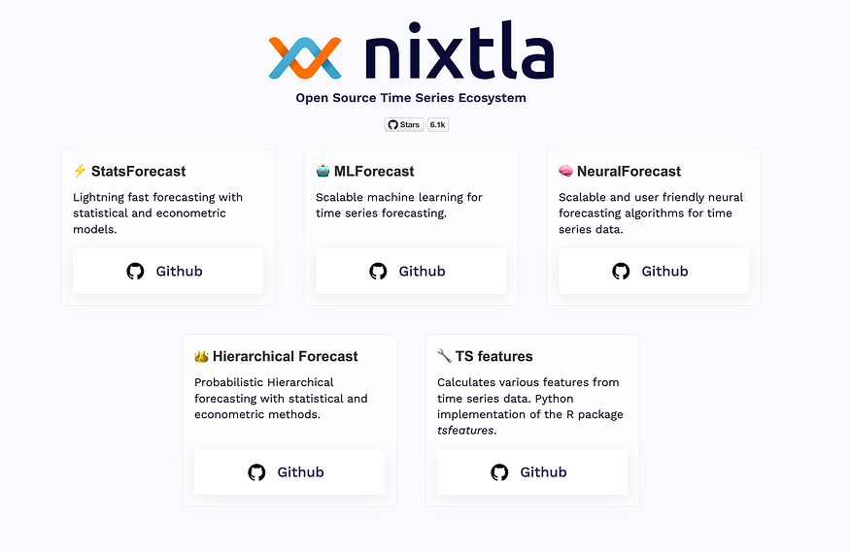
Conformal Prediction with NIXTLA
Nixtla is an open-source framework dedicated to time series forecasting, and it is helpful for low-code.
Organized into the following libraries:
-StatsForecast;
-MLForecast;
-NeuralForecast;
-TimeGPT
Conformal Prediction Approaches:
-Conformal Distribution;
-Conformal Error
Nixtla’s Approach to Non-Exchangeable Data using Rolling Window Cross-Validation for Interval Calibration
https://www.nixtla.io/open-source

Slide 17
What are AI Agents?
An AI agent is an application designed to achieve a goal by observing the world and acting upon it using the available tools. These agents are autonomous and can act independently of human intervention when given proper goals. In the context of Generative AI, an agent is a program that enables Large Language Models (LLMs) to perform actions by extending their capabilities through access to tools, knowledge, and learning from experience.
LLMs
Action
Knowledge
Tools
Learning

Slide 18
Reasoning
Collaborating
Why AI Agents?
-> Autonomously Perform Tasks
-> Adapt and Learn
-> Increase Productivity and Efficiency
-> Enable Personalisation and Scalability
Acting
Observing
Self-Refining
Planning

Slide 19

pyautogen framework for AI Agents development
AutoGen (pyautogen), now as AG2, is an open-source programming framework originally developed by Microsoft. It is designed for building AI agents and sophisticated cooperation among multiple agents in order to solve complex tasks.
https://deepai.org/machine-learning-model/text2img

Slide 20
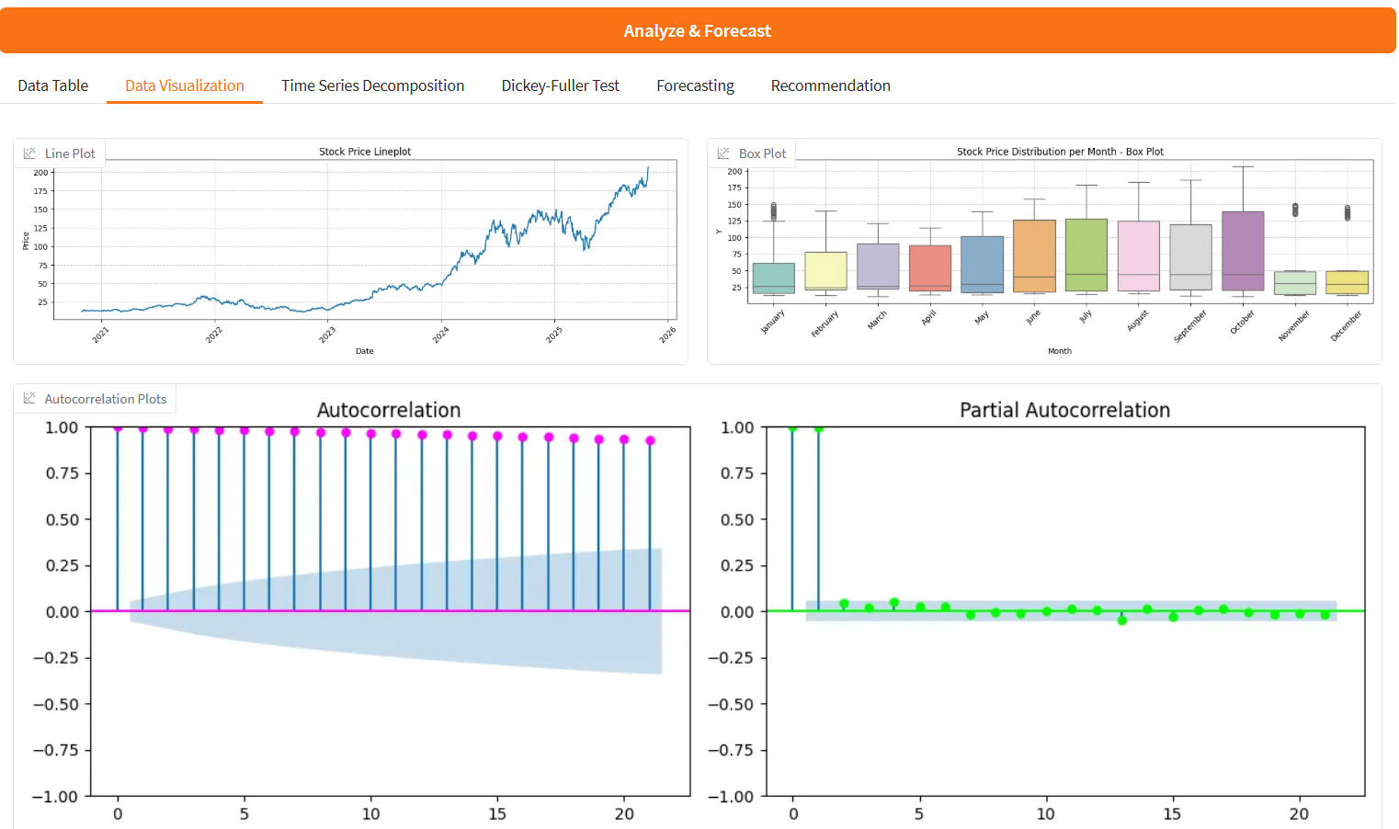
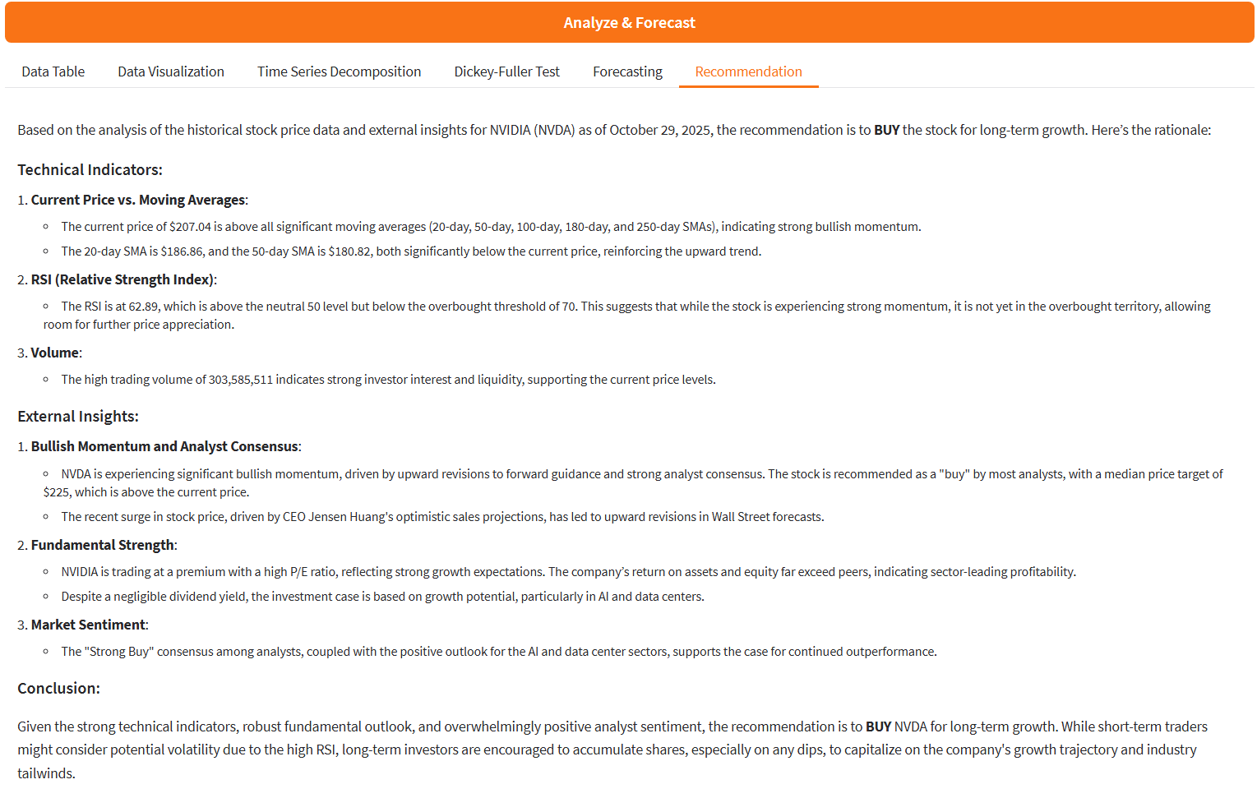
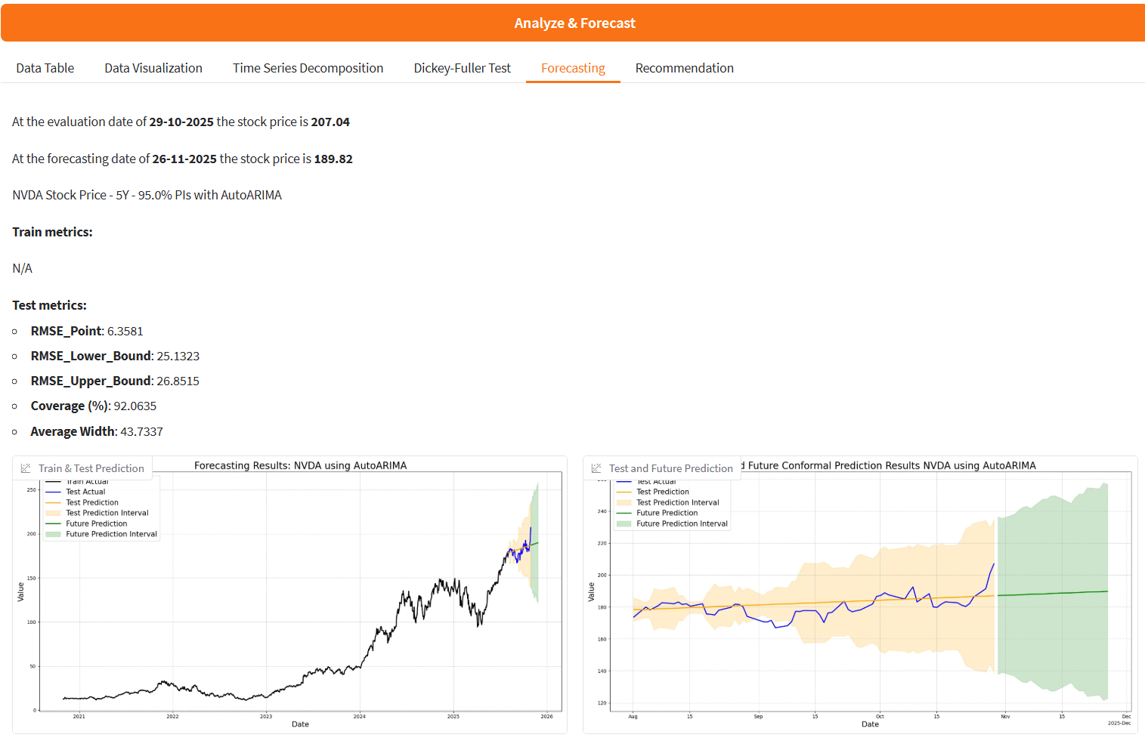

Build the App
Hugging Face app

Slide 21
Conclusions
What I’ve learned
✅NIXTLA for time series is a good open-source framework projected for use cases with low code and the opportunity for scalable solutions.
✅AI Agents employed as recommendation systems are powerful in explaining your data and in managing external resources.
✅Hugging Face Spaces are GitHub repositories that are easy to use and can be used as your portfolio.

Slide 22
References
A Gentle Introduction to Conformal Prediction and Distribution-Free Uncertainty Quantification
Theoretical Foundations of Conformal Prediction
A Tutorial on Conformal Prediction
Conformal Prediction: A Unified Review of Theory and New Challenges
Conformal Prediction Guide
Practical Guide to applied Conformal Prediction in Python
Introduction to Conformal Prediction in Python
Awesome Conformal Prediction
Forecasting: Principles and Practice, the Pythonic Way
pyautogen · PyPI
Gradio Documentation
Introduction - TimeGPT Foundational model for time series forecasting and anomaly detection
StatsForecast ⚡️ - Nixtla
mlforecast – Nixtla
About NeuralForecast – Nixtla
Notebooks
stock-market-forecasting-with-nixtla-conformal-prediction

Slide 23
?
?
?
?
Thank you
?
?
?
Keep in touch:
Linkedin
Newsletter
Medium
Website

