Slide 1
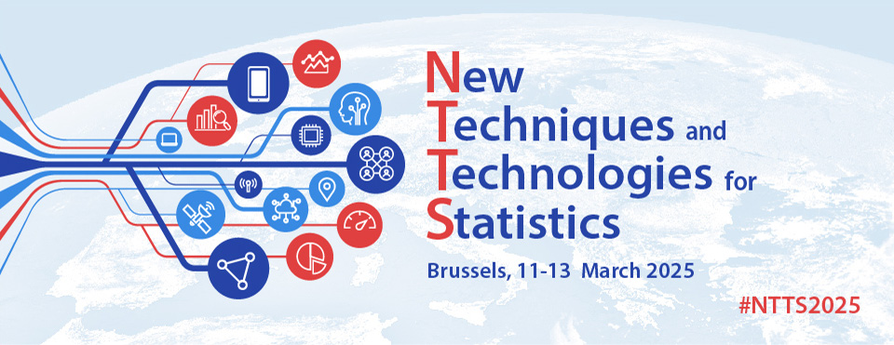

US Injuries Flood Prediction with Large Language Models Data Augmentation
#NTTS2025
Brussels, 13th March 2025
Claudio G. Giancaterino

Slide 2

Earth’s Changing Climate is the new challenge of this century
https://www.climatechangeguide.com/climate-change.html
What is Climate Change?
Climate change refers to a significant difference in the average temperature, precipitation, wind patterns, cloudiness, humidity, atmospheric pressure, and other factors of the climate system observed over decades, usually 30 years or more.

Slide 3
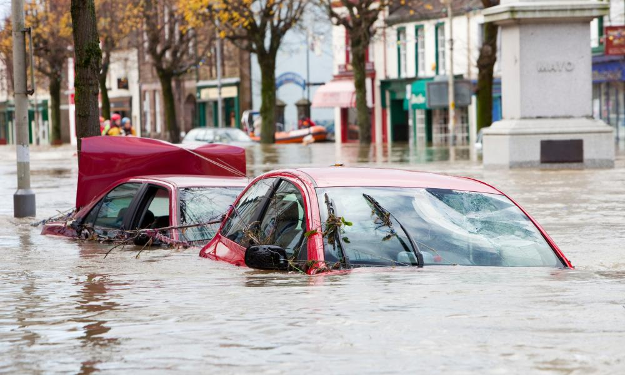
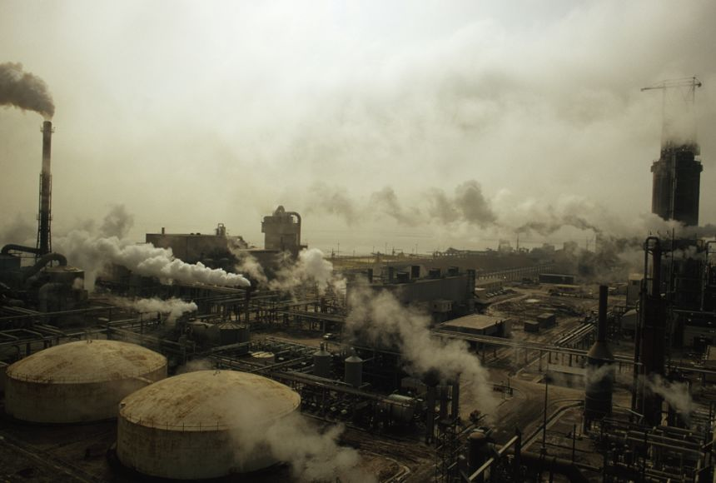
https://www.wwf.org.uk/learn/climate-change#why-we-need-to-act-now-on-climate-change
Causes of Climate Change
Burning fossil fuels: industrialised nations have been burning excessive amounts of fossil fuels like coal, oil, and gas for the past 150 years, which releases carbon dioxide.
Farming and livestock breeding: countries have intensified their agricultural activities to sustain meat-heavy diets, resulting in significant greenhouse gas emissions.
Cutting down forests: large-scale deforestation reduces the absorption of carbon dioxide, as trees naturally absorb it.
Impact of Climate Change
-Extreme weather events
-Ecological effects
-Impacts on people
-Damage and fatalities
https://education.nationalgeographic.org/resource/earths-changing-climate/

Slide 4
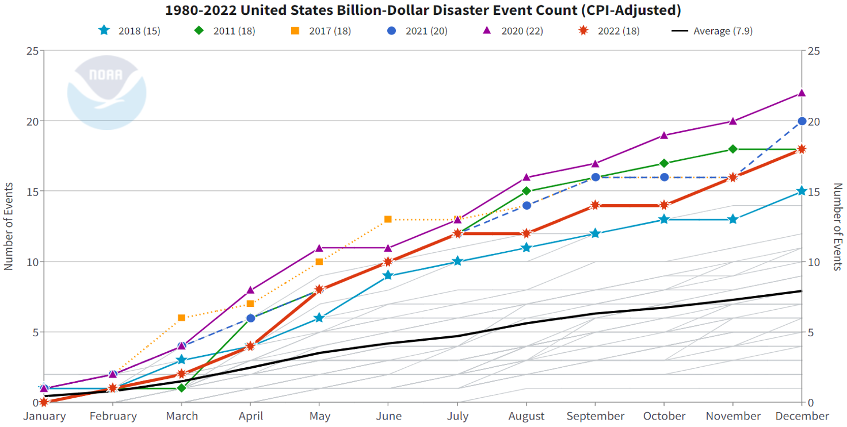
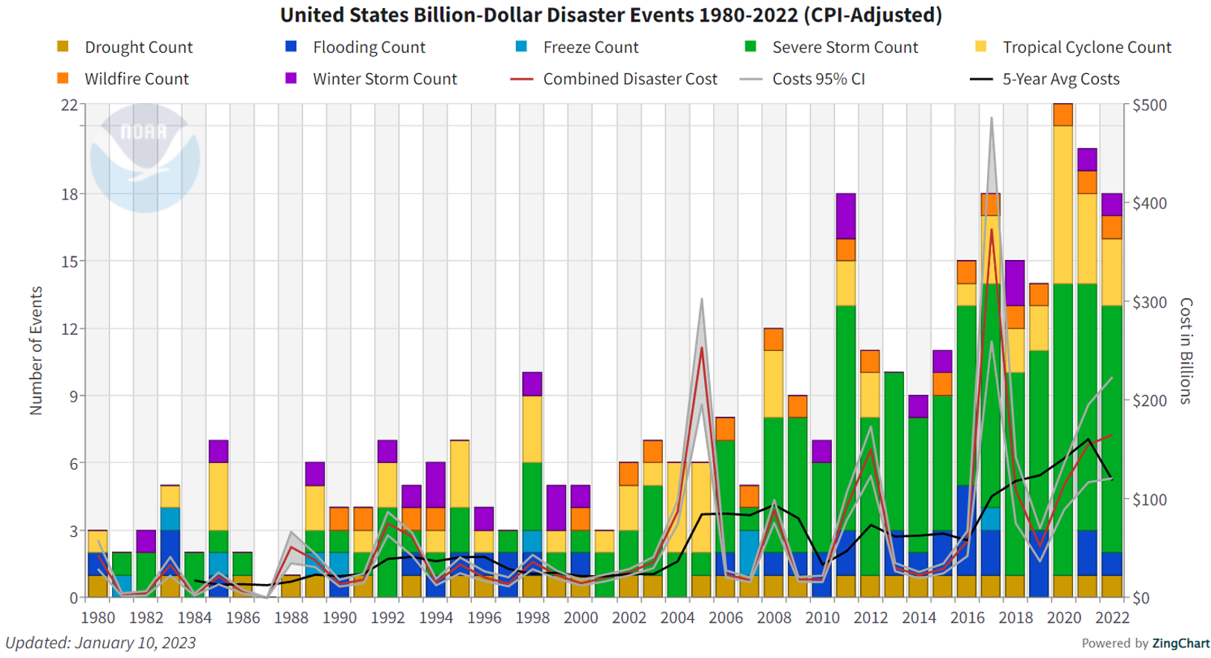
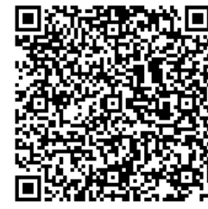
Influence of Climate Change on Environmental Events
In 2023, the NOAA National Centers for Environmental Information (NCEI) released the 2022 U.S. weather and climate disasters report. Since 1980, the U.S. has experienced 341 weather and climate disasters where overall damages/costs reached or exceeded $1 billion, with a cumulative cost exceeding $2.475 trillion. Mitigating future risks requires addressing the compounding hazards driven by our changing climate.
https://www.climate.gov/news-features/blogs/beyond-data/2022-us-billion-dollar-weather-and-climate-disasters-historical

Slide 5


Data Flow Chart
Data Cleaning
Data Augmentation with LLMs
Feature Engineering
Data Collection
ExploratoryData Analysis
Pre-Processing
Risk Modelling
Single-Step
Forecasting
Multi-Step
Forecasting

Slide 6

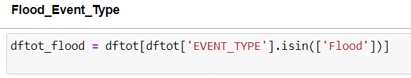
Data Collection & Data Cleaning
Data have been collected from the open source NCDC Storm Events Database.
Storm Data is provided by the National Weather Service (NWS) and contain statistics on personal injuries, deaths and damage estimates.
Storm Data covers the United States of America. The data collected began as early as 1950 through to the 2022.
The data contain a chronological listing, by state, of hurricanes, tornadoes, thunderstorms, hail, floods, drought conditions, lightning, high winds,
snow, temperature extremes and other weather phenomena.
From the website has been downloaded dataset for each year and then merged into one big dataset.
The data collected contains 51 columns included 2 text columns, and 1.794.914 rows.
The job has been done on “flood” event type, so firstly the database was realized selecting rows with the interested event type, then removing all missing values, and redundant columns or not related to the topic.
Last step involved the monetary conversion from string to numbers for the damage columns.
The final shape of the dataset: 31 columns x 38.398 records.
Database: https://www.ncei.noaa.gov/access/metadata/landing-page/bin/iso?id=gov.noaa.ncdc:C00510
Dictionary:
https://www.ncei.noaa.gov/pub/data/swdi/stormevents/csvfiles/Storm-Data-Bulk-csv-Format.pdf

Slide 7
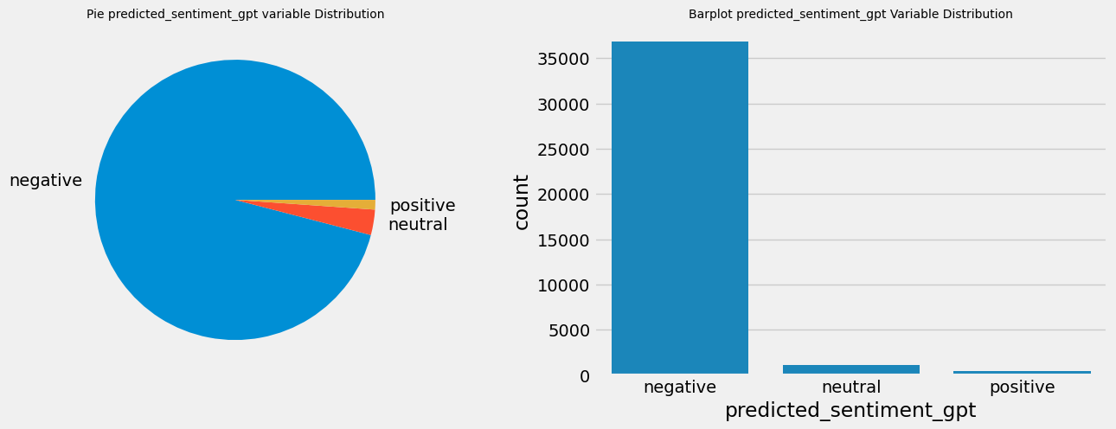
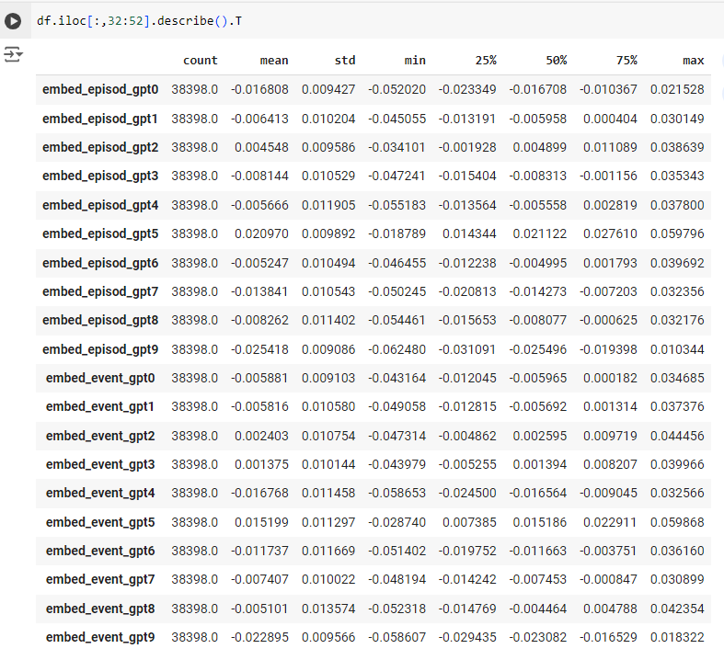
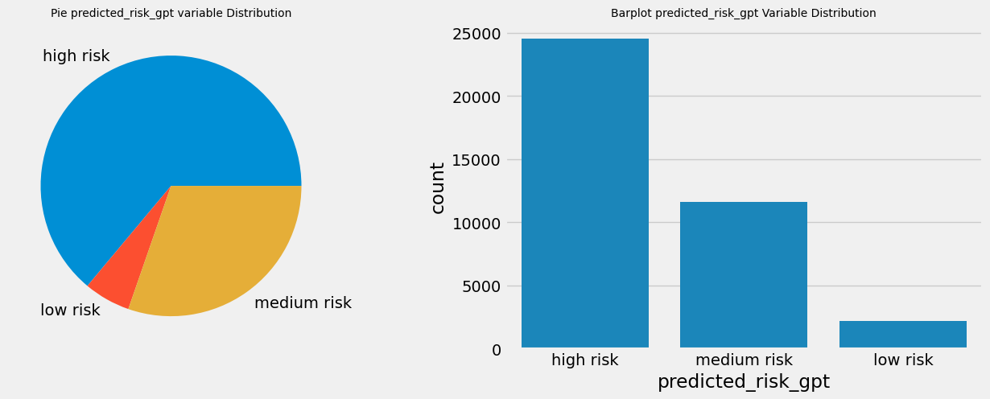
Data Augmentation with Large Language Models
Scikit-LLM is a Python library that incorporates large language models into the scikit-learn
framework. It’s a tool to perform Natural Language Processing (NLP) tasks all within the Scikit-Learn
pipeline. It started integrating OpenAI models. In this role, GPT-3.5 turbo (ChatGPT engine) was used for data augmentation by constructing features using zero-shot text classification and text vectorization.

Slide 8
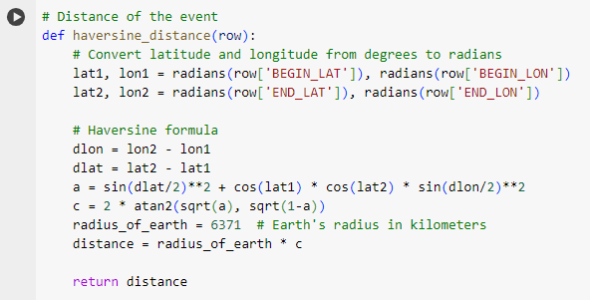
Feature Engineering
In this process, new features were created by extracting the year, month, day, and time from the beginning and end of each event. The difference between dates was extrapolated in days and hours, origin and destination names were merged, categorical features were encoded, grouping less relevant classes. New target variables were generated grouping the target variables of interest with secondary target variables. The distance between the starting and ending points of the event was calculated using the haversine distance. Lag and rolling window mean features were generated to capture seasonality.
Target Variables
Injuries Direct
Deaths Direct
Damage Property
Injuries Indirect
Deaths Indirect
Damage Crops
New Target Variables
Injuries Direct
Deaths Direct
Damage Property
Whole Injuries
Whole Deaths
Whole Damage

Slide 9
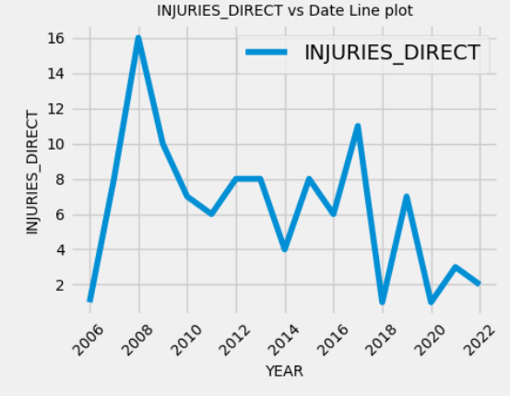
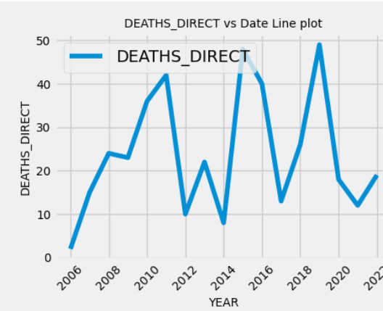
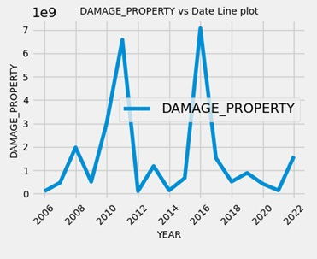
Exploratory Data Analysis
After data cleaning and data augmentation, the dataset reached the following shape:
53 columns and 38398 rows. The observations span from 2006 to 2022.
-The Injuries Direct target variable shows a peak of injuries in 2006, followed by a decreasing number in the subsequent years with a second peak in 2017. California had the highest number of injuries registered.
-The Deaths Direct target variable shows fluctuating behaviour, with peaks in mortality observed in 2011, 2015, and 2019. Kentucky, Missouri, and North Carolina had the highest number of deaths observed.
-The Damage Property target variable indicates two peaks of disasters in 2011 and 2016, with Lousiana having the highest level of damage.

Slide 10
Pre-Processing
Removed Outliers with Isolation Forest
Removed Zero Variance and Correlated Predictors

Slide 11
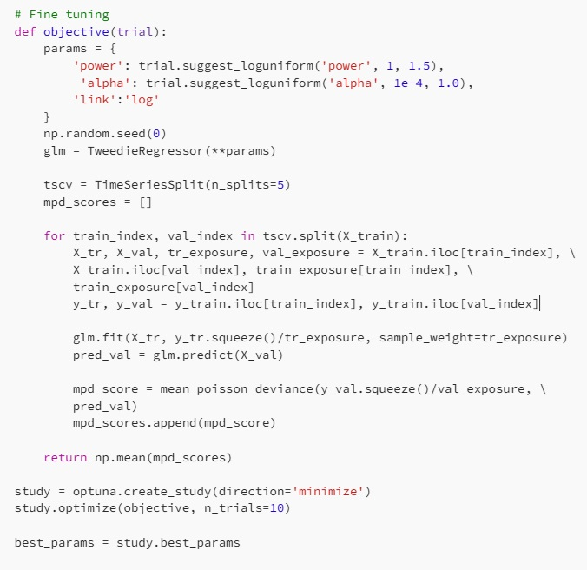
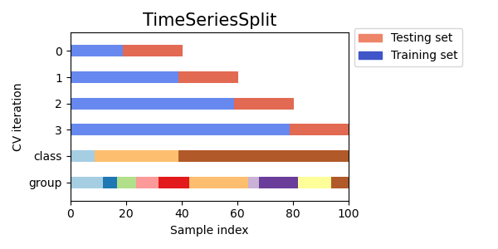
Risk Modelling
Generalized Linear Models (GLM) using Tweedie distribution
Generalized Additive Models (GAM)
Gradient Boosting Machines by LightGBM, XGBoost, CATBoost
Fine-tuned models using a time series cross validation with optuna, an automatic hyperparameter optimization software framework.

Slide 12
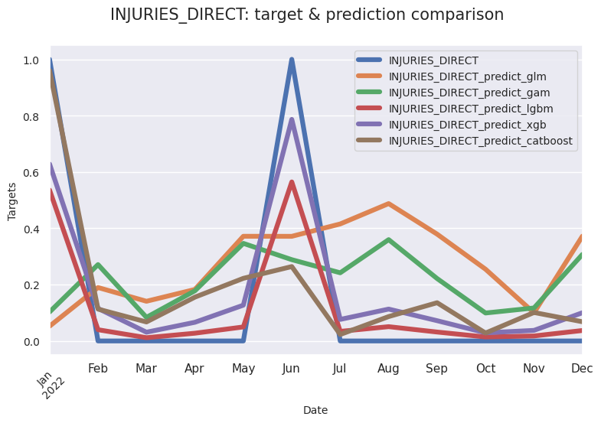
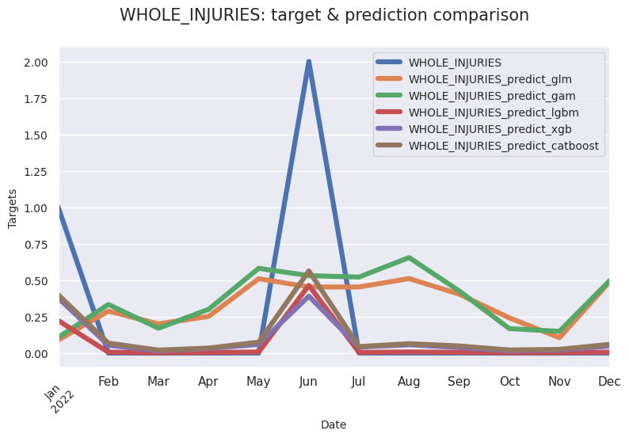
Single-Step Forecasting (Predictions)
Train:
2006-2021
Test:
2022
Gradient Boosting Machines can generalise observations in a better way

Slide 13
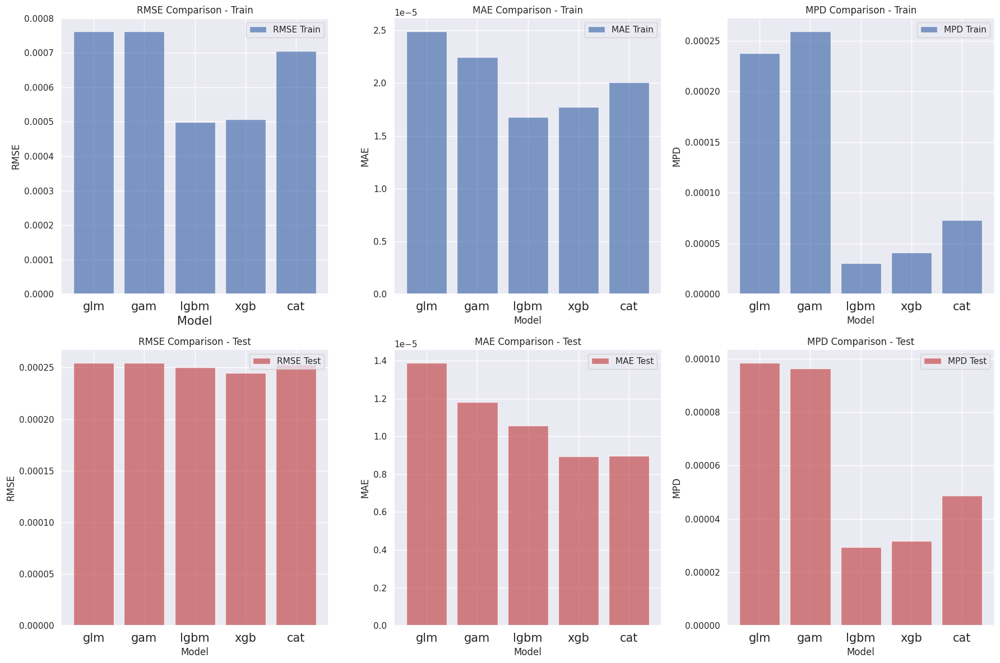
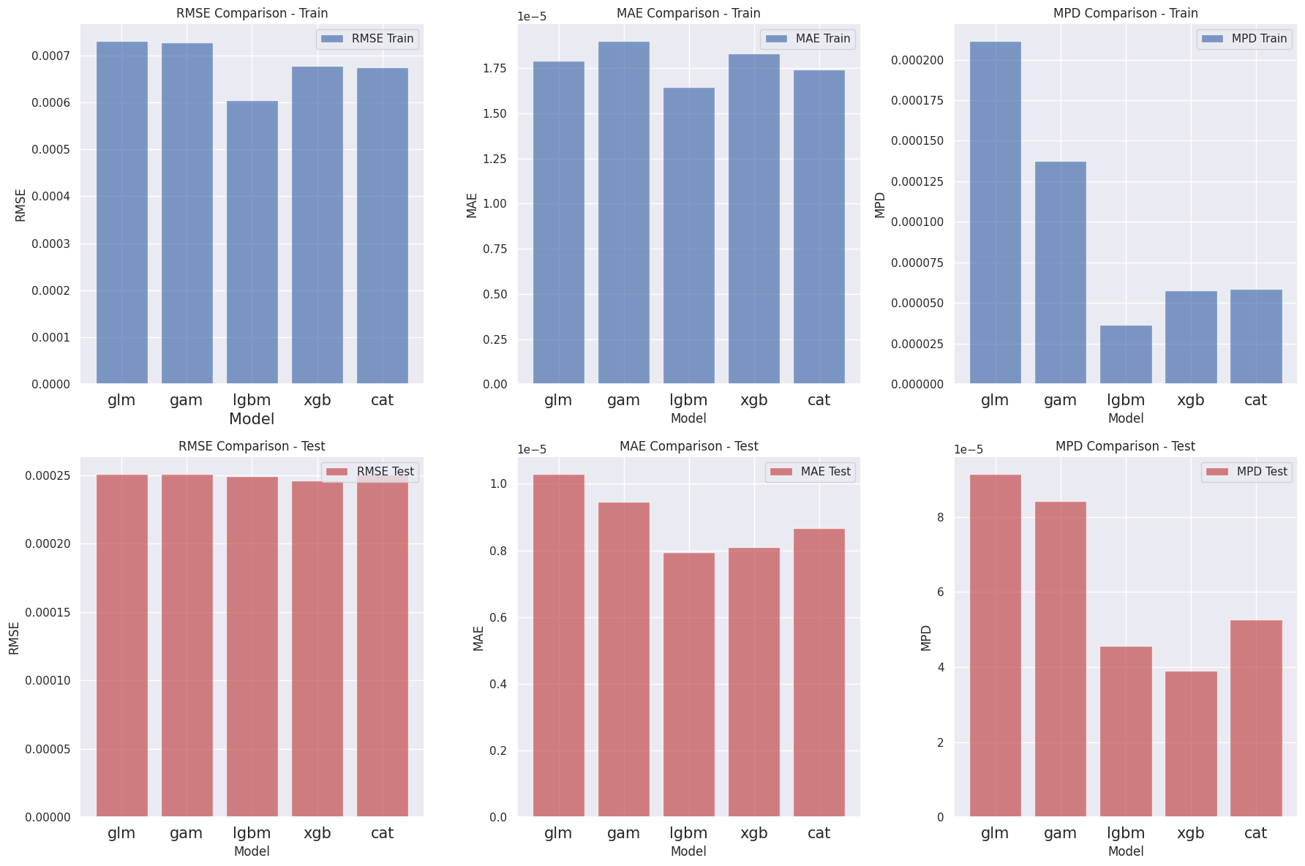
Single-Step Forecasting (Performance no augmentation)
Performance comparison on RMSE, MAE and Mean Poisson Deviance (MPD) metrics. Actuarial models are not competitive compared with Gradient Boosting Machines.
InjuriesDirect
Whole Injuries

Slide 14
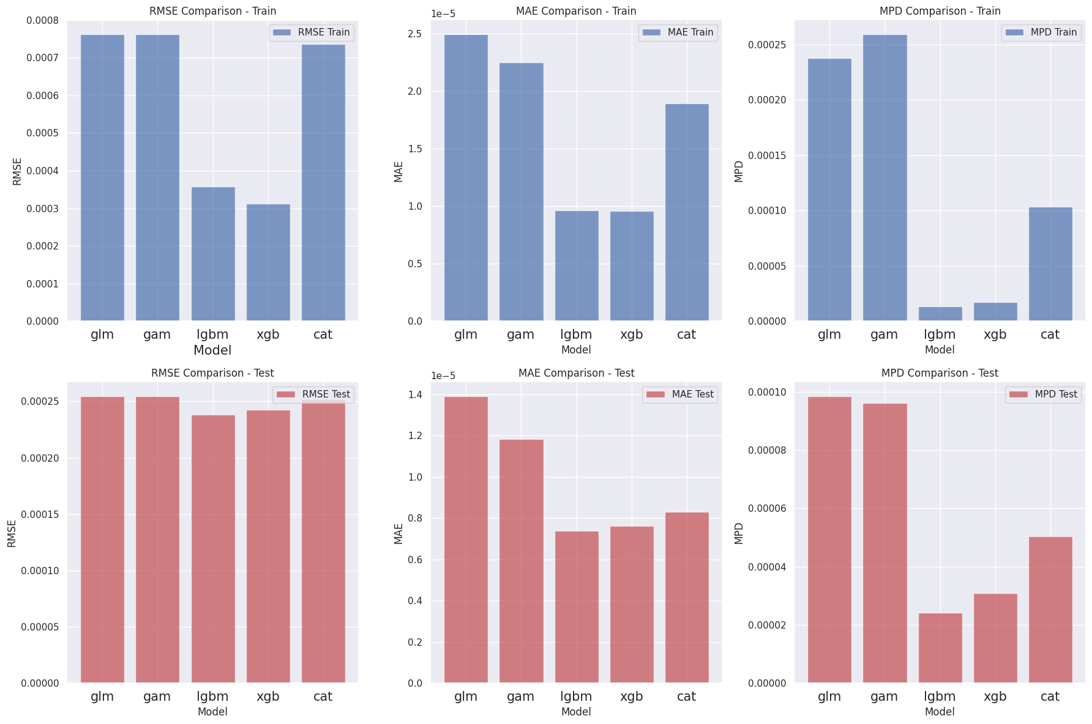
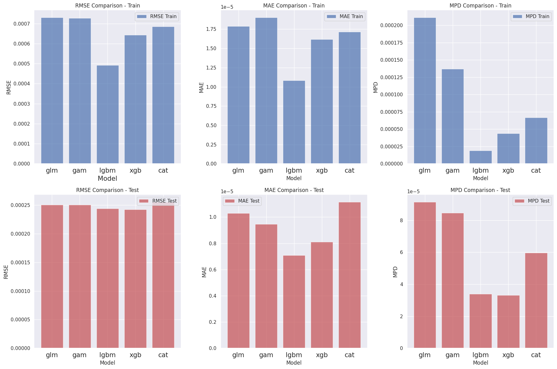
Single-Step Forecasting (Performance with augmentation)
Additional LLMs features boost performance at the ensemble trees, especially LightGBM and XGBoost.
Injuries Direct
Whole Injuries

Slide 15
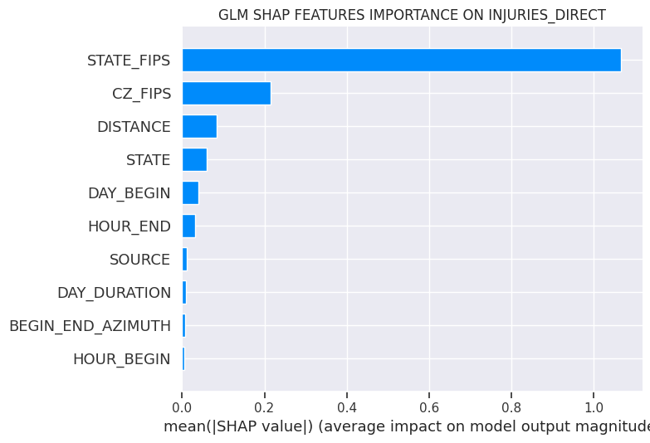
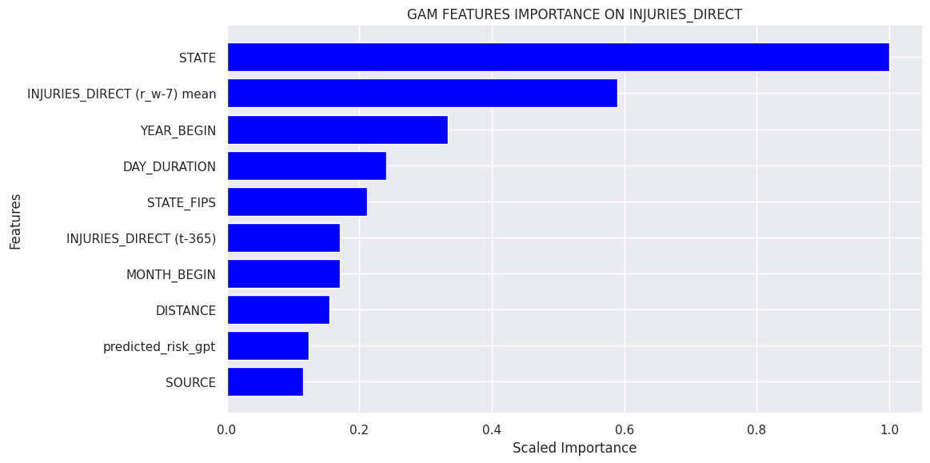
Single-Step Forecasting (Features Importance)
Only GAM shows the Predicted risk GPT feature among the top ten most important features,
but it does not impact on performance.

Slide 16
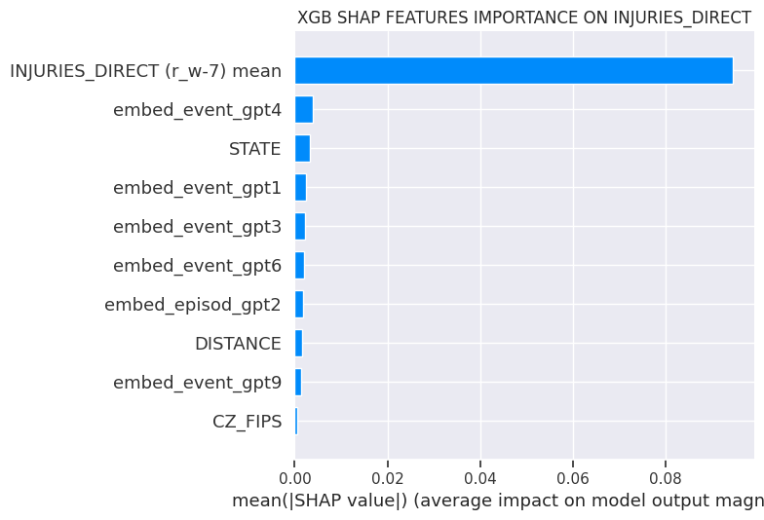
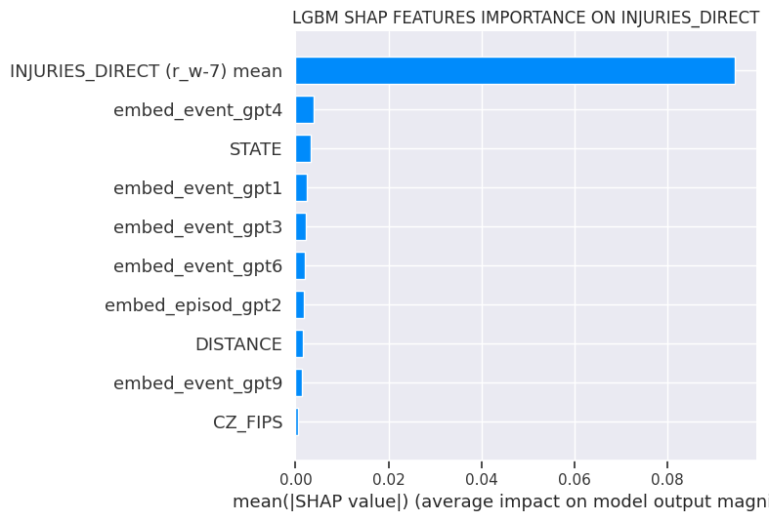

Single-Step Forecasting (Features Importance)
Gradient Boosting Machines shows rolling window mean as the most important feature followed by the embedding features.

Slide 17
Multi-Step Forecasting
In single step forecasting, the goal is to predict just the next time point: t -> t+1
In multi-step forecasting the goal is to predict the next horizon time points into the future, with h>1 and predict t+1, t+2, t+3…
One technique is the Recursive Forecasting: train one model and use it recursively for each step of the horizon.
Train:
2006-2019
T+1:
2020
T+2:
2021
T+3:
2022

Slide 18
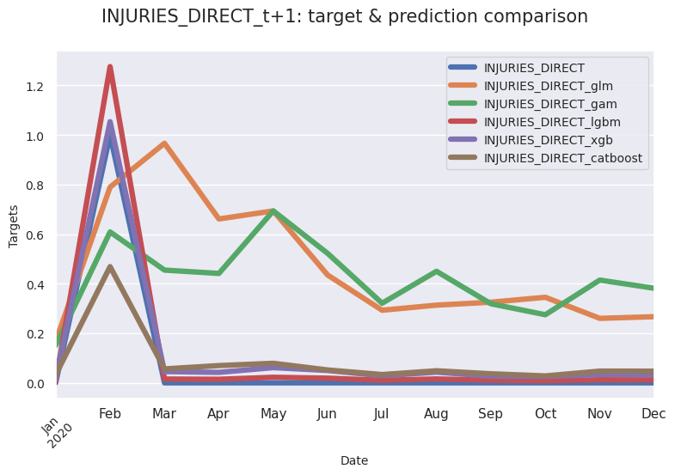
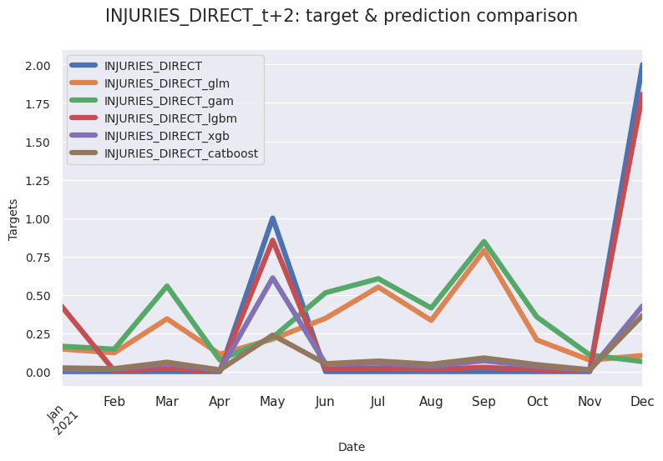
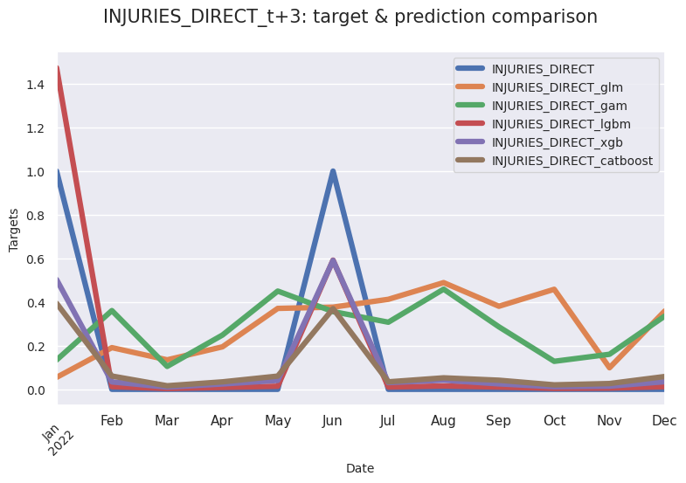
Multi-Step Forecasting (Predictions)
T+1
T+2
T+3
Gradient Boosting Machines outperform actuarial models in all forecasting steps.

Slide 19
Take-Aways
Fighting climate risk events requires big data to improve prediction and understanding features involved in these events.
This study showcases the potential of integrating modern Machine Learning and Generative AI to enhance climate change modelling and prediction. The results highlight the importance of feature engineering in general and the role of features extracted and generated by LLMs.
Modern Machine Learning and Generative AI can be used to improve the mapping of high-risk zones providing more accurate quotes.

Slide 20
References
Claudio G. Giancaterino, *US Injuries Flood Prediction with Large Language Models Data Augmentation*, SSRN. https://papers.ssrn.com/sol3/papers.cfm?abstract_id=5120965
P.J. Brockwell, R.A. Davis (2016). *Introduction to Time Series and Forecasting*, Springer.
J. Birkmann, T. Welle (2015). *Assessing the risk of loss and damage: exposure, vulnerability and risk to climate-related hazards for different country classifications*, International Journal of Global Warming.
Dineva Snezhana, (2023). *Applying Artificial Intelligence (AI) for Mitigation Climate Change Consequences of the Natural Disasters*, SSRN.
Adam B. Smith (2022). *2022 U.S. billion-dollar weather and climate disasters in historical context*, NOAA National Centers for Environmental Information.
Data: https://www.ncei.noaa.gov/access/metadata/landing-page/bin/iso?id=gov.noaa.ncdc:C00510
Github Repository: https://github.com/claudio1975/US_Injuries_Flood_Prediction

Slide 21




?
?
?
?
Thank you
?
?
?
Keep in touch:
Linkedin Newsletter Medium Website

