Slide 1
Optimus Mexico
PV + BESS revenue optimization for the Mexican electricity market
System overview & flow | June 2026 | Goldbeck Solar

Slide 2
What is Optimus Mexico?
Purpose: estimate how much money a solar + battery project would make at any node of the Mexican electricity market — and whether a behind-the-meter battery pays off for an industrial CFE customer.
Two analysis tracks in one tool:
Wholesale (MEM): CENACE hourly PML prices + PV profile → optimized BESS dispatch → revenues from energy arbitrage, PPAs and the capacity market.
Behind-the-Meter (CFE): 15-minute load data → CFE bill reconstruction (GDMTH) → peak-shaving / TOU dispatch → investor decision with GO / REVISE / NO-GO.
Deliverables: interactive web app, Excel / Word / PDF / PowerPoint reports, investor-grade summaries with CAPEX/OPEX/IRR, full pytest-verified engine (71 tests).
Built to be integrated into Optimus AI after testing.

Slide 3
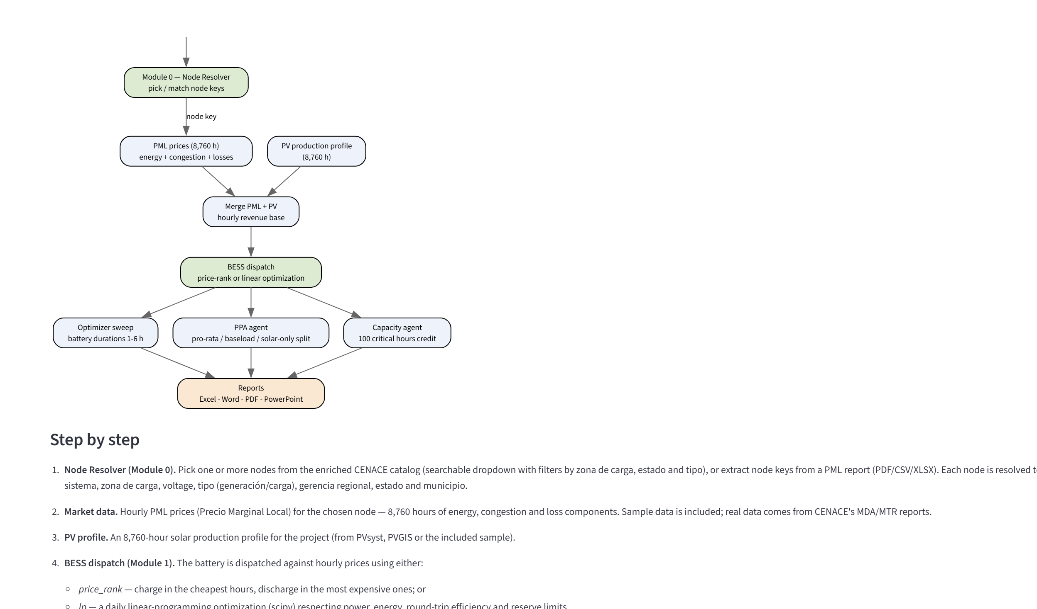
System flow — wholesale market track
CENACE node catalog
~3,000 NodosP enriched with zona, tipo, gerencia, estado
Node Resolver
pick nodes from dropdown or extract from PML reports
Market & PV data
8,760 h PML + PV profile (upload or MW AC/MWp/yield specs)
BESS dispatch
price-rank heuristic or daily linear optimization
PPA / Capacity
contract structures + 100 critical hours credit
Reports
Excel, Word, PDF, PowerPoint + investor report + project IRR

Slide 4
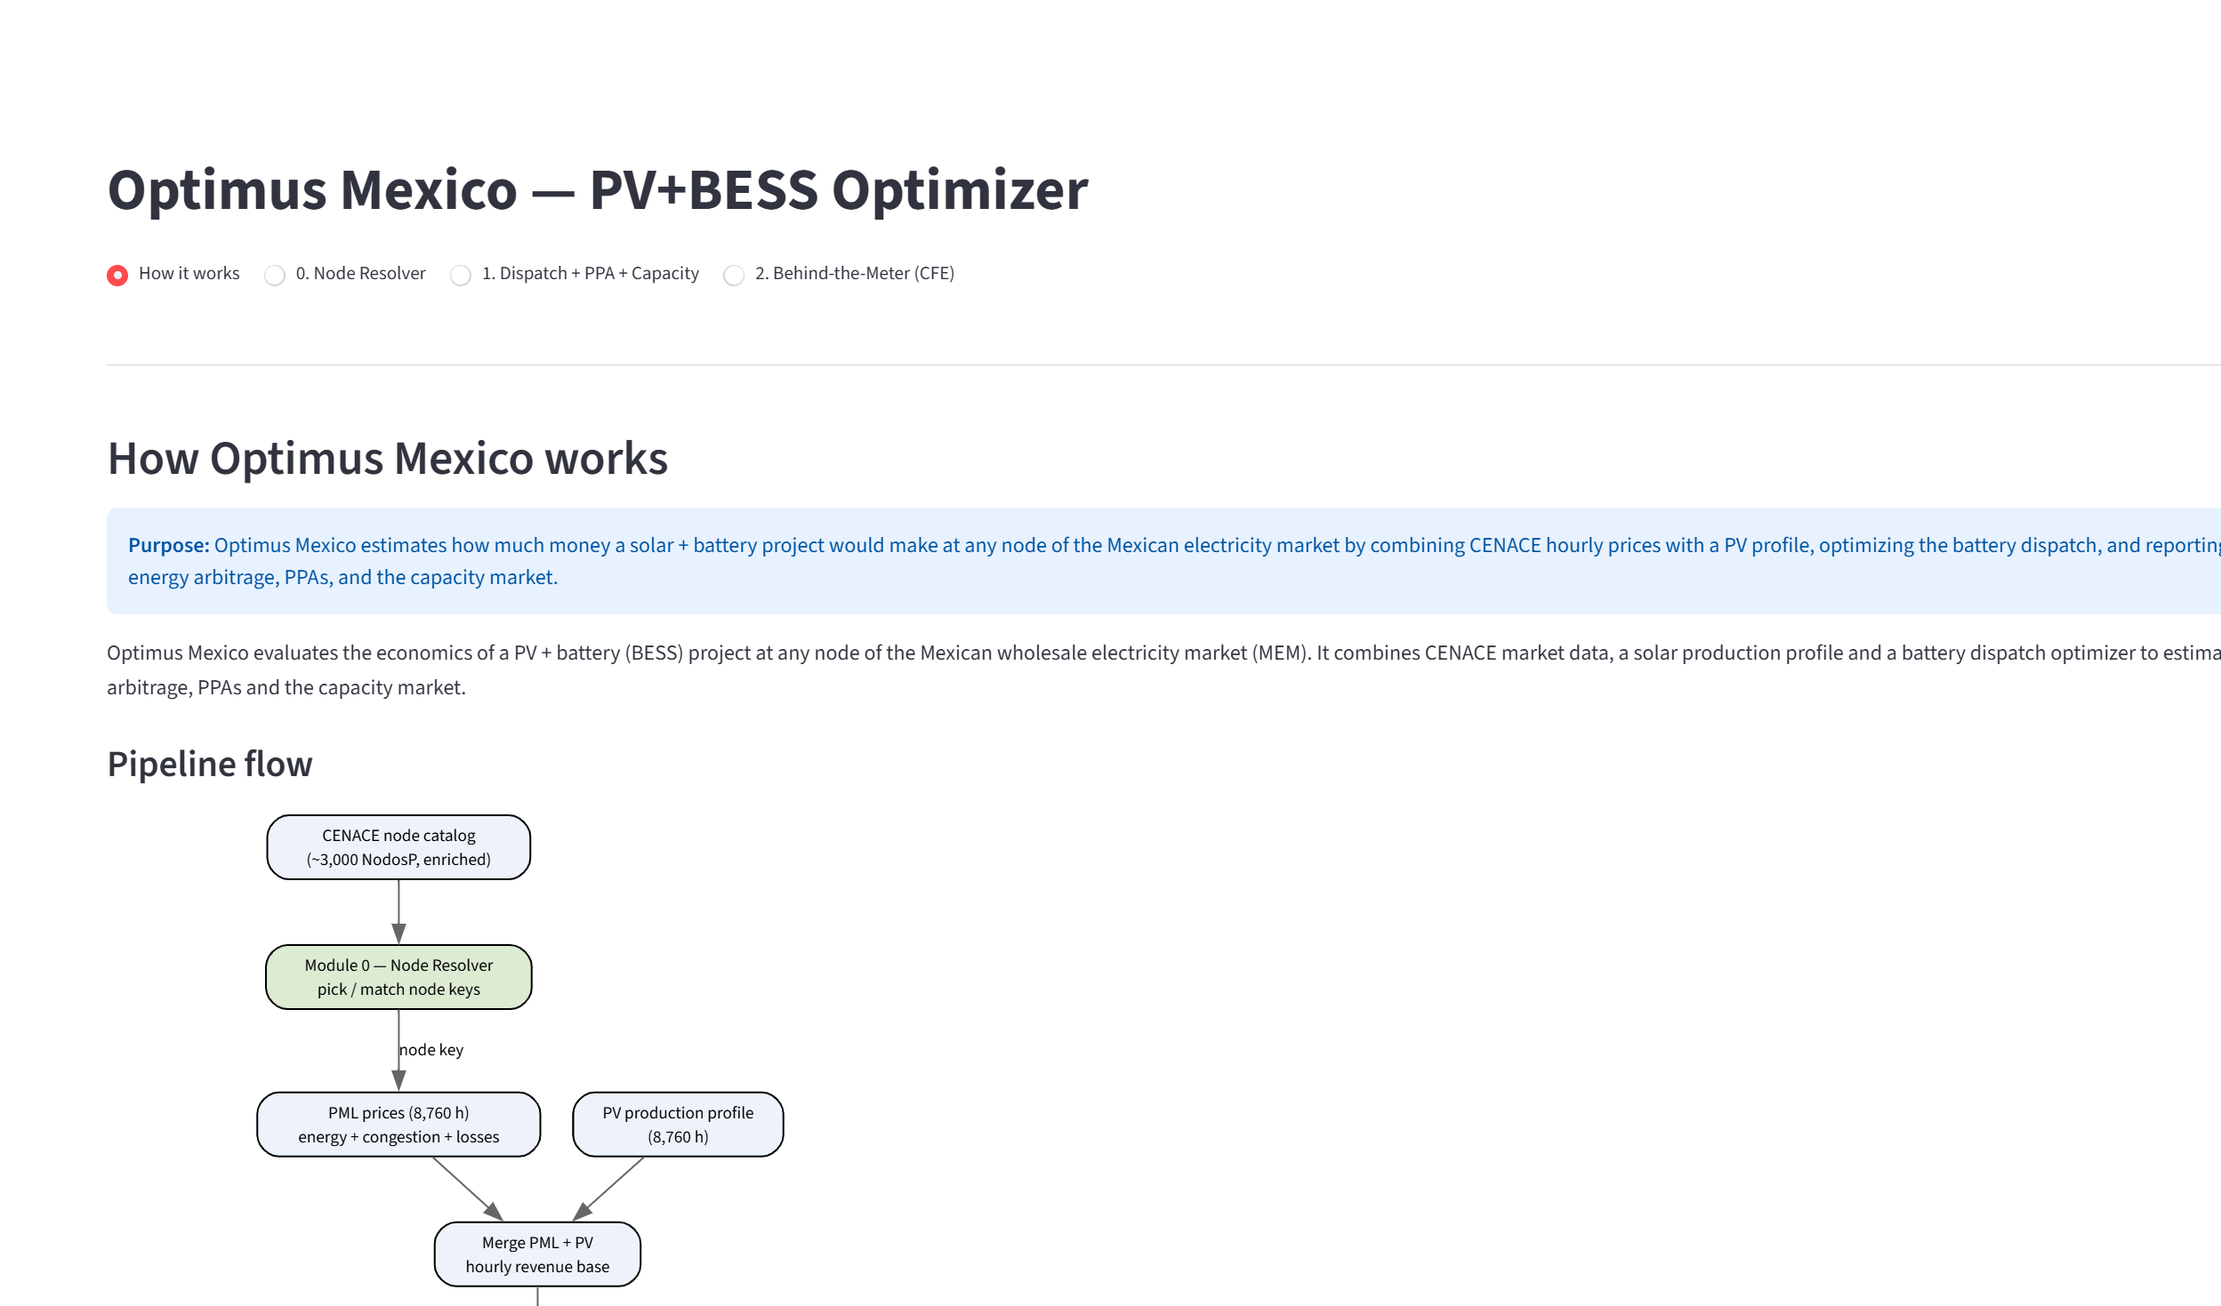
The app — horizontal navigation, four pages
How it works — purpose, pipeline diagram, data inventory with live found/missing status.
0. Node Resolver — searchable catalog dropdown with filters.
1. Front-of-Meter Dispatch + PPA + Capacity — wholesale revenue + CAPEX/OPEX/IRR.
2. Behind-the-Meter (CFE) — bill savings, readiness gate, savings IRR.
PV input: upload a profile OR enter MW AC, MWp, yield and degradation.
Launch: double-click run_app.bat (creates venv and installs dependencies automatically).

Slide 5
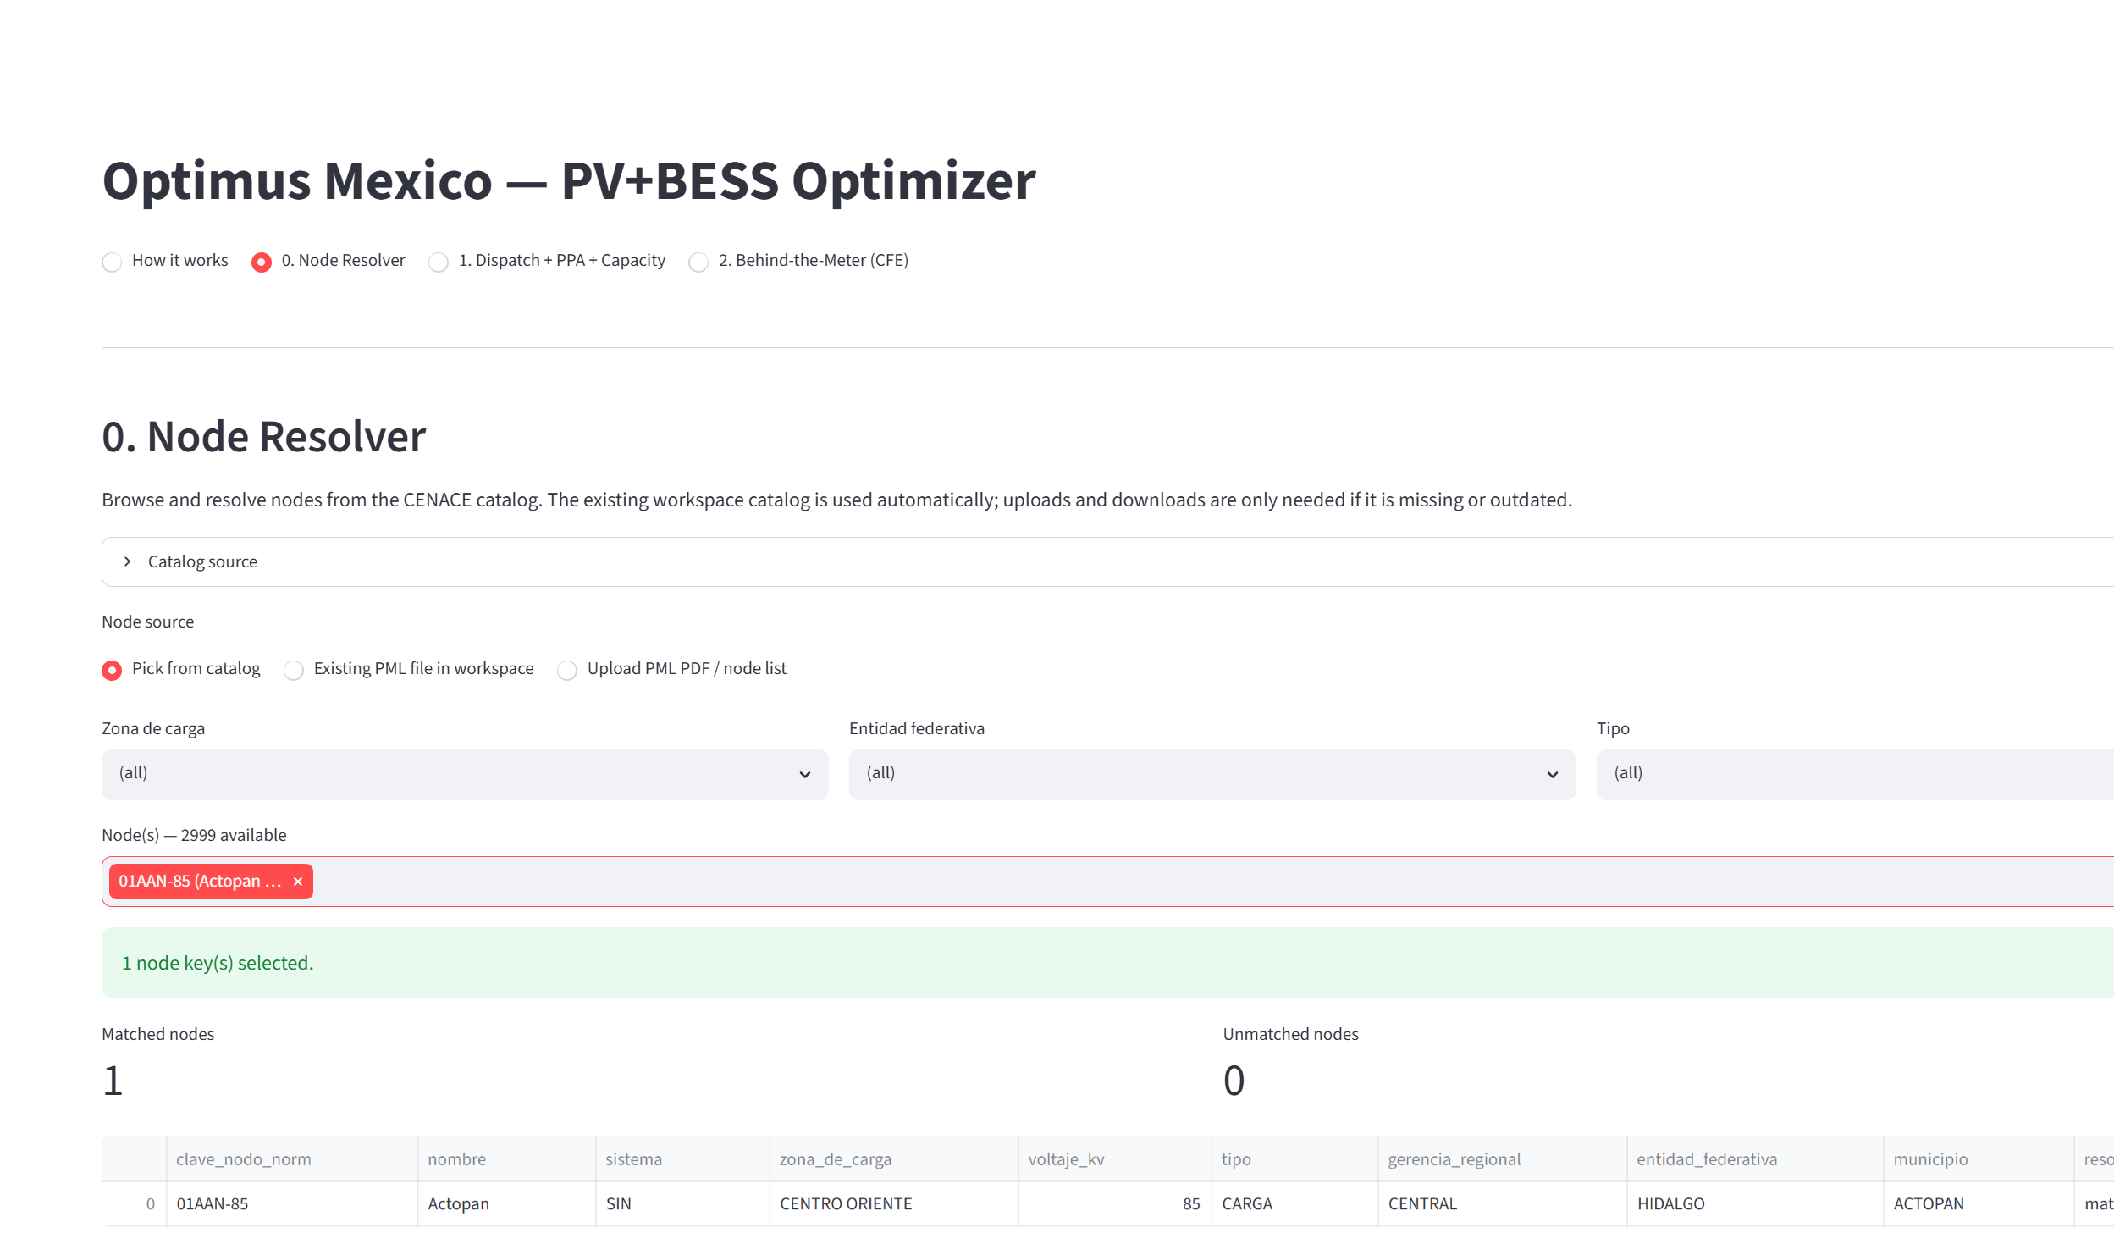
Module 0 — Node Resolver
Every project starts at a node: the price point where energy is settled.
Enriched CENACE catalog: 2,999 nodes with zona de carga, tipo (generación/carga), gerencia regional, estado and municipio.
Pick nodes from a searchable dropdown (filter by zona, estado, tipo) — or extract node keys from a CENACE PML report (PDF/CSV/XLSX).
Output: resolution workbook with full node context, ready for the dispatch module or the PML scraper.

Slide 6
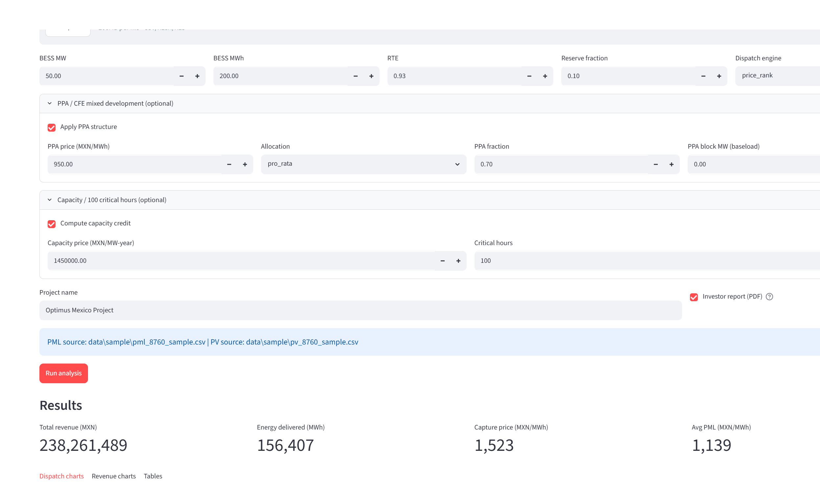
Module 1 — Front-of-Meter Dispatch, PPA & Capacity
Merges 8,760 h of nodal PML prices with PV (upload or synthesized from specs).
Battery dispatch engines:
price_rank — transparent daily heuristic (charge cheap, discharge expensive)
lp — daily linear program with SOC carry-over, efficiency and cycle limits
Duration sweep 2-8 h finds the most profitable battery size.
PPA structures: pro-rata, baseload block, solar-only — vs merchant.
Capacity market: 100 critical hours → accredited MW → MXN/year.
Project economics: PV+BESS CAPEX, OPEX/insurance, financing → unlevered & levered IRR.

Slide 7
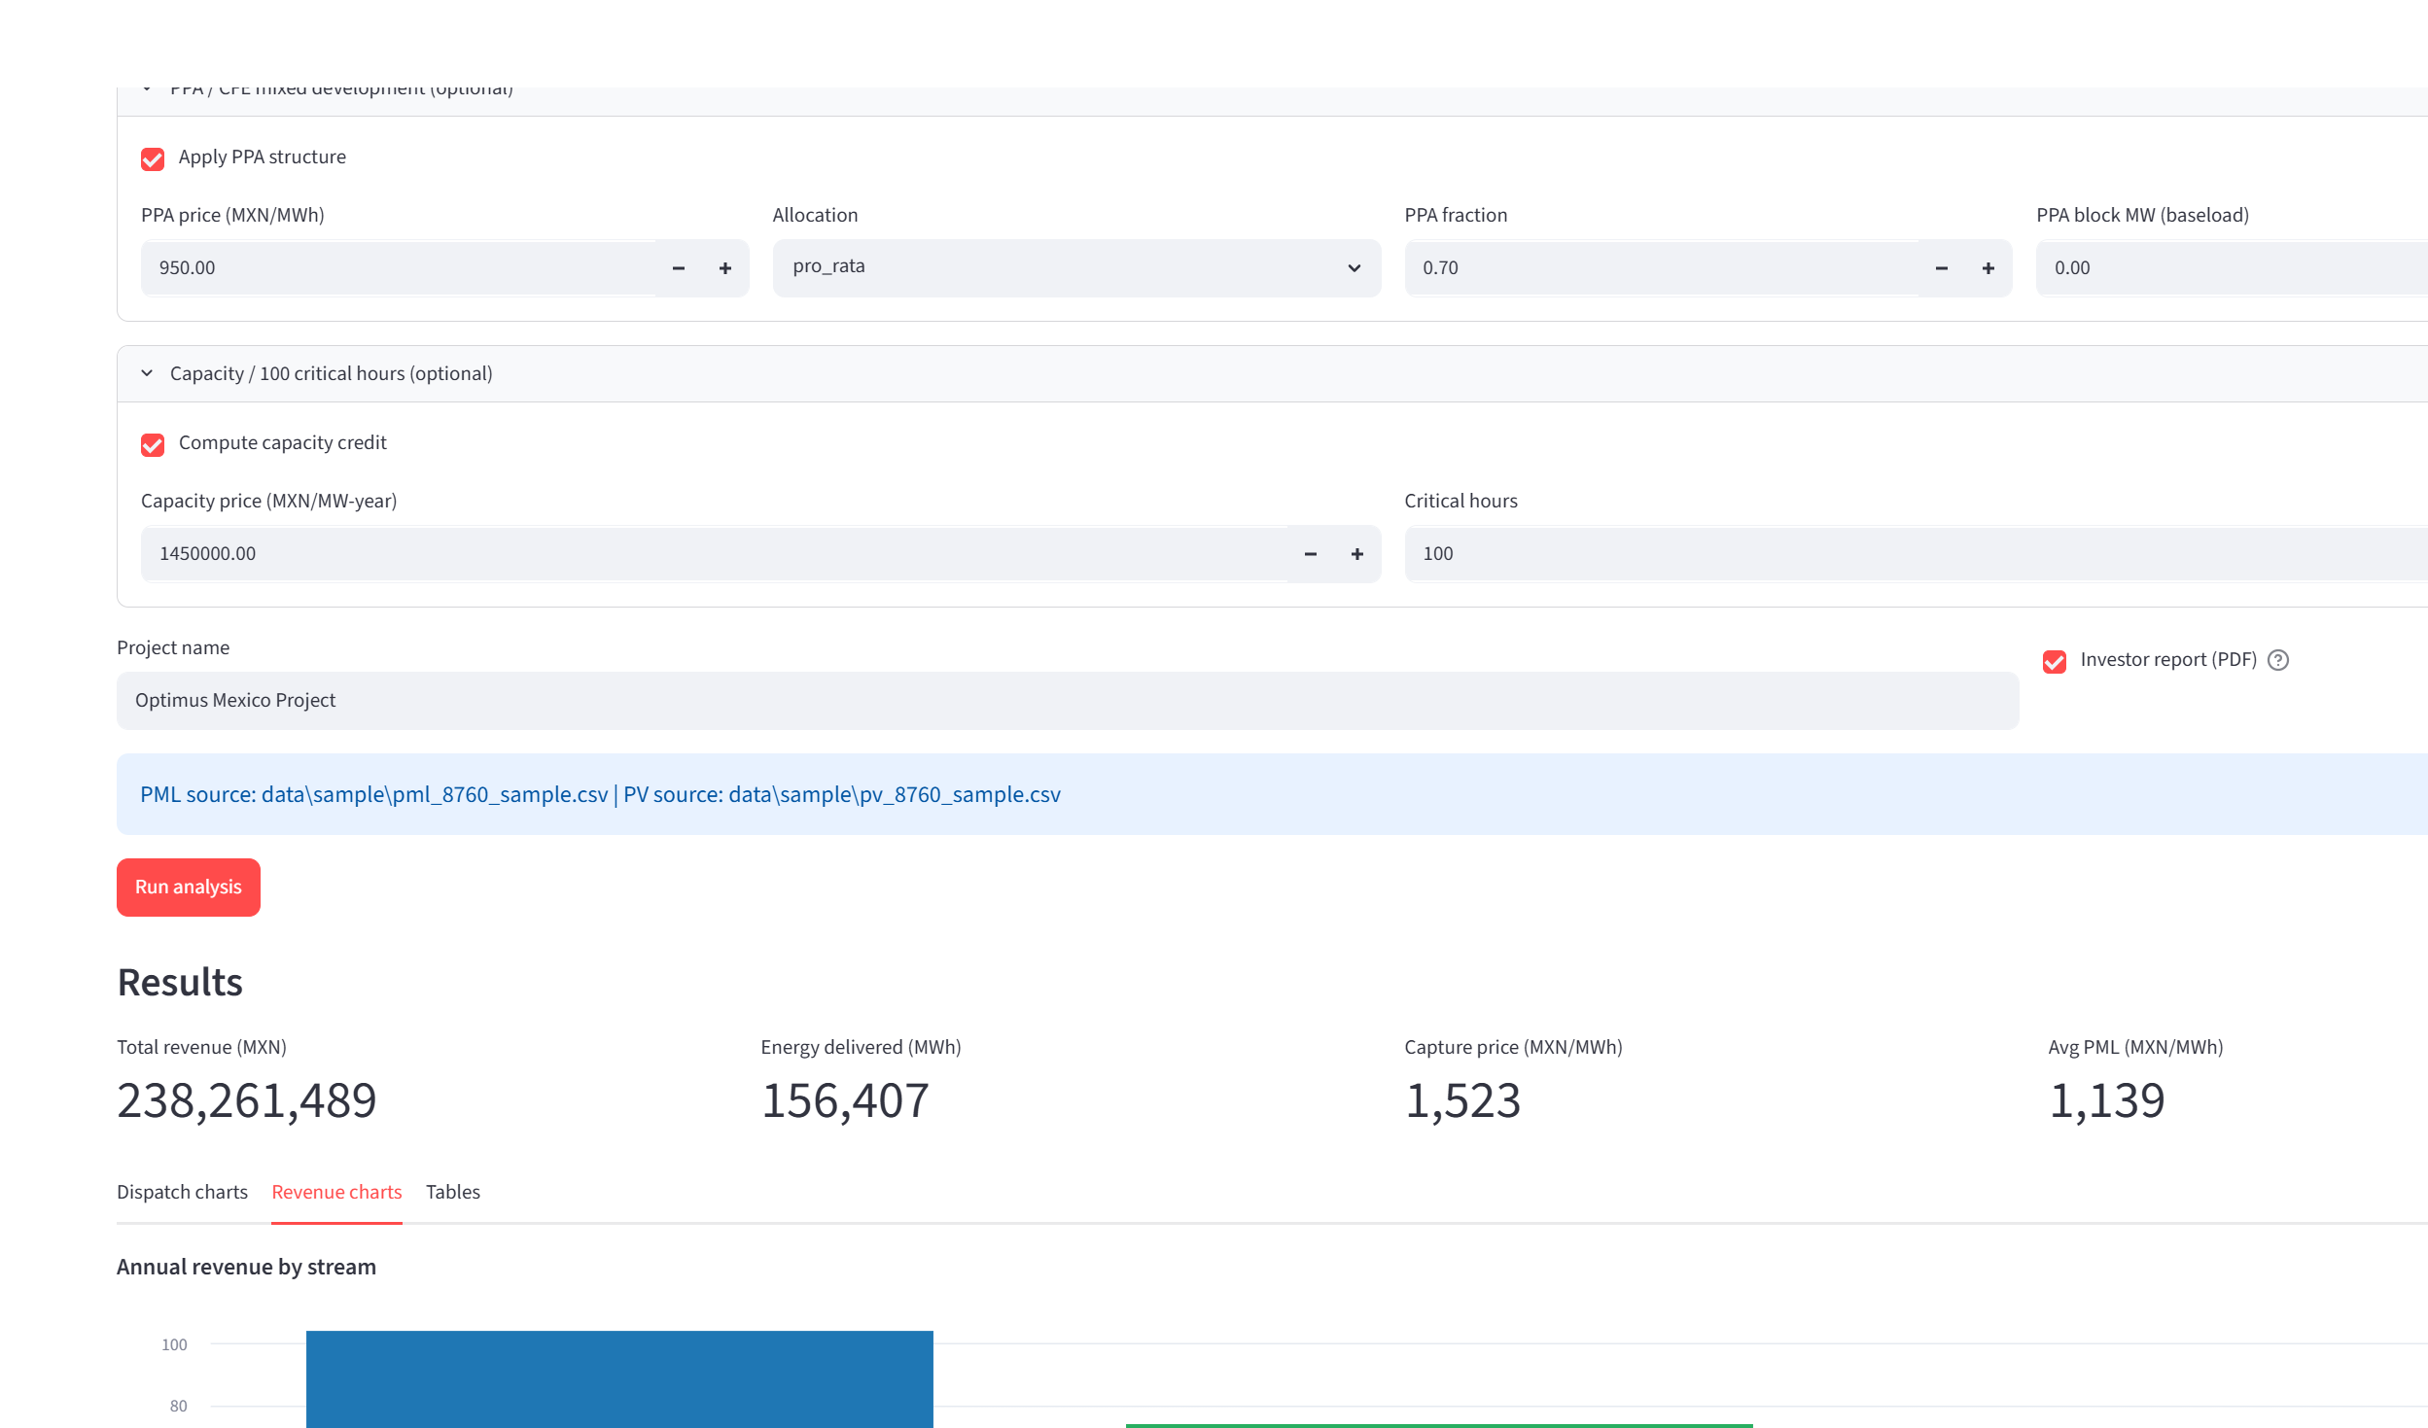
Module 1 — Revenue & project economics
Interactive charts: average-day dispatch profile, single-day detail (flows + SOC + price), annual revenue by stream, monthly stacked revenue.
Project economics panel: CAPEX (PV USD/kWp + BESS USD/kWh), OPEX, insurance, financing, project life → NPV, payback, unlevered and levered project IRR.
Sample-data result: MXN 238M total revenue (PPA + Capacity + Merchant).
One click exports: Excel workbook, Word, PDF, PowerPoint — plus investor report PDF.

Slide 8
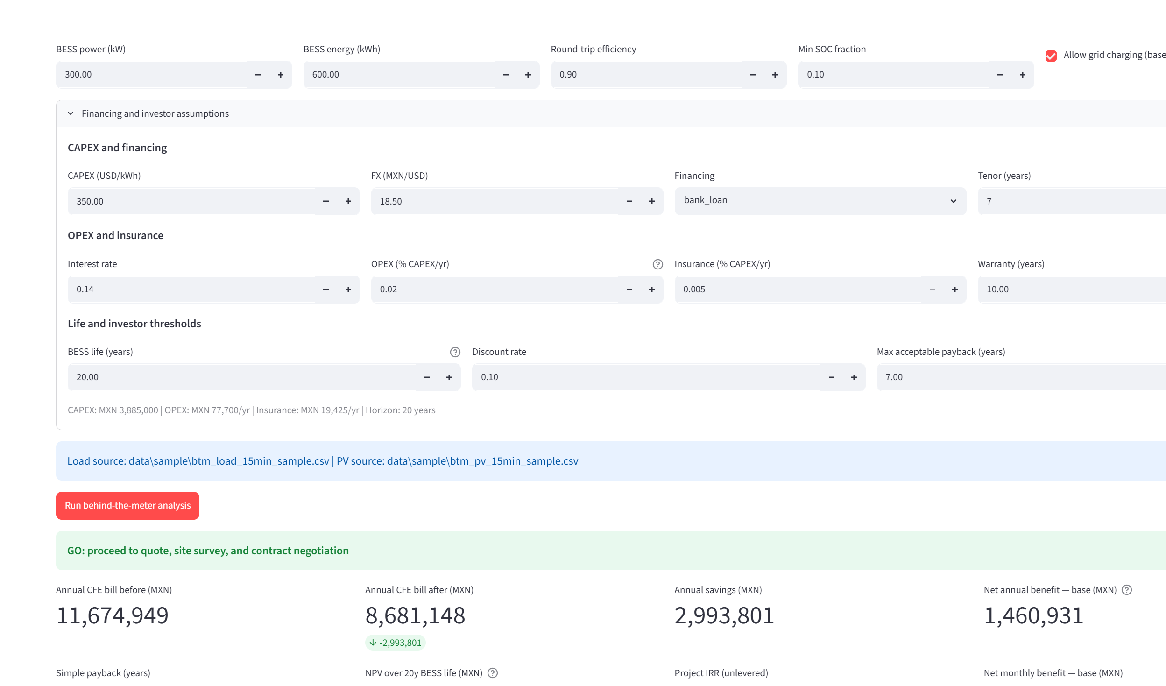
Module 2 — Behind-the-Meter (CFE) — how it flows
15-minute load + PV data
upload or PV specs (MW AC / MWp / yield)
CFE tariff calendar
GDMTH base / intermedia / punta, seasons, holidays
Baseline bill reconstruction
energy by period + capacity & distribution demand
Dispatch engine
rule-based screening OR LP bankable (import-cap sweep)
Optimized bill + savings
savings by CFE tariff component; BTM-only revenues
Investor layer
readiness gate DEMO→INVESTMENT READY; IRR on CFE savings

Slide 9
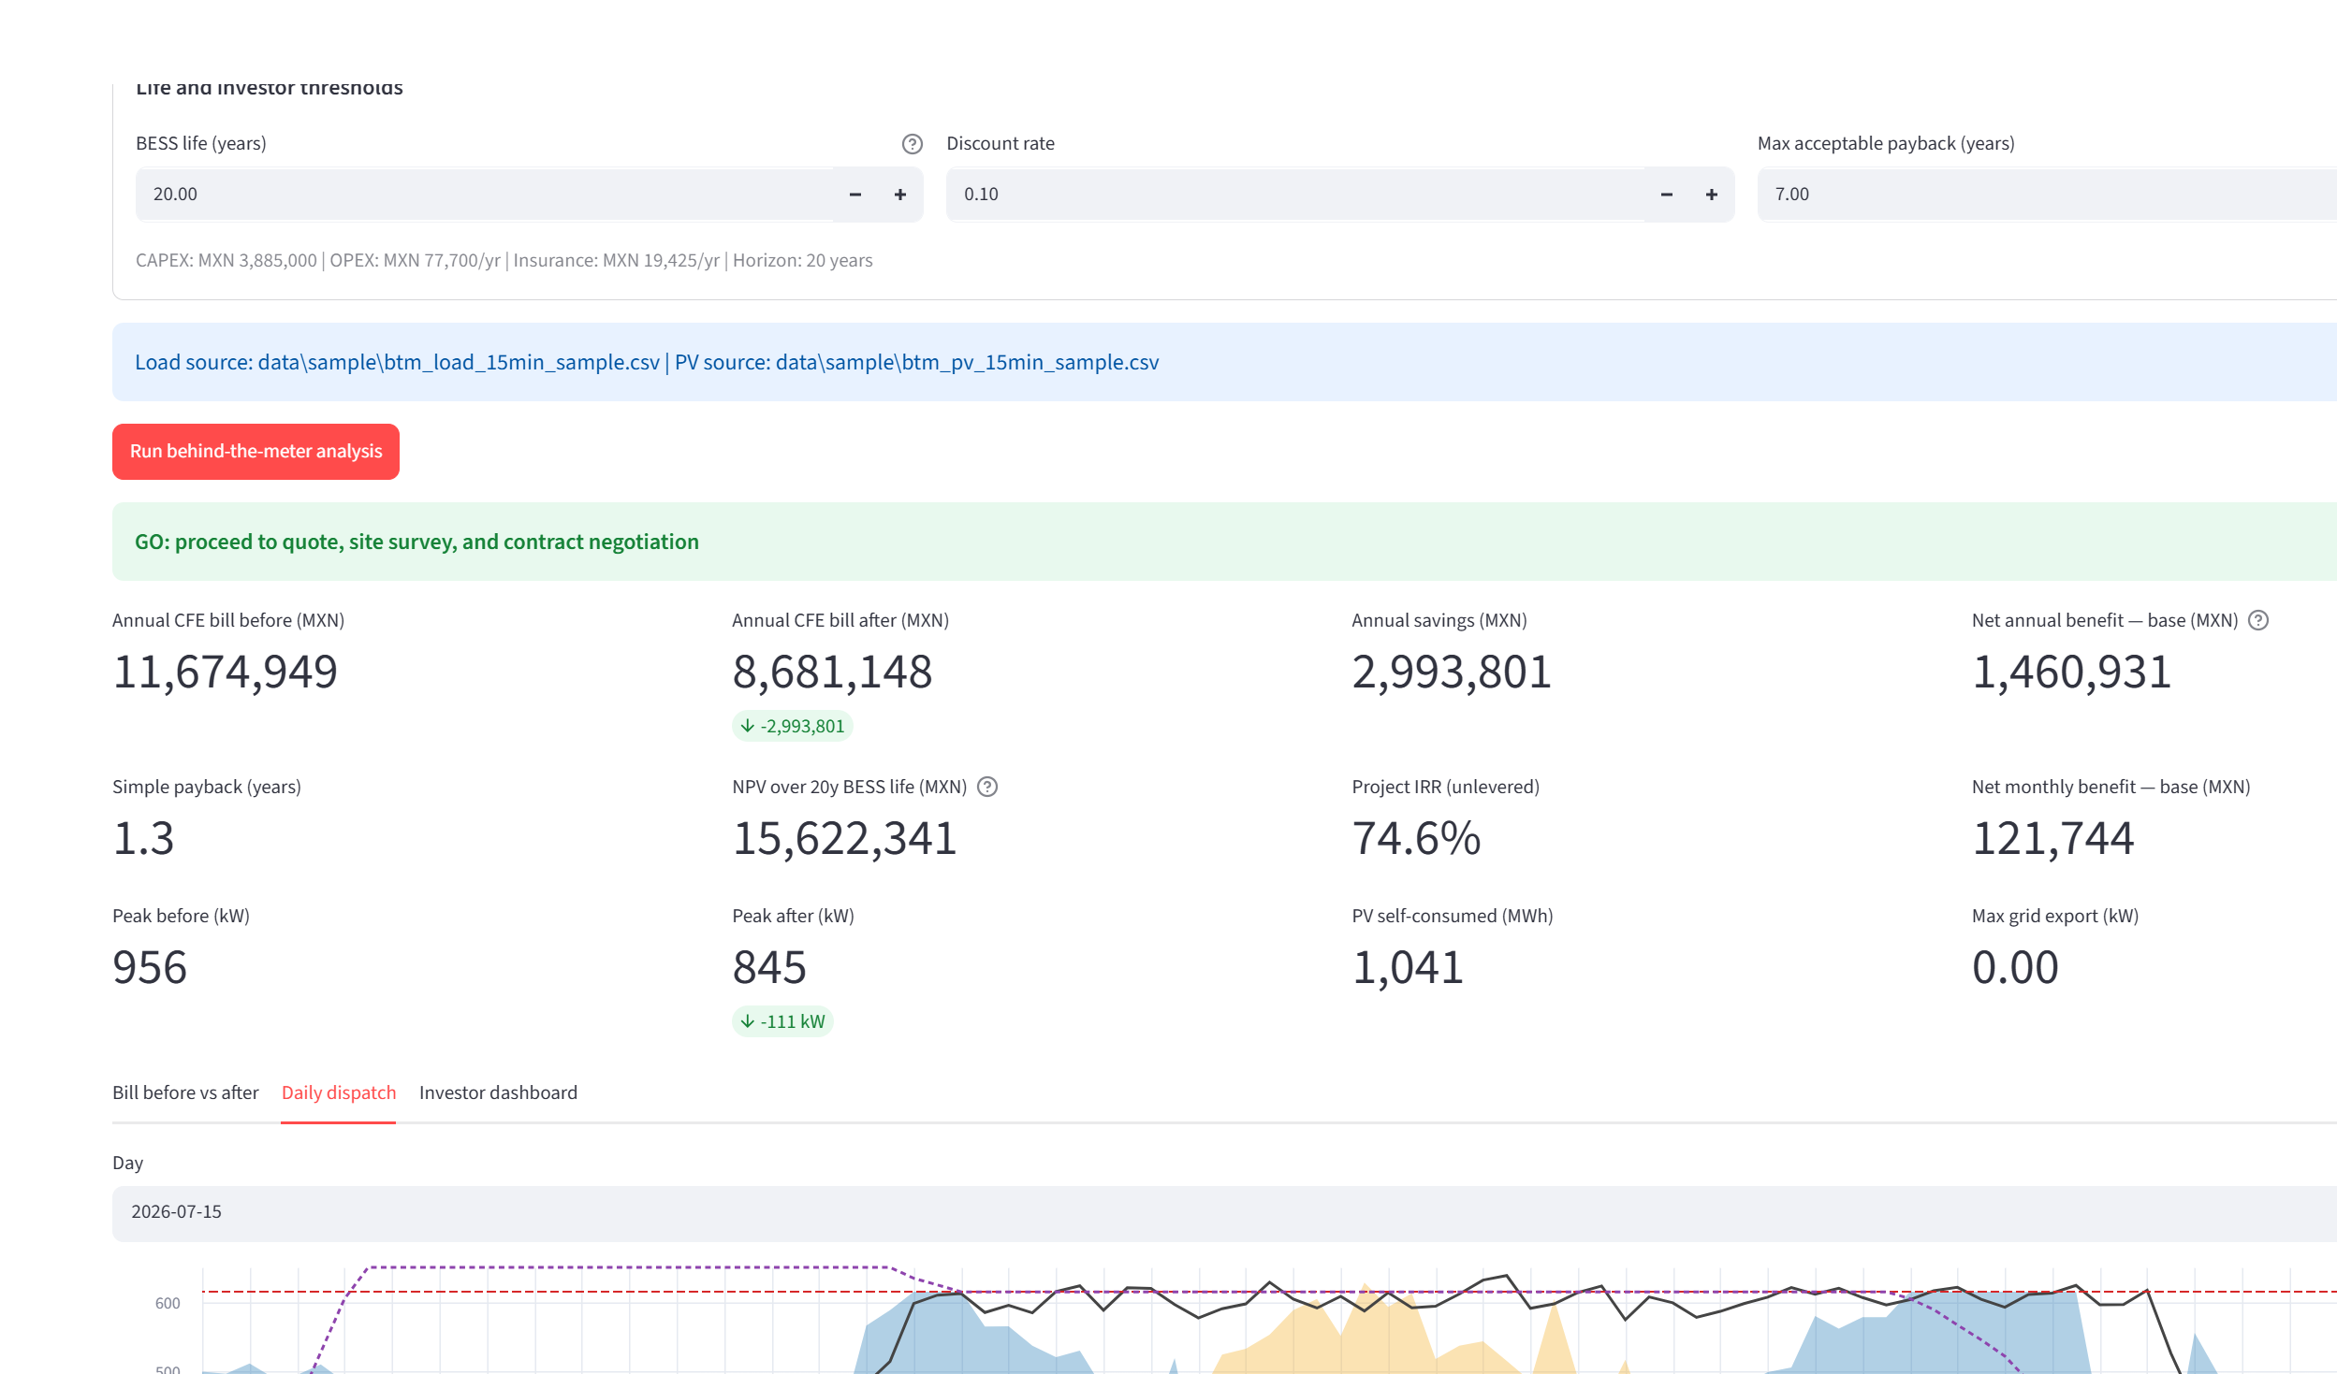
Module 2 — Daily dispatch & bill savings
The battery keeps grid import under a monthly cap (found by binary search) and shifts punta-period energy to cheap base hours.
PV serves load first; surplus charges the battery; nothing is exported.
Sample plant (956 kW peak, 500 kWp PV, 300 kW / 600 kWh BESS):
CFE bill before: MXN 11.67M/yr → after: MXN 8.68M/yr
Annual savings: MXN 2.99M | peak shaved 956 → 845 kW | zero export

Slide 10
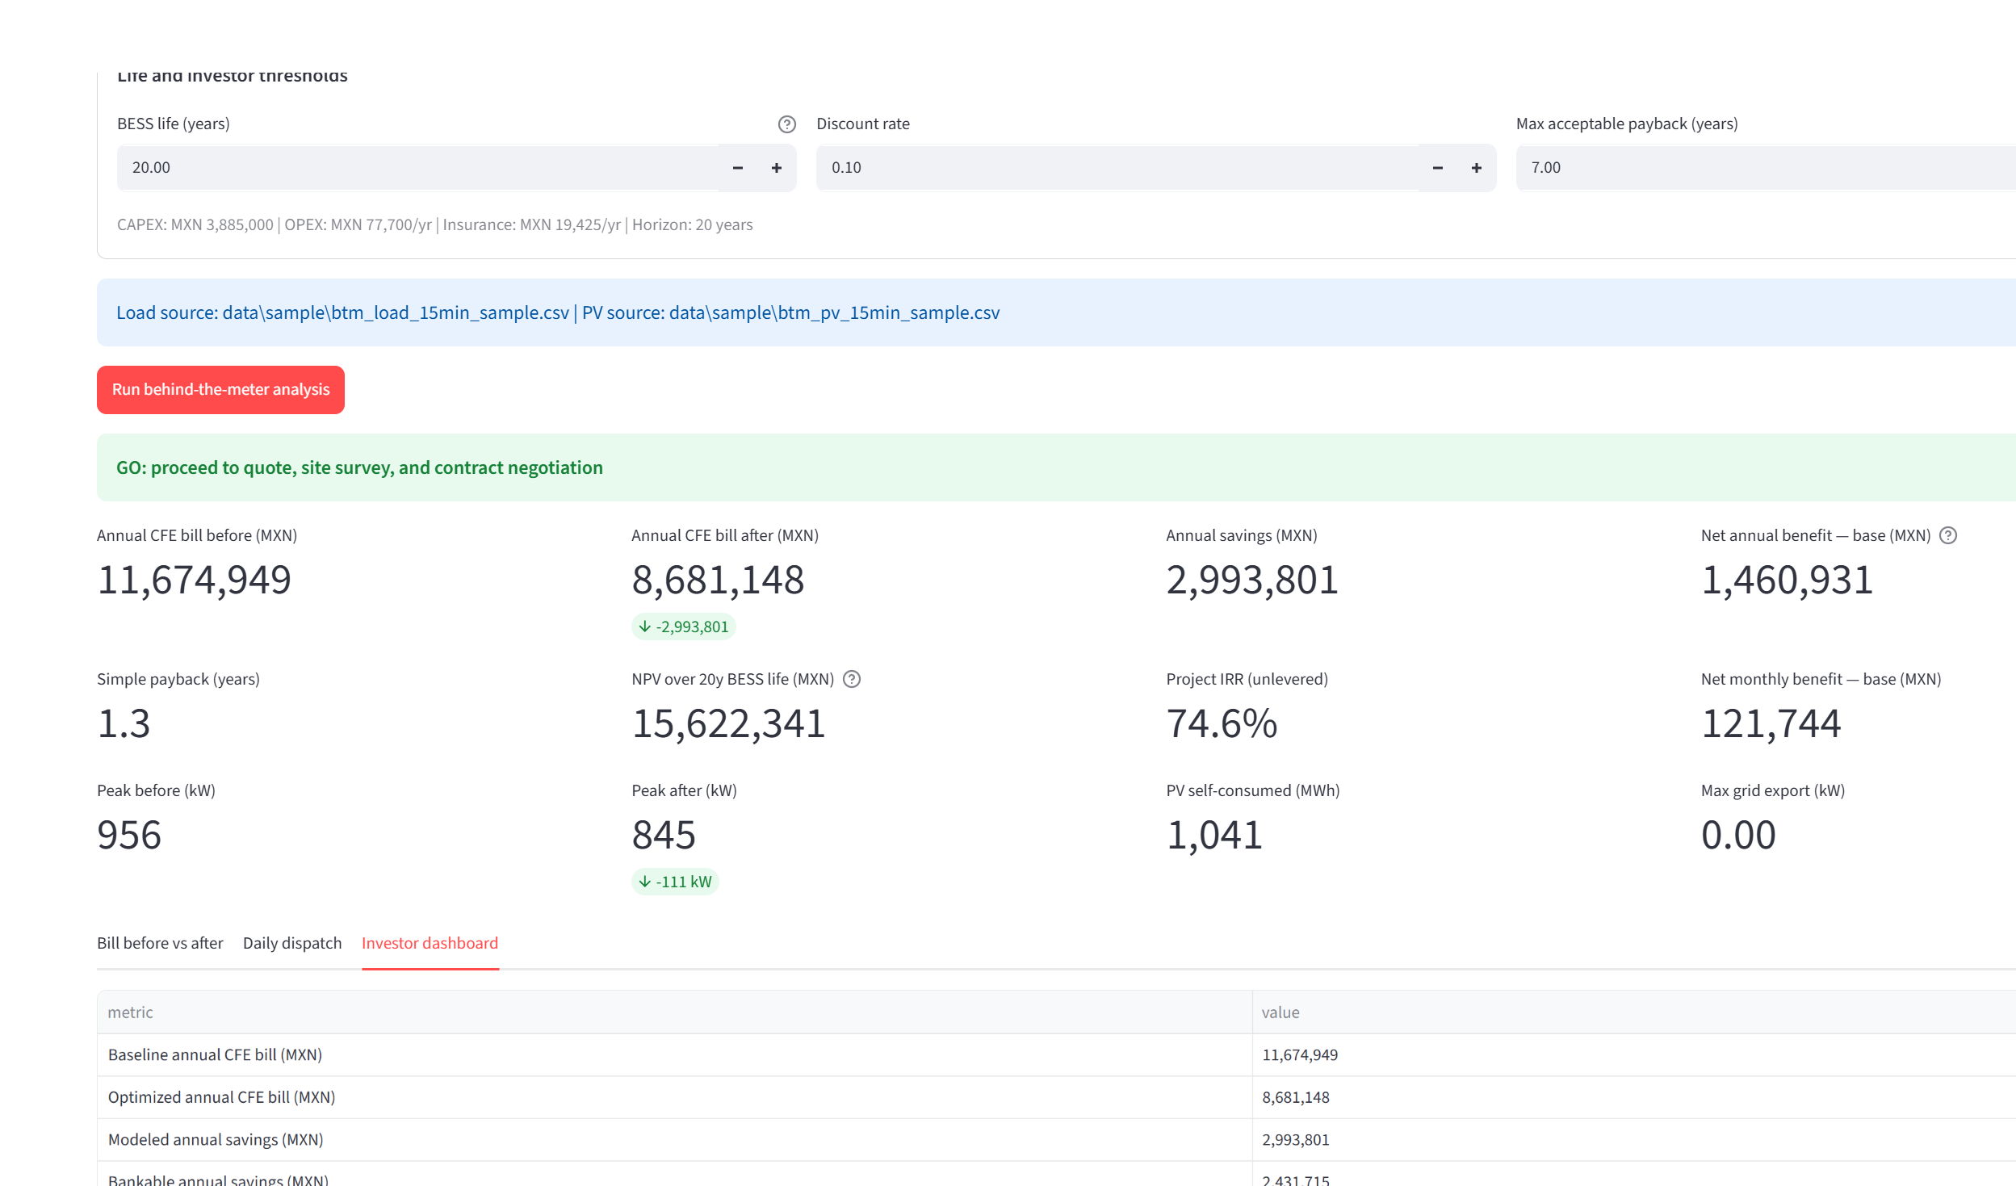
Module 2 — Investor layer & savings IRR
Converts the technical model into an investment answer for an owner-manager.
Explicit costs: CAPEX (PV USD/kWp + BESS USD/kWh × FX), OPEX %/yr, insurance %/yr, financing (cash / lease / loan) and configurable BESS life (default 20 years).
IRR on CFE savings — unlevered (bill savings − OPEX vs CAPEX) and levered (bankable savings after financing); NPV and payback over BESS life.
Investment readiness gate: DEMO | SCREENING | REVISE | INVESTMENT READY — GO/REVISE/NO-GO blocked unless INVESTMENT READY (sample data = DEMO).
Conservative haircuts on bankable savings; red flags; Excel investor package.
Sub-workflows: Screening, Bankable Investor, Customer Proposal, Technical Dispatch.

Slide 11
Technology, quality & next steps
Stack: Python, Streamlit, pandas, scipy (HiGHS LP), Altair charts, openpyxl / python-docx / reportlab / python-pptx for reports.
Agent architecture: each capability is an isolated, testable module — ready to plug into Optimus AI.
Quality: 71 automated tests (wholesale dispatch, BTM tariff/bill/dispatch, BTM revenue guard, readiness gate, LP optimizer, PV synthesis, FOM economics).
New agents: pv_synthesis, fom_investor, btm_lp_optimizer, btm_revenue_guard, btm_investment_readiness.
Data: official CENACE node catalog (auto-download + enrich), CNE 2026 starter tariffs, synthetic sample profiles for instant demos.
Next: CENACE PML live scraping hardening, CFE/CNE tariff scrapers, PDF bill parser, DIST/DIT tariffs, multi-year PPA cash flows, Optimus AI integration.

