Slide 1


Redux Toolkit
& Reselect
createSelector — why it matters
~15 minutes
Prerequisites: createSlice, useSelector basics

Slide 2





Agenda
01
The problem: naive selectors
3 min
02
What createSelector does
3 min
03
Live render demo — with & without
4 min
04
RTK patterns & pitfalls
3 min
05
Summary & Q&A
2 min

Slide 3
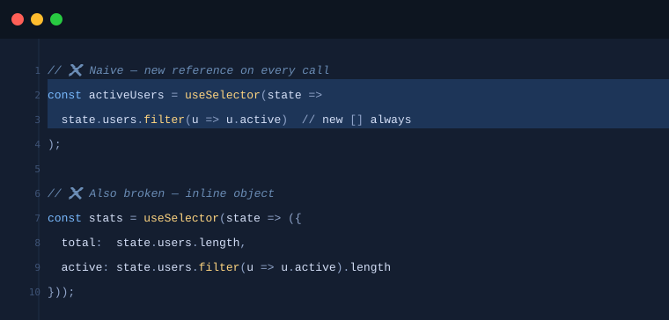
SECTION 1
Naive Selectors
Every time useSelector runs, React re-renders the component if the selector returns a new reference — even if the data is logically identical.
.filter(), .map(), {} and [] always create a new reference. useSelector uses === — so every Redux action causes a re-render.
500-user list re-rendering on every badge counter tick = wasted work on every unrelated action.
0:00 – 3:00

Slide 4
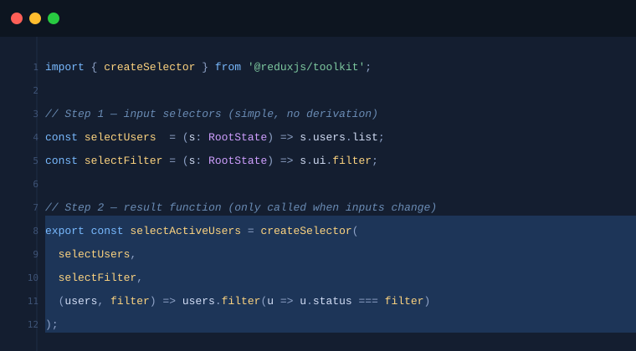


SECTION 2
What createSelector Does
Input selectors
Simple fns that return slices of state. No derivation, no computation.
Reference check
Reselect compares inputs with === to the last call.
Cache hit
Same inputs → return previous result reference. Zero re-render.
Cache miss
Inputs changed → run result function → cache new result.
3:00 – 6:00

Slide 5
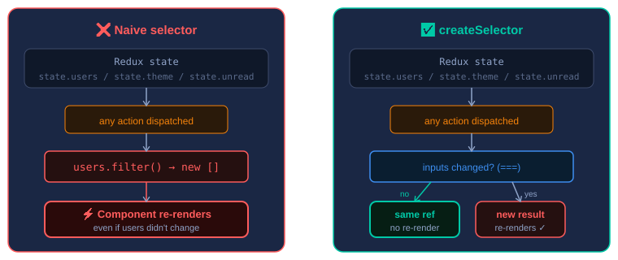
Naive vs. Memoized — Decision Flow
3:00 – 6:00

Slide 6
SECTION 3
Live Render Demo
After 10 unrelated dispatches (theme toggle, badge increment):
Naive selector
re-renders
createSelector
re-renders
24×
2×
Key insight: Dispatching unrelated actions (theme, badges) doesn't change state.users → memoized selector returns same reference → useSelector bails out → zero re-render.
6:00 – 10:00

Slide 7
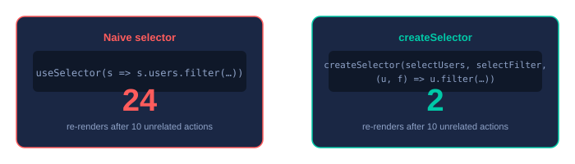
The numbers speak for themselves
Actions dispatched:
Increment unread (×5)
Naive: re-renders each time | Memo: 0 re-renders
Toggle theme (×3)
Naive: re-renders each time | Memo: 0 re-renders
Add active user (×2)
Naive: re-renders | Memo: re-renders ✓ (correct)

Slide 8
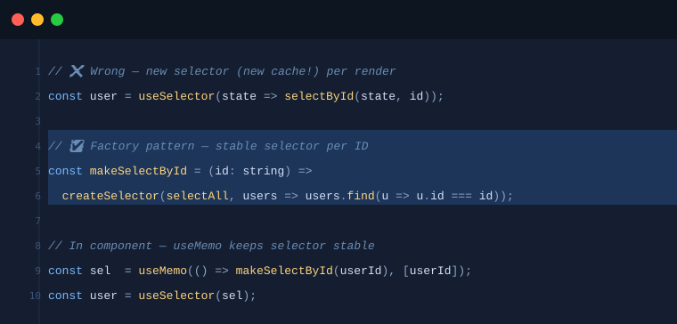
SECTION 4
RTK Patterns & Pitfalls
Pattern 1 — Co-locate with slices
Pattern 2 — Factory for parameterized selectors
10:00 – 13:00

Slide 9
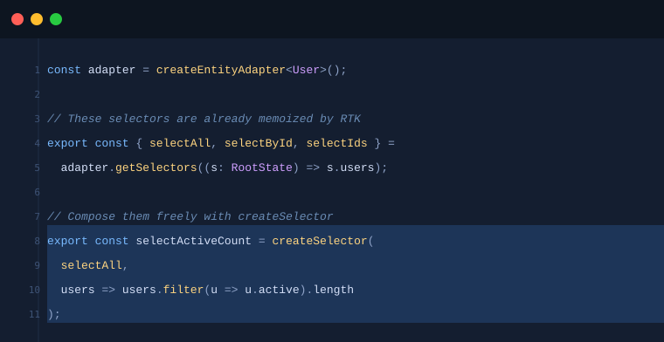
Pitfall & Pattern 3
Pitfall: Inline object in useSelector
useSelector(s => ({ a: s.x, b: s.y })) — even with createSelector outside, building an inline object in useSelector without memoization is still a new reference every time. Always derive objects in the result function.
Pattern 3 — createEntityAdapter (already memoized)
10:00 – 13:00

Slide 10
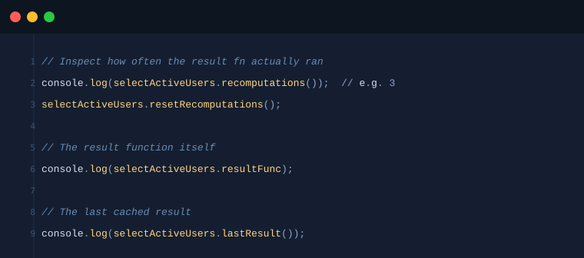


Debugging & DevTools
React Profiler
Record interactions. Orange/red = re-rendering. A memoized selector should turn data-heavy lists gray.
Redux DevTools
Use the Diff view. If the diff doesn't touch your slice, a memoized selector suppresses the re-render.
.recomputations()
Higher than expected? Your input selectors may be returning new references on unrelated dispatches.
Rule of thumb:
Any useSelector returning a derived value (array, object, computed number) → createSelector. Direct primitive reads (state.theme, state.users.length) are safe inline — primitives compare by value.
13:00 – 14:00

Slide 11
SECTION 5
Summary
.filter(), .map(), {} and [] always produce new references → unnecessary re-renders
createSelector memoizes by input reference equality — result fn runs only when inputs change
Input selectors: simple, no derivation. All logic goes in the result function
Parameterized selectors: use the factory pattern (useMemo + makeSelect…)
createEntityAdapter selectors are already memoized — compose them freely
Validate with .recomputations() and the React Profiler
14:00 – 15:00

Slide 12
Questions & Further Reading
reselect.js.org
Official Reselect documentation
redux-toolkit.js.org/api/createSelector
RTK createSelector API reference
redux.js.org/usage/deriving-data-selectors
Deriving Data with Selectors (Redux guide)
Thanks! Any questions?

