Slide 1
Bphi MC normalization workflow proposal
Claudio October 8, 2020

Slide 2
The “problem” to solve
Fits to mass/lifetime give upper limit on number of reconstructed events N_{UL}
We want to get limit on BR(B→phi X)*BR(phi→μμ)
Need luminosity, Acceptance*Efficiency, σ(pp → B)
For σ(pp → B) we should use FONLL (also gives uncertainties)
Our current MC workflow is the following
Generate σ(pp →B Bbar) with Pythia using default CMS Pythia settings
Set BR(B→phi X) = 50% BR(phi→μμ) = 100%
Here B means all B-mesons and B-baryons
Apply a GEN filter on muons from Phi: |η|<2.4. and P_{T} > 3 GeV
GEN filter efficiency ε_{GEN} ~ 3.5% for m(Phi)=2 GeV
Simulate/Reconstruct/Analyze the filtered events
Aside: we work with B-hadrons instead of b-quarks
because it is more straightforward

Slide 3
What are the issues
Want to use FONLL xsec and P_{T}(B) distribution not Pythia xsec and P_{T}(B) distribution
Easy to reweight P_{T}(B) in filtered MC
But ε_{GEN} is for Pythia P_{T}(B) distribution, so it is inconsistent (wrong)
Filtered events can have two B→Phi X→μμ X decays
These have higher acceptance
We are shooting for BR(B→phi X)*BR(phi→μμ) limits of order 10⁻⁹, so these events are not “realistic”.
Can we take care of all of these without significantly changing the MC workflow?
Yes, I think so
Can be achieved also by finetuning the GEN filter but the proposal here does not do that

Slide 4
One B→PhiX vs. two B→Phi X
Require one-and-only-one GEN Phi in the filtered events
This throws off the ε_{GEN} from Pythia.
That’s OK because we will recalculate it anyway (see later slides)
It also simplify the P_{T}(B) reweighting because there are two B in the event, and their P_{T} in Pythia is not the same, so which one should you reweight?
Note: our analysis does not care about the other B (mostly)

Slide 5
Pythia vs. FONLL
σ(pp→bbar)
Pythia inclusive gives 5.48 e8 pb
FONLL σ(pp→B) = 4.7^{+2.2}_{-1.9} e8 pb P_{T}(B)<100 and |η(B)|<10
Note FONLL gives σ for single B, so comparison is OK
P_{T}(B) and η
Pythia from sample of unfiltered MC
where we
have acceptance
where most of
x-section is

Slide 6
Pythia vs. FONLL shapes
Pythia has a harder P_{T} spectrum than FONLL
Actually, differences are a f(P_{T} , η) not just f(P_{T})
2D reweighting is in principle possible and overkill
Nevertheless, since we have no acceptance at high η, concentrate on semi-central region

Slide 7
P_{T}(B) and η(B) considerations, reweighting
There is no acceptance for |η(B)|>2.8 and P_{T}(B) < 5 GeV
The filter on η(μ) effectively filters on η(B) and P_{T}(B) already, no need to change
Therefore we concentrate on |η(B)|<2.8 and P_{T}(B) > 5 GeV
For your information:
FONLL σ(pp→B) = 1.33^{+0.54}_{-0.41} e8 pb 5<P_{T}(B)<100 and |η(B)| < 2.8
Pythia σ(pp→bbar) = 1.89 e8 pb 5<P_{T}(B) and |η(B)| < 2.8

Slide 8
Workflow Proposal (1)
For each phi mass make
GEN-SIM-RECO sample with filtered Pythia
GEN-only sample with unfiltered Pythia
This one should be quick
Process GEN-only sample as follows
Require one-and-only-one GEN B→phi P_{T}(B) > 5 |η(B)| < 2.8
Reweight P_{T}(B) in shape only based on FONLL-central
Save the shape-reweighting function w(P_{T}).
Independent of phi mass (can combine mass samples for better stats)
Apply dimuon filter |η|<2.4 and P_{T} > 3 GeV
Extract ε_{GEN} for filtered events
This depends on phi mass, in principle
Repeat to get w(P_{T}) and ε_{GEN} for FONLL-up and FONLL-down

Slide 9
Workflow Proposal (2)
Analysis of filtered sample
Require one-and-only-one GEN B→phi P_{T}(B) > 5 |η(B)| < 2.8. No. of events N₀
Weight each events by w(P_{T}). This now can change total number of events to N₁
The equivalent number of generated unfiltered events for normalizing the integrated lumi of the sample is N₁ / ε_{GEN}
Analyze weighted events to get efficiency*Acceptance. (call this acc)
Limit on BR = ½ N_{UL} / (acc * Lumi * ε_{GEN} * σ) where
The factor of ½ comes from the fact that there are two B’s in each event
σ to be used is FONLL σ(pp→B) for P_{T}(B) > 5 and |η(B)| < 2.8
Use w(P_{T}), ε_{GEN} , σ(pp→B) for FONLL-up/FONLL-down for systematics
I bet that σ(pp→B) variations are the most important, and that will make things easy
Sanity check of workflow proposal in next page

Slide 10
Sanity check, 100 event toy example, 2 Pt bins only
Toy inputs:
Pythia unfiltered, what we (pretend to) have: (90, 10)
FONLL unfiltered, what it should be, shape reweight only: (80, 20). (this is an extreme toy)
Filter efficiency by bin : (20%, 50%)
From toy inputs:
Pt shape-only reweight function w = (8/9, 2)
Shape-corrected overall filter eff = (0.2, 0.5) * (8/9, 2) * (90,10) = (16, 10) = 26%
Pythia filtered, what we have = (90,10) * (0.2, 0.5) = (18, 5)
FONLL filtered, what it should be = (80, 20) * (0.2, 0.5) = (16, 10)
Correcting Pythia filtered (what we have) to FONLL filtred (what it should be)
(18,5) * (8/9, 2) = (16,10)
Consistency with filter efficiency
(16,10) → 26 events = 26% of 100 we started with

Slide 11
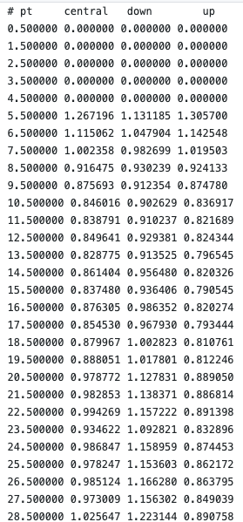
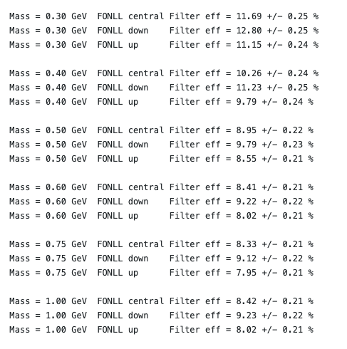
Status: ready to go
Nick provided unfiltered Pythia data at different m(phi)
Have tables of w(P_{T}) and ε(mass), as well as needed σ (page 7)
https://github.com/claudiocc1/Bphi

Slide 12
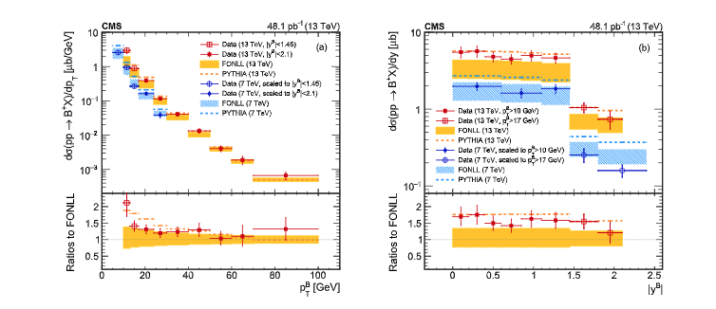
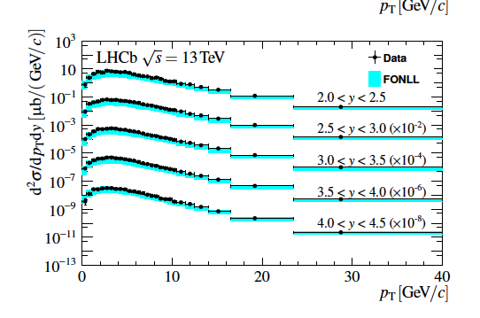
One last thing
LHC-b normalized to the observed B→ψK rate
Since the FONLL central σ is a little lower than data, by using FONLL central we are a bit pessimistic (esp. wrt comparing with LHC-b)

