Slide 1
Compare Bphi with LHC-b
Claudio 29 October

Slide 2
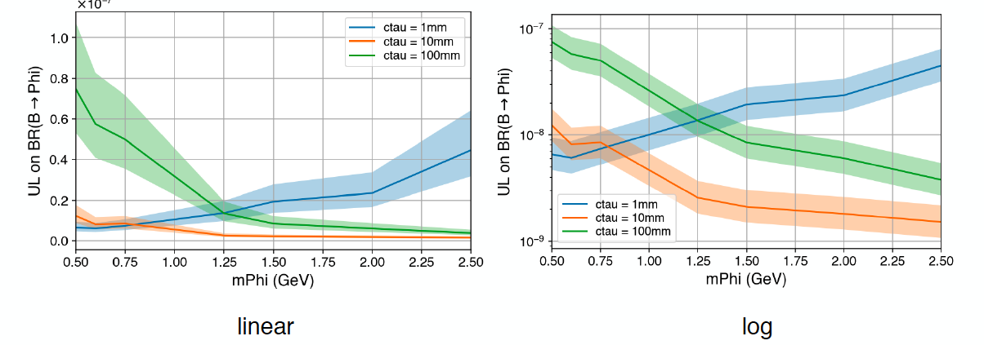
Nick took expected limit from Hardik on number of events in 10% of the data and turned them into expected limits on BR(b → Phi X) using the MC acceptances and the cross-sections from FONLL as proposed in this presentation https://github.com/claudiocc1/Bphi/raw/master/pptx/Bphi_Proposal_summary.pptx

Slide 3
Compare with LHCb
LHCB has exclusive limits on B⁰ →K*Phi and B⁺→K⁺Phi
We have inclusive limits on B→X Phi where B = B⁺, B⁰, B_{s}, Λ_{b}, B_{c}
To be fair, we calculate the acceptances for X=K⁺, K⁰, φ, Λ, D_{s}⁺
A smart reviewer may ask us what difference that makes…should think about that
Easier to set stringent exclusive limits because less background due to full reconstruction
Inclusive limits are more generic.
LHCb has nothing to say about B_{s} (for example)
LHCb is normalizing to reconstructed B states, eg, B⁺→J/Ψ K⁺ instead of FONLL
Because observed B cross-section is a bit larger than FONLL, LHCb gets a little bit of a bonus

Slide 4
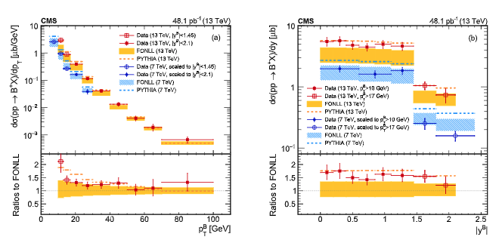
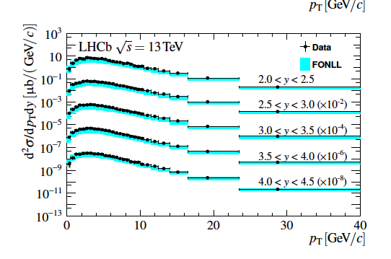
The LHC bonus: order 50% but within uncertainties, more or less
4

Slide 5
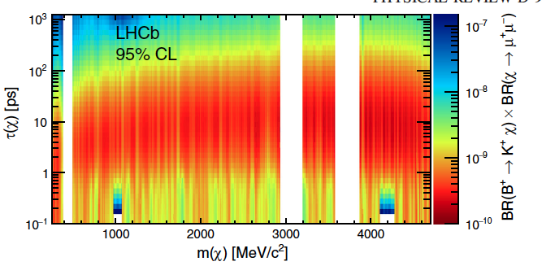
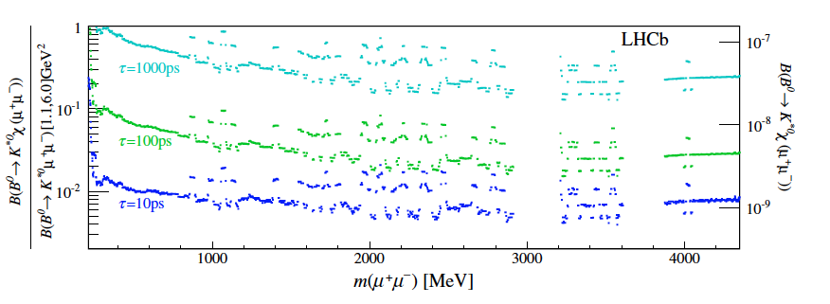
LHCb limits
https://journals.aps.org/prd/abstract/10.1103/PhysRevD.95.071101
B⁺→K⁺Phi
https://journals.aps.org/prd/abstract/10.1103/PhysRevD.95.071101
B⁰ →K*Phi

Slide 6
LHCb limits vs. our analysis
Got the actual data from LHCb
For B⁰ they provide an interpolating spline to any mass and lifetime
For B⁺ just the histogram. Bins are a bit coarse, I was not too careful about that
For our analysis
Scaled by sqrt(10) in going from 10% to 100% of data
Assumed b → B⁰ and b → B⁻ 0.344 each
The two effects cancel, more or less

Slide 7
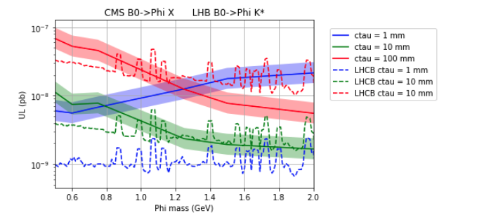
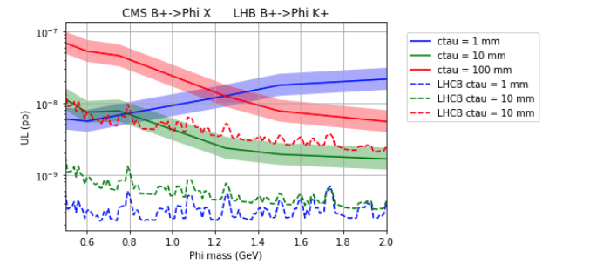
Conclusions:
Not that great
But competitive because inclusive and B_{s} etc
Worth including in the paper
Code in https://github.com/claudiocc1/Bphi

