Slide 1

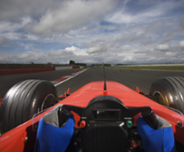


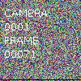
Camera Recorder
Video Stream
Multi-Video Grid Job
Grid Stream
Video Player
Video Data Generator Job
resize images
align by time window
join
Notes:
Camera Recorder
non-Flink application that reads frames from a video camera and writes to Pravega
Video Data Generator Job
Flink application that simulates additional cameras and writes to Pravega
Multi-Video Grid Job
Flink application that combines multiple camera feeds into a single feed
Video Player
Non-Flink application that reads video from a Pravega stream and displays it on the screen

Slide 2
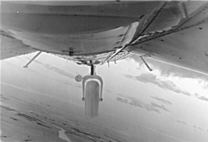
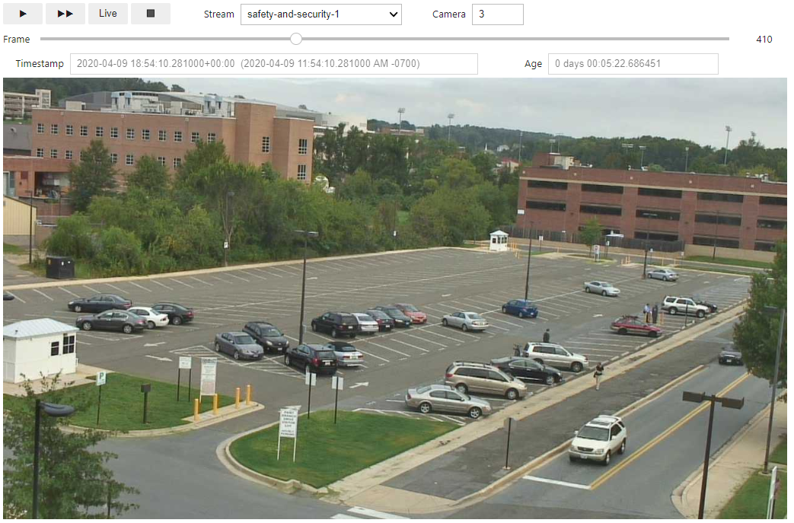
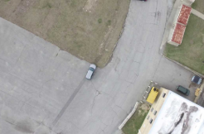
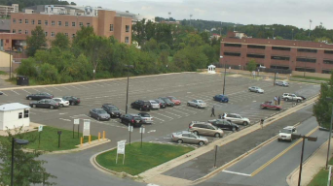
Pravega GRPC Gateway
Jupyter Notebook Server
Pravega
Tier 2
(simulated)
Notes:
Camera Recorder
non-Flink application that reads frames from a video camera and writes to Pravega
Video Data Generator Job
Flink application that simulates additional cameras and writes to Pravega
Multi-Video Grid Job
Flink application that combines multiple camera feeds into a single feed
Video Player
Non-Flink application that reads video from a Pravega stream and displays it on the screen

