Slide 1
New York City FC – Radar Player Comparison
Claudio Flores – 2021/03/07
The dashboard presents the main lineup of NYCFC in 2020.
Every NYCFC player can be compared with the top 5 players in his position that are most similar.
The values used are the season’s average in percentiles.
Values go from 100 (best) to 0 (worse).
Every field position shows different KPI’s.
The data used was obtained from whoscored.com.

Slide 2
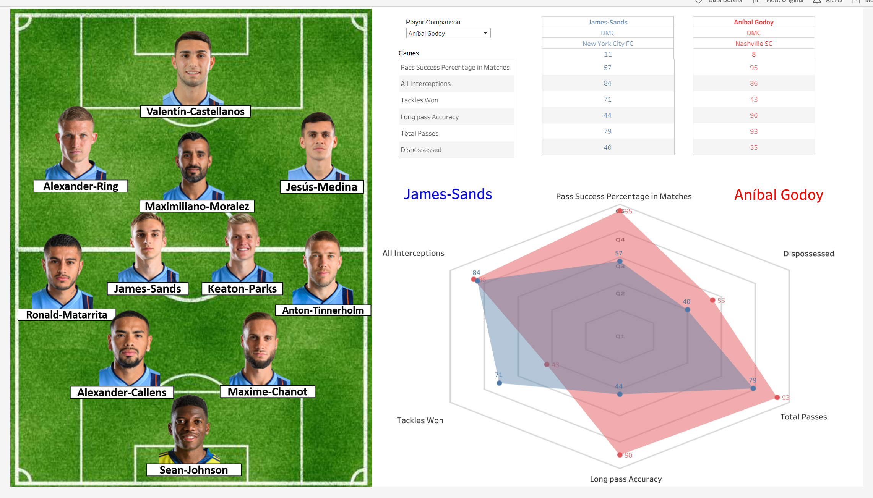
Tableau Dashboard
drop-down list
Instructions:
1. Click on a NYCFC player portrait.
2. Select an MLS player from the drop-down list.
3. Compare players.
Radar

