Slide 1
New Sitemap Generation
A serverless application

Slide 2
A sitemap is a file where you provide information about the pages, videos, and other files on your site, and the relationships between them. Search engines like Google read this file to more intelligently crawl your site. A sitemap tells the crawler which files you think are important in your site, and also provides valuable information about these files: for example, for pages, when the page was last updated, how often the page is changed, and any alternate language versions of a page. New solution: generate sitemap by leveraging API's and Python scripts

Slide 3
My experience
I’ve realized for this project the following system compose mainly from a Jenkins pipeline, and the integration with AWS, IBM WebSphere commerce and other internal tool like akamai, slack, artifactory.
The following approach enable the sitemap generation in an automated and serverless fashion.

Slide 4
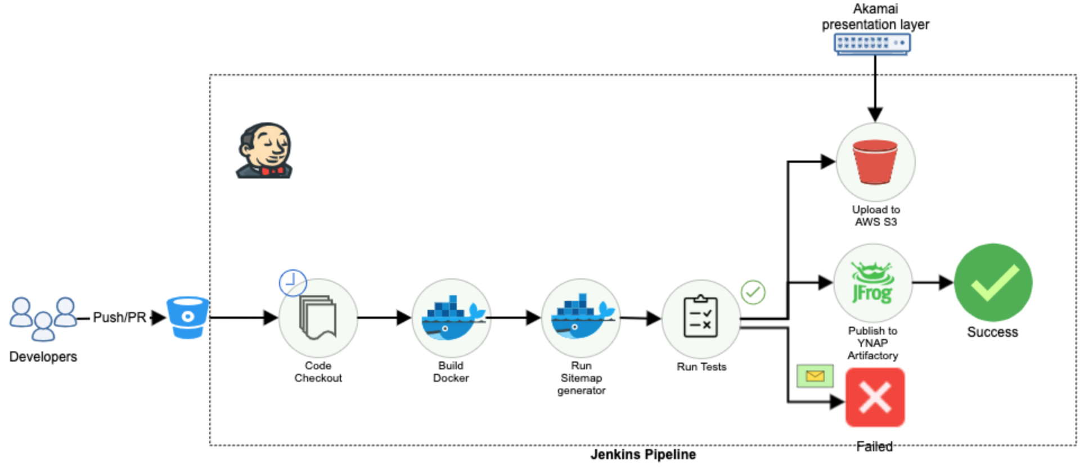
Serverless pipeline

Slide 5
1. Focus on overall system thinking
Before the realization of this new pipeline, sitemap was an application deployed on 2x2 servers(A/P) on our datacenter, the application on those server was cron triggered and of course those boxes were idles for most of the time during the day, but even if they were idles they need some level of maintenance(puppet cert renewal, disk space alerts, babysitting during switchover, restart over failed hypervisor…)
So being basically just a parametrized script I suggested to build this pipeline in a serverless fashion, that get activated by the Jenkins scheduler and live and die just to generate the sitemap file and save the product of the generation. Can be compared to an on-premise lambda…

Slide 6
2. Design Decisions
The first decision, for the statement made in the previous slide(1) was to understand that we didn’t need any server for this function.
Further decision being made during the study for this pipeline was mostly related of the networking and the fact that the business was involved being the generated file publicly exposed.
Networking: to have a fast generation of the sitemap the python application needed to be the ‘nearest network’ possible to the API-called(on AWS), we don’t want the call to go over Internet so we used an private endpoint exposed on internal MPLS.
Presentation Layer: As the s3 url was not business appealing, the trade off was to create an entry on our Akamai endpoint that remapped the s3 url.

Slide 7
3. Interfaces
The interfaces consumed for the sitemap generation are API exposed from the WebSphere Commerce, this are parametrized for country and different sites.
For publish the file on s3 are called the AWS API, the file is published as well on our internal artifactory(always API call), there is a slack notification system too attached in case of failing of the sitemap build.

Slide 8
4. Build Process
The build pipeline is the real core of the sitemap generation, as previously said the process is triggered by the Jenkins scheduler, this will spin up a build container that will checkout the code in another docker container(python image) install the needed requirement and will run querying the WCS API needed based on the different parameters specified in the scheduler.

Slide 9
5. Testing
After the build there is a test suite that run over the file generated that verify the formal correctness and if fits some quality requirement, if the file pass with success the test is pushed to the s3 as latest version and already exposed.
In case of error a slack notification is pushed to a slack channel and the file will not be updated.

Slide 10
6. Brittle parts
Even if the serverless approach is useful to reduce dependencies on the physical server(and reduce cost/time dedicate to it), is true the fact that this approach is strong tied to the Jenkins server and if there are problem or disservice on it will impact this service too.

