Slide 1
Pointers
A pointer is a reference to another variable (memory location) in a program
  Used to change variables inside a function (reference parameters)
  Used to remember a particular member of a group (such as an array)
  Used in dynamic (on-the-fly) memory allocation (especially of arrays)
  Used in building complex data structures (linked lists, stacks, queues, trees, etc.)

Slide 2
Outline
Pointers
  Basics
    Variable declaration, initialization, NULL pointer
    & (address) operator, * (indirection) operator
    Pointer parameters, return values
    Casting points, void *
  Arrays and pointers
    1D array and simple pointer
    Passing as parameter
  Dynamic memory allocation
    calloc, free, malloc, realloc
    Dynamic 2D array allocation (and non-square arrays)

Slide 3
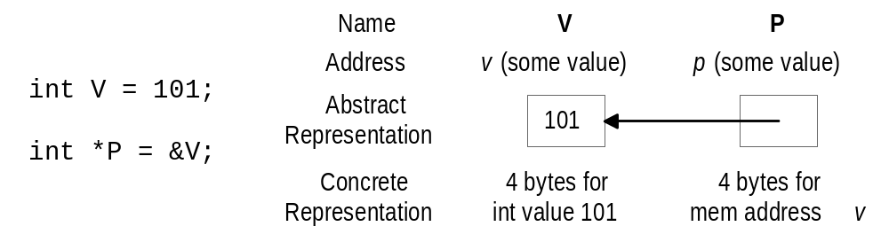
Pointer Basics
Variables are allocated at addresses in computer memory (address depends on computer/operating system)
Name of the variable is a reference to that memory address
A pointer variable contains a representation of an address of another variable (P is a pointer variable in the following):

Slide 4
Pointer Variable Definition
Basic syntax: Type *Name
Examples:
  int *P; /* P is var that can point to an int var */
  float *Q; /* Q is a float pointer */
  char *R; /* R is a char pointer */
Complex example:
  int *AP[5]; /* AP is an array of 5 pointers to ints */
  more on how to read complex declarations later

Slide 5
Address (&) Operator
The address (&) operator can be used in front of any variable object in C -- the result of the operation is the location in memory of the variable
Syntax: &VariableReference
Examples:
  int V;
  int *P;
  int A[5];
  &V - memory location of integer variable V
  &(A[2]) - memory location of array element 2 in array A
  &P - memory location of pointer variable P

Slide 6
Pointer Variable Initialization/Assignment
NULL - pointer lit constant to non-existent address
  used to indicate pointer points to nothing
Can initialize/assign pointer vars to NULL or use the address (&) op to get address of a variable
  variable in the address operator must be of the right type for the pointer (an integer pointer points only at integer variables)
Examples:
  int V;
  int *P = &V;
  int A[5];
  P = &(A[2]);

Slide 7
Indirection (*) Operator
A pointer variable contains a memory address
To refer to the contents of the variable that the pointer points to, we use indirection operator
Syntax: *PointerVariable
Example:
  int V = 101;
  int *P = &V;
  /* Then *P would refer to the contents of the variable V (in this case, the integer 101) */
  printf(“%d”,*P); /* Prints 101 */

Slide 8
Pointer Sample
int A = 3;
int B;
int *P = &A;
int *Q = P;
int *R = &B;
printf(“Enter value:“);
scanf(“%d”,R);
printf(“%d %d\n”,A,B);
printf(“%d %d %d\n”,
*P,*Q,*R);
Q = &B;
if (P == Q)
printf(“1\n”);
if (Q == R)
printf(“2\n”);
if (*P == *Q)
printf(“3\n”);
if (*Q == *R)
printf(“4\n”);
if (*P == *R)
printf(“5\n”);

Slide 9
Reference Parameters
To make changes to a variable that exist after a function ends, we pass the address of (a pointer to) the variable to the function (a reference parameter)
Then we use indirection operator inside the function to change the value the parameter points to:
  void changeVar(float *cvar) {
  *cvar = *cvar + 10.0;
  }
  float X = 5.0;
  changeVar(&X);
  printf(“%.1f\n”,X);

Slide 10
Pointer Return Values
A function can also return a pointer value:
float *findMax(float A[], int N) {
int I;
float *theMax = &(A[0]);
for (I = 1; I < N; I++)
if (A[I] > *theMax) theMax = &(A[I]);
return theMax;
}
void main() {
float A[5] = {0.0, 3.0, 1.5, 2.0, 4.1};
float *maxA;
maxA = findMax(A,5);
*maxA = *maxA + 1.0;
printf("%.1f %.1f\n",*maxA,A[4]);
}

Slide 11
Pointers to Pointers
A pointer can also be made to point to a pointer variable (but the pointer must be of a type that allows it to point to a pointer)
Example:
  int V = 101;
  int *P = &V; /* P points to int V */
  int **Q = &P; /* Q points to int pointer P */
  printf(“%d %d %d\n”,V,*P,**Q); /* prints 101 3 times */

Slide 12
Pointer Types
Pointers are generally of the same size (enough bytes to represent all possible memory addresses), but it is inappropriate to assign an address of one type of variable to a different type of pointer
Example:
  int V = 101;
  float *P = &V; /* Generally results in a Warning */
Warning rather than error because C will allow you to do this (it is appropriate in certain situations)

Slide 13
Casting Pointers
When assigning a memory address of a variable of one type to a pointer that points to another type it is best to use the cast operator to indicate the cast is intentional (this will remove the warning)
Example:
  int V = 101;
  float *P = (float *) &V; /* Casts int address to float * */
Removes warning, but is still a somewhat unsafe thing to do

Slide 14
The General (void) Pointer
A void * is considered to be a general pointer
No cast is needed to assign an address to a void * or from a void * to another pointer type
Example:
  int V = 101;
  void *G = &V; /* No warning */
  float *P = G; /* No warning, still not safe */
Certain library functions return void * results (more later)

Slide 15
1D Arrays and Pointers
int A[5] - A is the address where the array starts (first element), it is equivalent to &(A[0])
A is in some sense a pointer to an integer variable
To determine the address of A[x] use formula:
  (address of A + x * bytes to represent int)
  (address of array + element num * bytes for element size)
The + operator when applied to a pointer value uses the formula above:
  A + x is equivalent to &(A[x])
  *(A + x) is equivalent to A[x]

Slide 16
1D Array and Pointers Example
float A[6] = {1.0,2.0,1.0,0.5,3.0,2.0};
float *theMin = &(A[0]);
float *walker = &(A[1]);
while (walker < &(A[6])) {
if (*walker < *theMin)
theMin = walker;
walker = walker + 1;
}
printf("%.1f\n",*theMin);

Slide 17
1D Array as Parameter
When passing whole array as parameter use syntax ParamName[], but can also use *ParamName
Still treat the parameter as representing array:
  int totalArray(int *A, int N) {
  int total = 0;
  for (I = 0; I < N; I++)
  total += A[I];
  return total;
  }
For multi-dimensional arrays we still have to use the ArrayName[][Dim2][Dim3]etc. form

Slide 18
Understanding Complex Declarations
Right-left rule: when examining a declaration, start at the identifier, then read the first object to right, first to left, second to right, second to left, etc.
objects:
  Type
  * - pointer to
  [Dim] - 1D array of size Dim
  [Dim1][Dim2] - 2D of size Dim1,Dim2
  ( Params ) - function
Can use parentheses to halt reading in one direction

Slide 19
Declarations Examples
int A A is a int
float B [5] B is a 1D array of size 5 of floats
int * C C is a pointer to an int
char D [6][3] D is a 2D array of size 6,3 of chars
int * E [5] E is a 1D array of size 5 of
pointers to ints
int (* F) [5] F is a pointer to a
1D array of size 5 of ints
int G (…) G is a function returning an int
char * H (…) H is a function returning
a pointer to a char

Slide 20
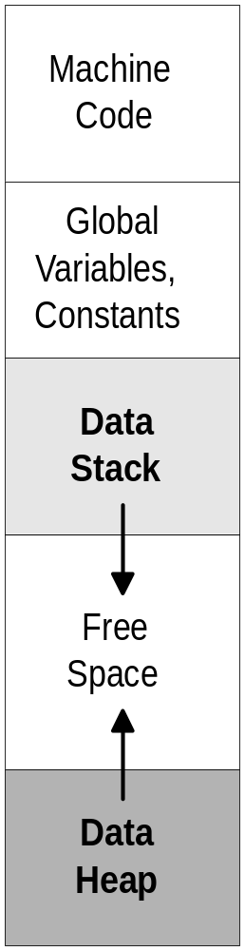
Program Parts
Space for program code includes space for machine language code and data
Data broken into:
  space for global variables and constants
  data stack - expands/shrinks while program runs
  data heap - expands/shrinks while program runs
Local variables in functions allocated when function starts:
  space put aside on the data stack
  when function ends, space is freed up
  must know size of data item (int, array, etc.) when allocated (static allocation)

Slide 21
Limits of Static Allocation
What if we don’t know how much space we will need ahead of time?
Example:
  ask user how many numbers to read in
  read set of numbers in to array (of appropriate size)
  calculate the average (look at all numbers)
  calculate the variance (based on the average)
Problem: how big do we make the array??
  using static allocation, have to make the array as big as the user might specify (might not be big enough)

Slide 22
Dynamic Memory Allocation
Allow the program to allocate some variables (notably arrays), during the program, based on variables in program (dynamically)
Previous example: ask the user how many numbers to read, then allocate array of appropriate size
Idea: user has routines to request some amount of memory, the user then uses this memory, and returns it when they are done
  memory allocated in the Data Heap

Slide 23
Memory Management Functions
calloc - routine used to allocate arrays of memory
malloc - routine used to allocate a single block of memory
realloc - routine used to extend the amount of space allocated previously
free - routine used to tell program a piece of memory no longer needed
  note: memory allocated dynamically does not go away at the end of functions, you MUST explicitly free it up

Slide 24
Array Allocation with calloc
prototype: void * calloc(size_t num, size_t esize)
  size_t is a special type used to indicate sizes, generally an unsigned int
  num is the number of elements to be allocated in the array
  esize is the size of the elements to be allocated
    generally use sizeof and type to get correct value
  an amount of memory of size num*esize allocated on heap
  calloc returns the address of the first byte of this memory
  generally we cast the result to the appropriate type
  if not enough memory is available, calloc returns NULL

Slide 25
calloc Example
float *nums;
int N;
int I;
printf(“Read how many numbers:”);
scanf(“%d”,&N);
nums = (float *) calloc(N, sizeof(float));
/* nums is now an array of floats of size N */
for (I = 0; I < N; I++) {
printf(“Please enter number %d: “,I+1);
scanf(“%f”,&(nums[I]));
}
/* Calculate average, etc. */

Slide 26
Releasing Memory (free)
prototype: void free(void *ptr)
  memory at location pointed to by ptr is released (so we could use it again in the future)
  program keeps track of each piece of memory allocated by where that memory starts
  if we free a piece of memory allocated with calloc, the entire array is freed (released)
  results are problematic if we pass as address to free an address of something that was not allocated dynamically (or has already been freed)

Slide 27
free Example
float *nums;
int N;
printf(“Read how many numbers:”);
scanf(“%d”,&N);
nums = (float *) calloc(N, sizeof(float));
/* use array nums */
/* when done with nums: */
free(nums);
/* would be an error to say it again - free(nums) */

Slide 28
The Importance of free
void problem() {
float *nums;
int N = 5;
nums = (float *) calloc(N, sizeof(float));
/* But no call to free with nums */
} /* problem ends */
When function problem called, space for array of size N allocated, when function ends, variable nums goes away, but the space nums points at (the array of size N) does not (allocated on the heap) - furthermore, we have no way to figure out where it is)
Problem called memory leakage

Slide 29
Array Allocation with malloc
prototype: void * malloc(size_t esize)
  similar to calloc, except we use it to allocate a single block of the given size esize
  as with calloc, memory is allocated from heap
  NULL returned if not enough memory available
  memory must be released using free once the user is done
  can perform the same function as calloc if we simply multiply the two arguments of calloc together
    malloc(N * sizeof(float)) is equivalent to
    calloc(N,sizeof(float))

Slide 30
Increasing Memory Size with realloc
prototype: void * realloc(void * ptr, size_t esize)
  ptr is a pointer to a piece of memory previously dynamically allocated
  esize is new size to allocate (no effect if esize is smaller than the size of the memory block ptr points to already)
  program allocates memory of size esize,
  then it copies the contents of the memory at ptr to the first part of the new piece of memory,
  finally, the old piece of memory is freed up

Slide 31
realloc Example
float *nums;
int I;
nums = (float *) calloc(5, sizeof(float));
/* nums is an array of 5 floating point values */
for (I = 0; I < 5; I++)
nums[I] = 2.0 * I;
/* nums[0]=0.0, nums[1]=2.0, nums[2]=4.0, etc. */
nums = (float *) realloc(nums,10 * sizeof(float));
/* An array of 10 floating point values is allocated, the first 5 floats from the old nums are copied as the first 5 floats of the new nums, then the old nums is released */

Slide 32
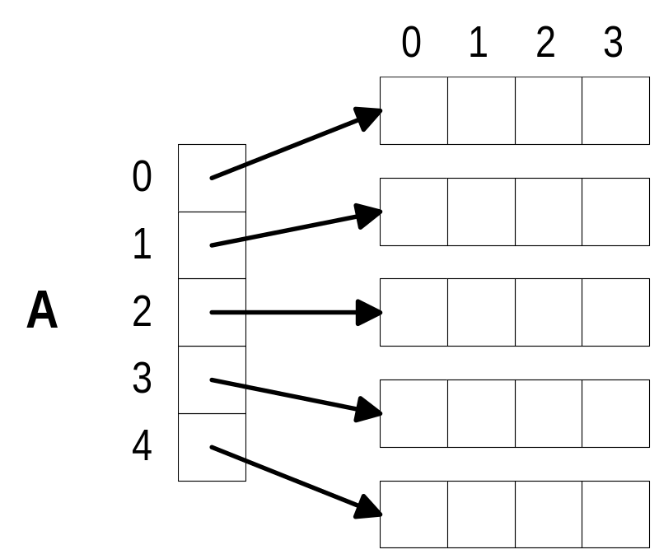
Dynamically Allocating 2D Arrays
Can not simply dynamically allocate 2D (or higher) array
Idea - allocate an array of pointers (first dimension), make each pointer point to a 1D array of the appropriate size
Can treat result as 2D array

Slide 33
Dynamically Allocating 2D Array
float **A; /* A is an array (pointer) of float
pointers */
int I;
A = (float **) calloc(5,sizeof(float *));
/* A is a 1D array (size 5) of float pointers */
for (I = 0; I < 5; I++)
A[I] = (float *) calloc(4,sizeof(float));
/* Each element of array points to an array of 4 float variables */
/* A[I][J] is the Jth entry in the array that the Ith member of A points to */

Slide 34
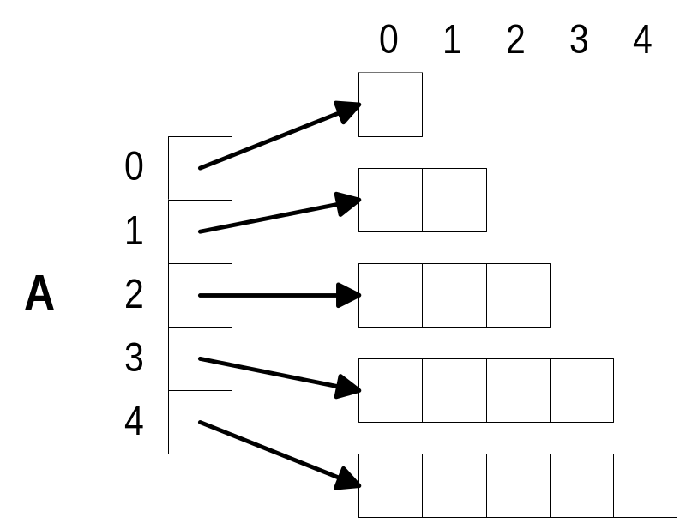
Non-Square 2D Arrays
No need to allocate square 2D arrays:
float **A;
int I;
A = (float **) calloc(5,
sizeof(float *));
for (I = 0; I < 5; I++)
A[I] = (float **)
calloc(I+1,
sizeof(float));

