Slide 1
A “simple” D3 example for digital publishing
FIRST DRAFT
Claudio Tubertini CLUEB Bologna

Slide 2
Grammar of graphics
https://r4ds.had.co.nz/
https://ggplot2.tidyverse.org/
Kyran Dale, Data Visualization with Python and JavaScript, O'Reilly Media, 2016
https://www.oreilly.com/online-learning/
Data visualization model in R, Python, Java, C++
Data (input)
processing
Output: HTML, PDF, etc.

Slide 3
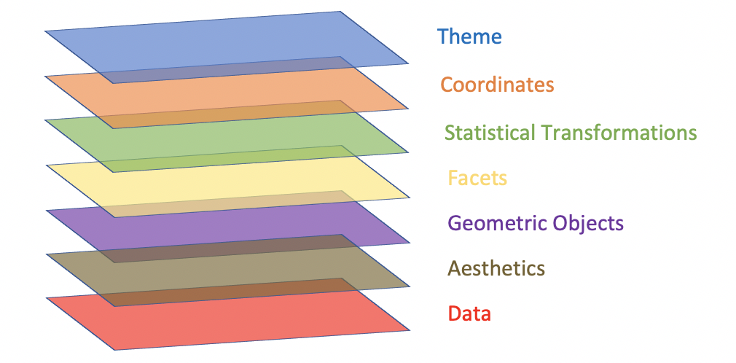
Grammar of graphics
Layer
Data
Mapping
Statistical transformation (stat)
Geometric object (geom)
Position adjustment (position)
Scale
Coordinate system (coord)
Faceting (facet)
Defaults
Data
Mapping
http://vita.had.co.nz/papers/layered-grammar.html

Slide 4
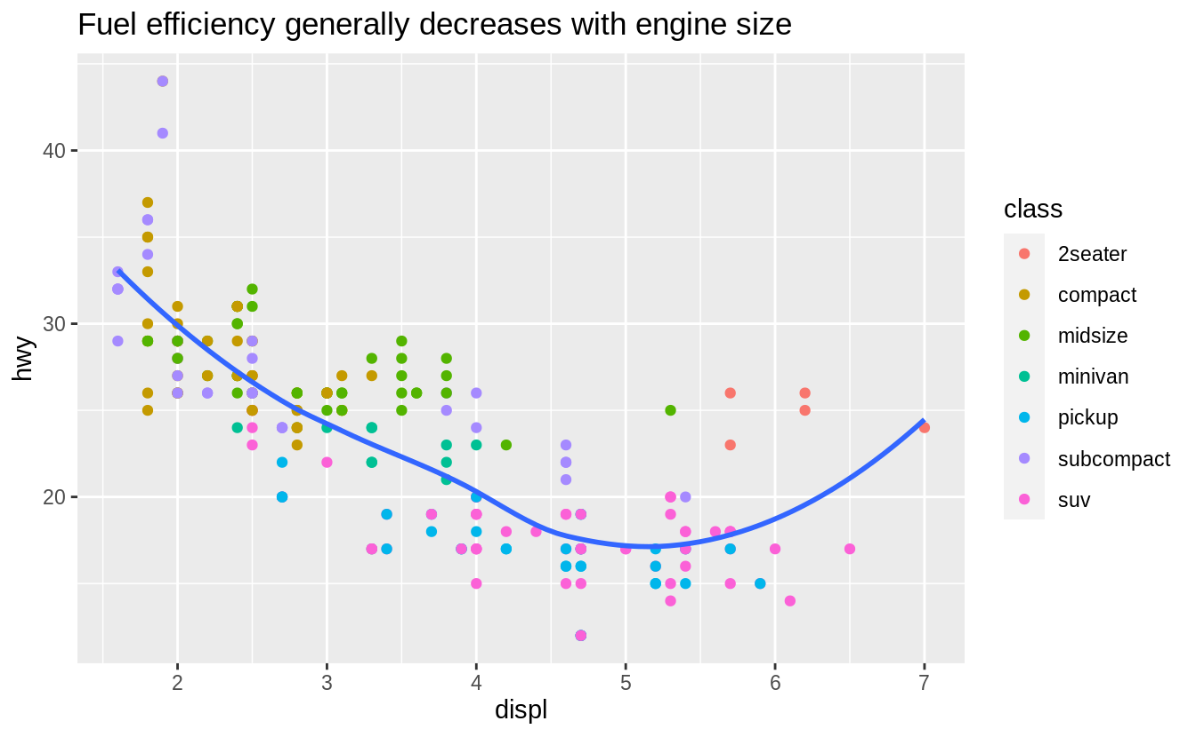
Data visualization in R
Mpg are the data over which we apply the aesthetic (in this case is a geometric relation between displacement and highway miles per gallon, aes(displ, hwy), then we apply a type of representation, points of colors related to class (sport, wagon, etc.) , then a statistics (a smooth curve), and eventually the labels .
ggplot(mpg, aes(displ, hwy)) +
geom_point(aes(color = class)) +
geom_smooth(se = FALSE) +
labs(title = "Fuel efficiency generally decreases with engine size")
Displ: engine displacement, in litres
Hwy: highway miles per gallon

Slide 5
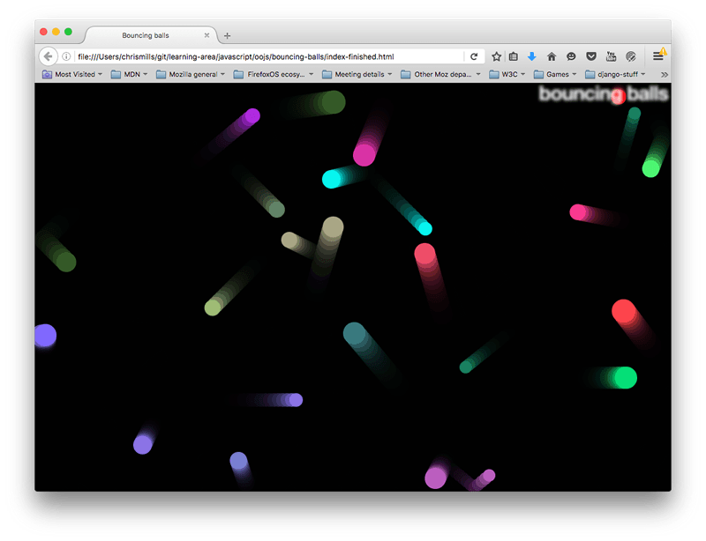

An alternative route: canvas
https://developer.mozilla.org/en-US/docs/Web/API/Canvas_API/Tutorial
Canvas API
<canvas></canvas>
E.g. gamification,

Slide 6
A canvas example
canvas_example.html
const canvas = document.querySelector('.myCanvas');
const width = canvas.width = window.innerWidth;
const height = canvas.height = window.innerHeight;
const ctx = canvas.getContext('2d');
ctx.fillStyle = 'rgb(0,0,0)';
ctx.fillRect(0,0,width,height);
ctx.fillStyle = 'rgb(255,0,0)';
ctx.fillRect(50,50,100,150);
ctx.fillStyle = 'rgb(0,255,0)';
ctx.fillRect(75,75,100,100);
ctx.fillStyle = 'rgba(255,0,255,0.75)';
ctx.fillRect(25,100,175,50);
ctx.strokeStyle = 'rgb(255,255,255)';
ctx.lineWidth = 5;
ctx.strokeRect(25,25,175,200);
Set the canvas with class=’myCanvas’
canvas extends all available space in the window
canvas.getcontext return canvas object with the methods
Fill the canvas with color black
Fill a square of color red
Fill a square of different size of color green
Now a square with opacity less than 1 that is alpha = 0.75
Then just a square contour with a stroke of 5px of color white

Slide 7
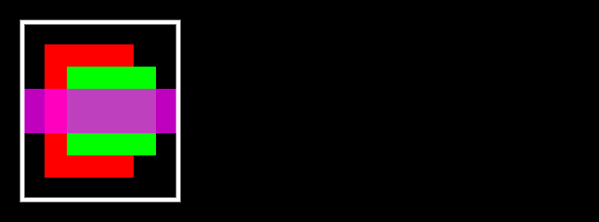
The result in a browser

Slide 8
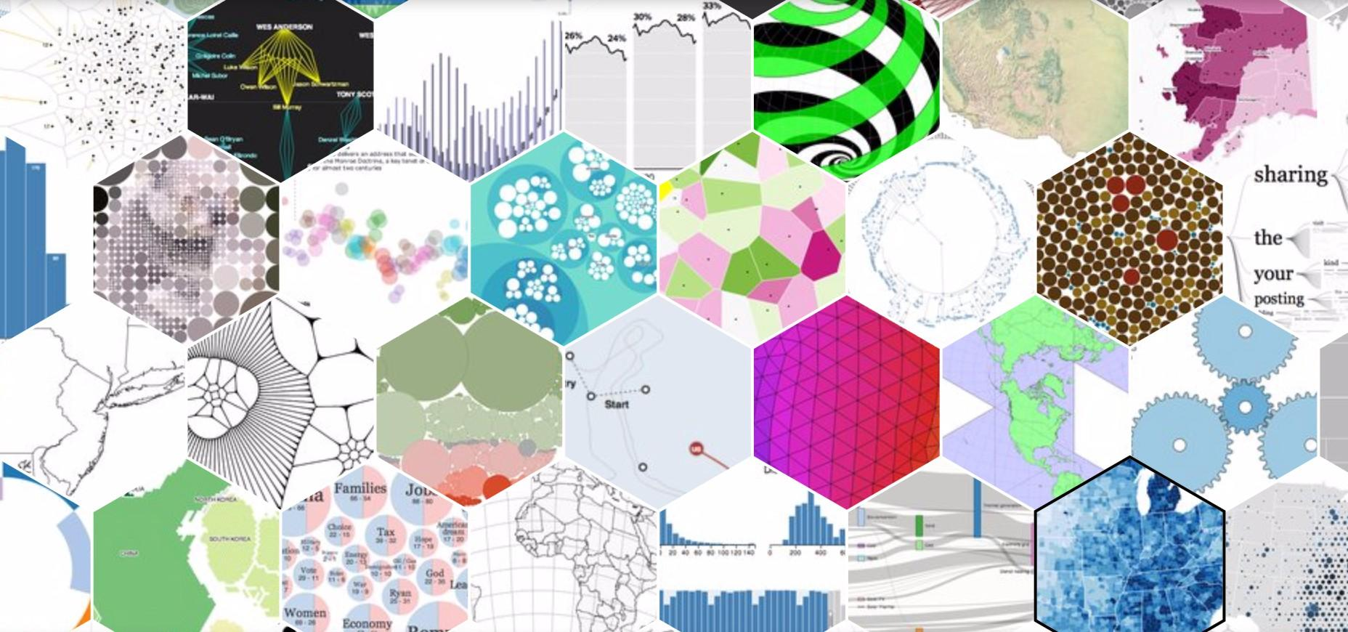
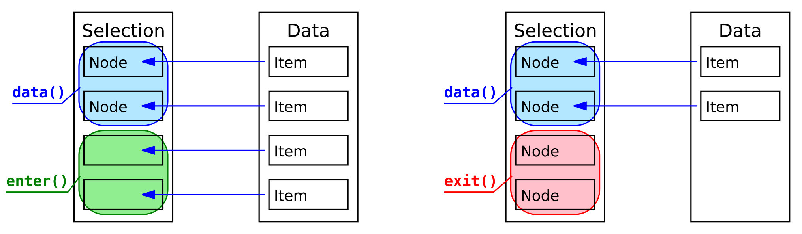
D3 is halfway between data processing and html canvas
Data import and processing data
Processing and design DOM element
HTML
Node are selected DOM elements to which data are associated one-to-one
d3.select( "svg" ).selectAll( "circle" )
.data( data ).enter() .append( "circle" ).attr( "fill", "red );
We select the element ‘ svg’ under which we select subnodes ‘circle’. If there are more data than nodes, we use enter() (adding nodes that receive data). On the contrary if there are more nodes than data, we can use exit() to remove the the extra nodes or to add different data. In D3V5 join() with its three parameters reduce all this mess..

Slide 9
Some of the example of this bootcamp require I/O from external file. To avoid CORS problems run a web server in the same directory where are the example files
In nodejs npm install -g http-server http-server ./your/directory -p 8080
In Python python -m http.server -d ./your/directory 8080

Slide 10
Modifying DOM elements
<!-- DOM_example_0.html -->
<!DOCTYPE html>
<html lang="en">
<head>
<title>D3: Selections</title>
</head>
<body>
<div class="about-me">
<p>Ciao benvenuti a WHOmanities!</p>
<ul id="list">
<li>I'm a powerlifter</li>
<li>I'm studying DHDK</li>
<li>I love D3.js!</li>
</ul>
</div>
<script src="https://d3js.org/d3.v5.min.js"></script>
<script src="main.js"></script>
</body>
</html>
<!-- main.js -->
const listItems = [...document.getElementsByTagName('li')];
listItems.map(item => item.style.setProperty('font-weight', 'bold'));
const ul = document.getElementsByTagName('ul')[0];
const newItem = document.createElement('li');
newItem.appendChild(document.createTextNode(`I'm learning about selections.`));
ul.appendChild(newItem);
<!-- main_D3.js -->
const li = d3.selectAll('li').style('font-weight', 'bold');
const ul = d3.select('ul');
ul.append('li').text(`I'm learning about selections`);
const ul = d3.select('ul');
ul.select('li').style('color', 'red');
ul.append('li').text(`I'm learning about selections`);

Slide 11
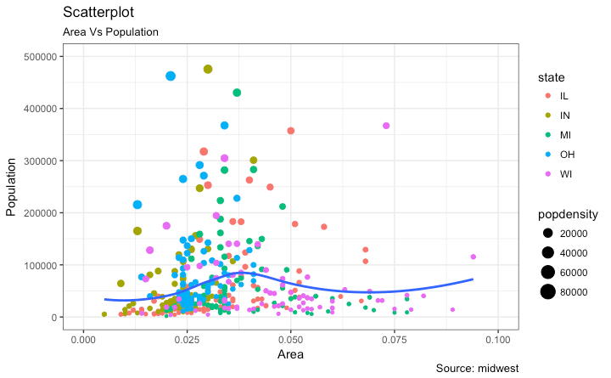
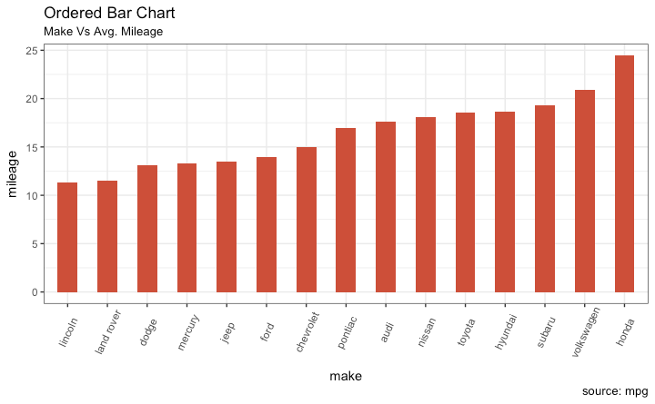
A few examples 1

Slide 12
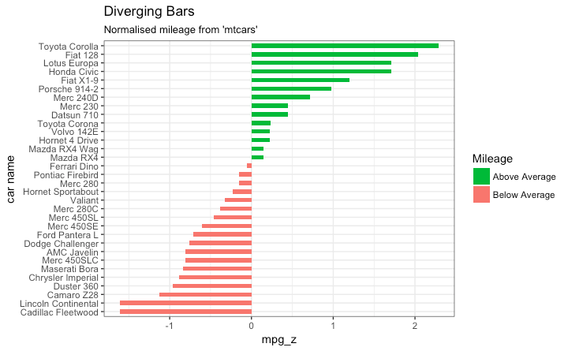
A few examples 2

Slide 13
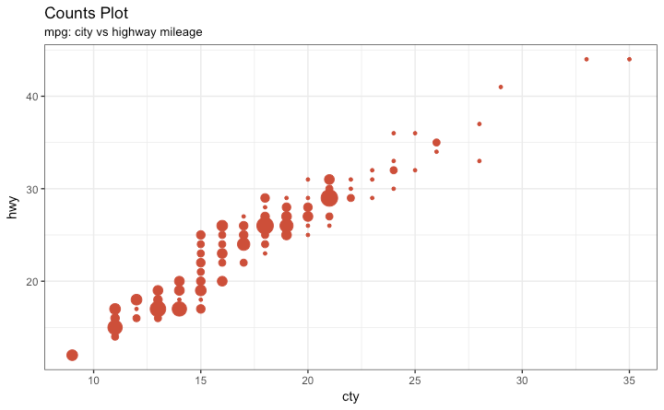
A few examples 3

Slide 14
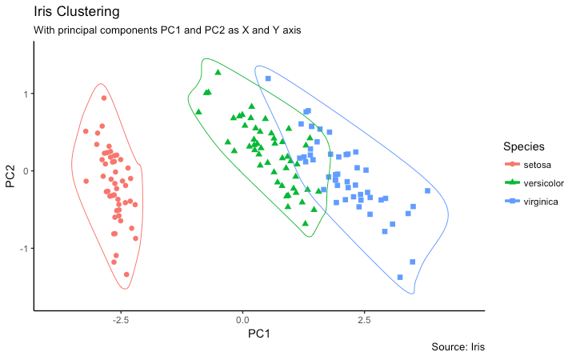
A few examples 4

Slide 15
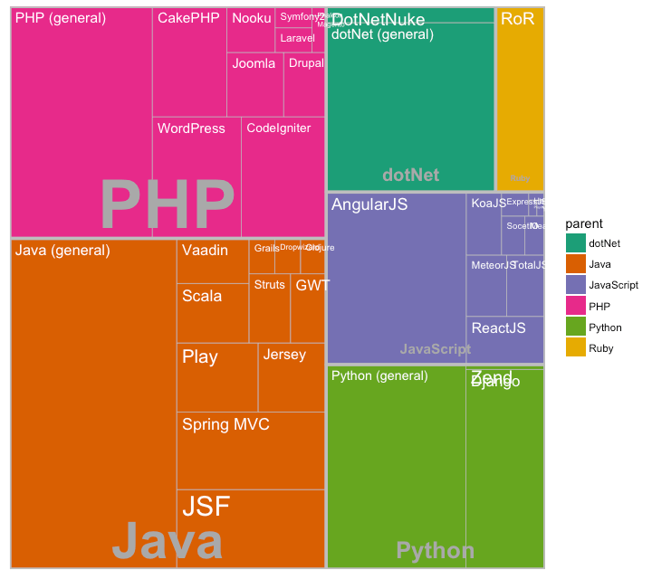
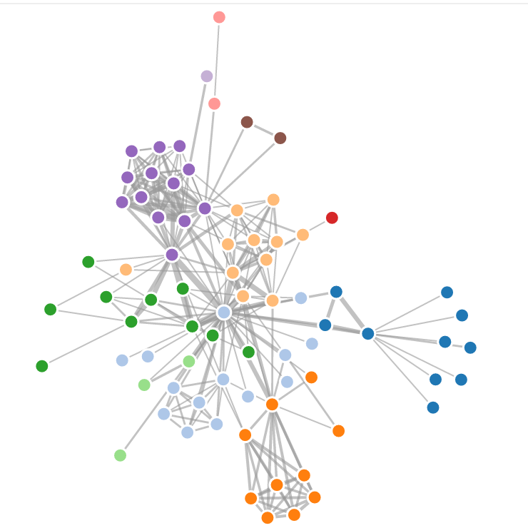
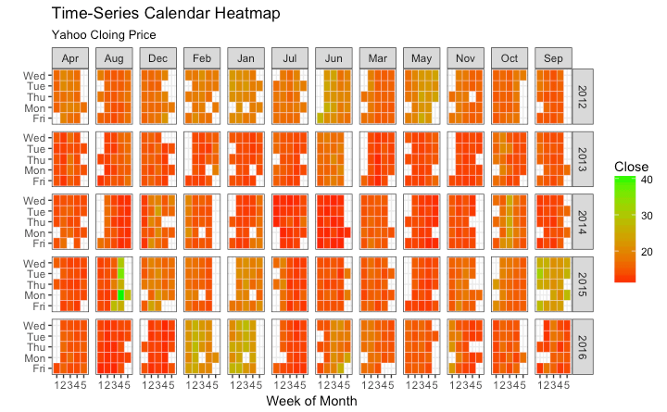
A few examples 5
Hierarchical graph
Tree map
Heat map

Slide 16
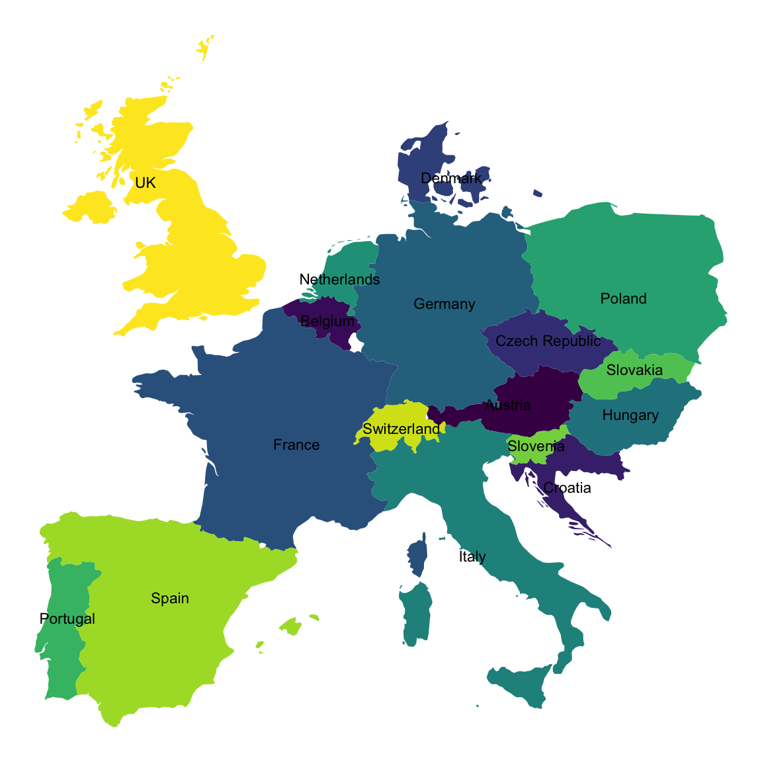
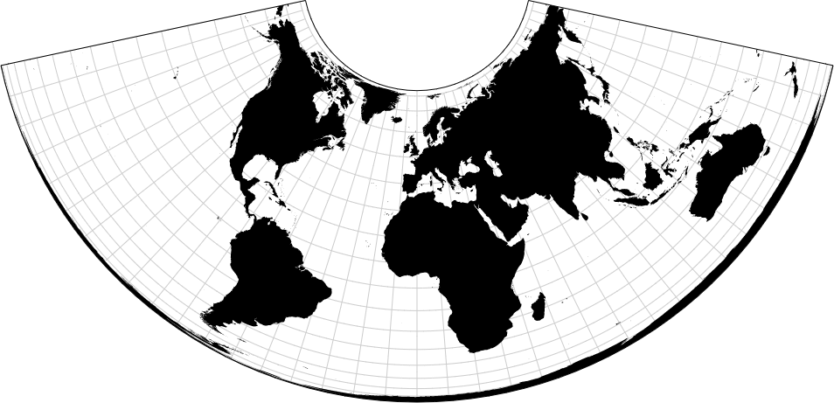
A few examples 6

Slide 17
Data
Processing with visualization grammar
Output: HTML, PDF
To import data you can use D3 and Lodash (https://observablehq.com/@dakoop/getting-started-learn-js-data) but it’s easier if you use Python or R and pass a json object to D3
If you aim to a PDF, stick to R (https://www.tidyverse.org/) or Python (https://www.scipy.org/), but for HTML output D3 really shines (https://d3js.org/)
Why data visualization is so important?
Infographics examples:
https://github.com/wbkd/awesome-interactive-journalism
Aside To keep yourself updated
use an rss feed reader

Slide 18
D3 basic grammar
d3.select(), return the first item; d3.selectAll() return an array, can be used to access DOM elements by name, class, id, or other css selectors.
Modifying selected elements: d3.selectAll(“circle”).attr(“fill”, “#ff0000”) d3.select(“h1”).text(“Hello World!”) d3.select(“svg”).append(“rect”).attr(“x”,50).attr(“y”,100) .attr(“width”,100).attr(“height”,100).attr(“fill”,”#0000FF”)
data() function binds data to a selection.

Slide 19
Building step by step a bar-graph with color transition I part
Check index_1.html
Retrieve the data
d3.csv("https://claudiotubertini.github.io/WHOmanities/covid_italy.csv") .then(data => data.map(x => {return { day: x["day"], Region: x["Region"], country: x["Country Name"], Confirmed: +x["Confirmed"], "Cumulative Confirmed": +x["Cumulative Confirmed"]}})) .then(function(data){ return console.log(JSON.stringify(data)) });

Slide 20
Building step by step a bar-graph with color transition II part 1
Designing the bar chart // set the dimensions and margins of the graph var margin = {top: 40, right: 20, bottom: 70, left: 100}, width = 1260 - margin.left - margin.right, height = 700 - margin.top - margin.bottom; // Set the ranges and axis var x = d3.scaleBand().range([0, width]) var y = d3.scaleLinear().range([height, 0]); var xAxis = d3.axisBottom().scale(x); var yAxis = d3.axisLeft().scale(y).ticks(10); // append the svg object to the body of the page // append a 'group' element to 'svg' // moves the 'group' element to the top left margin var svg = d3.select("body").append("svg") .attr("width", width + margin.left + margin.right) .attr("height", height + margin.top + margin.bottom) .append("g").attr("transform", "translate(" + margin.left + "," + margin.top + ")");
Check index_2.htm

Slide 21
Building step by step a bar-graph with color transition II part 2
// Scale the range of the data in the domains x.domain(data.map(function(d) { return d.date; })); y.domain([0, d3.max(data, function(d) { return d["Cumulative Confirmed"]; })]); // append the rectangles for the bar chart svg.selectAll(".bar").data(data) .enter().append("rect") .attr("class", "bar") .style("fill", 'lime') .attr("x", function(d) { return x(d.date); }).attr("width", 10) .attr("y", function(d) { return y(d["Cumulative Confirmed"]); }) .attr("height", function(d) { return height - y(d["Cumulative Confirmed"]); }); // Axis labels and titles svg.append("g").attr("class", "x axis") .attr("transform", "translate(0," + height + ")").call(xAxis).selectAll("text") .style("text-anchor", "end").attr("dx", "-.8em").attr("dy", "-.55em") .attr("transform", "rotate(-90)" );

Slide 22
Building step by step a bar-graph with color transition III 1
Check index_3.html
A (very simple) transition example
We download two different data set let data = await d3.csv("https://claudiotubertini.github.io/WHOmanities/covid_italy.csv")
let data2 = await d3.csv("https://claudiotubertini.github.io/WHOmanities/covid_germany.csv")

Slide 23
Building step by step a bar-graph with color transition III 2
We create an onclick event on the svg
svg.on( "click", function() { [ data, data2 ] = [ data2, data ]; mycolor = (mycolor == "steelblue")? "lime" : "steelblue"; svg.selectAll(".bar").data(data) .transition().duration( 1000 ).delay( (d,i)=>100*i ) .style("fill", mycolor) .attr("x", function(d) { return x(d.date); }) .attr("width", 10) .attr("y", function(d) { return y(d["Cumulative Confirmed"]); }) .attr("height", function(d) { return height - y(d["Cumulative Confirmed"]); }); });

Slide 24
Distributable scripting content
Online? May be on paper
Content can present both in web site and books (epub)
Books can be read offline, are shareable, and are durable
If you want to distribute your content as a multi device app try:
Ionic Framework 5 (https://ionicframework.com/)
ePub3: insert interactive content using D3, canvas or webGL in an iframe
https://www.w3.org/publishing/epub32/epub-contentdocs.html#example-4

Slide 25
D3 Bibliography
https://observablehq.com/@d3/gallery
https://github.com/d3/d3/blob/master/API.md

