Slide 1

Vista system restore rootkit
Principle and protection
Edward Sun
Notes:
按一下以新增備忘稿

Slide 2
About speaker
Network ID : CardMagic
Author of DarkSpy anti-rootkit
Posted several articles on rootkit.com
R&D of some world famous kernel level products in global companies
Experienced in Windows kernel mode research and programming
Now is a researcher of Trend Micro threat solution team
MSN: onlyonejazz at hotmail.com

Slide 3
What will be introduced
Internals of Vista system restore
A user-mode rootkit to hide arbitrary file or registry key from Windows Vista system restore
A new way to bypass modern HIPS
Detection and protection of the threat

Slide 4
Agenda
Vista system restore (VSR) introduction
VSR internals
VSR rootkit
A new way to bypass HIPS
Protect & detect VSR
Demo
Notes:
此簡報對觀眾的助益為何：成年的學習者會因為了解主題的重要性何在及其理由，從而對該主題產生較大的興趣。
簡報者在此主題的專業程度：簡短地在此區中陳述擁有的認證，或是參與者必須聽從您的原因。

Slide 5
Vista system restore (VSR) introduction
VSR allows user to use restore point to return their system files and settings to an earlier point in time
System restore in Vista has been enhanced a lot and use new architecture & implementation which is different from XP’s
System Restore can make changes to Windows system files, registry settings, and programs installed on your computer. It also can make changes to scripts, batch files, and other types of executable files on your computer

Slide 6
VSR internals
But how does VSR work? Microsoft hasn’t provided detail document about how it works .
We will introduce the whole process in three phases
1. Create restore point (when you click “Create” button)
2. Serve a restore request (when you click “Restore” button)
3. Shutdown & Startup (when the system shuts down after you clicking “Restore”)
Notes:
在這張投影片上的單元說明應該要簡短

Slide 7
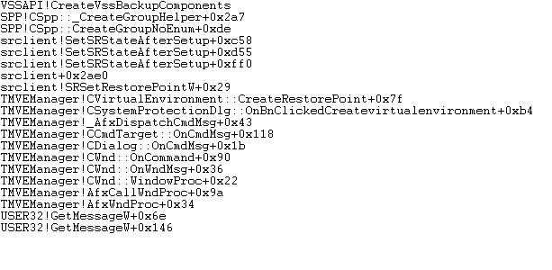
Create restore point
Rely on shadow copy mechanism to create a volume shadow copy, see the call stack of SRSetRestorePoint

Slide 8
Shadow copy
Implemented with volume filter -- Volsnap.sys
It can back up original sector when it finds any writer’s modification action and provide backup application a point in time view of a volume
E.g. if application(writer) has written a,b,d, the original copy of these sectors are kept by shadow copy service in storage. When backup application accesses the three sectors, shadow copy service will route the request to original copy. However, when c is requested, the service will direct the request to real volume.

Slide 9
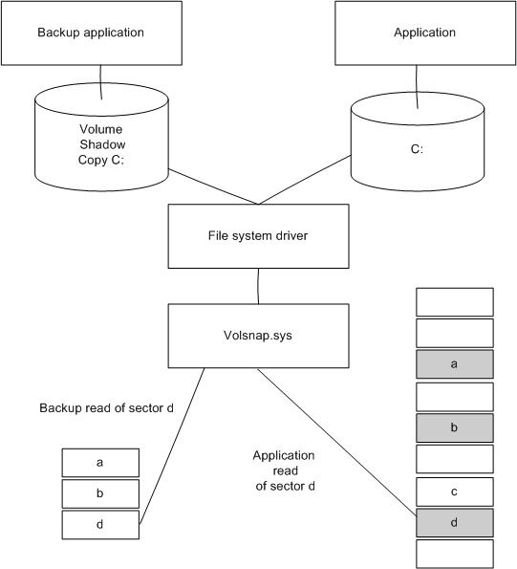

Slide 10
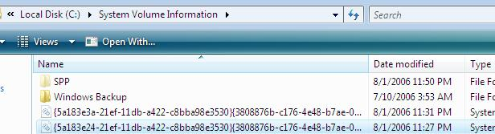
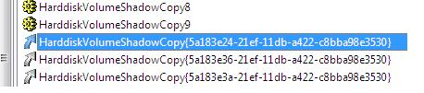
Associated shadow copy files located here:
Backup file id matches the name of shadow volume device name

Slide 11

Serve a restore request
When backup program calls restoration method, two processes will be launched : WmiPrvSE.exe( to hold srwmi.dll) , dllhost.exe(to hold srcore.dll)

Slide 12
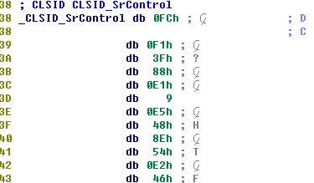
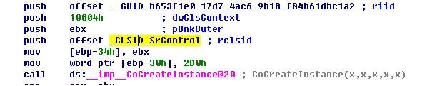

Then the control transferred to srwmi.dll -- CSrWMIProvider::Restore
This method will involve srcore.dll:
CreateInstance here
Clsid
Corresponding Registry key

Slide 13
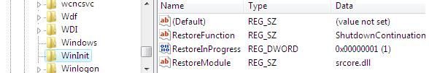
srcore.dll will do some preparation and configuration work and then call its internal interface _RegisterForShutdownContinuation.
This routine will create WinInit key and register a callback function for Windows shutdown. And the key looks like
The routine will be called for shutdown restoration logic

Slide 14
Shutdown & Startup
The Shutdown Call back:
When system shuts down, the ShutdownContinuation will be called, and this callback routine is exported by srcore.dll. In this routine, it will parse shadow volume information and restore various system elements. The main restore logic include two parts :

Slide 15
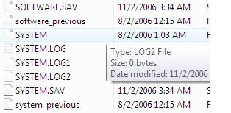
a. Registry restore :
The registry restore is based on hive file:
srcore will firstly rename the original hive file and then copy the backed hive file from volume shadow copy. The original hive file will be renamed as xxxx_previous, and after reboot system will use the backed hive file.

Slide 16
b. File restore:
Modified file will be restored immediately, excepted inaccessible file.
For inaccessible file :
srcore will firstly copy the old version file to the restore folder and name it like :
Then it will register an autorun program called srdelayed.exe which will be executed when system starts up, and meanwhile log the operations which will be done by srdelayed.exe in <System volume information>\systemrestore\DelayedOperations. srdelayed.exe will overwrite the inaccessible file later with the copied file.
Show result :
Finally,srcore will register an autorun entry under <RunOnce> key to execute rstrui.exe to show the restore status when user enter system next time.

Slide 17
Startup :
In the startup, Windows will run srdelayed.exe to do some remaining post actions (e.g. move the copied file to overwrite the file which is inaccessible in previous restore). And then run rstrui.exe to show restore result to user.

Slide 18
VSR rootkit
Purpose :
survive after the system restore
hide following items from system restore:
1. registry items
2. executables

Slide 19
Approach :
1. How this rootkit intercept the restore process:
Thru shutdown call back hooking :
Microsoft has passed the restore function name
and module under WinInit as described before :

Slide 20
This key will be set when the system requests a restore. If rootkit dynamically modifies this key to point to its module and routine when after system sets this key, guess what will happen ?
Yes, the rootkit’s module will be loaded, Microsoft has no checking on the module.
2. How can it continue the system restore:
It loads srcore.dll internally ,and call ShutdownContinuation exported by srcore itself.

Slide 21
3. How can it make file survive?
It loads file in memory before calling ShutdownContinuation exported by srcore.dll, and restore the files from memory to disk after the calling. (because all files and registery items are restored in the calling)
4. How can it make registry item survive?
This is relatively difficult, but still easy for a rootkit author. As described before, OS will rename original hive to a new name ,and copy restored hive to the location.
However, after these operations in calling of ShutdownContinuation exported by srcore.dll, both the restored hive file and renamed hive file will be locked.

Slide 22
What VSR does to solve the locking problem is to hook IAT of srcore.dll to intercept the call : RegLoadKeyW
In its hooking procedure of RegLoadKeyW, it will follow the below steps :
For registry hive it wants to hide items in:
a. load the key ourselves to a temp key before calling the real RegLoadKeyW
b. do recovery (write rootkit protected registry items to registry) under temp key
c. unload the key
d. pass the call control to real RegLoadKeyW and return
For registry hive it doesn’t want to hide any item in, just simply pass the call control to real RegLoadKeyW and return.

Slide 23
A new way to bypass HIPS
Malware author might benefit from shutdown call back hook to bypass commercial HIPS
The theory :
1. Malware initiates a restore from any restore point, and modify restore module and routine to point to malicious ones.
2. When user shuts down his computer, malicious module will be called, and malware can do anything they want (E.g. create malicious autorun key) without popup of HIPS in its module.

Slide 24
But there might be some concerns:
1. Will user notice if the shutdown takes long time to complete? (Because the restoration will happen during system shuts down)
No, because malware will not need to call original ShutdownContinuation for any restore actions. This will make the shutdown very quick.
2. How malware solves Vista’s popup for restore error next time when user logs on if it doesn’t call original ShutdownContinuation ?
This can be done by deletion of run key rstrui.exe under <RunOnce>

Slide 25
Protect & detect VSR
Microsoft needs to use more secure parameter passing method (e.g. do signature verification for calling module)
For commercial HIPS to protect VSR intrusion , they need to monitor the WinInit modification by a malware.
But the challenge is : Microsoft might still leaves some other places to implement VSR.

Slide 26
For detection of the VSR, security providers can use the cross-compare technology for rootkit detection.
In order to get the real view of files & reg keys that system restore should restore, they can access the volume shadow copy to enumerate the files & reg keys in restore point.
How can they access ?
Just use Win32 API (e.g. FindFirstFile), but pass the path parameter like:
\\.\HarddiskVolumeShadowCopy2\Windows\system32
(But the media is just read-only)

Slide 27
Thanks
Q & A

