Slide 1

RAIDE: Rootkit Analysis Identification Elimination
by
Jamie Butler & Peter Silberman

Slide 2
Who Are We?
Peter Silberman
  Sophomore College Student
  Independent Security Research
  Author of FUTo
  Contributor to openRCE.org (VISIT THE SITE)
Jamie Butler
  CTO of Komoku http://www.komoku.com/
    Software attestation
    Rootkit detection
  Author of Rootkits: Subverting the Windows Kernel
  Co-author of Shadow Walker proof-of-concept memory subversion rootkit
  Pioneer of Direct Kernel Object Manipulation (DKOM)

Slide 3
Agenda
Overview of Rootkits
    Hooks
      Import Address Table (IAT)
      KeServiceDescriptorTable
        Inline
        Entry overwrite
      I/O Request Packet (IRP)
      Interrupt Descriptor Table
    Hiding Processes
      Detecting Hidden Processes
  RAIDE
  Demo using RAIDE

Slide 4
What is a rootkit
Definition might include
  a set of programs which patch and Trojan existing execution paths within the system
    Hooks or Modifies existing execution paths of important operating system functions
  The key point of a rootkit is stealth.
History of Rootkits
  Replace binaries like ls, ps, du, etc.
  Trojan login program to steal passwords

Slide 5
Hooking in User Land
IAT hooks
  Hooking code must run in or alter the address space of the target process
    If you try to patch a shared DLL such as KERNEL32.DLL or NTDLL.DLL, you will get a private copy of the DLL.
  Three documented ways to gain execution in the target address space
    CreateRemoteThread
    Globally hooking Windows messages
    Using the Registry
      HKEY_LOCAL_MACHINE\Software\Microsoft\Windows NT\CurrentVersion\Windows\AppInit_DLLs

Slide 6
IAT HOOK
Import Address Table
FunctionName or Ordinal
0x11223344
Table Entry

Slide 7
Some DLL
IAT HOOK
CODE
FunctionName or Ordinal
0x11223344
CODE
Table Entry

Slide 8
Some DLL
IAT HOOK
CODE
Some Rootkit
BAD CODE
CODE

Slide 9
Some DLL
IAT HOOK
CODE
Some Rootkit
BAD CODE
CODE

Slide 10
Hooking in Kernel Space
The operating system is global memory
Does not rely on process context
  Except when portions of a driver are pageable
By altering a single piece of code or a single pointer to code, the rootkit subverts every process on the system

Slide 11
KiSystemService
System Call
ZwCreateFile:
mov eax,0x25
mov edx, 0x7ffe0300
Call [edx]
0x25
Call
nt!NtCreateFile
Table Entry
System Service
Descriptor Table
USER MODE
KERNEL MODE

Slide 12
Kernel or module
System Call
ZwCreateFile:
mov eax,0x25
mov edx, 0x7ffe0300
Call [edx]
0x25
Some rootkit
Call
nt!NtCreateFile
System Service
Descriptor Table
USER MODE
KERNEL MODE

Slide 13
Kernel or module
System Call
ZwCreateFile:
mov eax,0x25
mov edx, 0x7ffe0300
Call [edx]
0x25
Some rootkit
System Service
Descriptor Table
System Service
Descriptor Table
Some rootkit
USER MODE
KERNEL MODE

Slide 14
System Call
Nt!NtCreateFile
jmp 0008:11223344
[…]
ZwCreateFile:
mov eax,0x25
mov edx, 0x7ffe0300
Call [edx]
Kernel or module
0x25
[…]
mov edi,edi
push ebp
mov ebp,esp
jmp nt!NtCreateFile+08
System Service
Descriptor Table
Some rootkit
USER MODE
KERNEL MODE

Slide 15
I/O Manager and IRP Hooking
System calls used to send commands
  NtDeviceIoControlFile
  NtWriteFile
  Etc.
Requests are converted to I/O Request Packets (IRPs)
IRPs are delivered to lower level drivers

Slide 16
I/O Manager and IRP Hooking
Every driver is represented by a DRIVER_OBJECT
IRPs are handled by a set of 28 function pointers within the DRIVER_OBJECT
A rootkit can hook one of these function pointers to gain control

Slide 17
Interrupt Descriptor Table Hooks
Each CPU has an IDT
IDT contains pointers to Interrupt Service Routines (ISRs)
Uses for IDT hooks
  Take over the virtual memory manager
  Single step the processor
  Intercept keystrokes

Slide 18
Hiding Processes
DKOM Uses
  To hide a process
    Locate the EPROCESS block of the process to hide
    Change the process behind it to point to the process after the process you are hiding
    Change the process after it to point to the process before the one you are trying to hide
  Add Privileges to Tokens
  Add Groups to Tokens
  Manipulate the Token to Fool the Windows Event Viewer
  Hide Ports

Slide 19
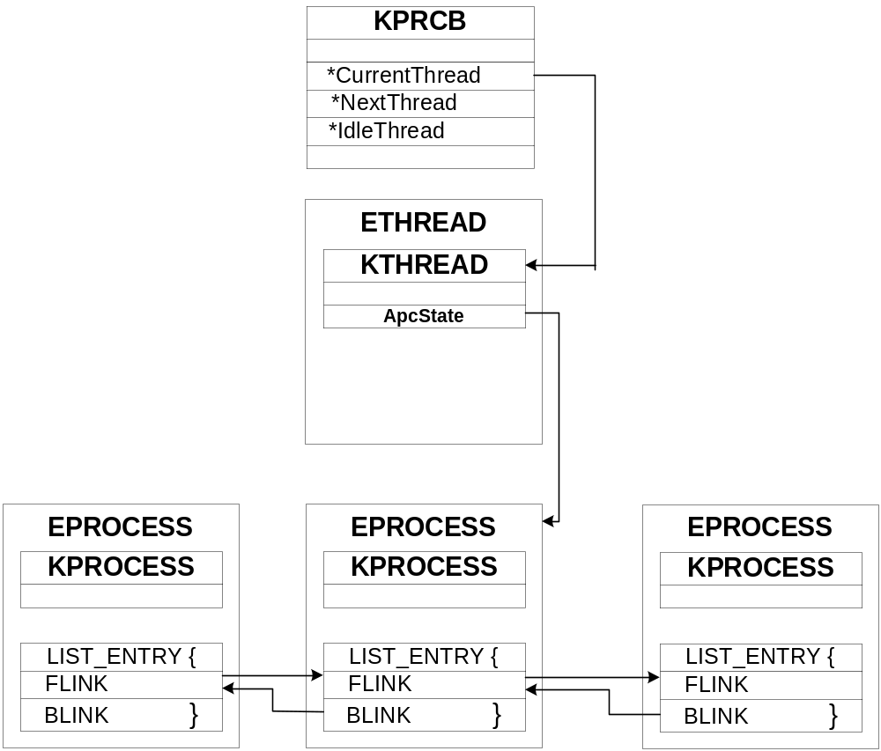
Hiding Processes - Windows

Slide 20
FUTo – Hiding From the Tables
FUTo
  Uninformed Journal Vol. 3 (http://www.uninformed.org)
  New version of FU hence the ‘To’
  Hides from IceSword and Blacklight
    Blacklight patched on 2/17/06
Removes itself from the PspCidTable

Slide 21
PspCidTable (PspPidTable)
PspCidTable
  Job of PspCidTable is to keep track of all the processes and threads
    PspCidTable’s indexes are the PIDs of processes.
    Returns the address of the EPROCESS of a process at the location corresponding to the PID.
Problems:
  Relying on a single data structure is not a very robust
  By altering one data structure much of the OS has no idea the hidden process exists

Slide 22
Kernel Structures: The Tables
Handle Table:
  Handles are an index into the Handle Table for a particular object
  Objects represent processes, threads, tokens, events, ports, etc.
  The Object Manager must do the translation from a handle to an object
  The Object Manager consults the Security Reference Monitor to determine access to the object
  Every process has its own handle table to keep track of the handles it owns

Slide 23
Kernel Structures: Handle Tables
lkd> dt nt!_HANDLE_TABLE
+0x000 TableCode : Uint4B
+0x004 QuotaProcess : Ptr32 _EPROCESS
+0x008 UniqueProcessId : Ptr32 Void
+0x00c HandleTableLock : [4] _EX_PUSH_LOCK
+0x01c HandleTableList : _LIST_ENTRY
+0x024 HandleContentionEvent : _EX_PUSH_LOCK
+0x028 DebugInfo : Ptr32 _HANDLE_TRACE_DEBUG_INFO
+0x02c ExtraInfoPages : Int4B
+0x030 FirstFree : Uint4B
+0x034 LastFree : Uint4B
+0x038 NextHandleNeedingPool: Uint4B
+0x03c HandleCount : Int4B
+0x040 Flags : Uint4B
+0x040 StrictFIFO : Pos 0, 1 Bit

Slide 24
Handle Table Translation
NtTerminateProcess:
PVOID obj = TranslateHandleToObject(hProcess);
test.exe ProcessId 152
{
HANDLE hProcess;
hProcess = OpenProcess(PROCESS_ALL_ACCESS, 0, 132);
if(hProcess == INVALID_HANDLE)
return 0;
TerminateProcess(hProcess);
}
TranslateHandleToObject
Process = PspCidTable[ PsGetCurrentProcessById() ];
if( Process == NULL) return 0;
return Process->ObjectTable[hProcess];
0 100 152
hProcess = 0x03
ZwTerminateProcess( hProcess );
0 1 2 3 .. .. .. .. 80 81 82 83 84
Object:
ObjectType = OBJ_PROCESS
Object = 0x8014231

Slide 25
Handle Table Translation
NtTerminateProcess:
PVOID obj = TranslateHandleToObject(hProcess);
test.exe ProcessId 152
{
HANDLE hProcess;
hProcess = OpenProcess(PROCESS_ALL_ACCESS, 0, 132);
if(hProcess == INVALID_HANDLE)
return 0;
TerminateProcess(hProcess);
}
TranslateHandleToObject
Process = PspCidTable[ PsGetCurrentProcessById()];
if( Process == NULL) return 0;
return Process->ObjectTable[hProcess];
hProcess = 0x03
0 100 152
ZwTerminateProcess( hProcess );
0 1 2 3 .. .. .. .. 80 81 82 83 84
Object:
ObjectType = OBJ_PROCESS
Object = 0x8014231

Slide 26
Detecting Processes
Blacklight Beta
  Released in March 2005
  Good hidden process and file detection
IceSword 1.12
  Robust tool offering:
    SSDT Hook Detection
    Hidden File and Registry Detection
    Hidden Process
    Hidden Ports and socket communication Detection
Common flaw
  Both applications rely upon the PspCidTable for detection

Slide 27
Detecting Hidden Processes
PID Bruteforce
Blacklight (Pre-Valentine’s)
  Bruteforces PIDs 0x0 - 0x4E1C
    Calls OpenProcess on each PID
      If Success store valid PID
    Else Continue Loop
  Finished looping, take list of known PIDs and compare it to list generated by calling CreateToolhelp32Snapshot
  Any differences are hidden processes
    Called Cross-View method or Difference Based Method

Slide 28
RAIDE

Slide 29
RAIDE
  What is RAIDE?
  What makes RAIDE different than Blacklight, RKDetector, Rootkit Revealer, VICE, SVV, SDTRestore?
  What doesn’t RAIDE do?

Slide 30
What is RAIDE
RAIDE is a complete toolkit offering:
  Forensic Capabilities (RKDetector)
    Dumping Process
  Hidden Process Detection (Blacklight)
  Hook Detection (SDTRestore, SVV, VICE)
  Hook Restoration (SDTRestore, SVV)
  IDT Detection
    Memory Subversion Detection
  Hidden Process Features
    Relink processes to make it visible
    Close Hidden Processes
    Hidden Process Method Detection – Example hook, DKOM, etc.

Slide 31
What Makes RAIDE Different?
  RAIDE combines most existing tools
  RAIDE detects Memory Subversion
  RAIDE gives the user more information about hidden processes
  RAIDE does not use IOCTL’s to communicate

Slide 32
What Doesn’t RAIDE Do?
  RAIDE does not detect hidden files, folders, or registry keys
  RAIDE does not restore Driver IRP hooks
  RAIDE does not restore IDT hooks
  RAIDE does not prevent a rootkit from loading

Slide 33
RAIDE Communication
RAIDE uses Shared Memory segments to pass information kernel land ←→ user land
  Shared Memory contains only encrypted data
  Communication uses randomly named events for signaling
  Uses randomly generated process names
    RAIDE spawns a user process from a driver to do a Difference Based or Cross-View comparison

Slide 34
Hidden Process Detection
Goal for Process Detection:
  Signature that can not be zeroed out
  Signature that is unique
    Signature must not have false positives

Slide 35
Hidden Process Detection
Signature:
  Locate pointers to “ServiceTable”
    ServiceTable = nt!KeServiceDescriptorTableShadow
    ServiceTable = nt!KeServiceDescriptorTable
  Contained in all ETHREAD
Hidden Process:
  Spawn a process with random name
    Spawned process generates process list
      sends processes list visible to RAIDE
    RAIDE compares the two lists finding the differences
      hidden processes

Slide 36
Hidden Process Method Detection
To detect hidden process methods, we need to know the two methods most commonly used.
  DKOM
  PspCidTable
If the process is not visible by walking ActiveProcessList in the EPROCESS block then it was hidden using the DKOM method.
  However for it to be hidden with the DKOM method it has to be visible in the PspCidTable, so RAIDE will walk that as well.
  If it is hidden in both it uses the FUTo method.

Slide 37
Shadow Walker Detection:
Illuminating the Shadows
Shadow Walker relies on IDT hook
  Check IDT 0x0e for a hook
    SW could modify itself to hide the IDT hook with an inline hook
Other detection schemes out there
  Remapping Memory
    By remapping, we mean remapping a given physical frame to a new virtual address (i.e. like the shared memory concept).

Slide 38
Hook Restoration
If an SSDT entry overwrite hook is detected
  Open ntoskrnl
  Obtain KeServiceDescriptorTable from file on disk
  Obtain original address for hooked index
  Recalculate address
  “re-hook” SSDT index with original address

Slide 39
Hook Restoration
If it is an inline hook:
  Open ntoskrnl on disk
  Obtain original function address
  Read first few instructions
  Restore first few instructions
    Can restore as many instructions as needed

Slide 40
Forensics
  RAIDE offers the user forensic features:
  Relinking Processes DKOM Method in Reverse
  Dumping Processes’ address spaces for analysis

Slide 41
Relinking Processes
DKOM is common hiding method
  DKOM relies on unlinking the EPROCESS link pointers
  Restore link pointers by passing the System EPROCESS and the hidden EPROCESS to InsertTailList
  Allows user to see process

Slide 42
Dumping Process
Dumping Process
  Allows Security Analysts to reverse the executable or system file and see what it was doing.
  Does not matter if the file is originally hidden on the HD
    Dumped file is renamed and put in working directory
    Dumping lets analyst bypass most packer and obfuscation protections

Slide 43
Thanks
Peter: bugcheck, xbud, thief, skape, pedram, greg h, nologin/research’ers, f-secure labs. And my school for cutting me a break on midterms.
Jamie: Lil’ L, lonerancher, Barns, Greg, and Bugcheck

Slide 44
DEMO

Slide 45
Questions?

