Slide 1

RAIDE: Rootkit Analysis Identification Elimination

Slide 2

Who Are We?
Peter Silberman
  Undergraduate College Student (*yuck*)
  Independent Security Research
  Author of FUTo, (soon to be released PAIMEIdiff)
  Contributor to http://www.openRCE.org (VISIT THE SITE)
Jamie Butler
  Currently Un-Employed…. ☺
    Software attestation
    Rootkit detection
  Author of Rootkits: Subverting the Windows Kernel
  Co-author of Shadow Walker proof-of-concept memory subversion rootkit
  Pioneer of Direct Kernel Object Manipulation (DKOM)

Slide 3
Agenda
What is going to be covered?
  Quick Review:
    Define Rootkits & Hooks
    Userland Hooks:
      Import Address Table (IAT)
      Export Address Table (EAT)
    Kernel Hooks:
      KeServiceDescriptorTable
        Inline Hooks
        Entry (Index) Overwrite
      I/O Request Packet (IRP)
      Interrupt Descriptor Table
      Model Specific Registers (MSR)
    Process Hiding:
      Old School DKOM (FU)
      New School FUTo
      Previous Detection Techniques
    RAIDE
    Demo

Slide 4
What is a Rootkit?
Definition might include
  a set of programs which patch and Trojan existing execution paths within the system
    Hooks or Modifies existing execution paths of important operating system functions
  The key point of a rootkit is stealth our definition includes they must make an attempt to hide some action.
    Rootkits that do not hide themselves are not then using stealth methods and will be visible to administrative or forensic tools (i.e. DeviceTree from OSR) shows all non-hidden drivers.

Slide 5
Userland Hooks
IAT hooks
  Hooking code must run in or alter the address space of the target process
    If you try to patch a shared DLL such as KERNEL32.DLL or NTDLL.DLL, you will get a private copy of the DLL.
  Three documented ways to gain execution in the target address space
    CreateRemoteThread
    Globally hooking Windows messages
    Using the Registry
      HKEY_LOCAL_MACHINE\Software\Microsoft\Windows NT\CurrentVersion\Windows\AppInit_DLLs

Slide 6
EAT Hooks
User mode DLL’s and Kernel drivers both export functions
  Export Address Table is a table of pointers to functions within a module that are callable by other modules
  Modifying this table in kernel mode will redirect every modified call to a hooked function
  Modifying this table in user mode will redirect every call within that given process space but not system wide.
Common Hooks in User mode:
  GetProcAddress
  LoadLibrary
  CreateToolhelp32Snapshot
Common Hooks in Kernel mode:
  Ndis*

Slide 7
Hooking The Kernel
  The operating system is global memory
  Does not rely on process context
    Except when portions of a driver are pageable
  By altering a single piece of code or a single pointer to code, the rootkit subverts every process on the system
  Kernel Object Hooking (KOH) is a great an example of pointer modification.
    Modification of function pointers to:
      Callbacks
      Driver Unload routines
      Etc..
    KOH introduces a very tough issue of detection since its hard to ascertain in a lot of cases where a pointer is suppose to point
    Greg H - http://www.rootkit.com/newsread.php?newsid=501

Slide 8
KeServiceDescriptorTable
KiSystemService
System Call
ZwCreateFile:
mov eax,0x25
mov edx, 0x7ffe0300
Call [edx]
0x25
NtCreateFile
System Service Descriptor Table
USER MODE
KERNEL MODE

Slide 9
KeServiceDescriptorTable
KiSystemService
System Call
ZwCreateFile:
mov eax,0x25
mov edx, 0x7ffe0300
Call [edx]
Kernel or Module
0x25
NtCreateFile
System Service Descriptor Table
USER MODE
KERNEL MODE

Slide 10
KeServiceDescriptorTable Entry Overwrite
KiSystemService
System Call
ZwCreateFile:
mov eax,0x25
mov edx, 0x7ffe0300
Call [edx]
Kernel or Module
0x25
Some Rootkit
System Service Descriptor Table
USER MODE
KERNEL MODE
See http://www.rootkit.com/vault/hoglund/basic_mdl_flags.zip

Slide 11
KeServiceDescriptorTable Inline Hook
Kernel or Module
Nt!NtCreateFile
jmp 0008:11223344
[…]
System Call
ZwCreateFile:
mov eax,0x25
mov edx, 0x7ffe0300
Call [edx]
0x25
[…]
mov edi,edi
push ebp
mov ebp,esp
jmp nt!NtCreateFile+08
System Service Descriptor Table
Some Rootkit
USER MODE
KERNEL MODE
See http://www.rootkit.com/vault/hoglund/migbot.zip

Slide 12
I/O Manager IRP Hooking
  System calls used to send commands
    NtDeviceIoControlFile
    NtWriteFile
    Etc.
  Requests are converted to I/O Request Packets (IRPs)
  IRPs are delivered to lower level drivers
  Examples of this kind of system modification can be seen in:
    TCPIRPHook (http://www.rootkit.com/vault/fuzen_op/TCPIRPHook.zip)
    Any and every firewall

Slide 13
Interrupt Hooking
  Each CPU has an IDT
  IDT contains pointers to Interrupt Service Routines (ISRs)
  Uses for IDT hooks
    Take over the virtual memory manager
    Single step the processor
    Intercept keystrokes
  Examples of this kind of system modification can be seen in:
    OverflowGuard
    Shadow Walker
    OneByteHook (http://www.bugcheck.org/code/bytehook.zip)

Slide 14
Model Specific Reigsters (MSR)
  SYSENETER is the replacement for int 2E which passed control from user mode to kernel mode.
    NTDLL loads EAX with the system call number (i.e. 0x25)
    EDX is loaded with the current stack pointer ESP
    NTDLL executes the SYSENTER instruction
  SYSENTER passes control to an address in the IA32_SYSENTER_EIP Model Specific Register.
  IA32_SYSENTER_EIP is readable and writable but is a privileged instruction.
  Examples of this kind of system modification can be seen in:
    SysEnterHook (http://www.rootkit.com/vault/fuzen_op/SysEnterHook.zip)

Slide 15
Process Hiding Circa 02
NTRootkit By Greg Hoglund
  Hooks the following functions to hide processes/files/registery entries:
    NTCreateFile
    NTCreateThread
    NTEnumerateKey
    NTEnumerateValueKey
    NTQueryKey
    NTQueryDirectoryFile
    NTQuerySystemInformation
  Quite dated but was the first public rootkit of its kind.
  Examples of this kind of system modification can be seen in:
    NTRootkit (https://www.rootkit.com/vault/hoglund/rk_044.zip)

Slide 16
Process Hiding Circa 04
FU by Jamie Butler
  FU introduces Direct Kernel Object Manipulation and takes process hiding to the next level.
DKOM can be used to:
  Hide a process
    Locate the EPROCESS block of the process to hide
    Change the process behind it to point to the process after the process you are hiding
    Change the process after it to point to the process before the one you are trying to hide
  Add Privileges to Tokens
  Add Groups to Tokens
  Manipulate the Token to Fool the Windows Event Viewer
  Hide Ports
  Examples of this kind of system modification can be seen in:
    FU (https://www.rootkit.com/vault/fuzen_op/FU_Rootkit.zip)

Slide 17
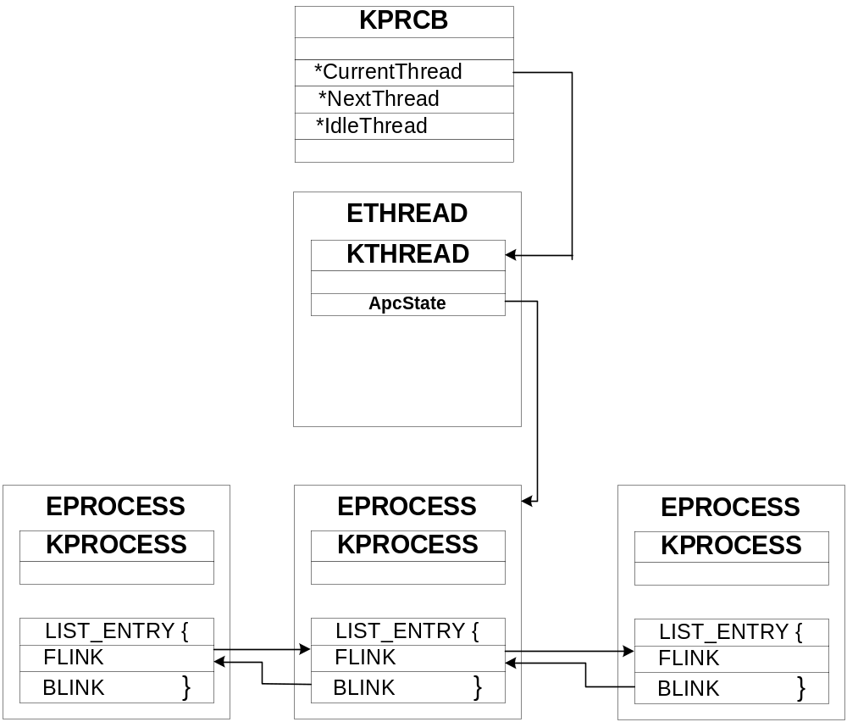
Hiding Processes - Windows

Slide 18
Process Hiding 06
PHIDE2 – by 90210
  Remove threads from KiWaitInListHead, KiWaitOutListHead and KiDispatcherReadyListHead and creates its own lists that it swaps in and out when it wants to give its own threads CPU time.
FUTo – by Peter Silberman & CHAOS
  Uninformed Journal Vol. 3 (http://www.uninformed.org)
  New version 2 of FU. Hence the ‘To’
  Hides from IceSword and Blacklight
    Option –pngh bypasses as of (06/26/06):
      Blacklight (F-Secure)
      AntiRootkit (BitDefender)
      Helios
    DarkSpy does detection FUTo -phng

Slide 19
FUTo – Modifying PspCidTable
FUTo removes itself from the PspCidTable.
PspCidTable
  Job of PspCidTable is to keep track of all the processes and threads
    PspCidTable’s indexes are the PIDs of processes.
    Returns the address of the EPROCESS of a process at the location corresponding to the PID.
Problems:
  Relying on a single data structure is not a very robust
  By altering one data structure much of the OS has no idea the hidden process exists

Slide 20
Kernel Structures: The Tables
Handle Table:
  Handles are an index into the Handle Table for a particular object
  Objects represent processes, threads, tokens, events, ports, etc.
  The Object Manager must do the translation from a handle to an object
  The Object Manager consults the Security Reference Monitor to determine access to the object
  Every process has its own handle table to keep track of the handles it owns

Slide 21
Kernel Structures: The Tables
lkd> dt nt!_HANDLE_TABLE
+0x000 TableCode : Uint4B
+0x004 QuotaProcess : Ptr32 _EPROCESS
+0x008 UniqueProcessId : Ptr32 Void
+0x00c HandleTableLock : [4] _EX_PUSH_LOCK
+0x01c HandleTableList : _LIST_ENTRY
+0x024 HandleContentionEvent : _EX_PUSH_LOCK
+0x028 DebugInfo : Ptr32 _HANDLE_TRACE_DEBUG_INFO
+0x02c ExtraInfoPages : Int4B
+0x030 FirstFree : Uint4B
+0x034 LastFree : Uint4B
+0x038 NextHandleNeedingPool: Uint4B
+0x03c HandleCount : Int4B
+0x040 Flags : Uint4B
+0x040 StrictFIFO : Pos 0, 1 Bit

Slide 22
Handle Table Translation
NtTerminateProcess:
PVOID obj = TranslateHandleToObject(hProcess);
test.exe ProcessId 152
{
HANDLE hProcess;
hProcess = OpenProcess(PROCESS_ALL_ACCESS, 0, 132);
if(hProcess == INVALID_HANDLE)
return 0;
TerminateProcess(hProcess);
}
TranslateHandleToObject
Process = PspCidTable[ PsGetCurrentProcessById() ];
if( Process == NULL) return 0;
return Process->ObjectTable[hProcess];
0 100 152
hProcess = 0x03
ZwTerminateProcess( hProcess );
0 1 2 3 .. .. .. .. 80 81 82 83 84
Object:
ObjectType = OBJ_PROCESS
Object = 0x8014231

Slide 23
Handle Table Translation
NtTerminateProcess:
PVOID obj = TranslateHandleToObject(hProcess);
test.exe ProcessId 152
{
HANDLE hProcess;
hProcess = OpenProcess(PROCESS_ALL_ACCESS, 0, 132);
if(hProcess == INVALID_HANDLE)
return 0;
TerminateProcess(hProcess);
}
TranslateHandleToObject
Process = PspCidTable[ PsGetCurrentProcessById() ];
if( Process == NULL) return 0;
return Process->ObjectTable[hProcess];
0 100 152
hProcess = 0x03
ZwTerminateProcess( hProcess );
0 1 2 3 .. .. .. .. 80 81 82 83 84
Object:
ObjectType = OBJ_PROCESS
Object = 0x8014231

Slide 24
Detecting Hidden Processes PID Bruteforce
Blacklight
  Bruteforces PIDs 0x0 - 0x4E1C
    Calls OpenThread on each PID
      If Success store valid PID
    Else Continue Loop
  Finished looping, take list of known PIDs and compare it to list generated by calling CreateToolhelp32Snapshot
  Any differences are hidden processes
    Called Cross-View method or Difference Based Method

Slide 25
RAIDE

Slide 26
RAIDE: Design Thoughts
RAIDE was designed to be an all stop shop for most common rootkit detection needs
RAIDE uses secure communication methods to prevent people from interfering with our communication
RAIDE is not developed with a GUI and does not require any runtime dll’s/frameworks etc.
RAIDE was designed for both advanced users who want the files for research and beginners who just want to be rootkit free.

Slide 27
RAIDE
RAIDE can run on:
  Win XP – SP2
  Win 2K SP4 (Hasn’t been tested on earlier versions, feel free to donate copies and RAIDE will support all win2k)
  Win 2k3 pre sp1 – Issues were found for post SP1 and support is currently in development.

Slide 28
RAIDE Communication
RAIDE communication designed to thwart Crappy And Stupid Application Specific Attacks (CASASA)
RAIDE uses Shared Memory segments to pass information kernel land ←→ user land
  Shared Memory segment is randomly generated
  Communication uses randomly named events for signaling
  Uses randomly generated process names
    RAIDE spawns a user process from a driver to do a Difference Based or Cross-View comparison
    The spawned process looks like any other process spawned from userland.

Slide 29
RAIDE: What it is not
A replacement for common sense!!!!
RAIDE will NOT keep you rootkit free nor will it pick up every rootkit. It’s a cat and mouse game
RAIDE will not find hidden files/directories/registry entries. There are no plans currently to support this.
RAIDE does not restore driver IRPs/IDT/MSR hooks.
RAIDE will not at the moment identify hidden drivers, but there are plenty of applications out there to do so.
RAIDE will not identify drivers hiding in plain sight as rootkits since they are not HIDDEN nor are they hiding ANYTHING.

Slide 30
RAIDE: Analysis (User Hooks)
Analyze User mode:
  In User mode check all “important” loaded modules:
    Verify each module’s IAT
      Make sure the function pointers point to the correct DLL
      Make sure the function pointers don’t point to .reloc sections
    Verify each module’s EAT
      Make sure the exported function pointers point within the DLL
      Make sure the exported function pointers don’t point out of the .text section

Slide 31
RAIDE: Analysis (Kernel Hooks)
Find Kernel mode hooks:
  Verify KiSystemServiceDescriptorTable (SSDT) function pointers
    Make sure the function pointers point within NTOSKRNL
    Verify each SSDT function’s have not been modified
      Load ntoskrnl off of disk and and compare the instructions
  Check the IDT make sure the handlers point to ntoskrnl
    Check within the preamble of each IDT handler make sure no common inline methods i.e. jmp, ret etc…
  Check the IA32_SYSENTER_EIP MSR to make sure it points to ntoskrnl
  Check important driver’s for IRPs hooks

Slide 32
RAIDE: Analysis
Analyze the system for DeepDoor and UAY like hooks:
  Low level NDIS hooks allow complete stealth command and control channels.
  Attackers have implemented their own TCP/IP stack in the Windows kernel and bypassed the existing stack.
    Provides invisibility from personal firewalls.
    Allows the attacker to communicate on non existent ports or on ports bound to other processes.
    See Alexander Tereskin’s talk on bypassing personal firewalls.

Slide 33
RAIDE: Analysis
Goal for Process Detection:
  Signature that can not be zeroed out
  Signature that is unique
  Signature must not have false positives

Slide 34
RAIDE: Analysis
Signature:
  Locate pointers to “ServiceTable”
    ServiceTable = nt!KeServiceDescriptorTableShadow
    ServiceTable = nt!KeServiceDescriptorTable
  Contained in all ETHREAD
Hidden Process:
  Spawn a process with random name
    Spawned process generates process list
      sends processes list visible to RAIDE
    RAIDE compares the two lists finding the differences
      hidden processes

Slide 35
RAIDE: Dumping Process
Dumping Process
  Allows Security Analysts to reverse the executable or system file and see what it was doing.
  Does not matter if the file is originally hidden on the HD.
    Dump file is renamed and put in the working directory.
    Dumping lets analysts bypass any packer protection.
    Note: sophisticated attack agents do not require the HD.

Slide 36
RAIDE: Analysis
Forensic Analysis of hooking modules or hidden processes:
  If a hook is found in kernel and the hooking module was identified, rename it and dump it to the current directory.
  If a hidden process is found, dump the process and all dlls in the user space to the current directory.
Feature is in BETA and not included in public release

Slide 37
RAIDE: Identification
Identification of Hooks:
  After analyzing the system, identify the hook type.
    Hook Types are as follows:
      SSDT Overwrite / SSDT Inline Hook
      IAT Overwrite / IAT Inline Hook
      EAT Overwrite / EAT Inline / EAT Forward Hook (user and kernel mode)
      IRP Hook
      IDT Hook
      MSR Hook
      Open Block/ Characteristics Hook
  After analyzing the system, identify the method being used to hide processes.
    The current methods identified are:
      DKOM
      PspCidTable modification

Slide 38
RAIDE: Identification
To detect hidden process methods, we need to know the two methods most commonly used.
  DKOM
  PspCidTable
If the process is not visible by walking ActiveProcessList in the EPROCESS block then it was hidden using the DKOM method.
  However for it to be hidden with the DKOM method it has to be visible in the PspCidTable, so RAIDE will walk that as well.
  If the process is hidden in both, the rootkit uses the FUTo method.

Slide 39
RAIDE: Identification
Whitelisting Firewalls
  Most firewalls act very similar if not exactly like rootkits.
  RAIDE whitelists drivers using signatures such as checksums and other values.
    If the hooking driver matches a signature the user is notified that tampering with the hook could result in system failure.
  RAIDE does NOT rely on behavioral analysis to identify firewalls, since any rootkit mimicking these behaviors would fool the system.

Slide 40
RAIDE: Identification
Currently identified Firewalls:
  Kaspersky Internet Security 6.0
  BitDefender 9 Professional Plus
  Outpost Firewall Pro v3.5
  F-Secure Internet Security 2006
  ZoneAlarm 6.5
  Kerio Personal Firewall 4.1
  Trend Micro PC-Cillin Internet Security 2006
  Kerio WinRoute 6.2.1
Identifies 253 hooks installed by these products.

Slide 41
RAIDE: Elimination
Rootkit Elimination
  Restore Hooks
    Restore the original value of inlined hooked functions
    Restore original function pointers in the SSDT
    Restore original values of drivers whose EAT have been modified
  Restore Process Options:
    Process hidden by DKOM:
      can be relinked to make the reappear in task manager.
      can be closed
    If a process is hidden using FUTo methods:
      It is not safe to close or attempt to relink the process

Slide 42
Thanks
Peter – Bugcheck, greg h, pedram, uninformed/research’ers
Jamie – the HBG crew, eEye (liquid dietitians), Lil’ L, and uninformed.

Slide 43
DEMO

Slide 44
DEMO
Our Demo VM will have the following:
  Hooks: (6 rootkits, no hands)
    Inline Hooks
    SSDT Overwrite Hooks
    Driver EAT Hooks
    MSR Hook
  Hidden Process:
    FU Hidden Process
    FUTo Hidden Process
  And….
    WinDbg
This is all on VMWare….

