Slide 1
TASK 1: LE STATS SPORTIF
CLAUDIU MOGODEANU – 331CC

Slide 2
CONTENTS
01
02
03
04
DATA ANALYSIS
THREAD POOL
Csv parsing
Thread organization
SERVER IMPLEMENTATION
TESTING
Flask 101
Checker & DIY

Slide 3
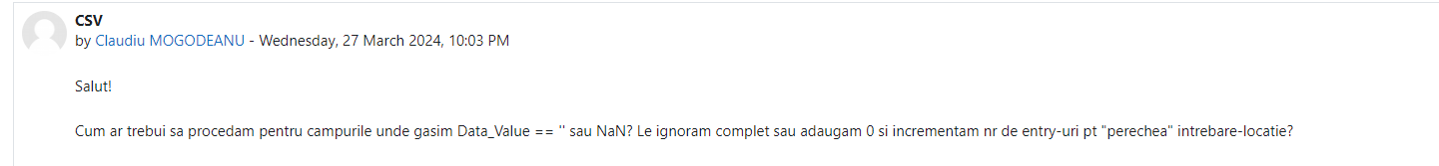
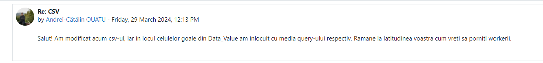
DATA ANALYSIS (1)
CSV Analysis
PROBLEM : NULL VALUES
SOLUTION: ASK ON FORUM AND TRY AGAIN

Slide 4

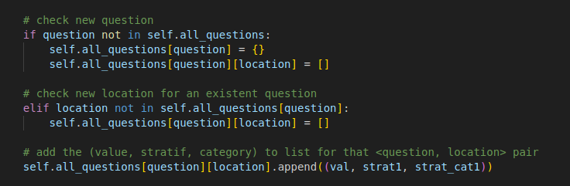
DATA ANALYSIS (2)
Data Storage -> Data Ingestor
GOAL: Comfortable data access
SOLUTION: Well thought data structures

Slide 5
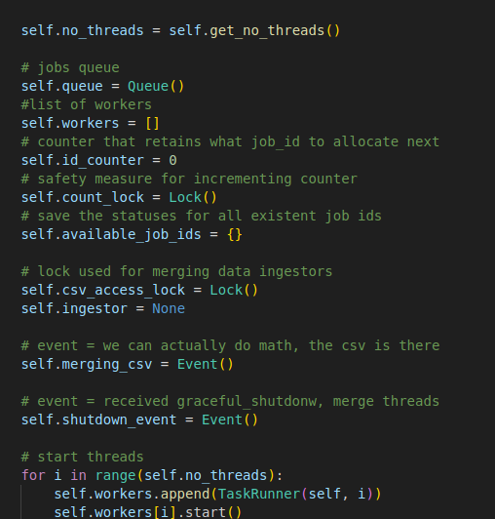
THREAD POOL (1)
ThreadPool is responsible for the concurrent execution of tasks from the queue based on a list of threads (TaskRunners).
Self made
Starts and controls TaskRunners
Adds job to queue
May join threads
Keeps a list of the statuses of all jobs

Slide 6

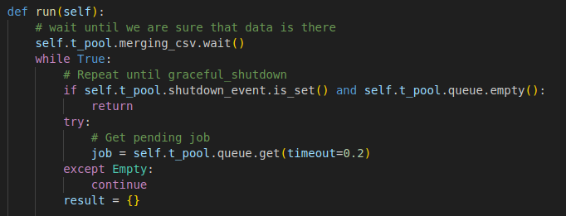
THREAD POOL (2)
TaskRunner -> waits for elements from Queue
Tradeoff: Timeout vs normal (fully blocking) vs nowait

Slide 7

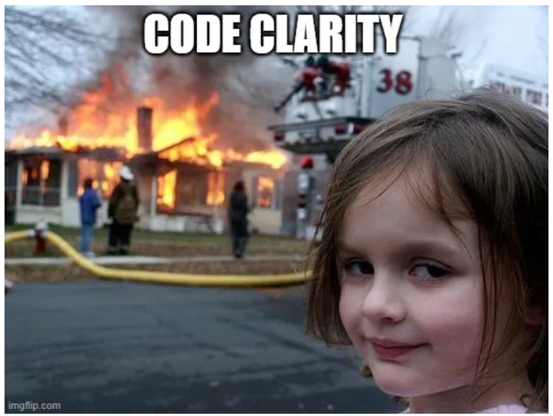
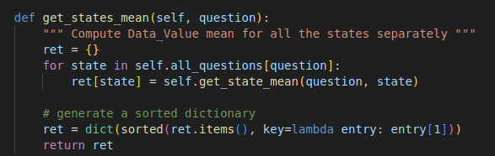
SERVER IMPLEMENTATION
Learned how to use Flask!
A lot of dependencies tradeoff

Slide 8
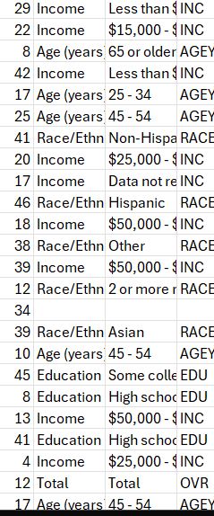
TESTING - CHECKER
Throwback NULL values -> still there
=> wrong results in some cases
CONCLUSION: Review by multiple people

Slide 9
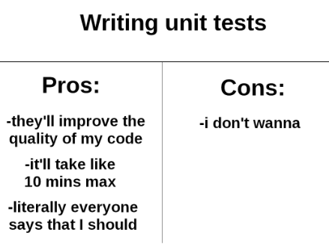

TESTING - DIY
Unittests -> check the math and precision
Stress Test -> multiple background processes Even though the processor is fast, managed to get multiple jobs in running state

Slide 10
THANK YOU!

