Slide 1
[ORM] Entity Framework

Slide 2
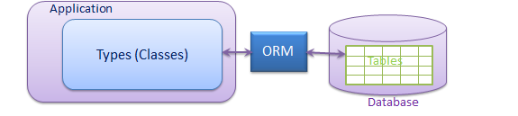
What is ORM (object-relational mapping )?
a programming technique for converting data between incompatible type systems in object-oriented programming languages.
this creates, in effect, a "virtual object database " that can be used from within the programming language.

Slide 3
Types of ORM
Entity Framework
nHibernate
LLBL
Dapper

Slide 4
What is Entity Framework?
The Microsoft ADO.NET Entity Framework is an Object/Relational Mapping (ORM) framework that enables developers to work with relational data as domain-specific objects (entities).

Slide 5
Why Entity Framework?
eliminates the need for most of the data access
developers retrieve (using Linq) and manipulate data as strongly typed objects
provides services like
change tracking - changes made to each object in the cache.
identity resolution - EF only maintains a single instance of an object with a specific entity key in the cache
lazy loading - the process whereby an entity or collection of entities is automatically loaded from the database the first time
that a property referring to the entity/entities is accessed.

Slide 6
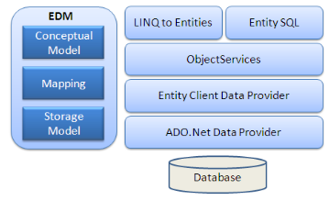
Entity Framework Architecture (mi se pare plictisitor, poate il scoatem)
EDM (Entity Data Model)
Conceptual Model: contains model classes and their relationships
Storage Model: database design model; includes tables, views, stored procedures, and their relationships and keys.
Mapping: information about how the conceptual model is mapped to the storage model.
LINQ to Entities: LINQ to Entities is a query language used to write queries against the object model.
Object Service: main entry point for accessing data from the database and to return it back. It is responsible for materialization
Entity Client Data Provider: converts L2E or Entity SQL queries into a SQL query
ADO.Net Data Provider: communicates with the database using standard ADO.Net.

Slide 7
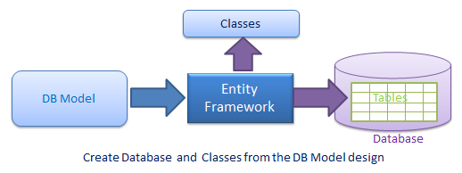
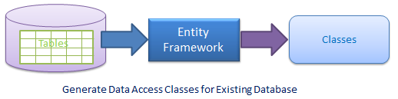
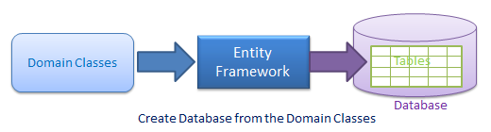
Types of EF
Database First
Code First
Model First

Slide 8
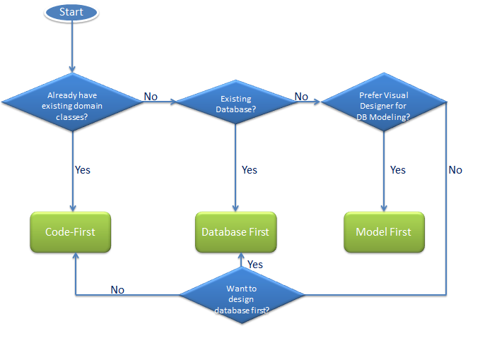
How to choose?

Slide 9
Bibliography
http://www.entityframeworktutorial.net/

