Slide 1
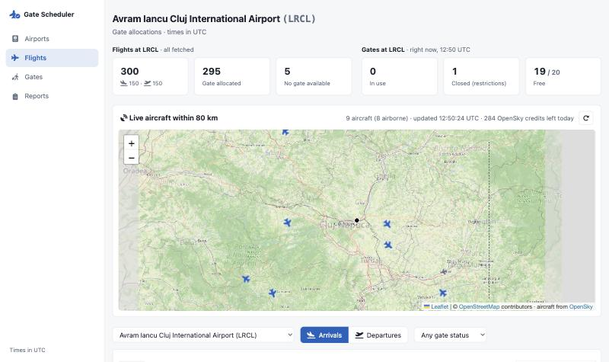
Gate Scheduler
GATE A1
Context & architecture
Flights page · live aircraft around Cluj
AirportLabs challenge · Laravel 13 · MySQL 8 · Docker
Notes:
~25s. Hi, I'm presenting the gate scheduler I built for the challenge.
In ten minutes: how I read the requirements, the technical decisions and their trade-offs, and how the solution would scale and fit into a wider airport ecosystem.
It's a Laravel 13 app on MySQL, running in Docker, with two scheduled jobs and a small server-rendered UI.

Slide 2





From five requirements to a working model
01
PROBLEM APPROACH
The brief
How I modelled it
20 gates, created by a migration
Gates belong to an airport: every airport gets A1–A10 and B1–B10
Fetch flights periodically (airport in .env)
A cron every 10 min, arrivals and departures, 13 airports, de-duplicated
90 min at the gate from moment T, one flight per gate
A window [T, T + 90) per flight; a gate is free only if nothing overlaps
Gates can be closed dynamically (B8 under repair)
Closures block a gate and move any flight already booked on it
A second cron that validates and reports
Every 15 min: repair conflicts, snapshot the numbers, store a report
Notes:
~55s. I started by turning each line of the brief into a concrete model.
Gates: the brief says 20 gates from a migration. I kept that, but made gates belong to an airport, so each airport gets its own 20 and flights never compete across airports.
Fetching: a scheduled command, airport configurable in .env as asked; I extended it to departures and to several airports.
The core rule is an interval problem: each flight holds a 90-minute window starting at T, and a gate can host only one window at a time.
Dynamic conditions became gate closures, which can be added at any time, even after flights were allocated.
And the second cron validates, repairs and stores a report. The fifth point, tests, I'll cover under maintenance.

Slide 3

What the data taught me about moment T
01
PROBLEM APPROACH
~1 day
403
≤ 2 days
4,000
delay: OpenSky publishes arrivals and departures in a nightly batch
anonymous calls to the flight endpoints are refused
per query, so a fetch is split into 24 h chunks
credits a day with an account; each flights call costs 4 or more
If T = “first time we saw the flight”, a nightly batch gives hundreds of flights the same T, and only 20 of them get a gate.
So: T comes from the flight itself (landing, or 90 min before take-off), configurable back to the brief's example; a 48 h look-back with de-duplication; demo data and caching to live within the limits.
Notes:
~55s. The brief leaves some things open: what exactly T is, whether departures count, one airport or many.
Before deciding, I probed the OpenSky API itself, and four facts changed the design.
Arrivals and departures only appear after a nightly batch. Anonymous calls get a 403. A query can span at most two days. And there's a daily credit budget.
The first fact matters most: if T were the first time we observed a flight, a single fetch of yesterday's batch would give hundreds of flights the same T, and only twenty would ever get a gate.
So T comes from the flight's own times: an arrival holds the gate from landing, a departure for the 90 minutes before take-off. The brief's 'first observed' rule is still one setting away.
And to stay within the limits: a 48-hour look-back that's safe to repeat, demo data for working without credentials, and caching.

Slide 4
Real data: what OpenSky leaves out
01
PROBLEM APPROACH
Flights with no origin or destination, %
21%
of 19,657 real flights: out of receiver coverage, OpenSky can't estimate the other airport. Nothing to fix on our side.
In flight
departures are listed before they land, with no destination yet. A refetch now fills it in instead of skipping the row.
320 vs 1,100
gate slots a day (20 gates × 90 min) vs. flights a day at a hub, so most hub flights get “No gate available”.
Notes:
~45s. With real credentials I swapped the demo data for live OpenSky data: about 19,700 flights over 48 hours.
One in five has no origin or destination. OpenSky estimates airports from where its receivers saw the aircraft, so outside coverage there's no estimate; that's why Dubai and Istanbul are near half. That's the source, so the UI says Unknown.
Part of it was ours: departures appear while still in the air, and the fetch used to skip rows it already had. Now a refetch fills in the destination without touching the gate. And one Zurich row with no timestamp used to fail the whole airport; such rows are now skipped.
Capacity: 20 gates at 90 minutes is about 320 slots a day, against over a thousand flights at a hub. That's the brief's constraint, not a bug; Cluj gets a gate for every flight.

Slide 5


One Laravel app, two scheduled jobs
02
TECHNICAL DECISIONS
Ingest
Allocate
Observe & act
flights:fetch · 10 min
right after each fetch
allocations:validate · 15 min
OpenSky API
GateWindowCalculator · moment T
AllocationValidator · repair conflicts
OpenSkyClient · 24 h chunks, OAuth, 404 = none
GateAllocator · lock gates, first free gate
validation_reports + logged events
flights · unique key, refetch fills late fields
gate_allocations · or “No gate available”
UI · Blade, jQuery, DataTables
Notes:
~45s. The architecture is deliberately simple: one Laravel application, one MySQL database, and a scheduler container that runs two commands.
Ingest: every ten minutes flights:fetch calls OpenSky through a small client that handles the two-day limit, the token and the 404-means-empty quirk. Rows are upserted on a unique key, so re-fetching the same 48 hours never duplicates anything, and only fills in what OpenSky learned since.
Allocate: straight after, the allocator works out each flight's window and books a gate, or records that none was free.
Observe and act: every fifteen minutes the validator re-checks everything, repairs conflicts and stores a report. The UI reads the same tables, and closing a gate from the UI runs the same allocation code immediately.

Slide 6





Inside the app: thin entry points, rules in services
02
TECHNICAL DECISIONS
UI
Blade · jQuery
Airports
Flights
Gates
Reports
DataTables, maps
Entry points
thin
HTTP: routes → Controllers
Cron: scheduler → Console commands
4 Controllers
Form Request
flights:fetch
allocations:
validate
gates:restrict
OpenSky API
flights, live states, tracks
Services
the rules
Allocation
OpenSky
GateAllocator
GateSchedule
GateRestrictor
Validator, Stats
Client
Map, Track
Models
Eloquent
Airport
Gate
GateRestriction
Flight
GateAllocation
Exception, Report
Flow: UI → Controllers / cron → Services → Models → MySQL
Database
MySQL 8
7 app tables + cache (live map, tracks, cron locks) + sessions
Notes:
~45s. Inside, the app is layered the usual Laravel way, with one rule: entry points stay thin.
At the top, the UI: four server-rendered pages with jQuery, DataTables and Leaflet maps.
Requests come in two ways: the browser through routes and controllers, with a Form Request validating input, or the scheduler running console commands. Neither contains business rules; both call the same services.
The services hold the rules: the allocator and its in-memory gate schedule, the gate closer, validator and stats, and the OpenSky client. Only those OpenSky services ever talk to the outside API.
Below that, Eloquent models, and MySQL, which besides the seven app tables holds the cache that protects the OpenSky credits and the scheduler's locks.
Because a closure from the UI and from the command line go through the same GateRestrictor, they can't behave differently.

Slide 7
Data model: airports own gates and flights
02
TECHNICAL DECISIONS
airports
flights
allocation_exceptions
Per airport
Gates and flights both belong to an airport, so airports never share gates.
One gate per flight
flight_id is unique on gate_allocations.
No overlaps
MySQL can't forbid overlapping ranges, so gate-row locks and the validator enforce it.
Idempotent fetch
The flights unique key makes re-fetching safe.
PK id
UQ icao_code (unique)
name, city
latitude, longitude
1:N
PK id
FK airport_id
direction, icao24
callsign, airline
dep / arr airport codes
first_seen, last_seen
observed_at, gate_status
UQ 4-column natural key
0..N
PK id
FK airport / flight / gate_id
type, message
context (JSON)
1:N
gates
validation_reports
PK id
FK airport_id
code, terminal
UQ unique (airport, code)
PK id
stats (JSON snapshot)
created_at
1:0..1
1:N
Legend
PK primary key FK foreign key
UQ unique (one row per value)
1:N one-to-many
1:0..1 one-to-one, optional
0..N zero or more, dashed line
gate_restrictions
gate_allocations
PK id
FK gate_id
starts_at, ends_at
reason
1:N
PK id
FK flight_id (unique)
FK gate_id
starts_at, ends_at
Notes:
~45s. This is the structure underneath.
Everything hangs off airports: an airport has its gates and its flights, so two airports never compete for the same gate.
A gate has its closures, the red table, and its allocations. A flight has at most one allocation, a unique key on flight_id, so double-booking a flight is impossible in the database.
What MySQL can't enforce is 'no two allocations on the same gate overlap in time'. That's why allocation locks the airport's gate rows, and the validator re-checks it every fifteen minutes.
The flights table's unique key on airport, direction, aircraft and first-seen time makes the repeated 48-hour fetch safe.
On the right: notable events go into allocation_exceptions, and each validation run stores a snapshot in validation_reports.

Slide 8
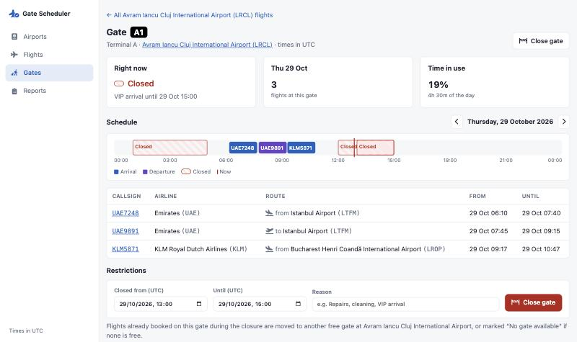
The allocation core: simple, locked, testable
02
TECHNICAL DECISIONS
1
Lock the airport's gate rows (SELECT … FOR UPDATE)
2
Window arrival: landing + 90 min; departure: 90 min before take-off
3
Sort flights by window start, earliest first
4
Match first gate with no overlapping booking or closure
Gate page: bookings and closures on a 24-hour strip
5
Save the booking, or mark “No gate available”
Closing a gate re-runs step 4 at once for the flights it hits; the 15-min validator is the safety net.
Notes:
~50s. The core is five steps, all inside one transaction per airport.
First we lock that airport's gate rows, so two runs, or a run and a user closing a gate, can never book the same gate at once.
Then each flight gets its window, flights are sorted by start time, and each takes the first gate where nothing overlaps: no other booking and no closure. Windows are half-open, so a flight leaving at 10:30 and one arriving at 10:30 can share a gate.
If nothing is free, the flight is marked 'No gate available' and the event is logged.
The matching rules live in a small class with no database access, which is what the unit tests target.
On the right is the gate page: bookings and closures on a timeline. When someone closes a gate there, the flights it hits are moved immediately, even if they were allocated hours ago.

Slide 9
Trade-offs I made
02
TECHNICAL DECISIONS
Decision | Chose | Instead of | Why
App shape | Laravel monolith + scheduler | Services, queue workers | Small domain, one deployable; migrations, ORM and scheduling built in
Moment T | Landing / take-off time (configurable) | First time observed | Batch data would give many flights the same T
Allocation | Greedy: earliest window, first free gate | Optimiser (ILP, graph colouring) | Predictable and explainable; fast enough at 20 gates per airport
Concurrency | Row locks per airport + validator | Postgres exclusion constraint | MySQL has no EXCLUDE; locks prevent clashes, validator double-checks
UI | Blade + jQuery + server-side DataTables | SPA (React, Vue) | No build step; paging and search run in SQL
Notes:
~55s. These are the decisions I'd expect to be challenged on.
App shape: microservices would be over-engineering for a domain this size. One Laravel app gives migrations, the ORM and a scheduler out of the box.
Moment T: covered; it's configurable.
Allocation: greedy, earliest window first, first free gate. An optimiser could fit a few more flights, but greedy is predictable, explainable and fast, and it's isolated in one class.
Concurrency: on Postgres an exclusion constraint could forbid overlaps in the database itself. MySQL has no equivalent, so I lock the airport's gate rows during allocation and run a validator that would catch and repair an overlap anyway.
UI: server-rendered pages with jQuery and DataTables doing server-side paging. No front-end build, and the heavy lifting happens in SQL.

Slide 10




Fitting into a wider airport ecosystem
03
SCALABILITY & MAINTENANCE
Swap the data source
Publish gate changes
OpenSky sits behind one client class. An AODB, airline schedules (planned STA/STD) or a live ADS-B feed can replace it without touching allocation.
The JSON endpoints exist today; next are a REST API and events (“gate assigned”, “gate changed”) for flight displays, ground handling and the AODB.
Scale per airport
Operate within limits
Each airport allocates under its own lock, so airports can run in parallel: one queued job per airport, more workers as airports are added.
API responses are cached and polling pauses on hidden tabs. Fetch frequency and look-back are config; flights can be archived by date as data grows.
Notes:
~55s. In a real airport this would be one component among many, so I kept the seams clean.
Data in: everything OpenSky-specific is inside one client class. In production you'd allocate from the airport's operational database or airline schedules, planned arrival and departure times, rather than from observed tracks, and that's a swap of one class.
Data out: the pages already use JSON endpoints. The natural next step is a proper API plus events whenever a gate is assigned or changes, so flight information displays, ground handling and the AODB can react.
Scale: allocation is locked per airport, so airports are independent and can run in parallel as queued jobs.
Limits: external calls are cached, and frequency and look-back are configuration, which matters because every call spends credits.

Slide 11



Scaling next: queues, live delays, a protected API
03
SCALABILITY & MAINTENANCE
Push, then queue
React to delays
Protect the API
webhooks + RabbitMQ
live positions from /states
auth wall, roles, rate limits
Provider webhooks push updates; cron only as fallback
Live position + ground speed of inbound flight
Login (Sanctum / SSO) + API tokens
RabbitMQ queue per job type
Estimated landing vs. its gate window
spatie/laravel-permission: teams, roles
N workers apply, then allocate per airport
Late? Shift the window, re-check the gate
Per-client limits, e.g. 60 req/min
React in seconds instead of polling; retries, dead letters, and concurrency capped to API budgets. (OpenSky is pull-only; AODB or airline feeds push.)
Re-uses relocate(): only the gate's following flights are re-checked, and each change is published as “gate changed”.
Per-team roles decide who may close a gate at which airport; every action is attributable; no client drains the OpenSky credits.
Notes:
~55s. Three things I'd add to run this at real scale. None are built yet; the current structure makes each a contained change.
Push, then queue: OpenSky only supports pulling, but production sources like an AODB or airline feeds can push by webhook. Each update goes on a RabbitMQ queue and a pool of workers applies it and re-allocates that airport, with the cron as a fallback. We react in seconds, failures are retried or dead-lettered, and capped concurrency keeps us inside API budgets. Allocation already locks per airport, so workers run in parallel safely.
Delays: live position and ground speed give an estimated landing time. If it drifts past the gate window, we shift the window and re-check that gate with the same relocate logic as closures, and publish the change.
API protection: login through SSO or Sanctum, API tokens for other systems, and spatie/laravel-permission for teams and roles, so Cluj operations can close Cluj gates but not Frankfurt's. Plus per-client rate limits, so nobody drains the OpenSky credits.

Slide 12
Built to be maintained
03
SCALABILITY & MAINTENANCE
81
Rules live in one place each
Gate matching, window strategy, status names and the gate palette are each defined once.
automated tests, from the matching rules to the pages
Conventions over cleverness
Plain Laravel: migrations, Eloquent, Form Requests, Pint formatting, PHPUnit with faked HTTP.
1
command: docker compose up
Observable by design
Every fetch failure, move and missing gate is logged; each 15-min report shows what changed.
13 × 20
Known limits no login yet; a flight without a gate isn't retried later; 20 gates can't hold a hub's day; credits cap how often 13 airports can be fetched.
airports × gates, all from migrations and seeders
Notes:
~45s. On maintenance: 81 automated tests, including pure unit tests of the matching rules and feature tests with OpenSky faked, so nothing depends on the network. Both real-data bugs got a test before the fix shipped.
One command brings up the app, database and scheduler, and migrations plus seeders build every airport and gate.
Each rule lives in exactly one place, which made later changes cheap, for example making status names readable everywhere or adding Cluj as the default airport.
I stuck to plain Laravel conventions, so another Laravel developer can find their way around immediately.
And it's observable: every failure and every move is logged, and the reports page shows what each validation run changed.
To be transparent about the limits: there's no login yet, a flight that found no gate isn't retried, 20 gates per airport can't hold a hub's traffic, and OpenSky credits cap the fetch frequency.

Slide 13




What I'd build next
Delay-aware allocation
Webhooks & queues
Auth, roles & limits
Gate compatibility
shift gate windows from live landing estimates
push updates into RabbitMQ; cron as fallback
login, Spatie teams and roles, per-client rate limits
aircraft size, buffer times, airline preferences
Questions?
Thank you
Notes:
~30s. So, in order, the next pieces would be: delay-aware allocation, webhooks and queues, authentication with roles and rate limits, and then gate compatibility, since not every aircraft fits every gate.
Thank you, happy to take questions or show the app live.

