Slide 1

SOFTWARE TESTING – FINAL PROJECT
Author: Turcanu Claudiu-Constantin
Session: January – May 2022
Group: 23

Slide 2
Agenda
1. App Description
2. Testing Approach
3. Testing Tools
4. Test Cases Overview
5. Test Cases Results
6. Bug Overview
7. Conclusion
8. Extra Info
2/16

Slide 3
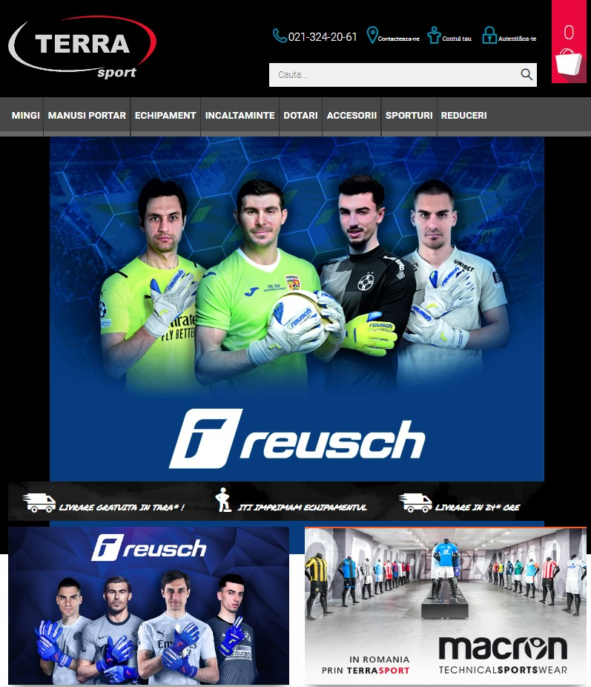
TERRASPORT (https://www.terrasport.ro/)
E-commerce website
Romanian retailer, provides a wide range of sport articles in online environment
App Description
Testing Approach
Testing Tools
Test Cases Overview
Test Cases Results
Bug Overview
Conclusion
Extra Information
3/16

Slide 4
Steps followed during testing:
Ad-hoc Testing (decide if the application is suitable for the project)
Exploratory Testing for learning the application and discovering bugs
Documentation of the Exploratory Testing Session
Planning the Testing Process
Design Test Cases based on Functional/Non-functional requirements
Executing Test Cases and Logging Bugs
Writing Test Report
App Description
Testing Approach
Testing Tools
Test Cases Overview
Test Cases Results
Bug Overview
Conclusion
Extra Information
4/16

Slide 5


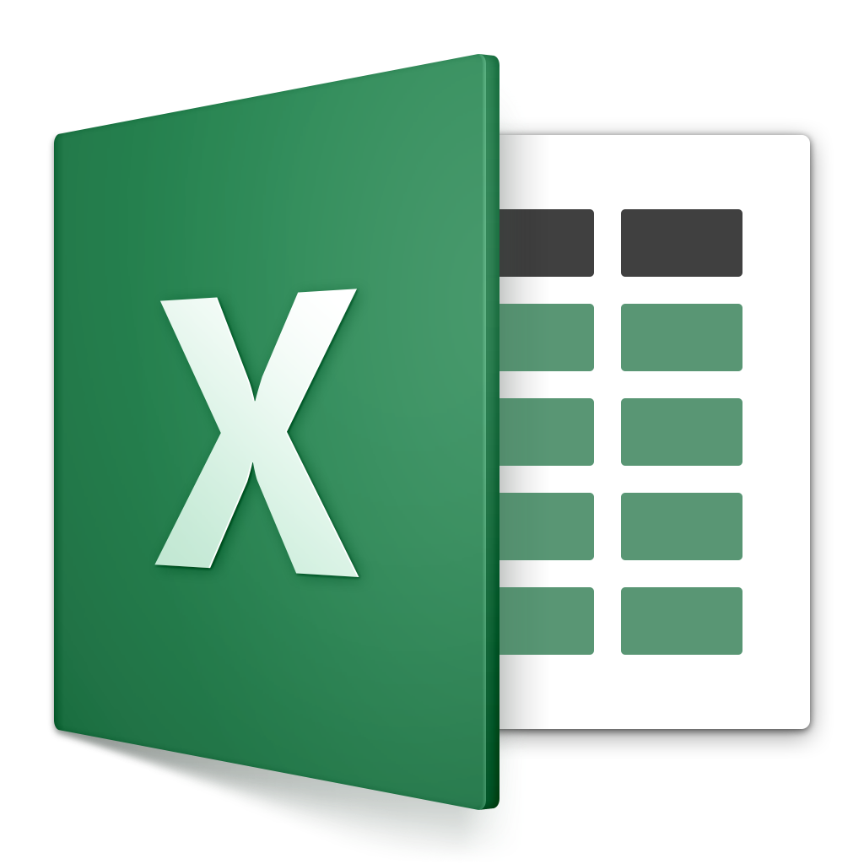



During the project it was necessary to use several tools:
App Description
TestLink – Registration of Test Cases
Mantis – Registration of Bugs
Excel – Test Data
Testing Approach
Testing Tools
Test Cases Overview
Test Cases Results
Bug Overview
Conclusion
Snipping Tool – Screenshots
Word – Bug Report
PowerPoint – Edit screenshot
Extra Information
5/16

Slide 6
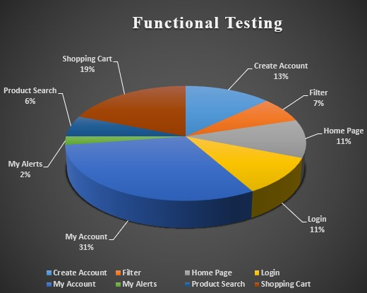
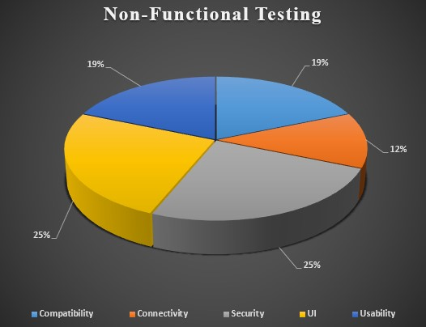
Testing process included an number of 100 test cases: 84 Functional Testing and 16 Non-Functional Testing
App Description
Testing Approach
Testing Tools
Test Cases Overview
Test Cases Results
Bug Overview
Conclusion
Extra Information
6/16

Slide 7
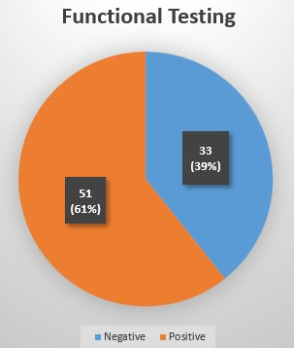
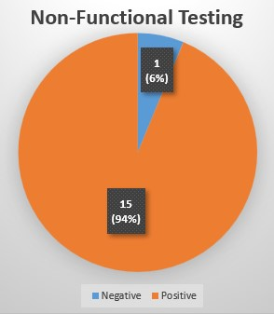
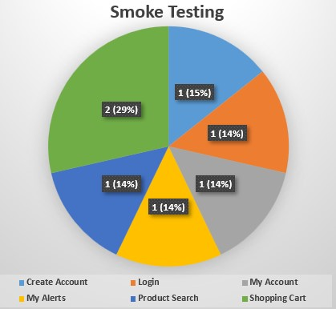
Other testing types used: Exploratory, Smoke, Positive, Negative
From 100 test cases: 66 were positive and 34 were negative
From 100 test cases: 7 were selected for Smoke Testing
App Description
Testing Approach
Testing Tools
Test Cases Overview
Test Cases Results
Bug Overview
Conclusion
Extra Information
7/16

Slide 8
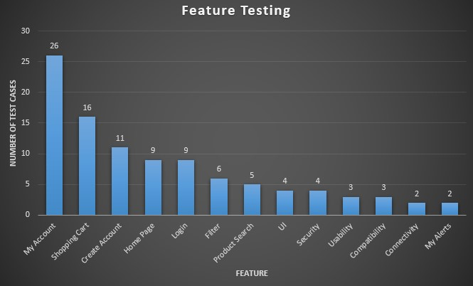
A total of 100 test cases was defined and 100 (100%) were executed for different features
App Description
Testing Approach
Testing Tools
Test Cases Overview
Test Cases Results
Bug Overview
Conclusion
Extra Information
8/16

Slide 9
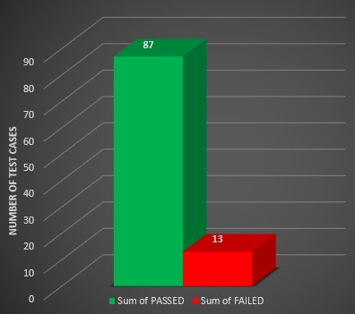
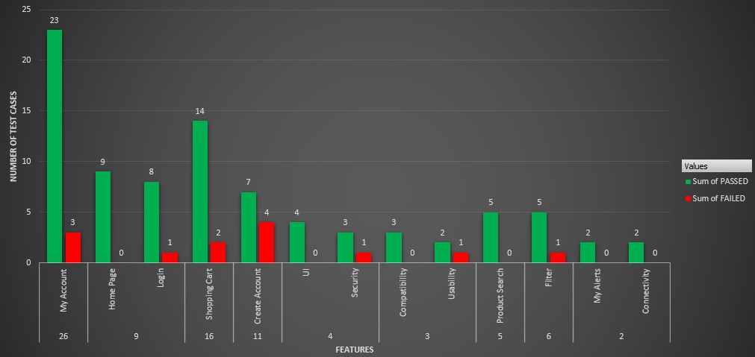
From 100 test cases executed => 87 passed and 13 failed without blocked or not run situations
Test Cases Rate by Status
Test Cases Rate by Features
App Description
Testing Approach
Testing Tools
Test Cases Overview
Test Cases Results
Bug Overview
Conclusion
Extra Information
9/16

Slide 10
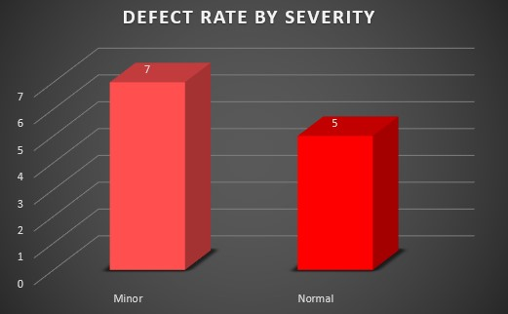
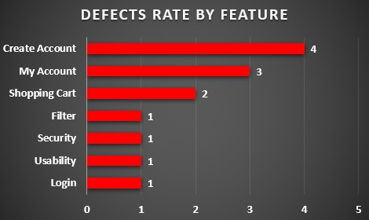
There was identify 13 bugs;
The severity of them is not a danger for the website: 5 normal and 7 minior
The most affected feature are Create Account and My Account
App Description
Testing Approach
Testing Tools
Test Cases Overview
Test Cases Results
Bug Overview
Conclusion
Extra Information
10/16

Slide 11

Testing the https://www.terrasport.ro/ website involved the execution of 100 test cases. The tests was performed completly and the results was that 87 tests passed and 13 test failed.
There was apply multiple testing types: Functional Testing; Non-Functional Testing; Positive; Negative; Exploratory; Smoke Testing.
The severity of the bug is not higher (7 bugs – minor and 5 bugs normal) and the user is able to perform an end-to-end flow => the website can remain in production.
For a good experience of the user, the bugs that was found need to be repair.
App Description
Testing Approach
Testing Tools
Test Cases Overview
Test Cases Results
Bug Overview
Conclusion
Extra Information
11/16

Slide 12
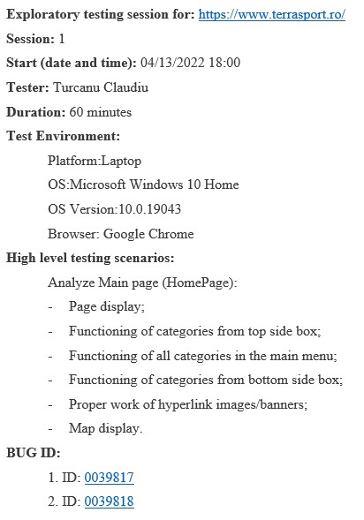
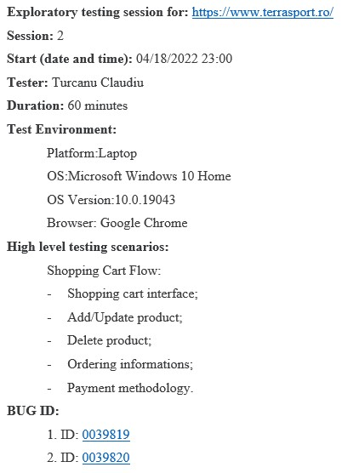
Exploratory Testing:
App Description
Testing Approach
Testing Tools
Test Cases Overview
Test Cases Results
Bug Overview
Conclusion
Extra Information
12/16

Slide 13
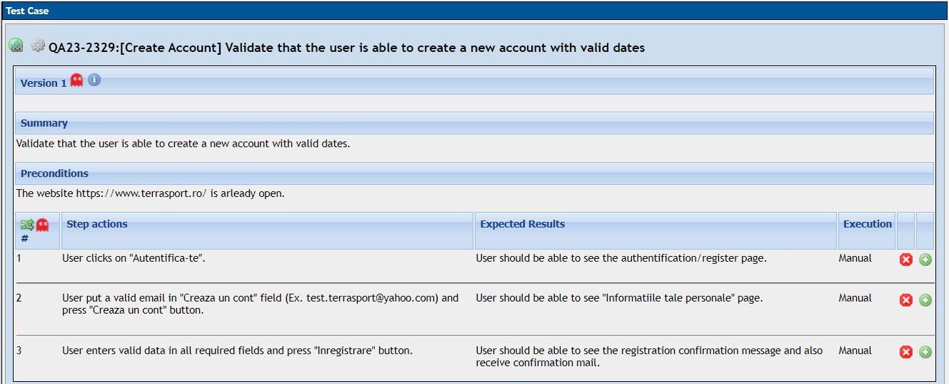
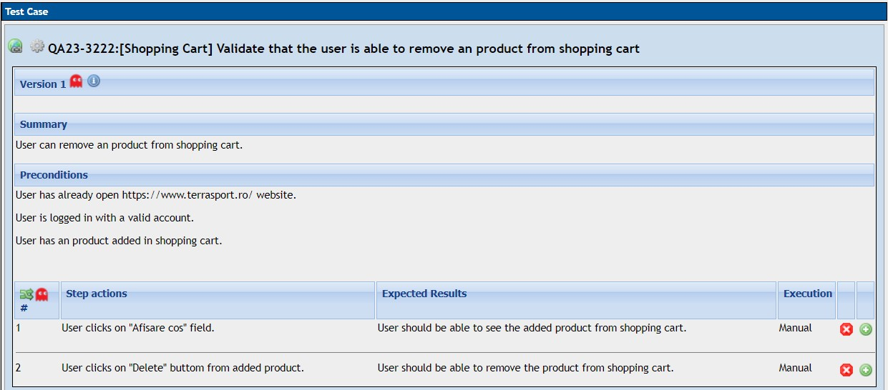
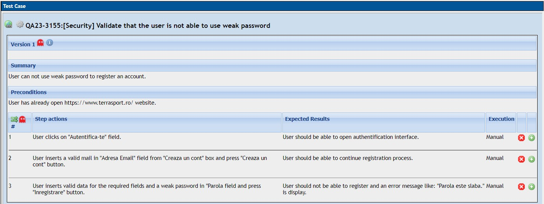
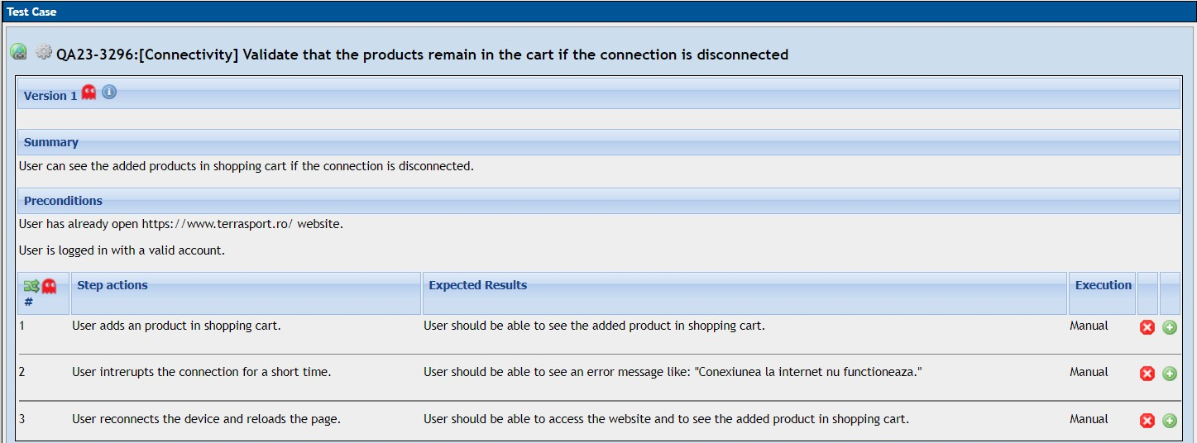
Example of Test Cases:
Functional
App Description
Testing Approach
Non-Functional
Testing Tools
Test Cases Overview
Test Cases Results
Bug Overview
Conclusion
Extra Information
13/16

Slide 14
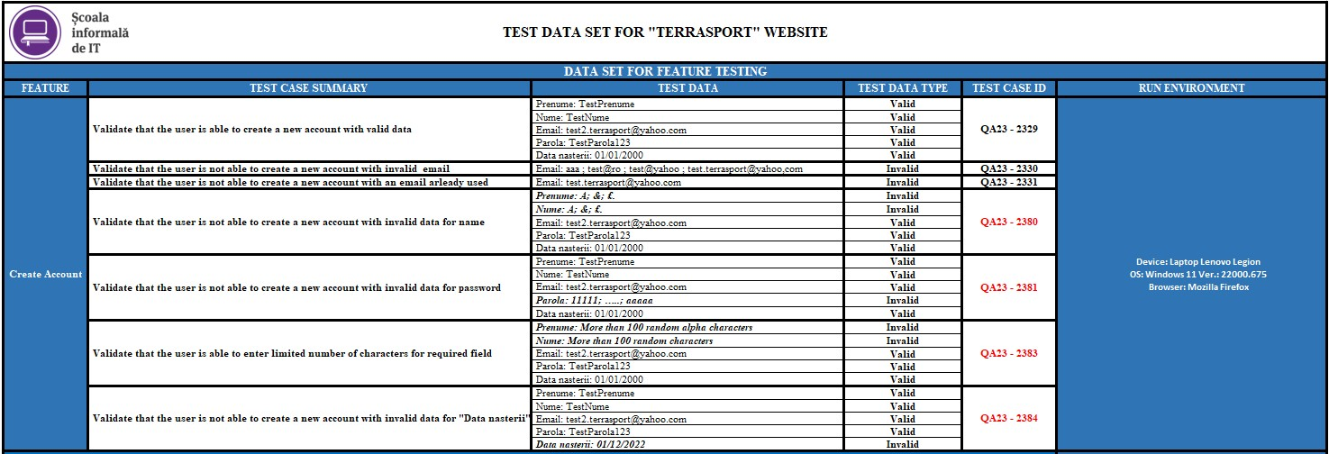
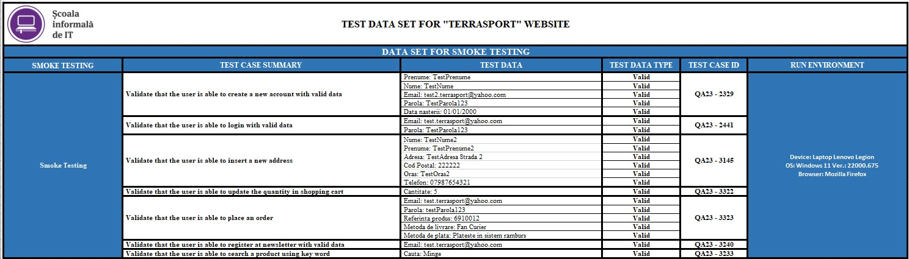
Example of Test Data:
Functional Testing
App Description
Testing Approach
Testing Tools
Smoke Testing
Test Cases Overview
Test Cases Results
Bug Overview
Conclusion
Extra Information
14/16

Slide 15
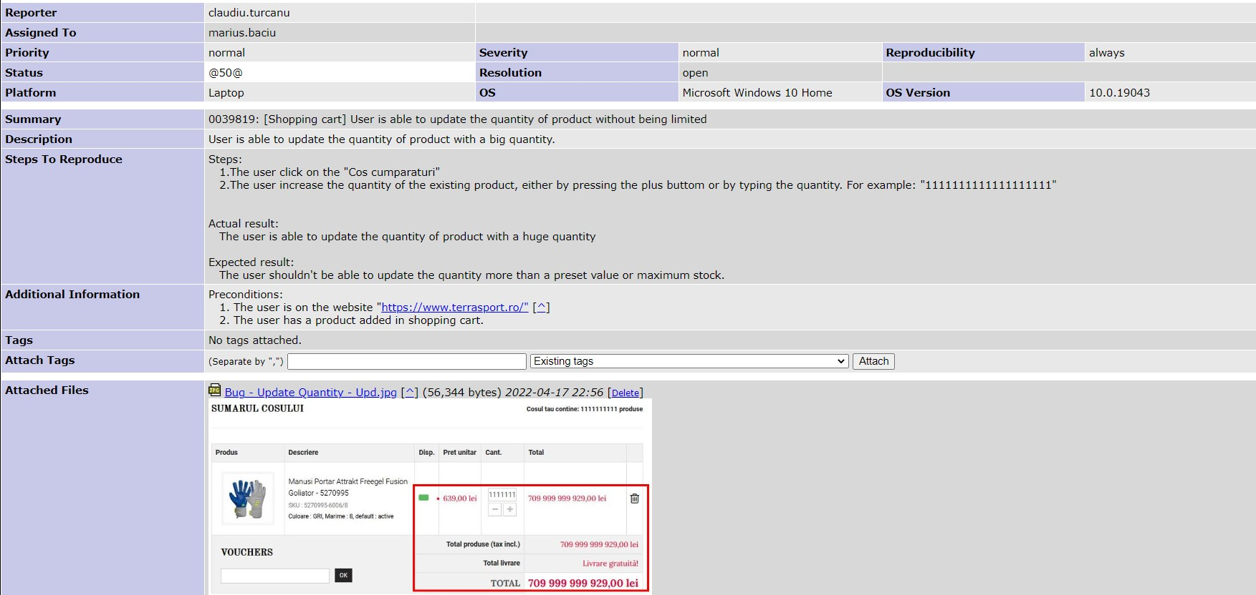
Example of Logged Bugs
App Description
Testing Approach
Testing Tools
Test Cases Overview
Test Cases Results
Bug Overview
Conclusion
Extra Information
15/16

Slide 16
THANK YOU!

