Slide 1
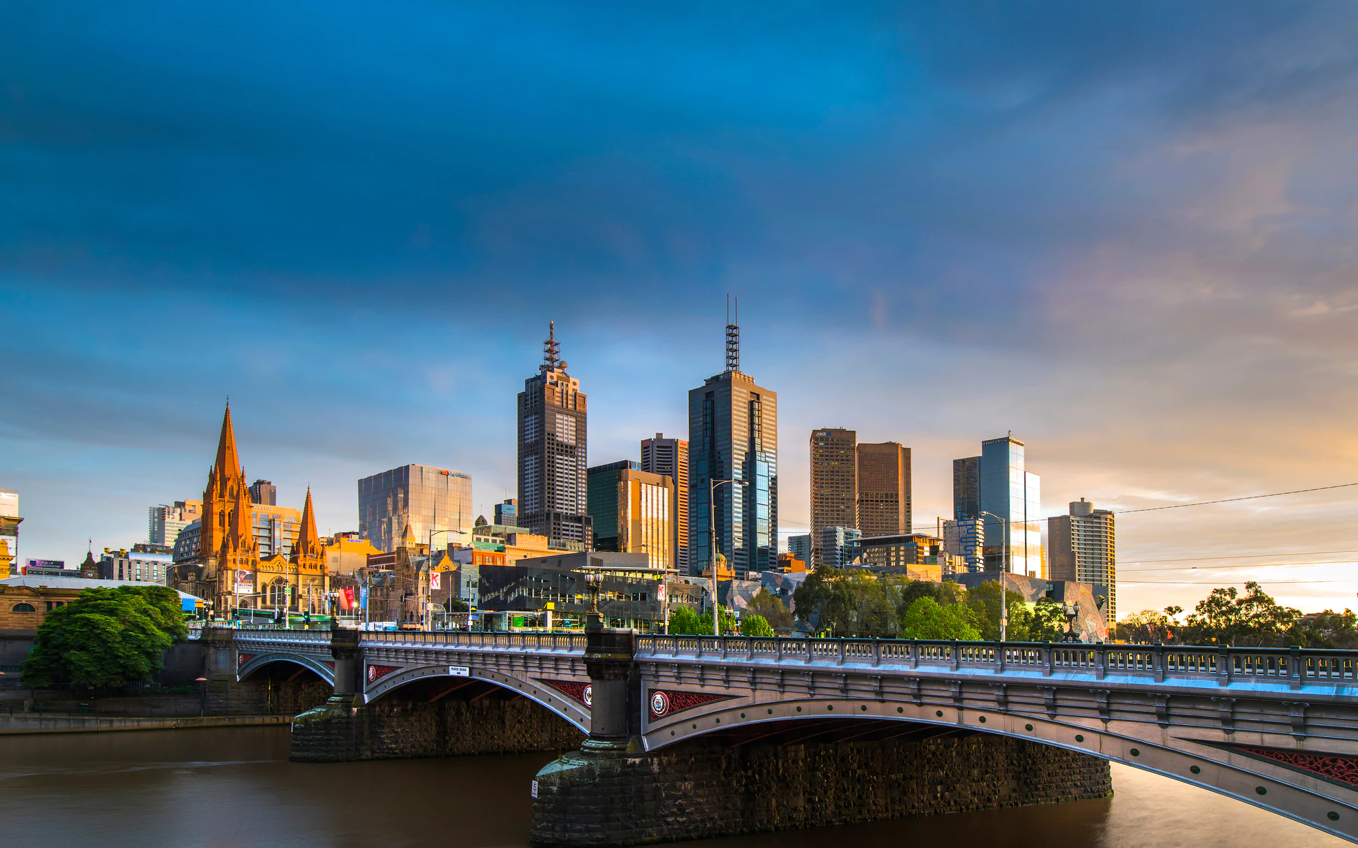
Explore Properties in Melbourne

Slide 2
Background of Melbourne’s Property Market
Property prices in Australia have been growing annually, with Melbourne as one of the cities leading this growth (Statista, 2022)
11th most liveable city (EIU's Global Liveability Ranking 2022)
This is due to a range of factors, including:
Relatively low crime rates
Plenty of jobs
Ease of public transport
Easy lifestyle
Notes:
https://www.statista.com/topics/4987/residential-housing-market-in-australia/#dossierKeyfigures
https://www.realestate.com.au/news/whos-to-blame-for-australias-exploding-property-prices-and-housing-affordability-crisis/

Slide 3
Data Cleaning Process
Focus of our analysis is on prices, hence not meaningful to keep data points without price
34,857 rows before data cleaning
1
Remove all rows without prices
Have similar longitude & latitude, able to reduce number of suburbs from 343 to 277
2
Group similar suburbs into 1 single suburb
(E.g. Altona, Altona Meadows, Altona North → Altona)
2
Group similar suburbs into 1 single suburb
(E.g. Altona, Altona Meadows, Altona North → Altona)
Necessary for analysis using real estate agents, prevent duplication of data
3
Only keep the first real estate agent’s name if there are dual real estate agent names
(E.g. Buxton/Advantage → Buxton)
27,247 rows after data cleaning

Slide 4
Should you buy a 2-bedroom apartment in Northcote?

Slide 5
Where is Northcote located?
Not one of the most expensive regions
Northern Metropolitan Region
Not one of the most expensive city council areas
Darebin City Council

Slide 6
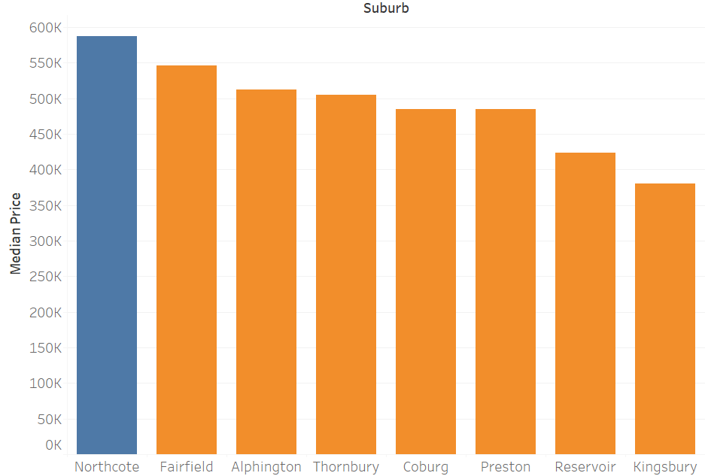

Other suburbs in Darebin City Council Area
Median price of 2-bedroom apartments in Northcote is the highest among other suburbs with the same council
Northcote is one of Melbourne’s most vibrant inner suburbs due to its attractive cafes, restaurants, shops and parks, which may explain its high prices
- Marc Pallisco

Slide 7
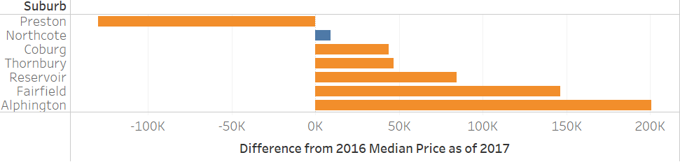
Other suburbs in Darebin City Council Area
Median price of 2-bedroom apartments in Preston decreased by $130,000 from 2016 to 2017
Median price of 2-bedroom apartments in Northcote increased by $9,000 from 2016 to 2017
Having the same council means residents enjoy the same policies and benefits, yet Northcote experienced increasing prices from 2016 to 2017, compared to Preston that saw a huge decrease in prices

Slide 8
Preston!
Should you buy a 2-bedroom apartment in Northcote?

Slide 9
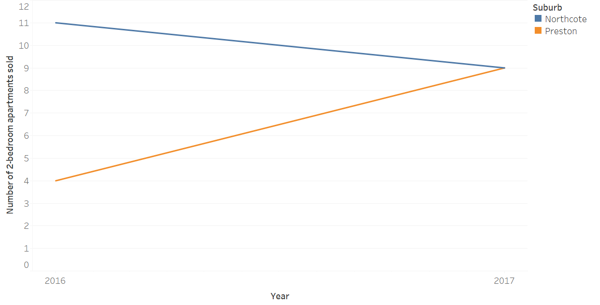
Preston vs Northcote
Preston is catching-up to Northcote in terms of popularity as seen from more people buying apartments in Preston as compared to Northcote from 2016 to 2017!
Number of 2-bedroom apartments sold in Northcote decreased from 11 in 2016 to 9 in 2017
Preston is seeing a influx of new generation restaurants, cafes and bars, which may explain its increasing popularity
- Paul Best
Over the same time period, number of 2-bedroom apartments sold in Preston increased from 4 to 9

Slide 10

Why not consider Preston?
Distance from CBD
Location:
Preston is slightly further from the CBD area as compared to Northcote
However, Preston has easy access into the CBD area and to the multitude of attractions in the Northern suburbs
People:
Good mix of long-term residents and new buyers
Culture:
Diverse, multicultural and lively!

Slide 11
Thank You!

