Slide 1
The Stock Synthesis model runs Now what?
Allan Hicks
Fish 507B
Spring 2016

Slide 2
You managed to run your SS model!
It read in all files correctly
It went into estimation
NOW WHAT?
Run without estimating parameters
Set “phase” to zero in the starter.ss file
Look at output (i.e., R4SS) to see if starting values are reasonable
Look at “new” files to verify that you are entering values correctly

Slide 3
The files look good
Estimate parameters
Set “phase” in starter.ss file to a value greater than maximum phase
It converged properly
The convergence criteria was met
There are no concerning messages from ADMB
There are no concerning messages from SS
The hessian was positive definite (if estimating a hessian)
A Report.sso file was created
NOW WHAT?

Slide 4
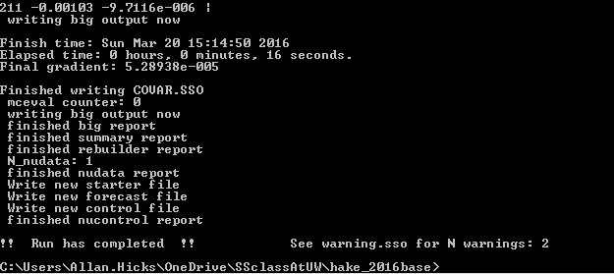
Look at command line output

Slide 5
Now we are ready for R4SS (output)
First read in output (and look at what is printed to screen)
run55 <- SS_output(dir=file.path(SSdir,"55_2016base"),
covar=FALSE)
The covar argument is necessary if you did not estimate a hessian

Slide 6
Now we are ready for R4SS (plots)
Now plot all the plots
SS_plots(run55, uncertainty=FALSE)
Use uncertainty=FALSE if covar=FALSE in SS_output
If uncertainty=TRUE then additional plots are created

Slide 7
Look at output and plots

Slide 8
Some things to look for in SS_output
Warnings
Table of phases
make sure everything looks as expected
Maximum gradient component
convergence
RMSE table
variance of main recruitment deviations
Index variance tuning check
r.m.s.e should be similar to Input+VarAdj+extra
Length comp Eff N tuning check
HarEffN/MeanInputN about 1
Age comp Eff N tuning check
HarEffN/MeanInputN about 1
Cormesssage
look for high and low correlations

Slide 9
Some things to look for in SS_plots (parameters and fits)
Warnings
Biology makes sense
Selectivity makes sense
Index
Fits and extra variation
Length- and age-comps
Fits
Pearson residuals (size, patterns)
Effective sample size (line through points and harmonic mean)
Francis weighting (fit through confidence intervals)
Time-series

Slide 10
Some things to look for in SS_plots (recruitment deviates)
Check the eras
Main is the informed period
Less autocorrelation
Lower asymptotic variance
Stable ratio between SE of deviate and sigma_R
Bias adjustment ramp (need to estimate a Hessian)
Bias adjust only the most informed deviates
Never fully bias adjust because not perfectly informed
Ramp up to informed deviates and down to forecast deviates
Suggested values for control file are useful, but not perfect
See Methot, R.D. and Taylor, I.G., 2011. Adjusting for bias due to variability of estimated recruitments in fishery assessment models. Can. J. Fish. Aquat. Sci., 68:1744-1760

Slide 11
Some things to look for in SS_plots (derived outputs)
After you have investigated fits, adjusted weights on data, and adjusted recruitment, look at the time series
Then, once you are comfortable with the model, think about forecasting

