Slide 1
Parameters
Allan Hicks
Fish 507B
Spring 2016

Slide 2
Parameter elements
Specified in the SS control file
Short parameter lines (7 elements)
#_Spawner-Recruitment Parameters
#_LO HI INIT PRIOR PR_type SD PHASE
5 20 10 9 -1 10 1 #Ln(R0)
Bounds
Initial value
Prior
Estimating phase
Optional comment
Full parameter lines (14 elements)
#Natural Mortality
#LO HI INIT PRIOR PR_type SD PHASE env-var use_dev dev_minyr dev_maxyr dev_stddev Block Block_Fxn
0.01 0.50 0.15 -1.8 3 0.3 6 0 0 0 0 0 0 0 #M
Bounds
Initial value
Prior
Estimating phase
Time-varying properties
Optional comment

Slide 3
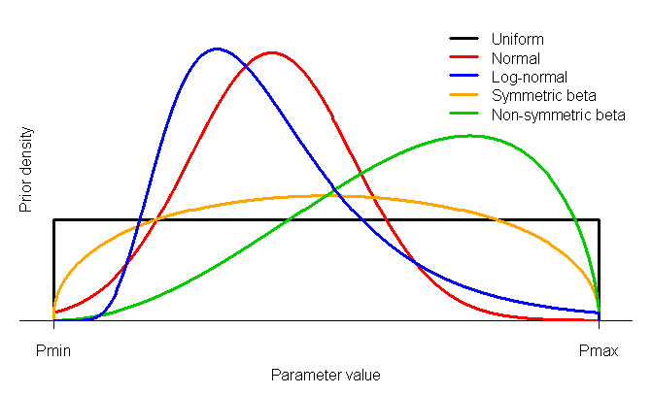
Bounds and priors
All parameters bounded
Prior options: uniform, normal, lognormal, symmetric and non-symmetric beta, or no prior (=uniform)

Slide 4
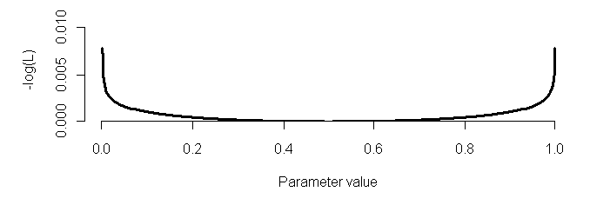
Soft bounds
Optional penalty applied to all parameters
Keeps ADMB from getting stuck on bounds
Acts along with user-specified priors
Equivalent to symmetric beta with shape parameter = 0.001

Slide 5
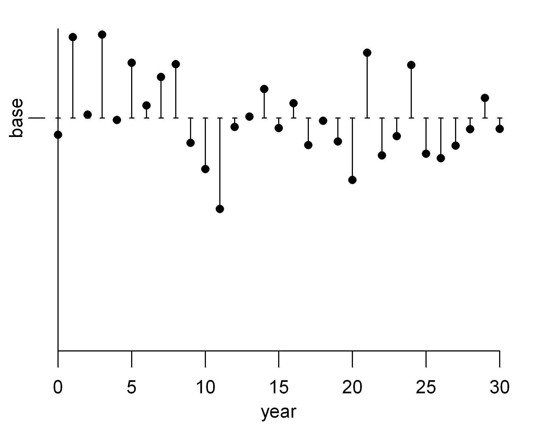
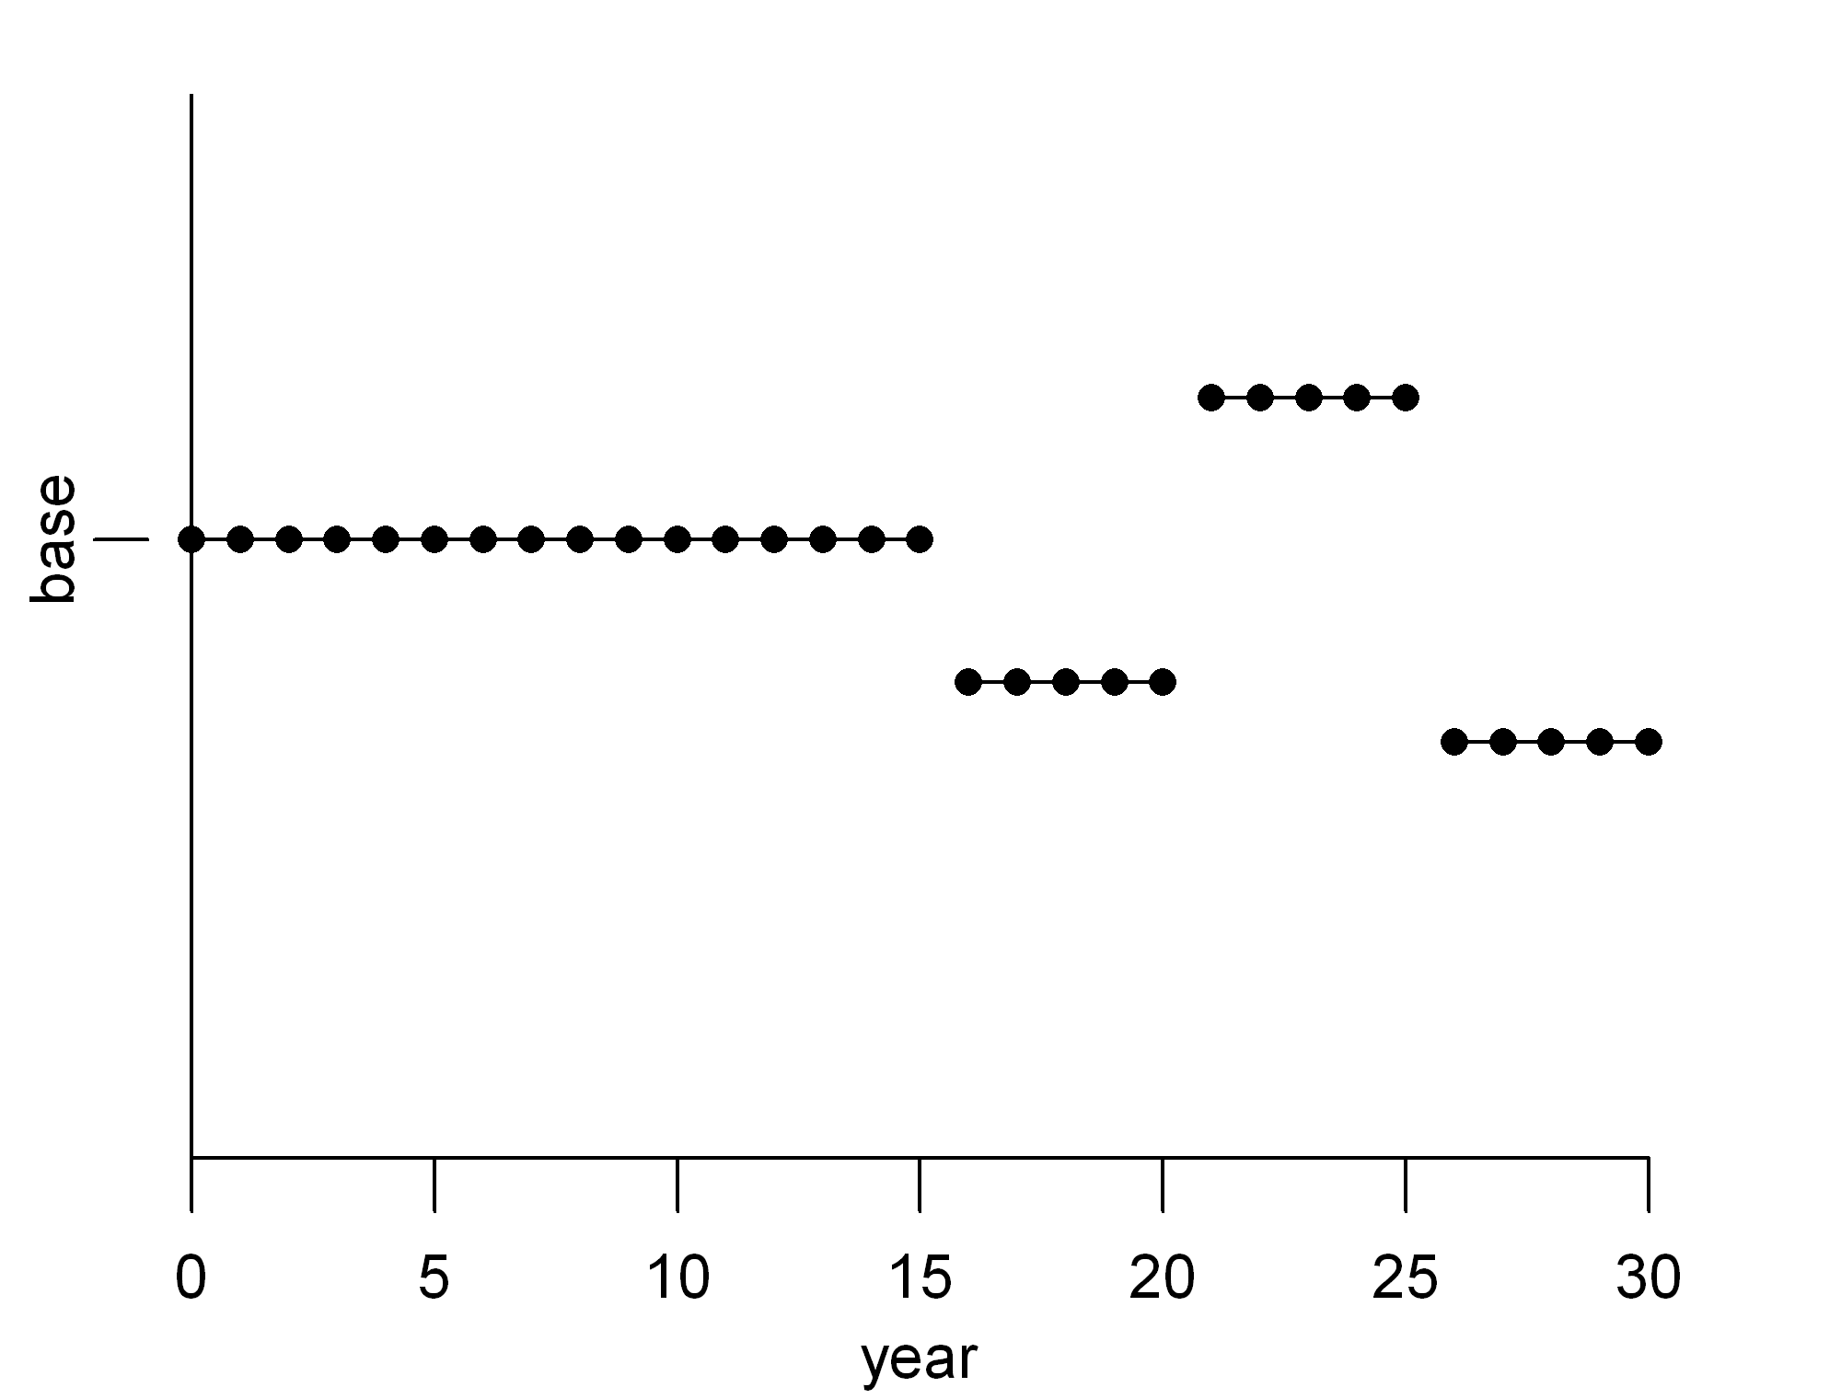
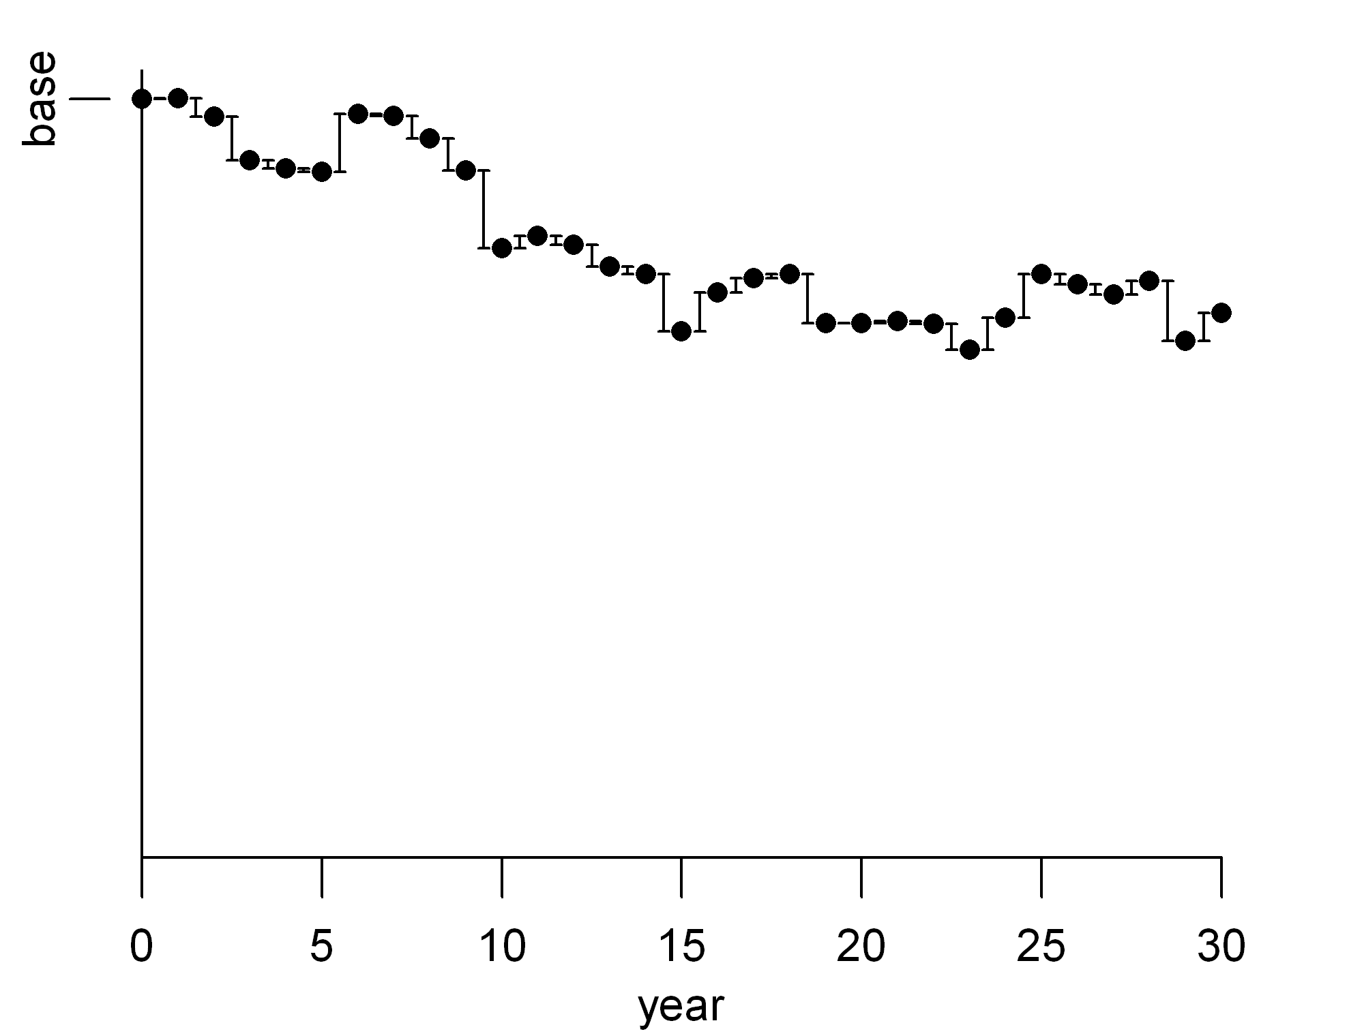
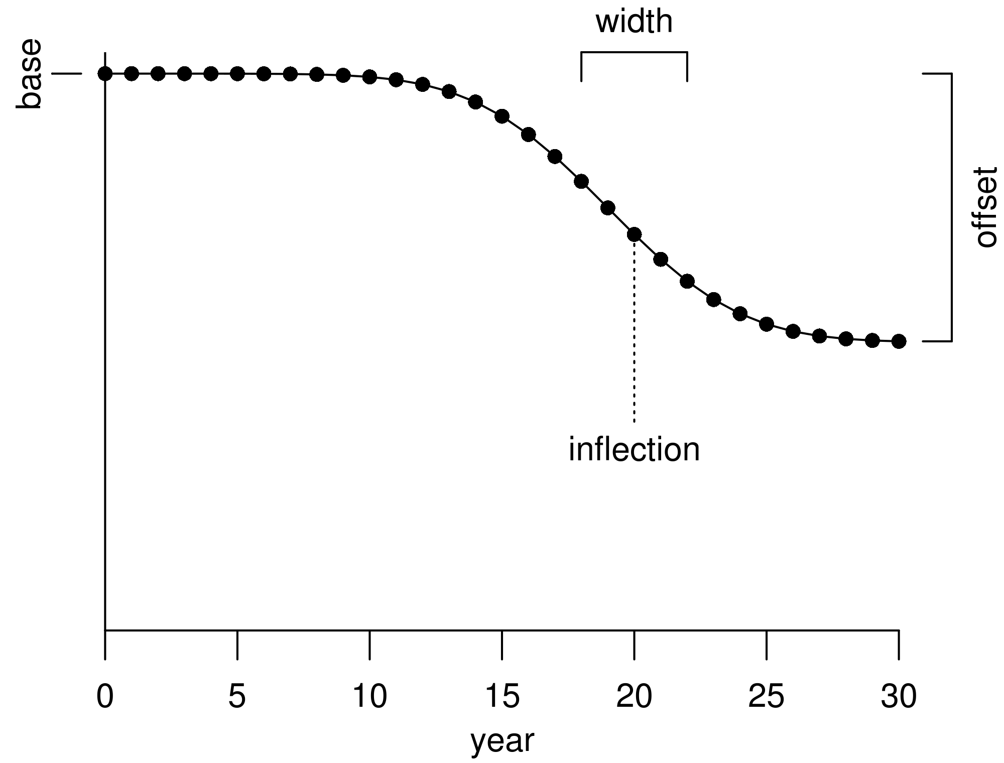
Temporal variation
Deviations (N std. dev. pars.)
Blocks (1 par. per block)
Random walk (N -1 std. dev. pars.)
Trend (3 pars.)

Slide 6
Temporal variation: blocks
Requires conditional input for extra parameters lines (same as other variation types)
Fixed time intervals specified in control file
Additional parameters may be:
Multiplicative offset from base value
Additive offset from base value
Replace base value for interval of years
May have random walk from one block to next

Slide 7
Temporal variation: deviations
Type (base+dev or base∙e^{dev})
Start and end years
Normal distribution penalty
Not sum-to-zero constraint
Temporal variation: random walk
Similar to deviations, but one less parameter
Parameters represent differences
Normal distribution penalty

Slide 8
Temporal variation: trends
Only 3 parameters
Smooth alternative to blocks for cases that don’t support many parameters
Final value may be offset from base or new value

Slide 9
Parameter as function of covariate
Environmental variable: E_{y}
Par_{y} = base+link∙E_{y} or base∙e^{Ey}
May be combined with other options (i.e. deviations around environmental index)
Covariate relationship to be used in future versions of SS for density dependence:
Mortality parameters as a function of biomass

Slide 10
Keeping time-varying parameters within bounds
Options:
time varying parameters unconstrained by bounds on base parameter
straightforward interpretation of values
may go outside reasonable range
logistic transformation to keep adjusted parameter value within bounds of base
transformed values harder to interpret
no problem with range

Slide 11
Offsets from other parameters
Parameters for males often treated as offsets from females (can do reverse too)
growth
mortality
selectivity
Additive or multiplicative options
Makes hypothesis testing easy (either fix offset at 0 or estimate)
Allows two-sex model with no additional data over single-sex model

Slide 12
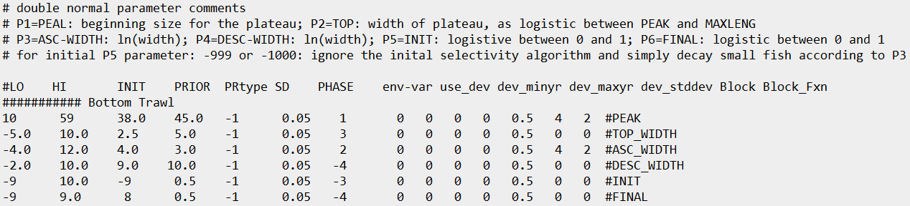
Example: Double normal selectivity
Blocks on peak and ascending width

