Slide 1

r4ss software for model diagnostics and plotting of SS output
Ian Stewart
International Pacific Halibut Commission

Slide 2
Problem:
It takes hundreds of model runs to do a decent stock assessment
SS produces a large number of files and outputs that need to be checked
Even a few processing steps add up quickly
Solution:
Automate:
- Input data error checks
- Model convergence assessment
- Output plotting
- Diagnostics and residuals

Slide 3
Topics:
Introduction to r4ss
Functions and options
Demonstration

Slide 4
Two download options
From CRAN - this can lag behind the most recent improvements
install.packages(“r4ss")
library(r4ss)
Directly from github - the most recent, but occasional bugs pop up
install.packages("devtools")
devtools::install_github("r4ss/r4ss")
library(r4ss)

Slide 5
My general approach:
I usually alternate between:
Command line
R
An editor
This package is intended “on-the-fly” modeling

Slide 6
Two primary functions:
SS_output()
- Grab all the output
- Summarize key quantities, statistics, diagnostics
- Create a list of objects for further processing
SS_plots()
- Make figures for model diagnosis
- Make figures for document preparation

Slide 7
Example
mymodelrun <- "example\\”
mydirectory <- "C:\\Users\\Ian\\Desktop\\UW class files\\"
mymodel <- SS_output(model="SS3",dir=paste(mydirectory,mymodelrun,sep=""))
What is now in the console?
names(mymodel)
mymodel$RunTime
mymodel$derived_quants
…

Slide 8
What are the inputs?
args(SS_output)

Slide 9
Useful SS_output() arguments:
dir = “ c:\\xxx\\xxx\\”
Locates the directory of the files to be read in
model = “ss3”
Name of the executable, you can rename
to indicate safe/optimized, or whatever you want.
ncols = 200
The maximum number of columns in files being read in.
If this value is too big, the function runs more slowly,
too small and you will get a warning. Find the right value for your model.
covar = T
Check the Hessian quantities and produce uncertainty plots?
forecast = T
Read report and plot the forecast years?
cormax = 0.95
The specified threshold for defining bad correlations

Slide 10
Example – more options
mymodel <- SS_output(ncols=43,cormax=0.89,model="SS3",dir=paste(mydirectory,mymodelrun,sep=""))
…

Slide 11
Reading through the output
Correlations, lack of correlations
Data dimensions/fleets
Parameters on bounds
Phases
…

Slide 12
Example
SS_plots(replist=mymodel)
- Where are these files?
- Reopening later
SS_plots(png=F,replist=mymodel)
- Page up and down between plots
- Resizing
If you are using the GUI plots (png=F), add this before each new plotting call:
rm(.SavedPlots,pos=1)

Slide 13
What are the other inputs?
args(SS_plots)

Slide 14
Just a few of the plotting arguments:
plot = c(1:24)
Plot just some of the output.
datplot = F
Plot the data by itself? Useful in document preparation
and to make sure you got the inputs right
bub.scale.dat = 3
How big should you make the data bubbles?
Depends on your display.
tslabels, catlabels
Add your own custom axis labels

Slide 15
Example
SS_plots(datplot=T,replist=mymodel) (Missing anything?)
rm(.SavedPlots,pos=1)
SS_plots(plot=3,png=F,replist=mymodel)
abline(h=450000,col="red",lwd=2)
SS_plots(bub.scale.dat=7,datplot=T,replist=mymodel)
SS_plots(plot=14,datplot=T,comp.yupper=0.7,png=F,replist=mymodel)
rm(.SavedPlots,pos=1)
SS_plots(plot=14,datplot=T,comp.yupper=0.7,png=F,replist=mymodel)

Slide 16
Other functions:
?r4ss # Then index
Compare two models
myothermodelrun <- "example2\\"
myothermodel <- SS_output(model="SS3",dir=paste(mydirectory,myothermodelrun,sep=""))
Mycomparisonlist <-list(mymodel,myothermodel)
Mycomparisonsummary <- SSsummarize(biglist= Mycomparisonlist)
rm(.SavedPlots,pos=1)
SSplotComparisons(summaryoutput=Mycomparisonsummary))

Slide 17
Other functions:
Compare two models
rm(.SavedPlots,pos=1)
SSplotComparisons(spacepoints=1,staggerpoints=0,summaryoutput=Mycomparisonsummary)
SStableComparisons()
Plot the parameter priors, estimates and uncertainty
SSplotPars()

Slide 18
Retrospective analyses
After running models with successive years of data peeled off:
Add: endyrvec=c(2015,2014)
Maybe: legendlabels=c(“Full data”,“1-year”)
…

Slide 19
Bayesian output
SSgetMCMC() #with appropriate arguments
Put the MLE and Bayesian results together
mcmccomplist <- list(mymodel,mymodel) # duplicated
mcmcsummary <- SSsummarize(biglist=mcmccomplist)
mcmcsummary$mcmc <- list(NA,mymodelmcmc$model1)
SSplotComparisons(mcmcVec=c(FALSE,TRUE),summaryoutput=mcmcsummary)
Chain diagnostics #Hake document has plots that show all this
mcmc.nuisance() #Summarises large number of posteriors at once
mcmc.out()

Slide 20
A few notes:
Read the GUI output! -- It has important stuff in it.
HTML doesn’t always update when directories are copied -- delete old plots for each new model directory
Plots can (and often should be) resized manually at the GUI
Headers are designed to remind the user, and should be cropped off later
- Demo font size, save, load, crop

Slide 21
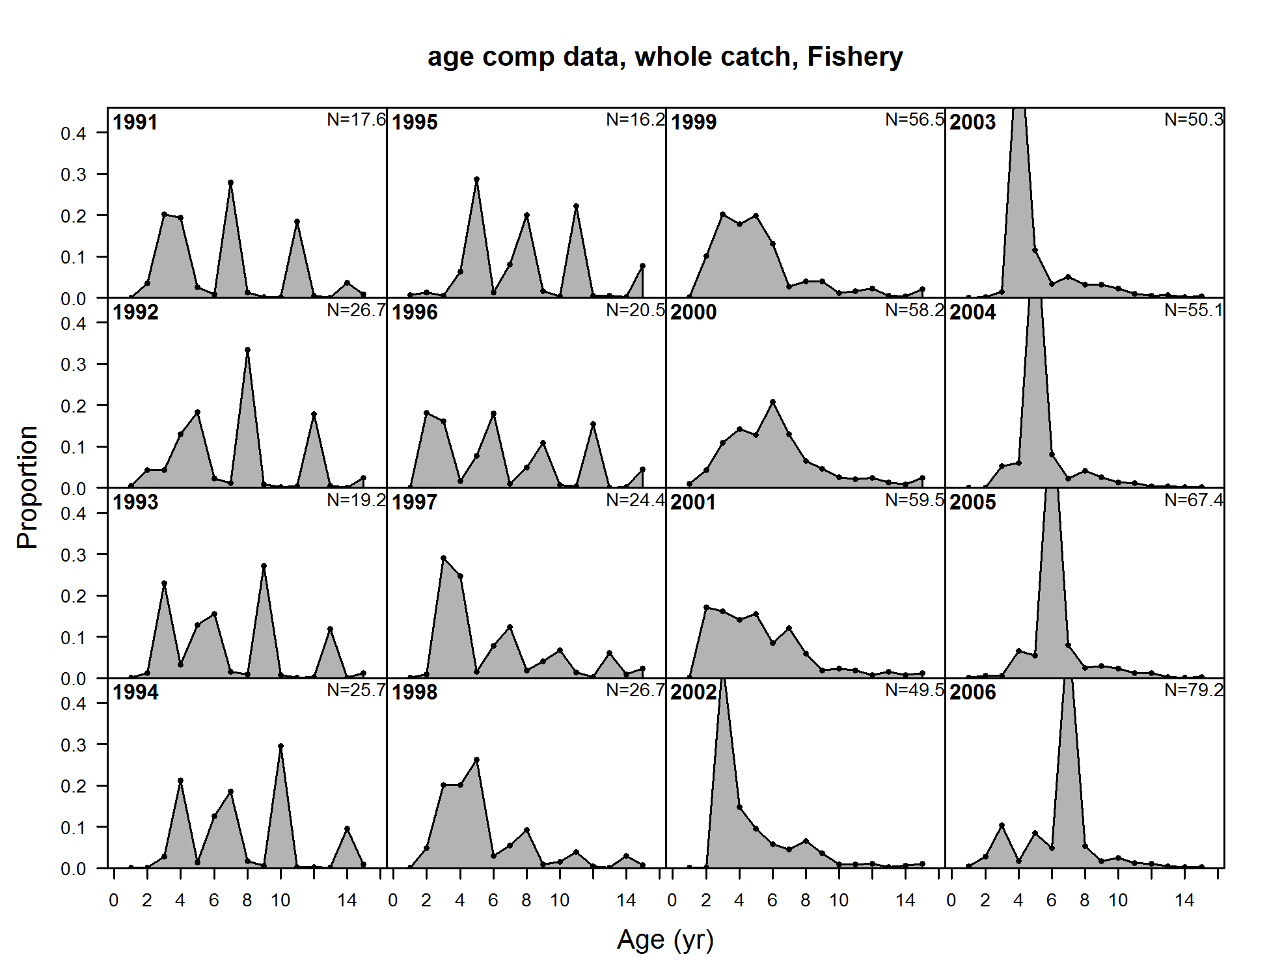
Headers:

Slide 22
Things r4ss doesn’t do:
At least one important aspect of any specific assessment
But you can:
Add to existing plots
Find and use objects directly
Pass arguments to subfunctions: e.g. custom labels
Modify the code for your needs
Make you a cup of coffee while your model converges and the Hessian inverts

Slide 23
Open source:
https://github.com/r4ss/r4ss
Download the code, post questions, report bugs, contribute!

