Slide 1

Fisheries Research Institute
Fisheries Department
Stock Assessment Model Small Pelagic. Chile.

Slide 2
Main features
Short Life Cycle (maximum longevity 4 years)
Fast somatic growth and seasonal oscilations
High instantaneous mortality rate
One distinct spawning season
With common sardine (Strangomera bentincki) these species are known for:
Inhabit only coastal waters (longitudinal distribution reaches only up to 30 nautical miles),
Neritic (inhabit depth less than 70 o 50 m respectively),
Conform very dense schools
Species highly influenced by biotic and abiotic factors (Aguayo & Soto, 1978, Serra, 1983, Cubillos y Arancibia 1993, Arancibia, et al, 1994, Cubillos et al, 2001).

Slide 3
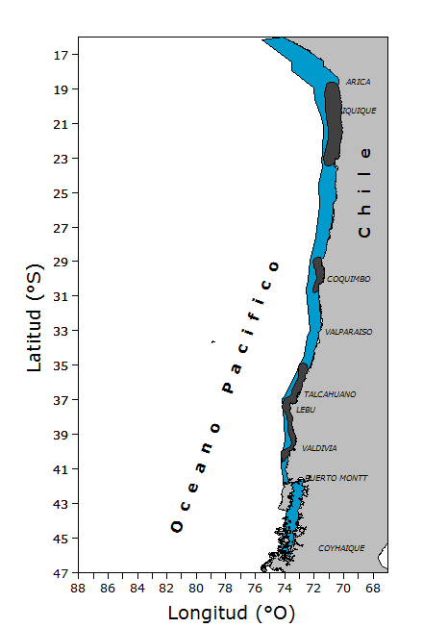
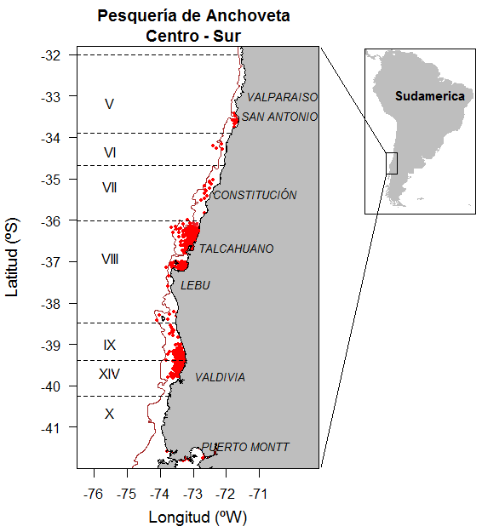
Spatial distribution sardine common and anchovy
Anchoveta del Norte
Anchoveta Centro-Norte
Anchoveta Centro-Sur
Fisheries Research Institute - Fisheries Department

Slide 4
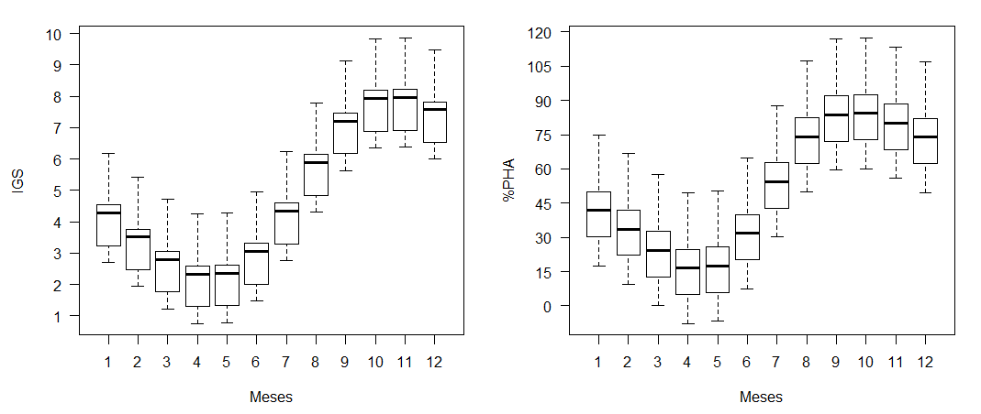
Spawning period
anchovy
Month
Month
sardine
common

Slide 5
Determination of ABC
September
INICIAL ABC
Based on the projection of Recruitment
July
FINAL REPORT
Tecnical Scientific Committee
Status Determination and range Updated ABC
June
Updated ABC Based on PELACES
Tecnical Scientifc Committee
Status determination and Initial ABC range
Monitoring of the Fishery
January
Recruitment index
Summer survey RECLAS
May
Index of Vulnerable Biomass
Fall Survey
PELACES
March
ABC Updated
Based on RECLAS
Scientific Committee
Determination of Status and range of
Updated ABC

Slide 6
Conceptual Model for the stock assessment
Unknown population parameters
Biological information
STOCK ASSESSMENT MODEL
Model - dynamics
Estimation of population variables
Model - observations
Estimated variables
Observed variables
OBJECTIVE FUNCTION
Solution
Model outputs

Slide 7
Exploitation strategy
Base on Fref (F60%mrs) in projection of 6years.
Performance indicators: reduction spawning biomass, future catches at different risk levels.
Output is a ABC by species.
From 2017 the Undersecretary of Fishing (manager) the possibility of exceeding the assigned catches (a+s) up to 40%. This mechanism is activated when any of the ABC for either species is exceeded.

Slide 8
Common sardine estimation model
Anchovy
estimation model
ABCs
ABCa
Technical Interaction
MIXED CATCH
OPERATIONAL PROBLEMS
CHAS MODEL
ABCt = ABCs + ABCa
Newt = ABCt + Delta (ABCt)
Delta_range = 0 - 0.4

Slide 9
Control rule to assess
Ct= Cs + Ca (estándar system)
New system (delta = 0 to 0.4)
Ct=Cs + Ca + delta (Cs+Ca)

Slide 10
Structure of the dynamic model
Time frame | Season (1º January – 31 december)
Allocation of age groups | 1º of January
Dominant age group in the catch | Age group 1
Oldest age group | Age group 4
N° years | 25
N° age groups | 5
Natural mortality (M=1/year) | 0.7
Fisheries Research Institute - Fisheries Department

Slide 11
Annual dynamic model in ages
Fisheries Research Institute - Fisheries Department

Slide 12
Modelling recruitment
Deviates from Average recruitment
Fisheries Research Institute - Fisheries Department

Slide 13
Used information
Input data | Period | Source of Information
Total annual landings | From 1991 to June 2018 | Oficial landing statistics, Compiled by the National Fisheries Service.
Size/age comps | From 1991 to June of 2015 | Monitoring of the fishery, of common sardine and anchovy in the V-X Regions through the monitoring of Inpesca.
Fleet
2) Summer survey | January 2000 to January 2018 | Hydroacoustic surveys of sardine and anchovy stocks between V and X regions, developed through Fondo de investigación Pesquera projects
3) Fall survey | From may 2003 To may 2018
Acoustic biomass | From January of 2000 To January of 2018
1) Summer survey
2) Fall Survey | 2003,2005-2007,2009-2018
Spawning biomass | 2002,2004-2005,2007-2016 | Spawning stock assessment of anchovy and sardine between regions V and X , funded by Fondo de investigación Pesquera.
1) Egg Survey
Mean weight at age | From 1991 to june 2018 | Monitoring of the fishery, common sardine and anchovy V-X Regions
Maturity at age | Constant | Aranís et al., 2006
Natural mortality | Constant | Cubillos et al., 1998b
Fisheries Research Institute - Fisheries Department

Slide 14
Annual Landings
anchovy
sardine common
Landings (thousands tons)
Landings (thousands tons)
Years
Years
Fisheries Research Institute - Fisheries Department

Slide 15
Abundance index
anchovy
anchovy
Biomass Summer survey (Ton)
Biomass Fall survey (Ton)
sardine common
Biomass Summer survey (Ton)
Biomass Fall survey (Ton)
sardine common

Slide 16
Size structure (Catch)
Maturity length =12 cms TL
low dominance of juveniles in catches
Proportion
Length (cms)
Fisheries Research Institute - Fisheries Department

Slide 17
Size structure (Survey acoustic summer)
Proportion
Length (cms)
Fisheries Research Institute - Fisheries Department

Slide 18
Size structure (Survey acoustic fall)
Proportion
Length (cms)
Fisheries Research Institute - Fisheries Department

Slide 19
Mean weight (Kilograms)
Fisheries Research Institute - Fisheries Department

Slide 20
Selectivity function (Survey acoustic)
➔ Asymptotic selectivity function
Constant between years for both, the position (age at 50% of exploitation) and dispersion (slope of the curvature) parameters
Selectivity function (Catch)
Random walk
Selectivity
Fisheries Research Institute - Fisheries Department

Slide 21
Assumptions
The anchovy population between V - X Region is a unit of stock in which the variations are explained by catch, recruitment and mortality
Observed data | Assumptions
Total annual landings | Represents the total catch of the annual period. It is assummed as a continuous process throughout the year. Observation error is considered CV= 0,01
Summer survey biomass | Represents biomass at the initial of the yeat,en of january, (0.083 of the year). error de observación CV= 0,3
Fall survey biomass | Represent biomass in may, 0.33 of the year. error de observación CV= 0,3
CPUE | Observation error is considered CV= 0,4
Annual mean weight | Is the mean weight used to generate estimates of Acoustic biomass of Autumn survey, landings and spawning biomass
Mean weight at the begining of yearr | Represent weight at the initial of the year (january) Used to generate estimates of Acoustic biomass of summer survey and total biomass
Lenght comps of the fleet | Represent the distribution of individuals in the catch by length Tamaño de muestra efectivo supuesto como parte del error de observación nm = 50
Lenght comps of Summer Survey | Representa la distribución de los ejemplares que están presenta en la captura del crucero de verano (enero) por grupo de edad. Tamaño de muestra efectivo supuesto como parte del error de observación nm = 30
Lenght comps of the Fall survey | Representa la distribución de los ejemplares que están presenta en la captura del crucero de otoño (mayo) por grupo de edad. Tamaño de muestra efectivo supuesto como parte del error de observación nm = 5
Fisheries Research Institute - Fisheries Department

Slide 22

Results of the
Stock Assessment
ANCHOVY
south-central zone of Chile
Fisheries Research Institute - Fisheries Department

Slide 23
Persistence, consistency and error of the assessment model
Base case fit
To the observed data series
CV CPUE=0.4
CV Landings=0.01
Summer survey
CV=0.3
Fall survey
CV=0.2
Fisheries Research Institute - Fisheries Department

Slide 24
Persistence, consistency and error of the assessment model
Residual catch
Residual CPUE
Residual
(index)
Years
Years
Residual survey fall
Residual survey summer
Years
Years
Fisheries Research Institute - Fisheries Department

Slide 25
Persistence, consistency and error of the assessment model
fit
residual of size structure
Catch
Proportion
Years
Length (cms)
Length (cms)
Fisheries Research Institute - Fisheries Department

Slide 26
Persistence, consistency and error of the assessment model
residual of size structure
fit
Years
Survey summer
Proportion
Length (cms)
Length (cms)
Fisheries Research Institute - Fisheries Department

Slide 27
Persistence, consistency and error of the assessment model
residual of size structure
fit
Years
Proportion
Survey fall
Length (cms)
Length (cms)
Fisheries Research Institute - Fisheries Department

Slide 28
RESULTS
Stock Indicators
Recruitment STOCK ASESSMENT
Recruitment deviates
Total Biomass
Spawning Biomass
Fishing Mortality
Fleet Selectivity, Summer and Fall Survey

Slide 29
Recruitment
estimated recruitment
Recruitment of anchovy of the V-X Regions.
Recruitment (number)
Average Rec
Years

Slide 30
Biomass
Confidence intervals for total biomass (upper panel) and spawning biomass (lower panel) of anchovy of the V-X regions. The shaded area corresponds to the asymptotic confidence interval and the dotted line the value of the central estimator.
Bmsy
Blim

Slide 31
Fishing Mortality and RPR
Reduction Index of spawning biomass in long term equilibrium (upper panel) of anchovy Central- South. The shaded area corresponds to the asymptotic confidence interval and the solid line corresponds to the value of the central estimator.
Bmsy
RPR
Fishing mortality (1/year)

Slide 32
Fleet selectivity and surveys for anchovy
* Fisheries
* varying selectivity through the years and ages.
Selectivity
Selectivity
0 1 2 3 4

Slide 33
DIAGRAM OF EXPLOITATION STATUS
Phase diagram of spawning biomass exploitation in relation to fishing mortality. The axes are standardized to values that generate the MSY proxy .

Slide 34
Determination of ABC for year 2015

